Slide 1
Swing

Slide 2
Swing
Swing is a set of classes that provides GUI controls more powerful and flexible components than are possible with the AWT.
Swing provides tabbed panes, scroll panes, trees, and tables.
Even components such as buttons have more capabilities in Swing. For example, a button may have both an image and a text string associated with it.

Slide 3
Swing
Swing components are not implemented by platform-specific code.
Instead, they are written entirely in Java and, therefore, are platform-independent.
They are hence called as lightweight components.

Slide 4
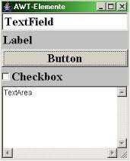
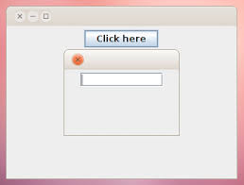
Swing

Slide 5
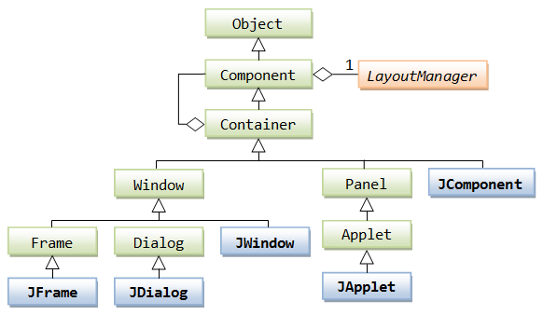
Swing-hierarchy

Slide 6
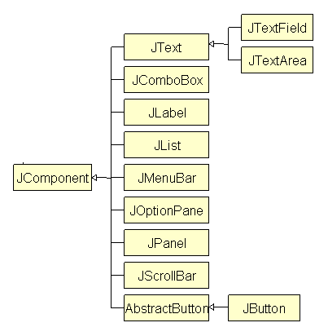
Swing-hierarchy

Slide 7
Icons
In Swing, icons are encapsulated by the ImageIcon class, which paints an icon from an image. Two of its constructors are s:
ImageIcon(String filename)
ImageIcon(URL url)
The first form uses the image in the file named filename. The second form uses the image in the resource identified by url.

Slide 8
Icons
Method | Description
int getIconWidth( ) | Returns the width of the icon in pixels.
int getIconHeight( ) | Returns the height of the icon in pixels.
void paintIcon(Component comp, Graphics g,int x, int y) | Paints the icon at position x, y on the graphics context g.

Slide 9
JLabel
Swing labels are instances of the JLabel class, which extends JComponent. It can display text and/or an icon. Some of its constructors are shown here:
JLabel(Icon i)
Label(String s)
JLabel(String s, Icon i, int align)
The align argument is either LEFT, RIGHT, CENTER, LEADING, or TRAILING. These constants are defined in the SwingConstants interface, along with several others used by the Swing classes.

Slide 10
JLabel
The icon and text associated with the label can be read and written by the following methods:
Icon getIcon( )
String getText( )
void setIcon(Icon i)
void setText(String s)

Slide 11
JTextField
JTextField( )
JTextField(int cols)
JTextField(String s, int cols)
JTextField(String s)

Slide 12
JButton
JButton(Icon i)
JButton(String s)
JButton(String s, Icon i)
The icon on the button can be set with:
void setDisabledIcon(Icon di)
void setPressedIcon(Icon pi)
void setSelectedIcon(Icon si)
void setRolloverIcon(Icon ri)

Slide 13
JCheckbox
JCheckBox(Icon i)
JCheckBox(Icon i, boolean state)
JCheckBox(String s)
JCheckBox(String s, boolean state)
JCheckBox(String s, Icon i)
JCheckBox(String s, Icon i, boolean state)

Slide 14
JRadioButton
JRadioButton(Icon i)
JRadioButton(Icon i, boolean state)
JRadioButton(String s)
JRadioButton(String s, boolean state)
JRadioButton(String s, Icon i)
JRadioButton(String s, Icon i, boolean state)
ButtonGroup();

Slide 15
JButtonGroup
bg.add(b1);
bg.add(b2);
bg.add(b3);

Slide 16
JComboBox
JComboBox( )
JComboBox(Vector v)
void addItem(Object obj)

Slide 17
JTabbedPane
A tabbed pane is a component that appears as a group of folders in a file cabinet. Each folder has a title. When a user selects a folder, its contents become visible.
Only one of the folders may be selected at a time.
Tabbed panes are commonly used for setting configuration options.
Tabbed panes are encapsulated by the JTabbedPane class, which extends JComponent.

Slide 18
JTabbedPane
void addTab(String str, Component comp)
Here, str is the title for the tab, and comp is the component that should be added to the tab. Typically, a JPanel or a subclass of it is added.
1. Create a JTabbedPane object.
2. Call addTab( ) to add a tab to the pane
3. Repeat step 2 for each tab.
4. Add the tabbed pane to the content pane of the applet.

Slide 19
JScrollPane
A scroll pane is a component that presents a rectangular area in which another component may be placed.
Horizontal and/or vertical scroll bars may be provided if necessary.
Scroll panes are implemented in Swing by the JScrollPane class, which extends JComponent.
JScrollPane(Component comp)
JScrollPane(int vsb, int hsb)
JScrollPane(Component comp, int vsb, int hsb)

Slide 20
JScrollPane
Here, comp is the component to be added to the scroll pane.
vsb and hsb are int constants that define when vertical and horizontal scroll bars for this scroll pane are shown.
These constants are defined by the ScrollPaneConstants interface.

Slide 21
JScrollPane
HORIZONTAL_SCROLLBAR_ALWAYS : Always provide horizontal scroll bar
HORIZONTAL_SCROLLBAR_AS_NEEDED :Provide horizontal scroll bar, if needed
VERTICAL_SCROLLBAR_ALWAYS :Always provide vertical scroll bar
VERTICAL_SCROLLBAR_AS_NEEDED :Provide vertical scroll bar, if needed

Slide 22
JTable
A table is a component that displays rows and columns of data.
One can drag the cursor on column boundaries to resize columns.
One can also drag a column to a new position.
Tables are implemented by the JTable class, which extends JComponent.

Slide 23
JTable
JTable(Object data[ ][ ], Object colHeads[ ])
Here, data is a two-dimensional array of the information to be presented.
colHeads is a one-dimensional array with the column headings.

Slide 24
JTable
1. Create a JTable object.
2. Create a JScrollPane object. (The arguments to the constructor specify the table and the policies for vertical and horizontal scroll bars.)
3. Add the scroll pane

Slide 25
JTree
A tree is a component that presents a hierarchical view of data. A user has the ability to expand or collapse individual subtrees in this display.
Trees are implemented in Swing by the JTree class, which extends JComponent.
JTree(Hashtable ht)
JTree(Object obj[ ])
JTree(TreeNode tn)
JTree(Vector v)

Slide 26
JTree-creation
The DefaultMutableTreeNode class implements the MutableTreeNode interface.
It represents a node in a tree. One of its constructors is
DefaultMutableTreeNode(Object obj)
To create a hierarchy of tree nodes, the add( ) method of DefaultMutableTreeNode can be used.
void add(MutableTreeNode child)
Here, child is a mutable tree node that is to be added as a child to the current node.

Slide 27
JTree-creation
// Create top node of tree
DefaultMutableTreeNode top = new DefaultMutableTreeNode(“CSE");

Slide 28
JTree-creation
// Create subtree of Final Year
DefaultMutableTreeNode a = new DefaultMutableTreeNode(“Final Year");
top.add(a);
DefaultMutableTreeNode a1 = new DefaultMutableTreeNode("A");
a.add(a1);
DefaultMutableTreeNode a2 = new DefaultMutableTreeNode(“B");
a.add(a2);

Slide 29
JTree-creation
// Create subtree of Third Year
DefaultMutableTreeNode b = new DefaultMutableTreeNode(“Third Year");
top.add(b);
DefaultMutableTreeNode b1 = new DefaultMutableTreeNode(“A");
b.add(b1);
DefaultMutableTreeNode b2 = new DefaultMutableTreeNode(“B");
b.add(b2);
DefaultMutableTreeNode b3 = new DefaultMutableTreeNode(“C");
b.add(b3);

Slide 30
JTree-creation
// Create tree
JTree tree = new JTree(top);
// Add tree to a scroll pane
int v = ScrollPaneConstants.VERTICAL_SCROLLBAR_AS_NEEDED;
int h = ScrollPaneConstants.HORIZONTAL_SCROLLBAR_AS_NEEDED;
JScrollPane jsp = new JScrollPane(tree, v, h);

Slide 31
JTree-events
Tree expansion events are described by the class TreeExpansionEvent in the javax.swing.event package.
The getPath( ) method of this class returns a TreePath object that describes the path to the changed node. Its signature is :
TreePath getPath( )

Slide 32
JTree-events
The TreeExpansionListener interface provides the following two methods:
void treeCollapsed(TreeExpansionEvent tee)
void treeExpanded(TreeExpansionEvent tee)
Here, tee is the tree expansion event. The first method is called when a subtree is hidden, and the second method is called when a subtree becomes visible.

