Slide 1
URLs, InetAddresses, and URLConnections

Slide 2
Hosts
Devices connected to the Internet are called hosts
Most hosts are computers, but hosts also include routers, printers, fax machines etc.

Slide 3
Internet addresses
Every host on the Internet is identified by a unique, four-byte Internet Protocol (IP) address.
This is written in dotted quad format like 199.1.32.90 where each byte is an unsigned integer between 0 and 255.

Slide 4
Domain Name System (DNS)
Numeric addresses are mapped to names like "www.bwec.ac.in" or “mail.yahoo.com" by DNS.

Slide 5
The InetAddress Class
The java.net.InetAddress class represents an IP address.
It converts numeric addresses to host names and host names to numeric addresses.
It is used by other network classes like Socket and ServerSocket to identify hosts

Slide 6
Creating InetAddresses
There are no public InetAddress() constructors. Arbitrary addresses may not be created.
All addresses that are created must be checked with DNS
public static InetAddress getByName(String host) throws UnknownHostException
public static InetAddress[] getAllByName(String host) throws UnknownHostException
public static InetAddress getLocalHost() throws UnknownHostException

Slide 7
Getter Methods
public String getHostName()
public byte[] getAddress()
public String getHostAddress()

Slide 8
Ports
In general a host has only one Internet address
This address is subdivided into 65,536 ports
Ports are logical abstractions that allow one host to communicate simultaneously with many other hosts
Many services run on well-known ports. For example, http tends to run on port 80

Slide 9
URLs
A URL, short for "Uniform Resource Locator", is a way to unambiguously identify the location of a resource on the Internet.

Slide 10
Example URLs
http://java.sun.com/
http://becbapatla.ac.in/cse/index.html
http://www.microsoftvirtualacademy.com/training-courses/html5-css3-fundamentals-development-for-absolute-beginners

Slide 11
The Pieces of a URL
the protocol (http://)
host name or address (www.bwec.ac.in)
port (80)
the path(index.html)
Notes:
Most URLs can be broken into about five pieces, not all of which are necessarily present in any given URL. These are:
There may also be a query string part which is used for CGI data. We’ll talk about that when we discuss CGIs.

Slide 12

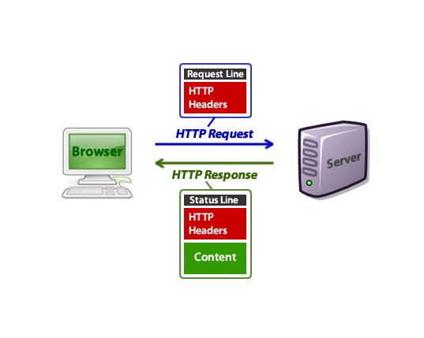
HTTP Request/Response

Slide 13
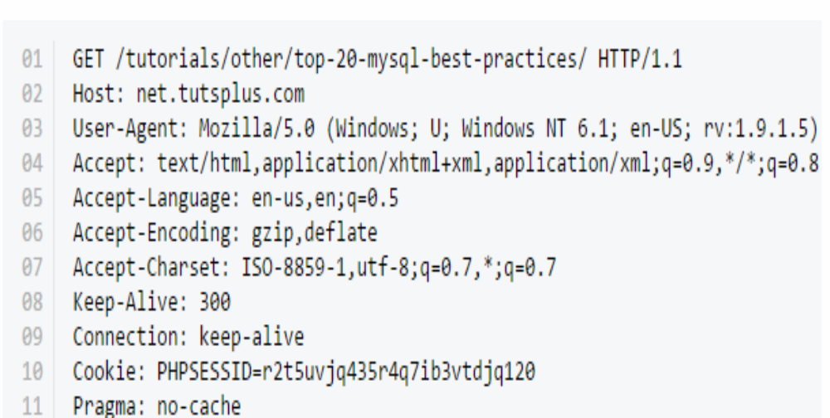
Request

Slide 14
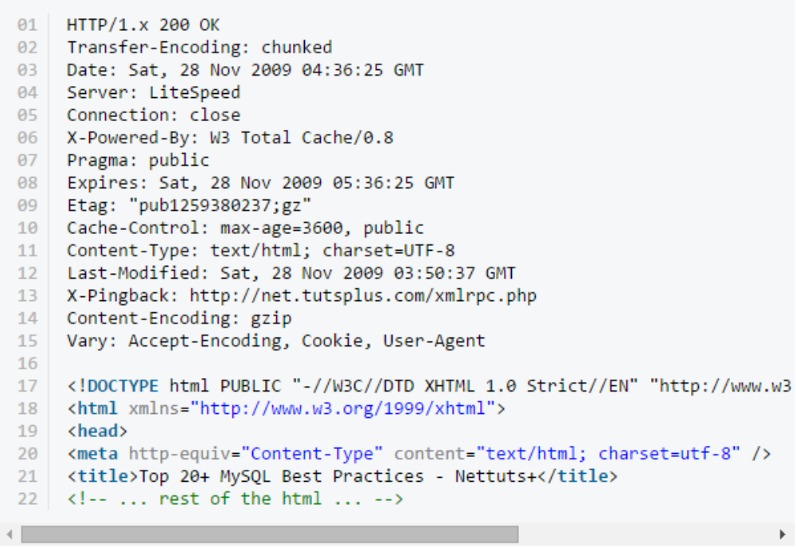
Response

Slide 15
The java.net.URL class
A URL object represents a URL.
The URL class contains methods to
create new URLs
parse the different parts of a URL
Get a connection object to the URL
get an input stream from a URL so you can read data from a server
get content from the server as a Java object

Slide 16
URL Constructors
There are four (six in 1.2) constructors in the java.net.URL class.
  public URL(String u) throws MalformedURLException
  public URL(String protocol, String host, String file) throws MalformedURLException
  public URL(String protocol, String host, int port, String file) throws MalformedURLException

Slide 17
URL Methods
Method | Description
public String getProtocol() | it returns the protocol of the URL.
public String getHost() | it returns the host name of the URL.
public String getPort() | it returns the Port Number of the URL.
public String getFile() | it returns the file name of the URL.
public URLConnection openConnection() | it returns the instance of URLConnection i.e. associated with this URL.

Slide 18
URLConnection
The java.net.URLConnection class is an abstract class that handles communication with different kinds of servers like ftp servers and web servers.
Protocol specific subclasses of URLConnection handle different kinds of servers.
By default, connections to HTTP URLs use the GET method.
Can send output as well as read input
Can post data
Can read headers from a connection

Slide 19
URLConnection steps:
1. The URL is constructed.
2. The URL’s openConnection() method creates the URLConnection object.
3. The response header information is read using getHeaderField().

Slide 20
I/O Across a URLConnection
Data may be read from the connection in one of two ways
  raw by using the input stream returned by getInputStream()
Data can be sent to the server using the output stream provided by getOutputStream().

Slide 21
Reading Header Data
The getHeaderField(String name) method returns the string value of a named header field.
Names are case-insensitive.
If the requested field is not present, null is returned.
  String lm = uc.getHeaderField("Last-modified");

Slide 22
Methods
These return the values of six particularly common header fields:
public int getContentLength()
public String getContentType()
public String getContentEncoding()
public long getExpiration()
public long getDate()
public long getLastModified()

Slide 23
TCP/IP Client Sockets
TCP/IP sockets are used to implement reliable, bidirectional, persistent, point-to-point, stream-based connections between hosts on the Internet.
A socket can be used to connect Java’s I/O system to other programs that may reside either on the local machine or on any other machine on the Internet.

Slide 24
TCP/IP Client Sockets
There are two kinds of TCP sockets in Java. One is for servers, and the other is for clients.
The ServerSocket class is designed to be a “listener,” which waits for clients to connect before doing anything.
ServerSocket is for servers.
The Socket class is for clients.
It is designed to connect to server sockets and initiate protocol exchanges.

Slide 25
TCP/IP Client Sockets
Socket(String hostName, int port) throws UnknownHostException, IOException | Creates a socket connected to the named host and port.
Socket(InetAddress ipAddress, int port) throws IOException | Creates a socket using a preexisting InetAddress object and a port.

Slide 26
TCP/IP Client Socket Methods
InetAddress getInetAddress( ) | Returns the InetAddress associated with the Socket object. It returns null if the socket is not connected.
int getPort( ) | Returns the remote port to which the invoking Socket object is connected. It returns 0 if the socket is not connected.
int getLocalPort( ) | Returns the local port to which the invoking Socket object is bound. It returns –1 if the socket is not bound.

Slide 27
TCP/IP Client Socket Methods
InputStream getInputStream( ) throws IOException | Returns the InputStream associated with the invoking socket.
OutputStream getOutputStream( ) throws IOException | Returns the OutputStream associated with the invoking socket.

