Slide 1
Sockets
TCP Sockets , Datagram Sockets

Slide 2
Sockets
A socket is an end point for communication between processes running on hosts on the internet.
The communication can be connection oriented or connection less.
TCP sockets are used to implement connection-oriented, reliable, bidirectional, point-to-point, stream-based connections between hosts on the Internet.
Datagram sockets facilitate connection less, unreliable communication.

Slide 3
TCP Sockets
A host may run several network processes.
A socket is identified by the host name(ip address) and the port.
Sockets facilitate connection and data transfer between the hosts.
A socket has output stream to send data to the remote host.
A socket has input stream to read data sent by the remote host to it.

Slide 4
Connection Sequence
Server
Client
my.server.it
Client Program/
Browser
FTP
HTTP
POP
http://my.server.it
23
110
80
Client Socket
Server Socket

Slide 5
TCP Standard Ports
Below 1024, assigned by the IANA
21 | FTP
23 | Telnet
80 | HTTP
110 | POP3
25 | SMTP
119 | NNTP

Slide 6
TCP Sockets
There are two kinds of TCP sockets in Java.
One is for servers, and the other is for clients.
The ServerSocket class is designed to be a “listener,” which waits for clients to connect before doing anything.
ServerSocket is for servers.
The Socket class is for clients.
It is designed to connect to server sockets and initiate protocol and data exchanges.

Slide 7
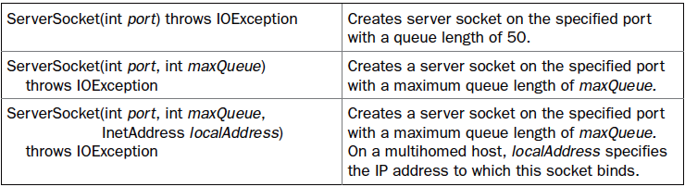
TCP ServerSocket
The ServerSocket class is designed to be a “listener,” which waits for clients to connect before doing anything.

Slide 8
TCP Sockets
The creation of a Socket object implicitly establishes a connection between the client and server.

Slide 9
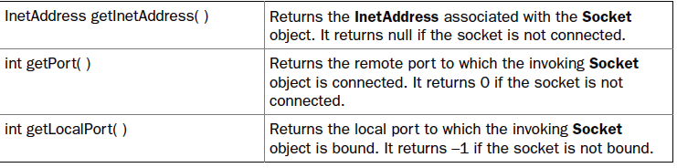
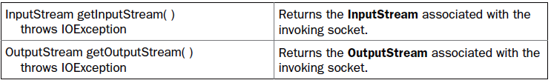
TCP Sockets
Methods

Slide 10
www.server.net
int PORT = 7777;
ss = new ServerSocket(PORT);
ss.accept();

Slide 11
7777
www.server.net
cs = new Socket(“www.server.net",17);

Slide 12

cs = new Socket(“www.server.net",17);

Slide 13
cout = new PrintWriter(cs.getOutputStream()); cout.println(“...”);

Slide 14
sin = new BufferedReader(new InputStreamReader(
ss.getInputStream())); String l=sin.readLine();

Slide 15
sout = new PrintWriter(ss.getOutputStream())); sout.println(“…”);

Slide 16
cin = new BufferedReader(new InputStreamReader(
cs.getInputStream())); String l=cin.readLine();

Slide 17
Datagram Sockets
The server creates a datagram socket and waits for packets from the clients.
The client creates a datagram socket.
The client creates a packet with data, destination host address and port. Its host address and port are automatically filled in the packet.
The client socket sends the client packet.

Slide 18
Datagram Sockets
The server socket receives the client packet.
The server extracts the client address and port number.
It creates a packet with response data , client address and the port.
The server datagram socket sends the packet to the client.
The client receives the packet and extracts the data.

Slide 19
Datagram Sockets
DatagramSocket() throws SocketException
DatagramSocket(int port) throws SocketException
DatagramSocket(int port, InetAddress ipAddress) throws SocketException

Slide 20
Datagram Sockets
void send(DatagramPacket packet) throws IOException
void receive(DatagramPacket packet) throws IOException

Slide 21
Datagram Packets
DatagramPacket(byte data[], int size)
DatagramPacket(byte data[], int offset, int size)
DatagramPacket(byte data[], int size, InetAddress ipAddress, int port)
DatagramPacket(byte data[], int offset, int size, InetAddress ipAddress, int port)

Slide 22
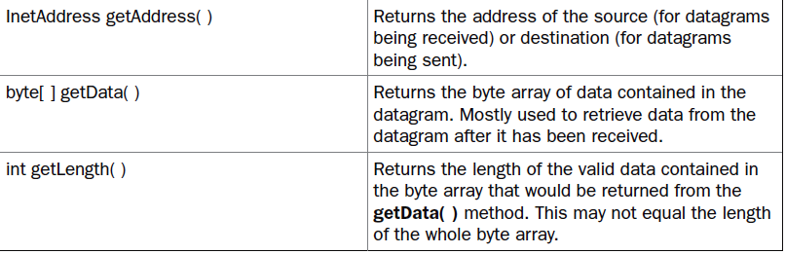
Datagram Packets

Slide 23
DatagramSocket ss=new DatagramSocket(1234);

Slide 25
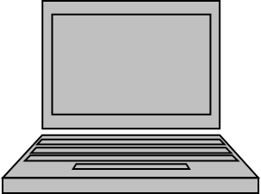
DatagramSocket cs=new DatagramSocket();

Slide 26
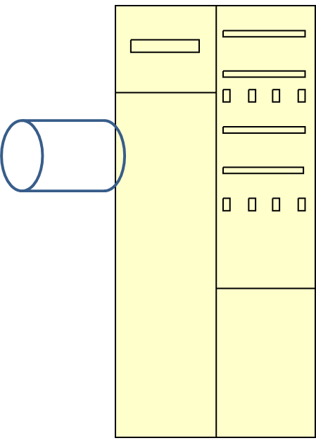

byte[] sd=d.getBytes();
DatagramPacket sp=new DatagramPacket(sd,sd.length,ip,1234);

Slide 27
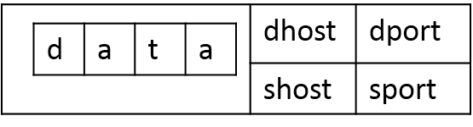
cs.send(sp);

Slide 29
InetAddress ip= rp.getAddress();
int port=rp.getPort();
Byte[] sd=d.getBytes();
DatagramPacket sp=
newDatagramPacket(sd,sd.length,ip,port);
ss.send(sp);

