Slide 1

Bicycle Safety Iot Capstone Project
By Benjamin K Hansen
And Lee Abeyta

Slide 2

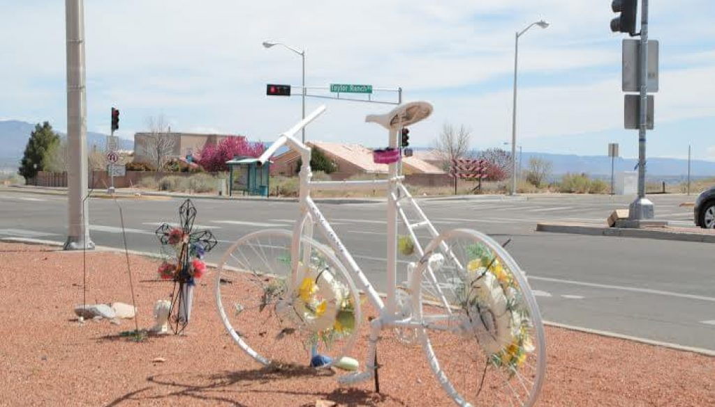
Bicycle safety envisioned
Urban environments that are eco-friendly and future minded.
Saving cyclist lives through inclusive and responsible infrastructure.
Economically sustainable infrastructure development.
Embedded systems that improve
commuter and pedestrian quality of life.

Slide 3
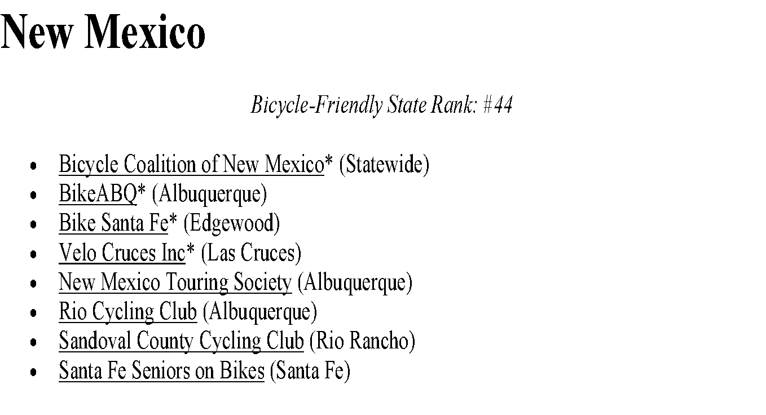
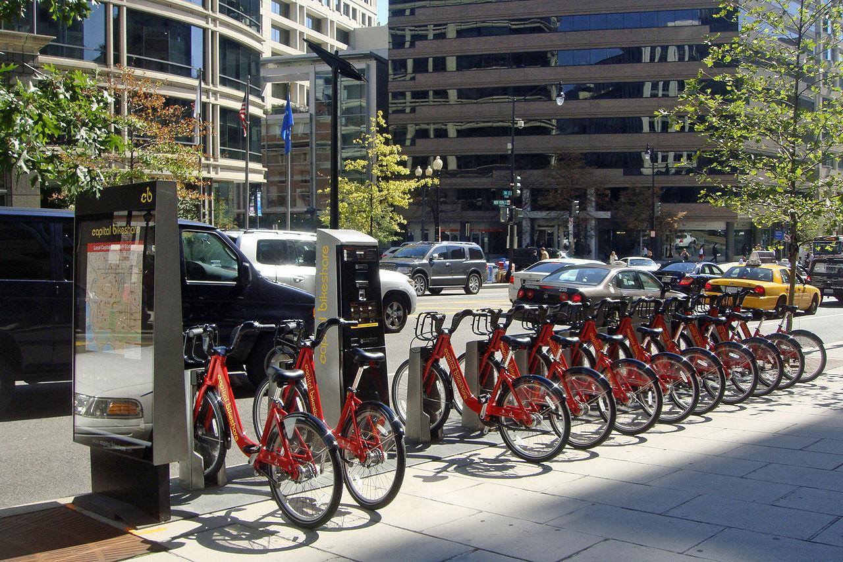
Interested Groups
Nationwide
Thousands of bicycle advocacy groups across the country.
65 American cities have bike share companies operating locally.
City and state transportation commissions.
Parents in every community.
Notes:
Seattle, Boston, San Francisco, Phoenix, and El Paso. Not it NM

Slide 4
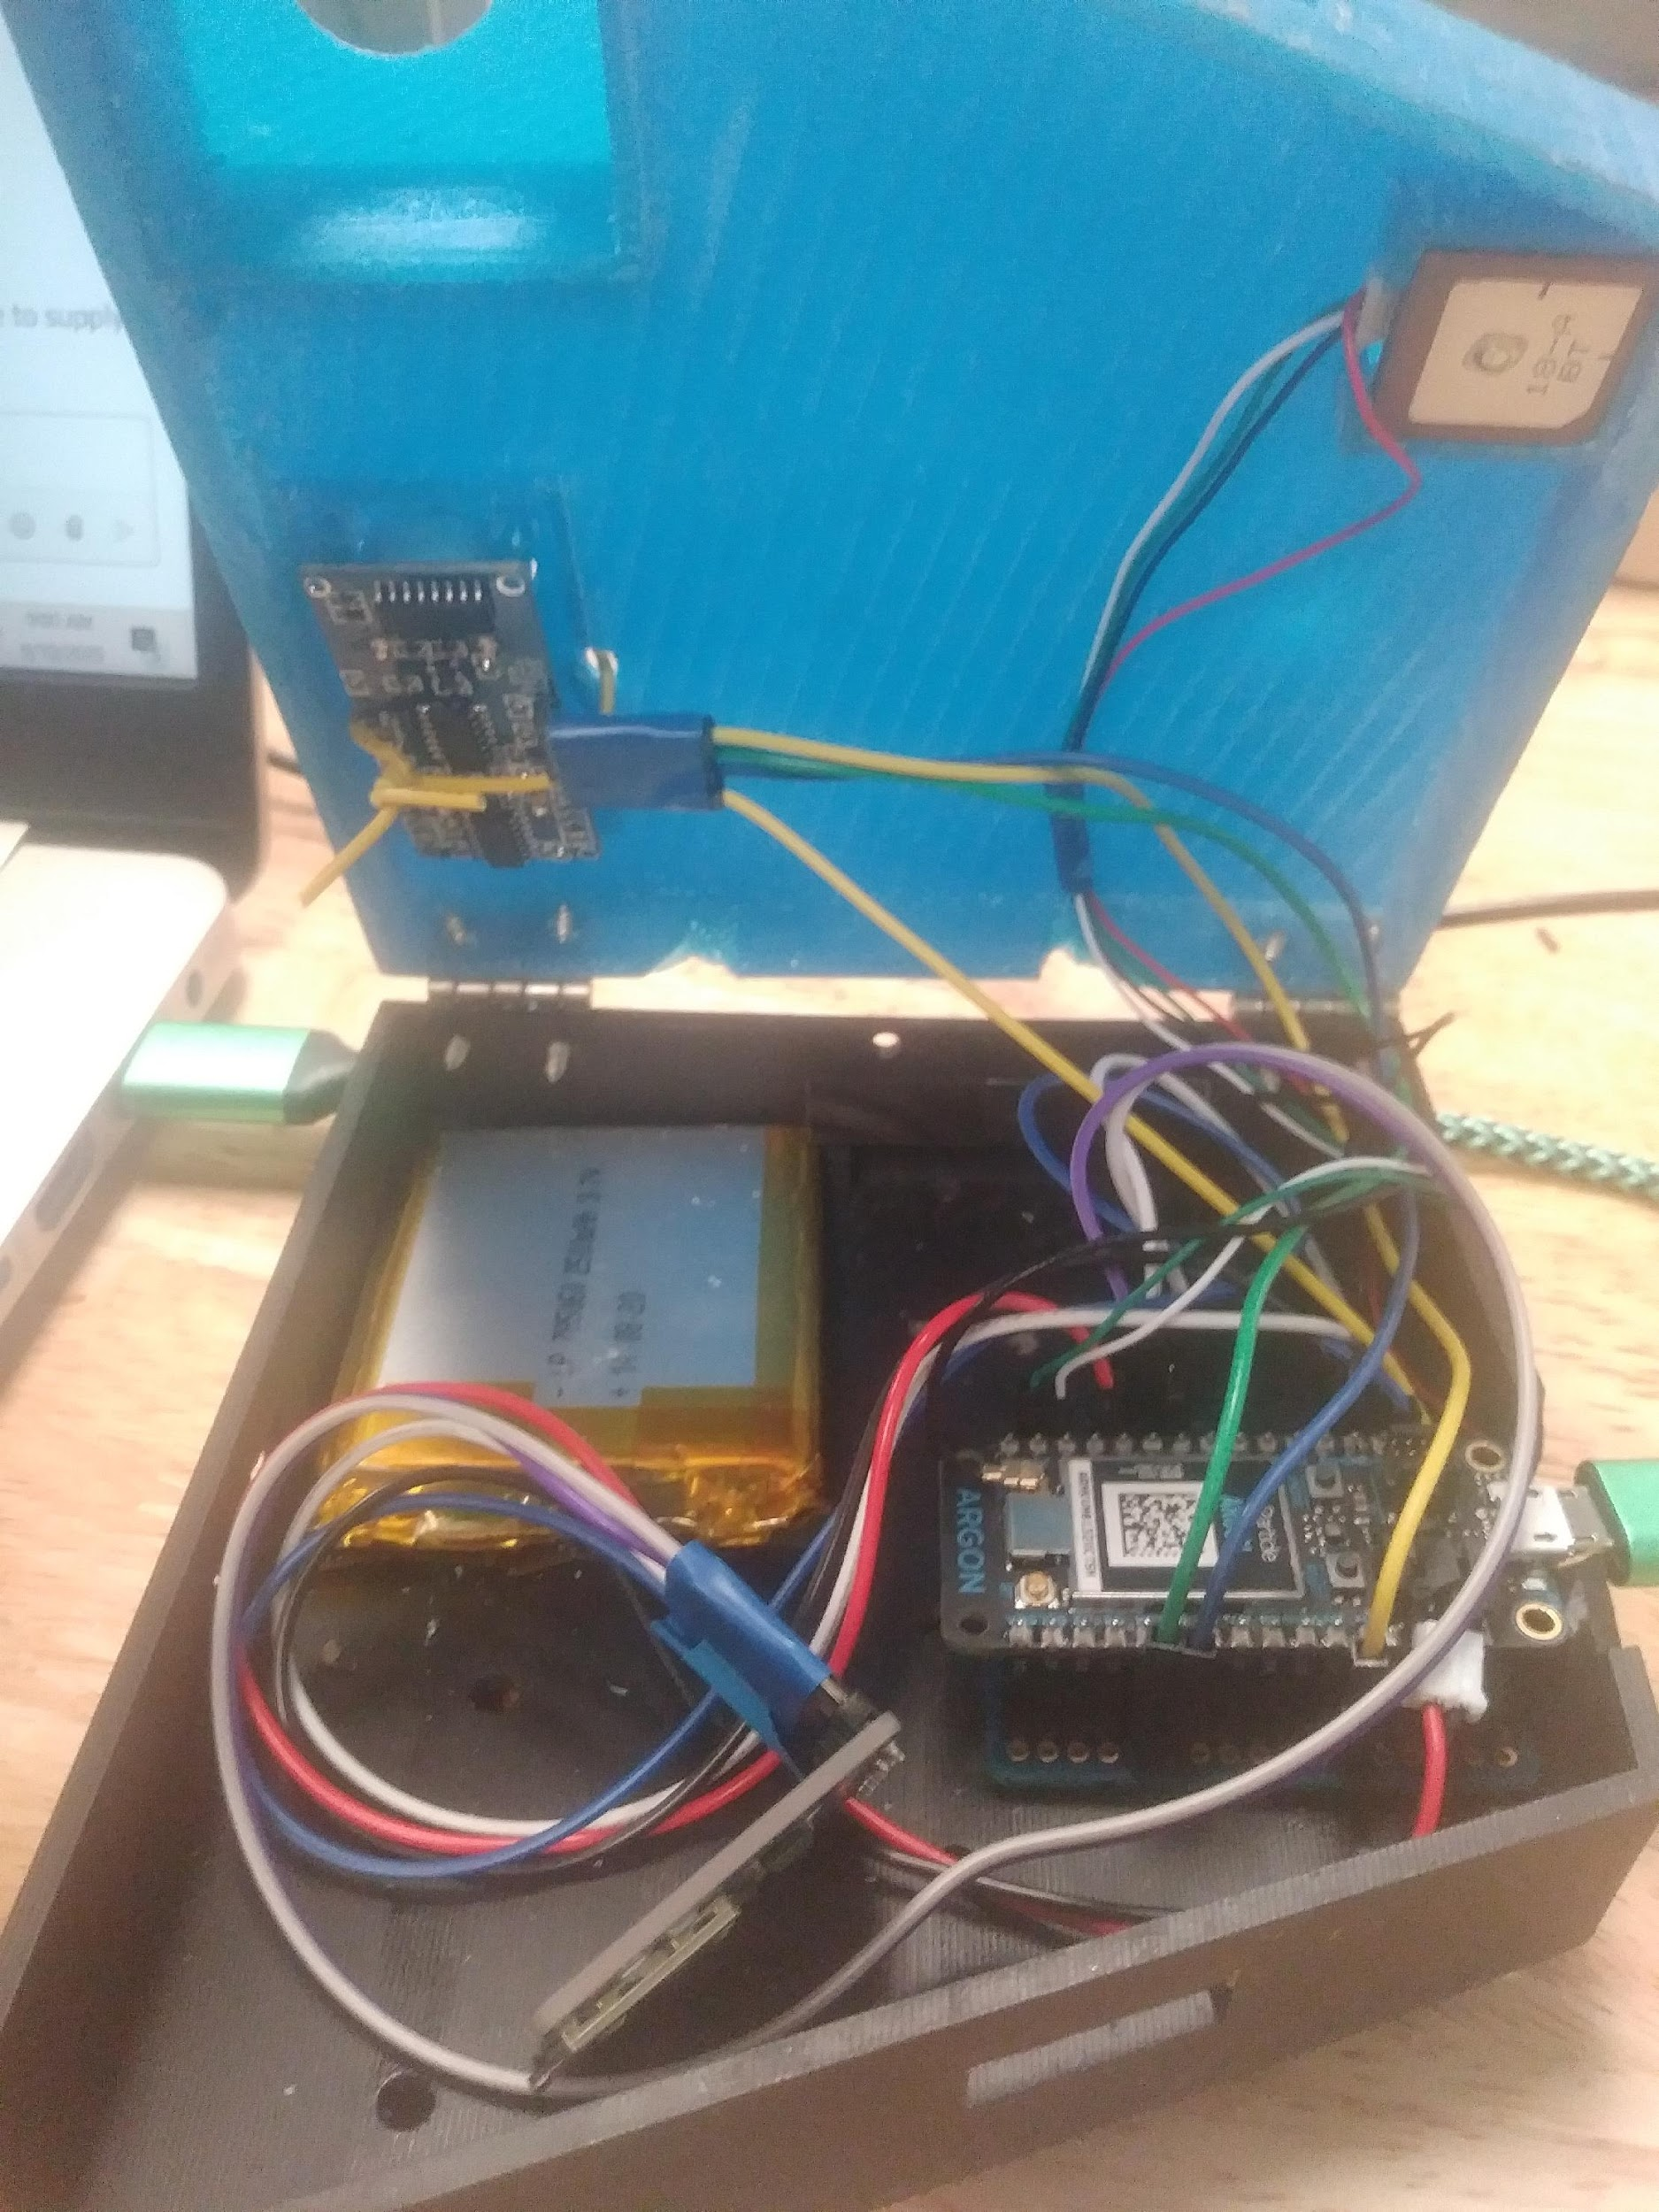
Components price list
Ultrasonic sensor $4.00
Mini GPS $15.00
UCAM-III $49.00
lithium-ion Battery $15.00
Micro Breadboard $8.00
Particle Argon $25.00
Adafruit MicroSD reader $7.50
Micro SD card $9.00

Slide 5
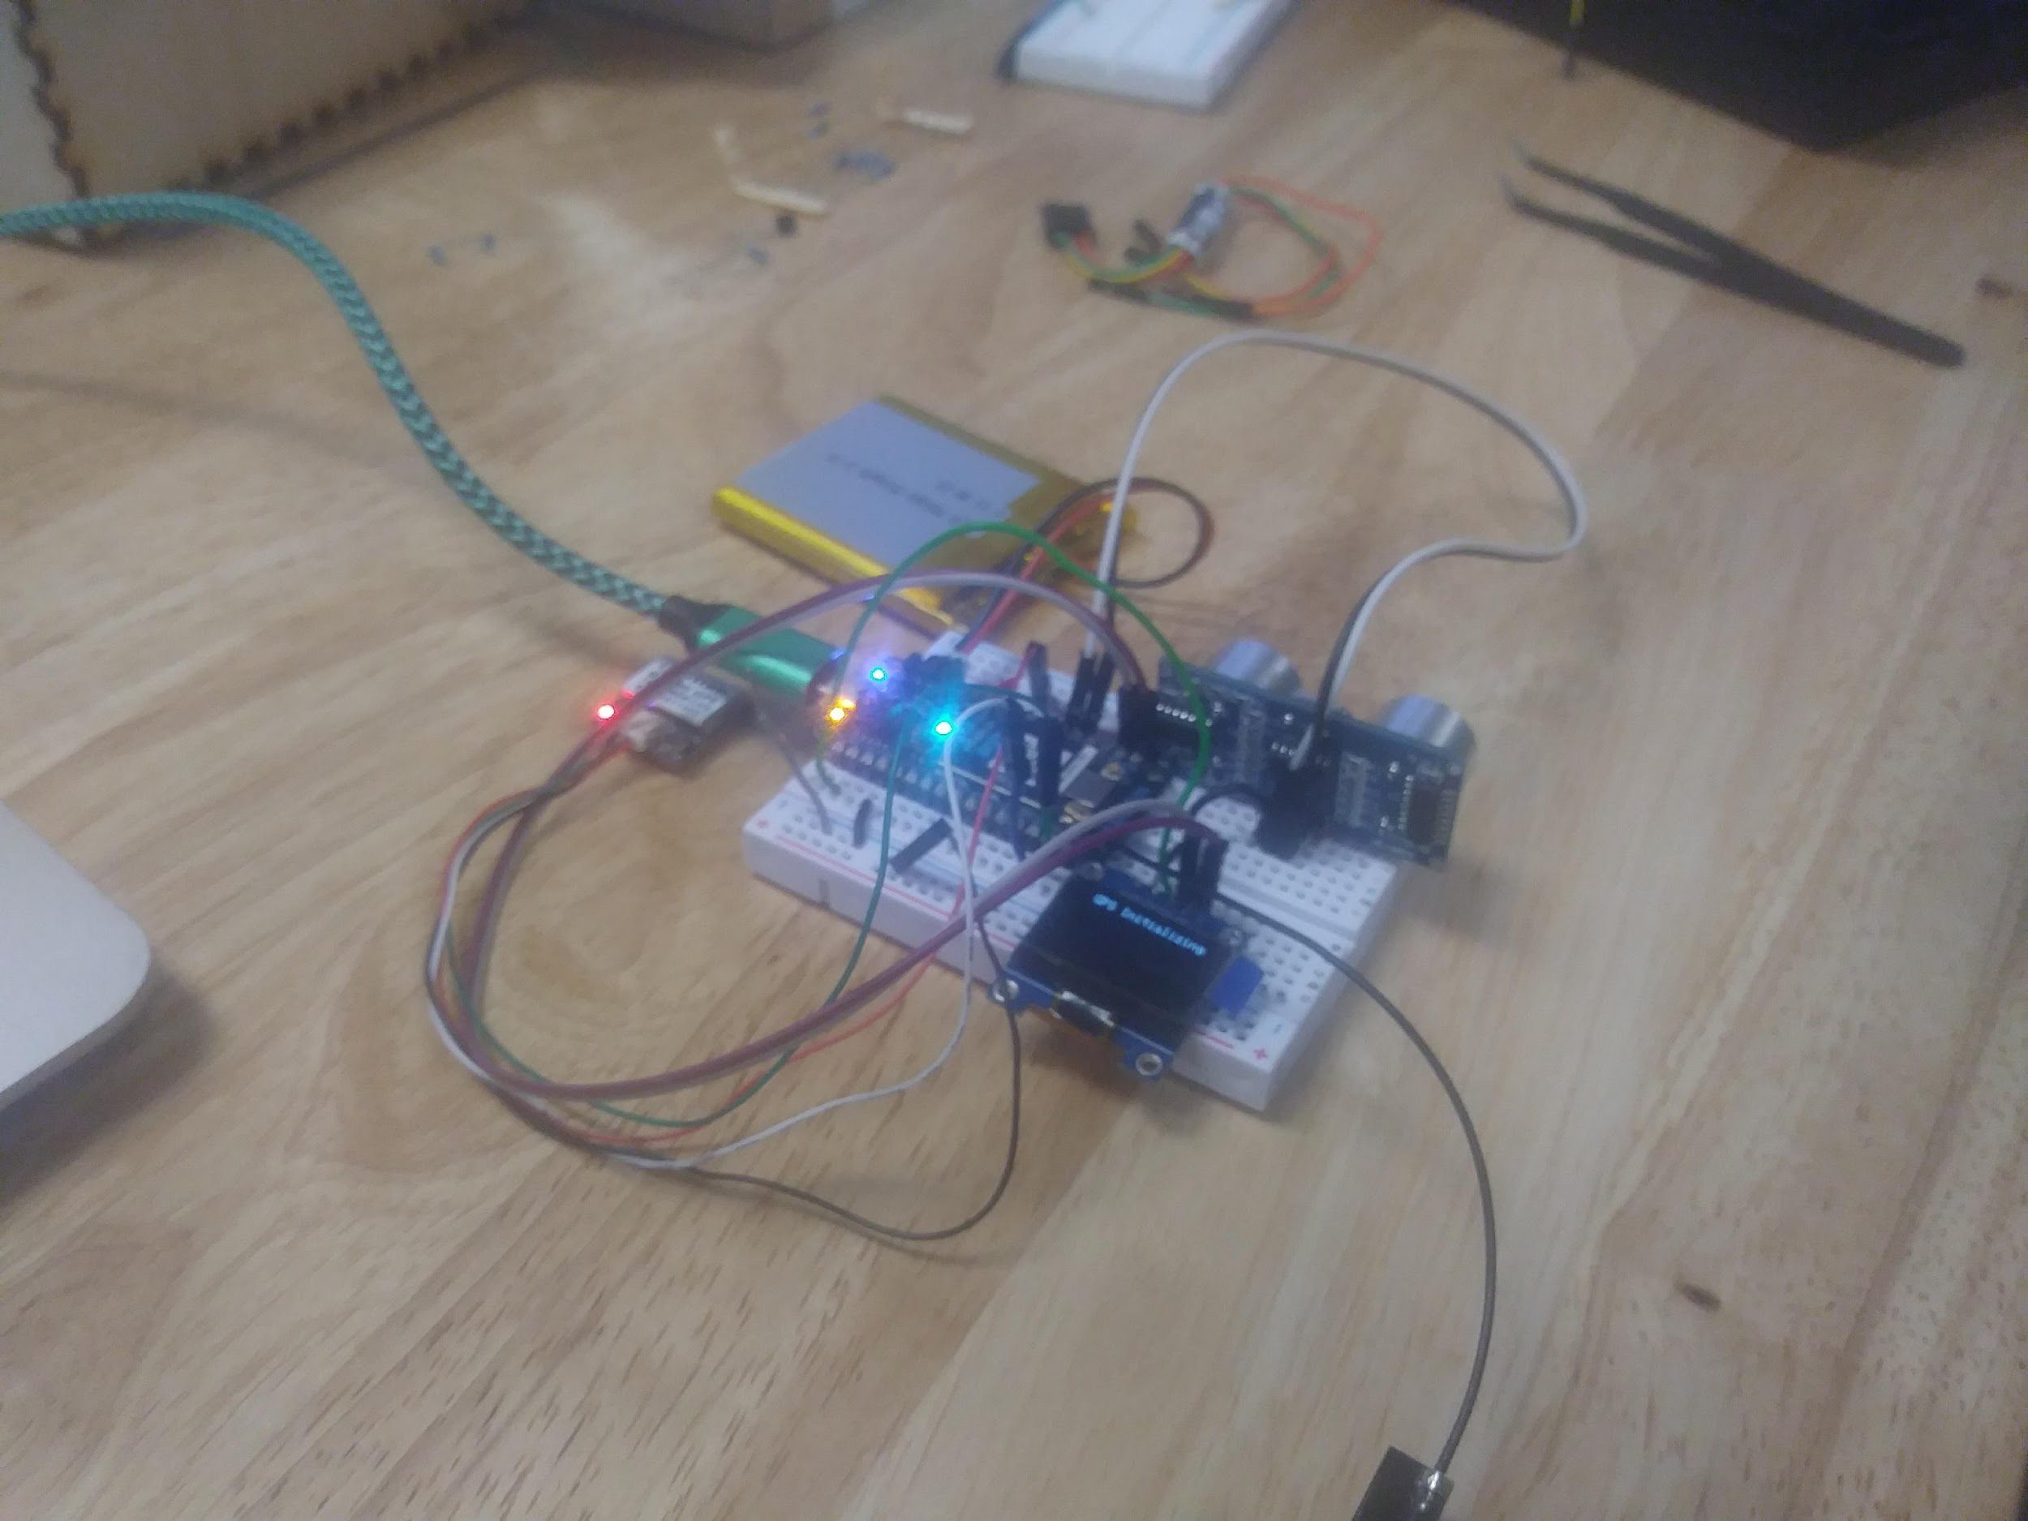
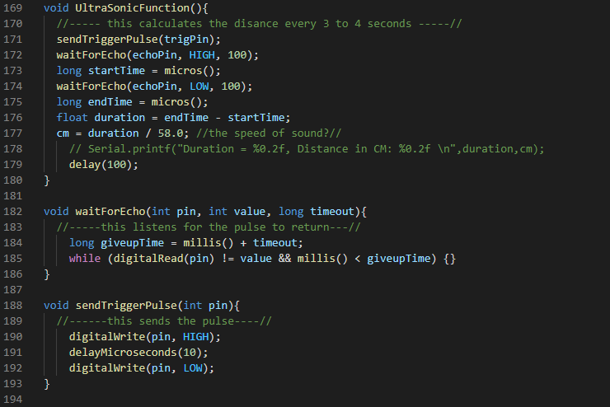
Ultrasonic Sensor
Hc-sr04
Code originally written for Arduino microprocessor.
Documentation stated accuracy up to 400cm.
Testing indicated accuracy just above 300cm.
Oblique angles on vehicles increased variance of results.
Low cost and lightweight.

Slide 6
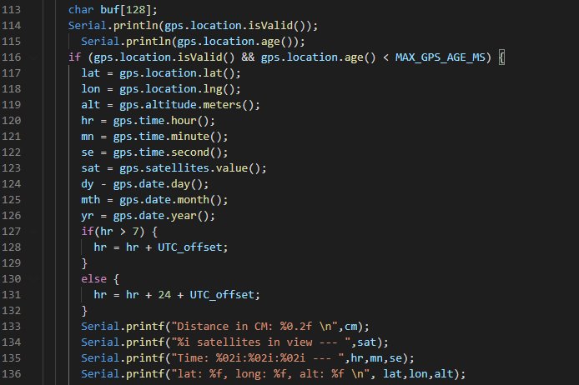
GPS
The GPS module experienced intermittent connectivity within and near buildings.

Slide 7
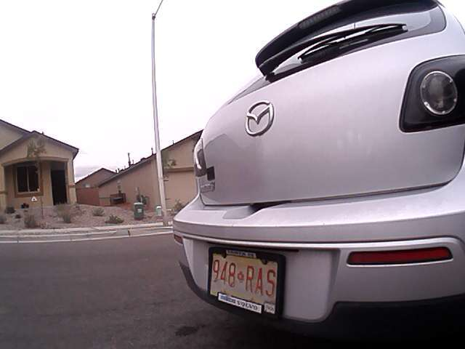
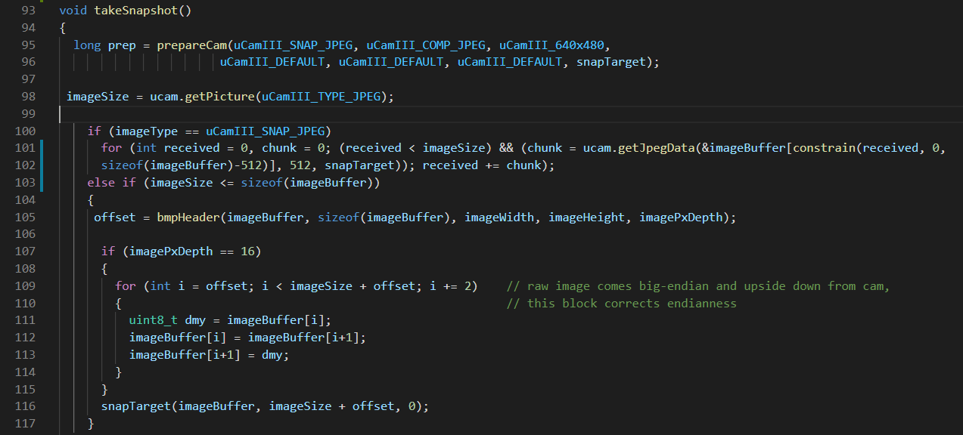
Camera
UCAM-III developed by 4d Systems.
The library in use was written for an older particle.
115° Field of View allows for wider shots with greater detail.

Slide 8
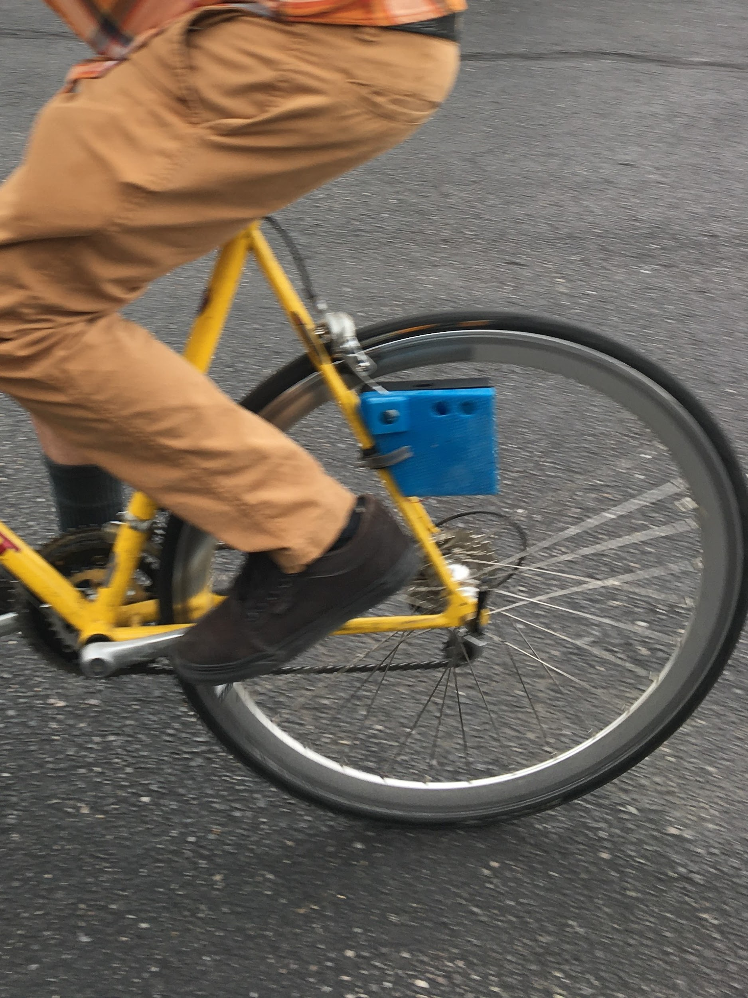

Designing the enclosure
Must be mountable on a bicycle.
Rugged design with all weather functionality in mind.

Slide 9
Future considerations
Additional features
LEDs
Accelerometer
Buttons
Addition applications
Retrofitting factories
Forklifts
Government &/Company vehicles
Anti-theft monitoring

Slide 10
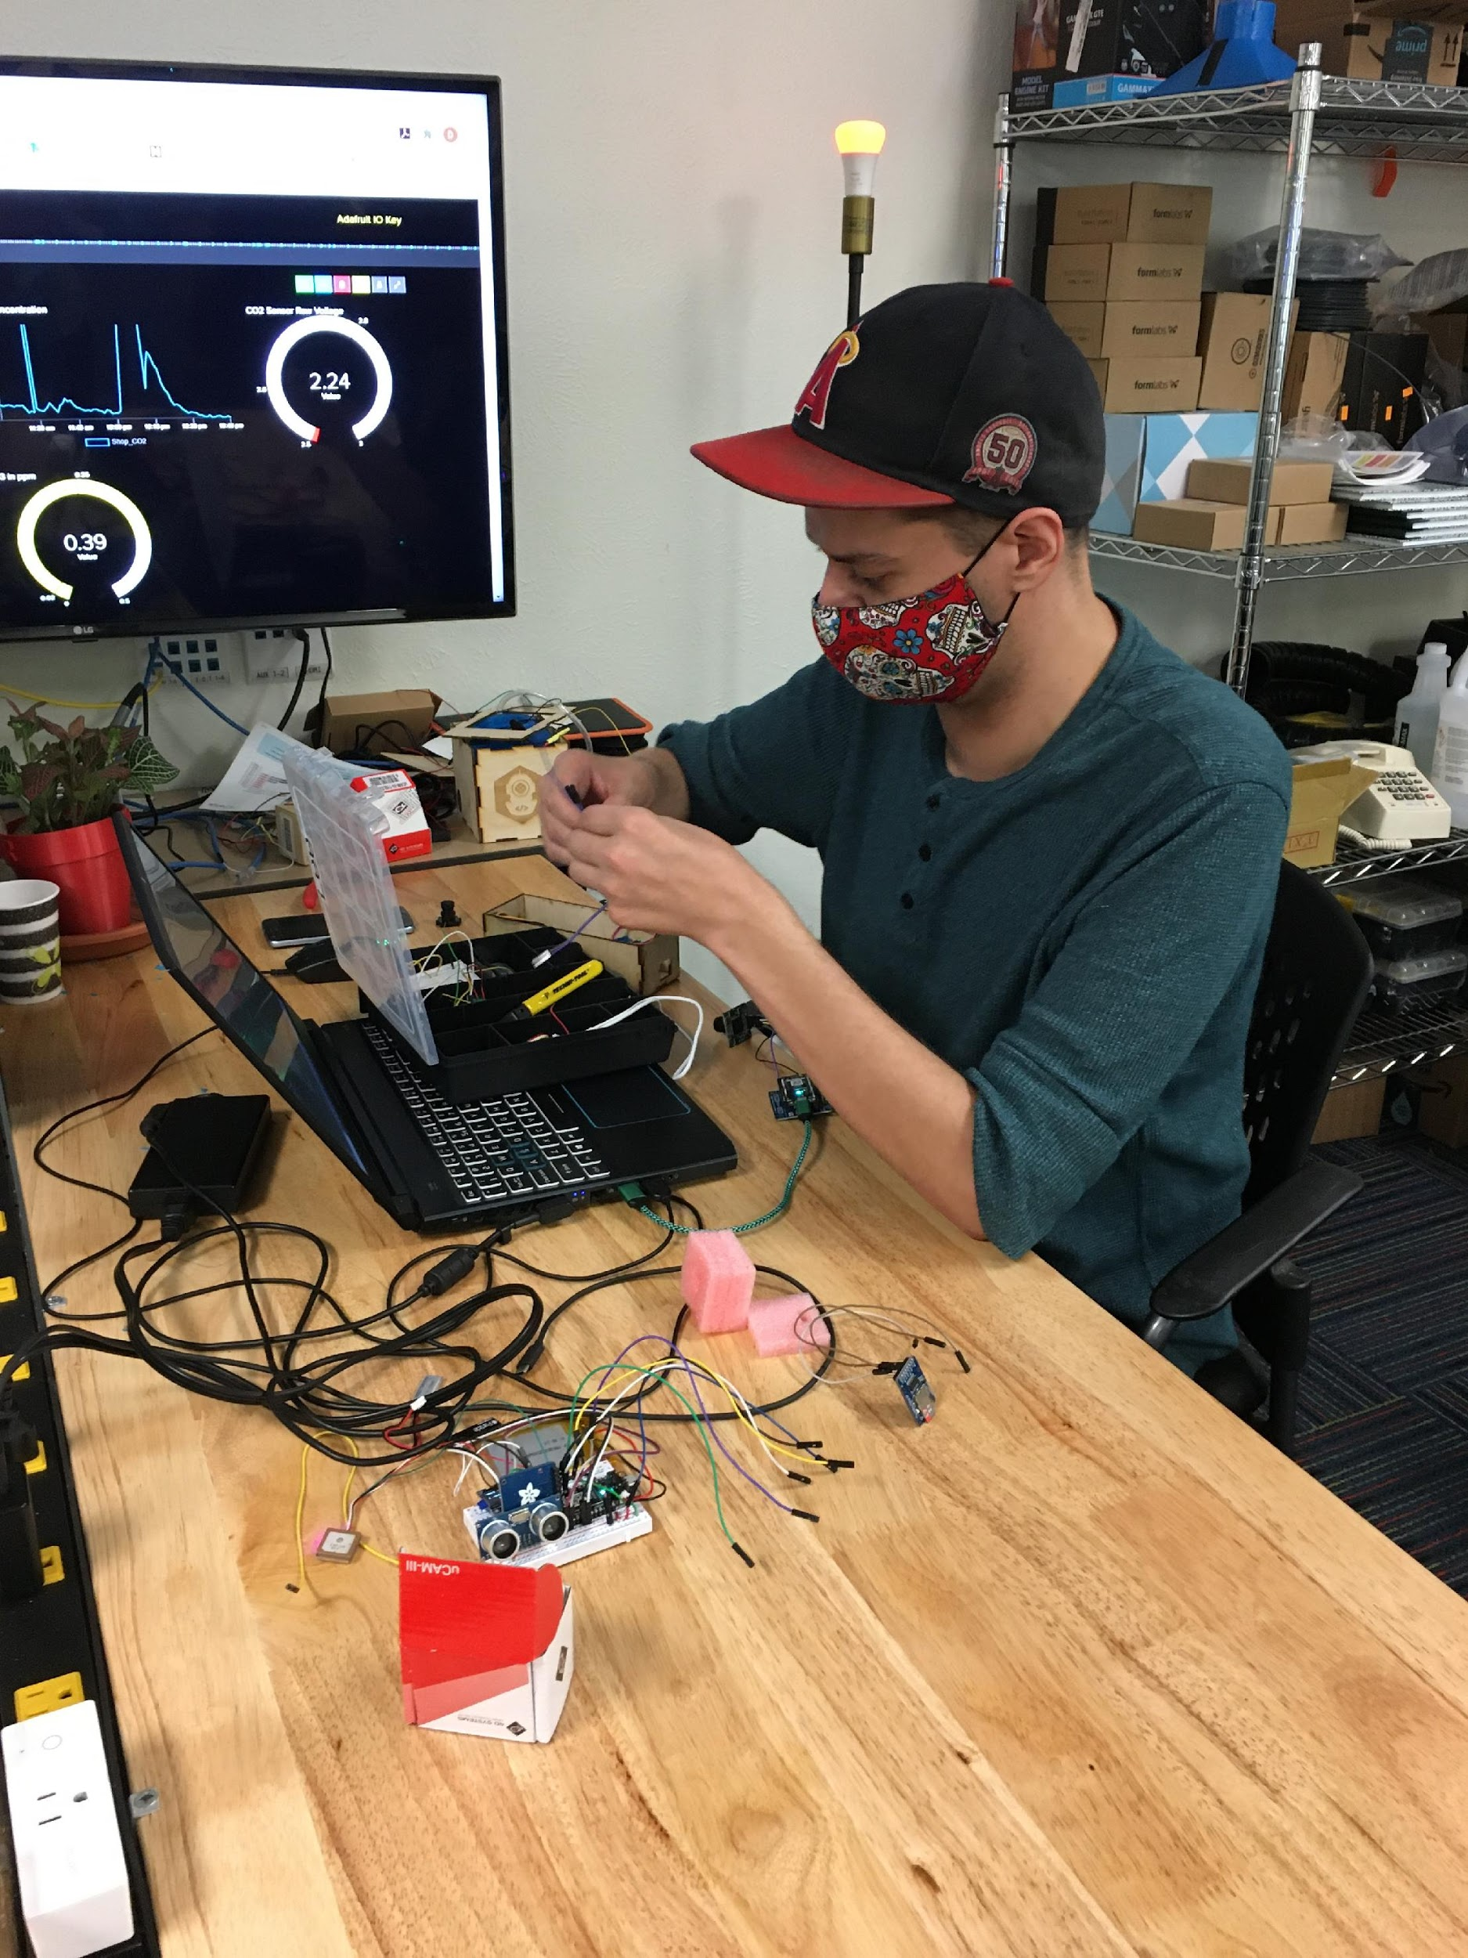
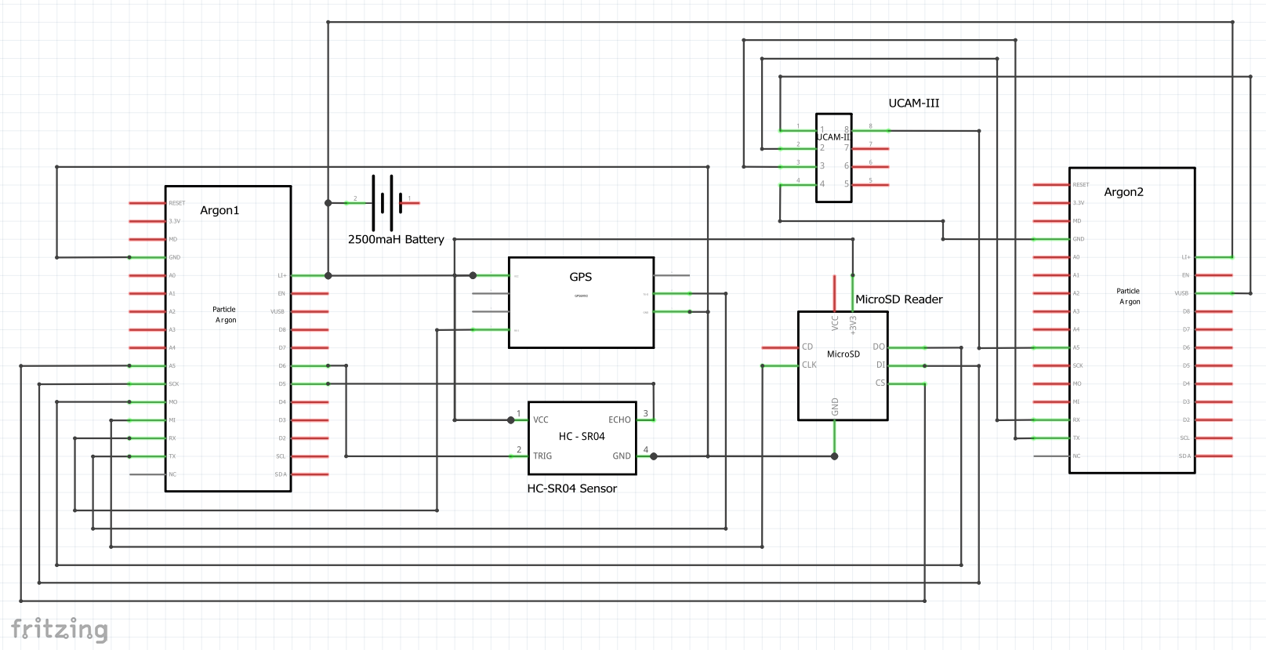
Schematic

Slide 11
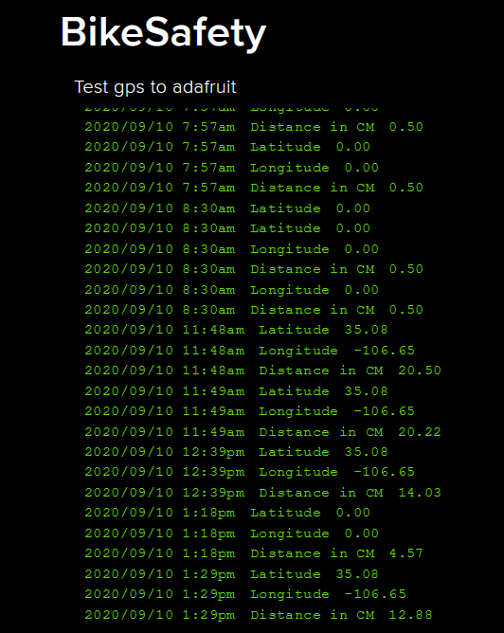
Contact Info
Benjamin Hansen
Phone 915-6670197
Email:
Benja.k.h@gmail.com
Linkedin: https://www.linkedin.com/in/benjamin-hansen-b315b3105
Github: https://github.com/BenjaKH
Hackster.io
https://hackster.io/benjakh
Lee Abeyta
Email: Nmlabeyta@gmail.com
Linkedin: https://www.linkedin.com/in/lee-abeyta-iot-tech/
Github: https://github.com/nmlabeyta

