Slide 1
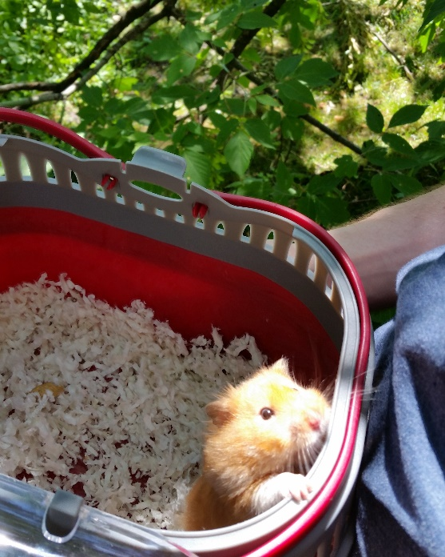
Simple example: Pet data
Suppose I collected a dataset of hamsters
PetName | Hamweight | Hammood
Winnie | 300 | 7
Hamlet | 140 | 5
Sally | 250 | 4
ErnestHamingway | 200 | 2

Slide 2
Suppose I also have a dataset of owners of all pets in the animal show (so there are other types of pet owners in this dataset)
OwnerName | PetType | PetName | CompetitionPlace
Todd | bird | Susan | 1
Iris | hamster | Winnie | 1
John | hamster | Hamlet | 9
Nick | squirrel | Sam | 5
Becca | dog | Toby | 3
Koji | hamster | Sally | 14

Slide 3
What type of join I use depends on the question I have & how inclusively I want to keep the dataset.

Slide 4
Left join:
I am a hamster researcher who only cares about matching hamsters to hamster owners. I don’t care about owners of other pets
BUT maybe I also want to know which hamsters I couldn’t match up w/ an owner
Maybe the owner info was just cursory information anyway, and I still really care about my precious hamster data
PetName | Hamweight | Hammood | OwnerName | Pettype | CompetitionPlace
Winnie | 300 | 7 | Iris | hamster | 1
Hamlet | 140 | 5 | John | hamster | 9
Sally | 250 | 4 | Koji | hamster | 14
ErnestHams | 200 | 2 | NA | NA | NA

Slide 5
Inner join:
I only care about hamsters that I could match up to owners data, who cares about the leftover hams?, my research question is all about the hamster-owner relationship.
PetName | Hamweight | Hammood | OwnerName | Pettype | CompetitionPlace
Winnie | 300 | 7 | Iris | hamster | 1
Hamlet | 140 | 5 | John | hamster | 9
Sally | 250 | 4 | Koji | hamster | 14

Slide 6
Full join:
I’m interested in retaining all possible information. Really, I’m just merging 2 datasets that I find to be equally important together.
Name | Hamweight | Hammood | OwnerName | Pettype | CompetitionPlace
Winnie | 300 | 7 | Iris | hamster | 1
Hamlet | 140 | 5 | John | hamster | 9
Sally | 250 | 4 | Koji | hamster | 14
ErnestHams | 200 | 2 | NA | NA | NA
Susan | NA | NA | Todd | bird | 1
Toby | NA | NA | Becca | dog | 3
Sam | NA | NA | Nick | squirrel | 5

Slide 7
Another way of looking at it…
Full Join
Inner Join
Dataset 1
Dataset 2
Left Join

