Slide 1

Methods Hour: Preregistration
By Nick Michalak, Koji Takahashi, & Joyce Lee
November 10, 2017

Slide 2
“All too often, we find ourselves unable to predict what will happen; yet after the fact we explain what did happen with a great deal of confidence. This ‘ability’ to explain that which we cannot predict, even in the absence of any additional information, represents an important, though subtle, flaw in our reasoning. It leads us to believe that there is a less uncertain world than there actually is...”
--- Amos Tversky

Slide 3
Hypothesis-generating vs. hypothesis-testing
Data can be used to generate or test hypotheses—not both
Generating and testing with same data reduces clarity and quality of results
Nosek, Ebersole, DeHaven, & Mellor (2017)
Notes:
Postdiciton. Characterized by the use of data to generate hypotheses about why something occurred. Data are already known and the postdiction is generated to explain why they occurred. For hypothesis-generating.
Prediction. Characterized by the acquisition of data to test ideas about what will occur. Data are used to confront the possibility that the prediction is wrong. For hypothesis-testing.
Preregistration separates hypothesis-generating (exploratory) from hypothesis-testing (confirmatory) research. Both are important, but the same data cannot be used to generate and test a hypothesis, which can happen unintentionally and reduce the clarity and quality of your results. Removing these potential conflicts through planning improves the quality and transparency of your research, helping others who may wish to build on it.

Slide 4
What is preregistration?
Make hypotheses, study design, and analytic decisions before collecting data
Then commit to that plan—post to a registry
Then selection of tests not influenced by observed data—prediction is possible
Preregistration makes clear what was planned vs. what was not; predicted vs. not predicted
Nosek, Ebersole, DeHaven, & Mellor (2017)
Notes:
Preregisration is basically making our hypotheses, design, and analysis decisions before we collect our results.
Preregistration. Preregistration of an analysis plan is committing to analytic steps without advance knowledge of the research outcomes. That commitment is usually accomplished by posting the analysis plan to an independent registry such as http://clinicaltrials.gov/ or http://osf.io/. The registry preserves the preregistration and makes it discoverable, sometimes after an embargo period.
With preregistration, prediction is achieved because selection of tests is not influenced by the observed data, and all conducted tests are knowable. The analysis plan provides constraint to specify how the data will be used to confront the research questions.
When you preregister your research, you're simply committing to your plan in advance, before you gather data. Preregistration separates hypothesis-generating (exploratory) from hypothesis-testing (confirmatory) research. Both are important, but the same data cannot be used to generate and test a hypothesis, which can happen unintentionally and reduce the clarity and quality of your results. Removing these potential conflicts through planning improves the quality and transparency of your research, helping others who may wish to build on it.

Slide 5
Why should Psychology preregister?
Null Hypothesis Significance Testing (NHST) assumes prediction
Preregistration satisfies prediction
Preregistration improves our ability to interpret our test results
Nosek, Ebersole, DeHaven, & Mellor (2017)
Notes:
The diagnosticity of a p-value is partly contingent on knowing how many tests were performed (27). Deciding that a given p < .05 result is unlikely✝, and therefore evidence against the null hypothesis, is very different if it was the only test conducted versus one of 20, 200, or 2000 tests.

Slide 6
Why should I preregister?
You’re making important decisions that affect your workflow earlier without the biases that occur once you have looked at the data.
You already do this (i.e., study idea pitch, dissertation proposal, grant writing, IRB application).
Center for Open Science (n.d.)
Notes:
By writing out data collection methods and analysis plans, you make important decisions that affect your workflow EARLIER without the biases that occur once the data are in front of you. It can be easier than many people believe.
Preregisration is basically making our hypotheses, design, and analysis decisions before we collect our results. We already do this to some extent (i.e., grant proposals, study idea pitches, dissertation proposals, IRB)

Slide 7
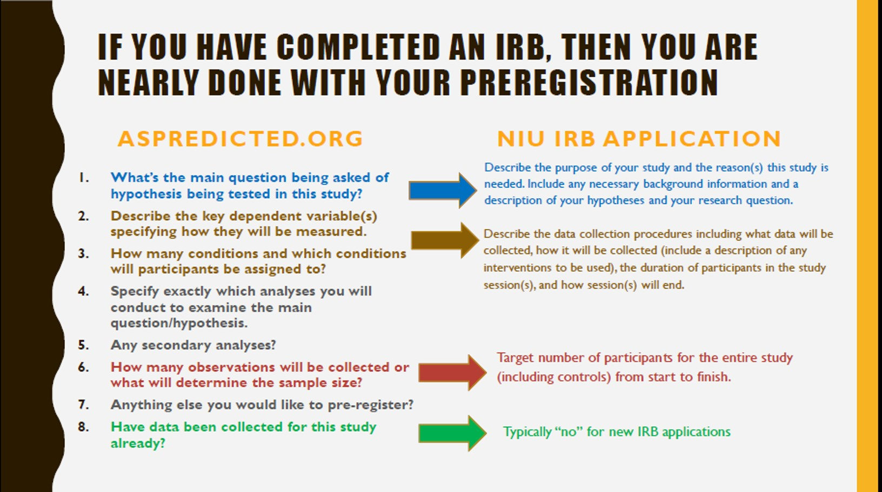
Preregistration may not be creating much “extra” work

Slide 8
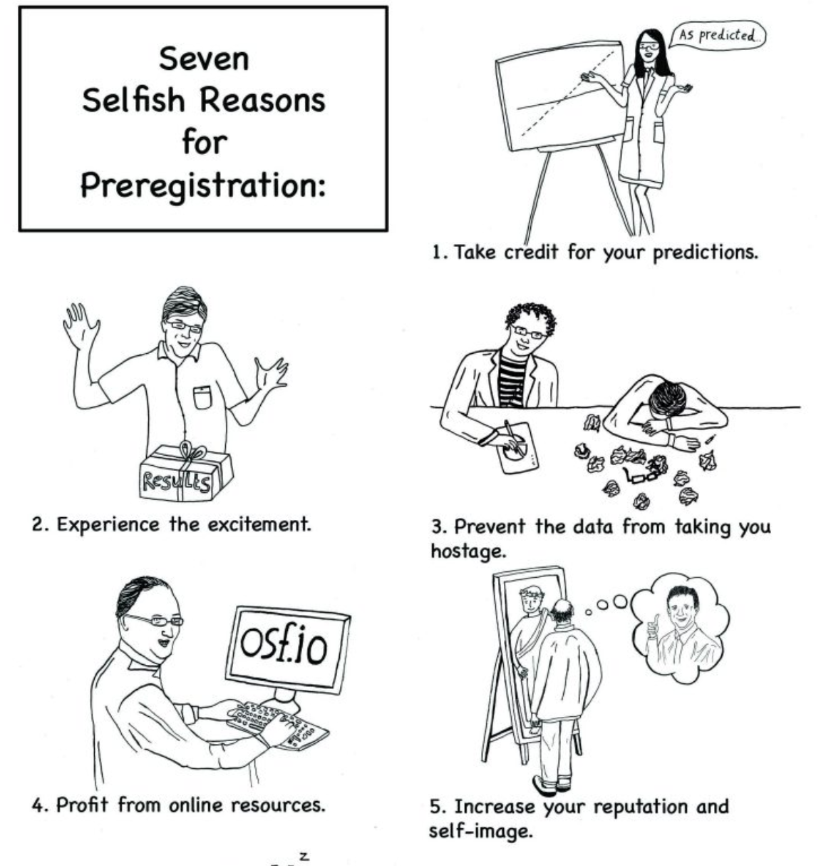
Why should I preregister (cont.)?
Take credit for your predictions
It can be exciting: Will your theory be confirmed or disconfirmed?
The write up can be faster and it allows you to have manuscripts accepted “in principle” regardless of how the results pan out (i.e., registered reports).
It bolsters confidence in findings and builds credibility.
Wagenmakers & Dutilh (2016)

Slide 9
Why should I preregister (cont.)?
Machine
Learning
Direct
Replication
Everything
Else
Fully Exploratory
Fully Confirmatory
Notes:
-Examples of the continuum: from machine learning (all exploratory, no decisions made in advance) to preregistered direct replications (all decisions made in advance)
-Discuss importance of these distinctions for statistical inference; also that we don’t have exact answers as to where on the continuum a particular project falls, but prereg gives us a lot of useful information for having an informed idea

Slide 10
General framework for preregistration
Preregistration is a flexible tool with many options.
Starting with a general framework and adapt.
General framework: Clear and specific outline for what you will test and how.
Moving from “preregistered studies” to “preregistered hypotheses and analyses.”
Important things to specify: hypotheses, variables, analyses, sample size.
Notes:
Develop a clear and specific plan for what you want readers to know was planned in advance.

Slide 11
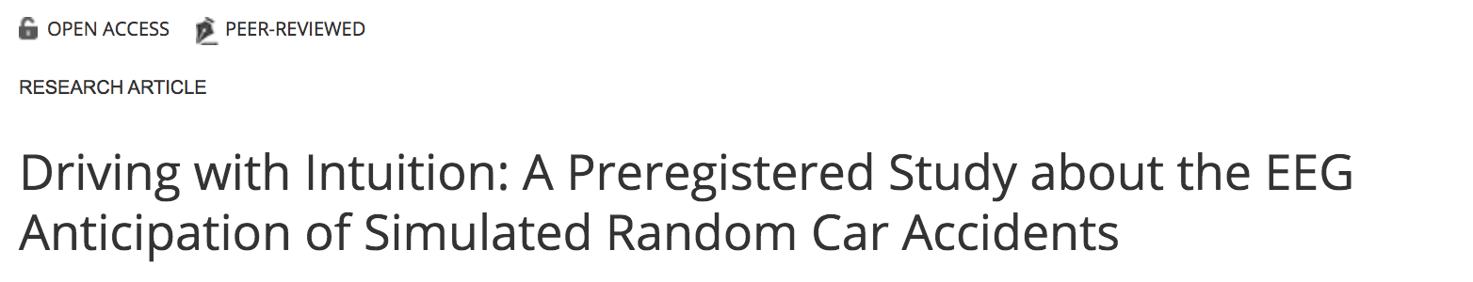
General framework for preregistration (cont.)
On preregistered studies vs. hypotheses and analyses
May colloquially talk about “preregistered study”, but in practice should think more specifically
One study can have many important confirmatory and exploratory analyses

Slide 12
General framework for preregistration (cont.)
Hypotheses: Specify what you want to test as clearly and specifically as you reasonably can.
Variables: Specify what measures you will use to test those hypotheses and how you will score them (e.g. averages, subscales, difference scores).
Analyses: Specify the specific analyses you will run to test focal hypotheses.
Sample size: Specify your planned sample size/stopping rule, exclusion criteria.

Slide 13
Examples of preregistration
Social Psychology
Developmental Psychology
Cognitive reappraisal and impulse inhibition
Considered well organized and clear by OSF
Includes hypotheses, variables, analyses and sample size
Rationale for sample size provided
Shows variables to be used in confirmatory and exploratory analyses
Nice framing of the how and why of exploratory analyses
Other section where accompanying preregistration and data deposit information are specified
Notes:
https://osf.io/2tpy9/register/565fb3678c5e4a66b5582f67

Slide 14
Instruction on how to get started
Be aware that there are many options for registry
Aspredicted.org:
More for experimental studies
Has an unlimited embargo period
Not peer-reviewed
Open Science Framework (OSF):
Has more options for preregistration format and templates
Can share and update your preregistration
Can use anonymous links to share during blind review
Preregistration becomes public after 4 year embargo period
Reviewed for completeness (i.e., challenge preregistrations)
Notes:
There are many online services that support preregistration. The best-known is the Open Science Framework (OSF). Other options for preregistration include ClinicalTrials.gov, AEA Registry (The American Economic Association’s registry for randomized controlled trials), EGAP (Evidence in Governance And Politics), Uri Simonsohn’s AsPredicted, and trial registries in the WHO Registry Network. PROSPERO for systematic reviews in health and social welfare; PROSPERO is facilitated by the Centers for Reviews and Dissemination at the University of York and funded by the National Institute for Health Research in the UK.

Slide 15
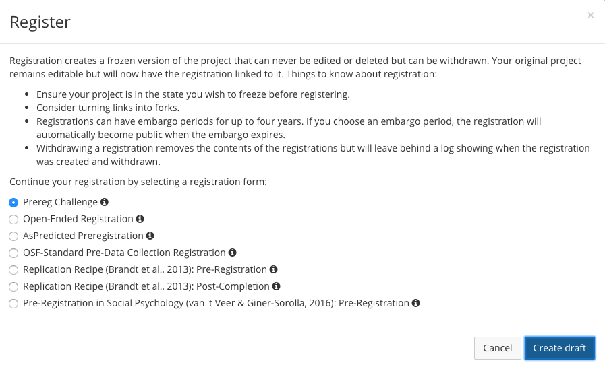
List of templates of OSF registration forms

Slide 16
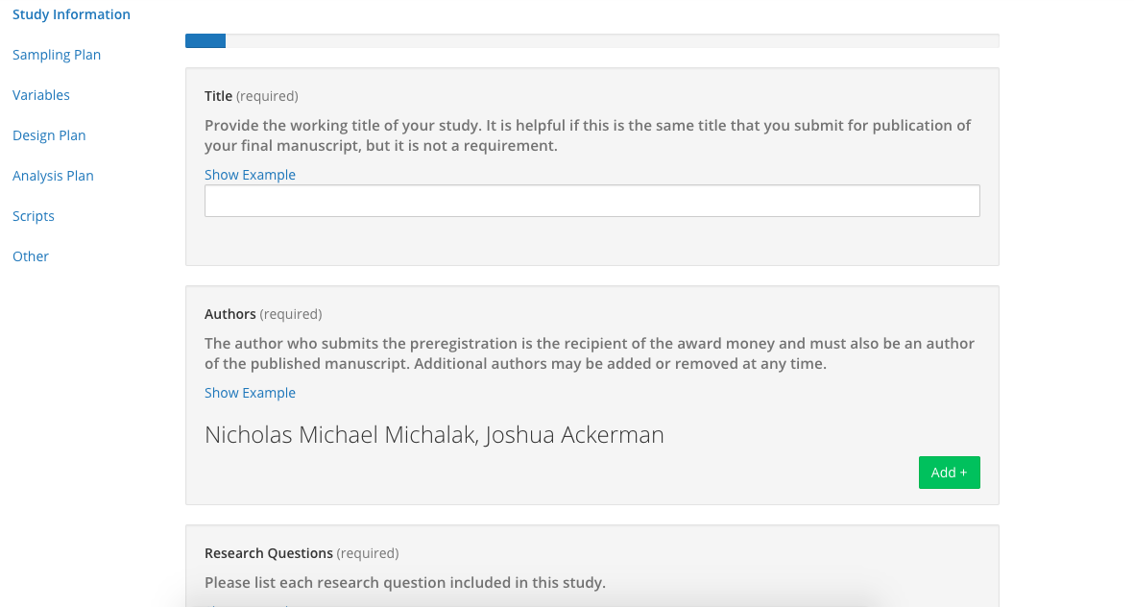
Example template

Slide 17

Preregistration Challenge
The Preregistration Challenge is a campaign designed to introduce researchers to the benefits of preregistration and reward those who do it with $1,000 prizes.
Notes:
One thousand researchers will win $1,000 each for publishing the results of preregistered research in an eligible journal.
Authors conduct the preregistration and meet eligibility criteria independently of the journal and journal review process. However, authors cannot publish in any journal to receive a prize. They must publish in an eligible journal, as determined by the prize administrators at the Center for Open Science.
Eligible journals demonstrate commitments to open, transparent science and maintain rigorous peer review processes for publication.

Slide 18
Examples of Preregistration Challenge eligible journals
General psychology: Psychological Science
Social psychology: Journal of Experimental Social Psychology, Journal of Social Psychology
Developmental psychology: Developmental Science, Cognitive Psychology, Behavior Research Methods
Clinical psychology: Clinical Psychological Science, Clinical Child and Family Psychology Review

Slide 19
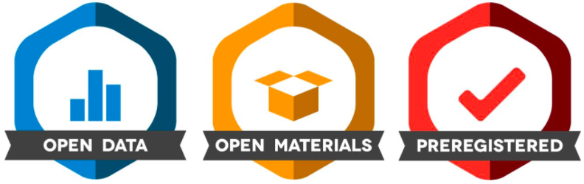
Open Practice badges in publications
Badges acknowledge open practices in journal manuscripts. There are different kinds of badges, including Open Data, Open Materials, Preregistered badges.
Notes:
Despite the importance of open communication for scientific progress, present norms do not provide strong incentives for individual researchers to share data, materials, or their research process. Journals can provide such incentives by acknowledging open practices with badges in publications.
Authors can earn up to three badges in recognition of open science practices. These include an Open Data badge, an Open Materials badge, and a Preregistration badge. Authors must provide the following to qualify for each badge:
Open Data badge: A URL, doi, or other permanent path for accessing data in a public and open-access repository; sufficient information for an independent researcher to reproduce results
Open Materials badge: A URL, doi, or other permanent path for accessing the materials in a public, open-access repository; Sufficient information for an independent researcher to reproduce the reported methodology
Preregistered badge: URL, doi, or other permanent path to the registration in a public, open-access repository;An analysis plan registered prior to examination of the data or observing the outcomes; Any additional registrations for the study other than the one reported; Any changes to the preregistered analysis plan for the primary confirmatory analysis; All of the analyses described in the registered plan reported in the article
Data, materials, and analysis plans must be permanent, time-stamped, and uneditable. Personal websites and most departmental websites do not qualify as repositories.
Databrary is a good example. It’s an open data repository for managing, sharing, and repurposing video and audio data for developmental science.
Badges do not define good practice; badges certify that a particular practice was followed.
Open studies get cited more often but correlational and too early to say.

Slide 20
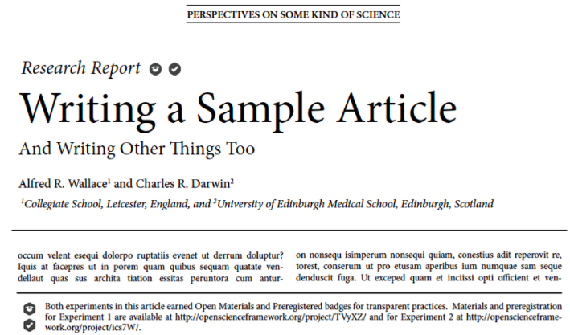

Open Practice badges in publications (cont.)
Example of what the badges might look like in a journal article:
Notes:
This week on Psychological Science’s OnlineFirst index:

Slide 21

Thank you!
Nick Michalak | nickmm@umich.edu | @nmmichalak
Koji Takahashi | kjtaka@umich.edu | @KojiJTaka
Joyce Lee | joyceyl@umich.edu | @joyceyeaeunlee
Notes:
KojiJTaka

Slide 22
Appendix A: Additional concerns related to preregistration
Misconceptions that you cannot do exploratory analyses.
In preregistration, there is a section to indicate exploratory analyses.
Limits the analyses you want to do.
In preregistration, you can be specific about analyses and can change preregistration with justification--this leaves record of change.

Slide 23
Appendix B: Tips for a successful preregistration for the Preregistration Challenge
Clearly describe your hypotheses, variables, and analyses.
Specify the significance threshold.
Make sure each hypothesis has an analysis plan.
Fully specify the state of the data.
Number the tests you are going to conduct.
Move analyses that you cannot fully pre-specify to the exploratory section.
DeHaven (2017)
Notes:
https://cos.io/blog/10-tips-successful-prereg-challenge-submission/

Slide 24
Appendix C: Helpful links
Psychology’s ‘registration revolution’
Seven selfish reasons for preregistration
AsPredicted registry
Open Science Framework registry
Registered reports
Preregistration templates
A detailed example of how to do preregistration on OSF
Preregistration Challenge YouTube video
Preregistration Challenge eligible journals
Journals that offer Open Practice badges

