Slide 1
What makes a good test?
Nick Michalak

Slide 2
X → ? → Y
Do explicit and implicit attitudes correlate?
Is antidepressant medication an effective treatment for depression?
Does watching TV increase aggression in children?
Does attention improve memory?
Does mortality increase and does fertility decrease after maturity?

Slide 3
Presentation roadmap
Some test equations
Some pretend tests (experiments)
  More wrong way of analyzing data
  Less wrong way of analyzing data
Discussion
New and fancy way to test interaction hypotheses
More discussion

Slide 4
More specific hypothesis are easier to falsify. That’s good.
Dienes (2008); Popper (1934/1959)

Slide 5
The difference between significant and not significant is not itself statistically significant
Gelman & Stern (2006)

Slide 6


$$t= \frac{\overline{x} − μ_{0} }{s/{\sqrt{n}}}$$
Test one mean
$$t= \frac{\overline{x}1 −\overline{x}2}{\sqrt{\frac{s_{1}^{2}}{N1}+\frac{s_{2}^{2}}{N2}}}$$
Test more means

Slide 7


$$t= \frac{estimate −null value }{error}$$
$$t= \frac{estimate −another estimate}{all the errors}$$

Slide 8


$$t= \frac{has error−doesn^{′}t have error}{the first thing^{′}s error}$$
$$t= \frac{has error−also has error}{all that error}$$

Slide 9

$$t= \frac{(\hat{β} − β_{0})\sqrt{n −2}}{\sqrt{{SSR}/{\sum_{i=1}^{n}{{(x}_{i}}−\overline{x})}}}$$

Slide 10

$$t= \frac{slope−null value}{the model^{′}s error}$$
One regression slope

Slide 11

$$t= \frac{{\hat{β}}_{1}−{\hat{β}}_{2}}{\sqrt{{var(\hat{β}}_{1})+var\left({\hat{β}}_{2}\right)−2(cov({\hat{β}}_{1},{\hat{β}}_{2})}}$$

Slide 12

$$t= \frac{slope−another slope}{unique error for their difference}$$
Slopes from the same regression

Slide 13
Now for some pretend experiments

Slide 14
A hypothesis
Feeling powerful (compared to feeling powerless) increases motivation (but not positive affect) in those with lower self-efficacy (but not lower self-esteem), which leads to better negotiation performance

Slide 15
Study 1
Manipulation
Measure
200 people randomly assigned to feel more powerful or to feel powerless
Self-reported motivation

Slide 16
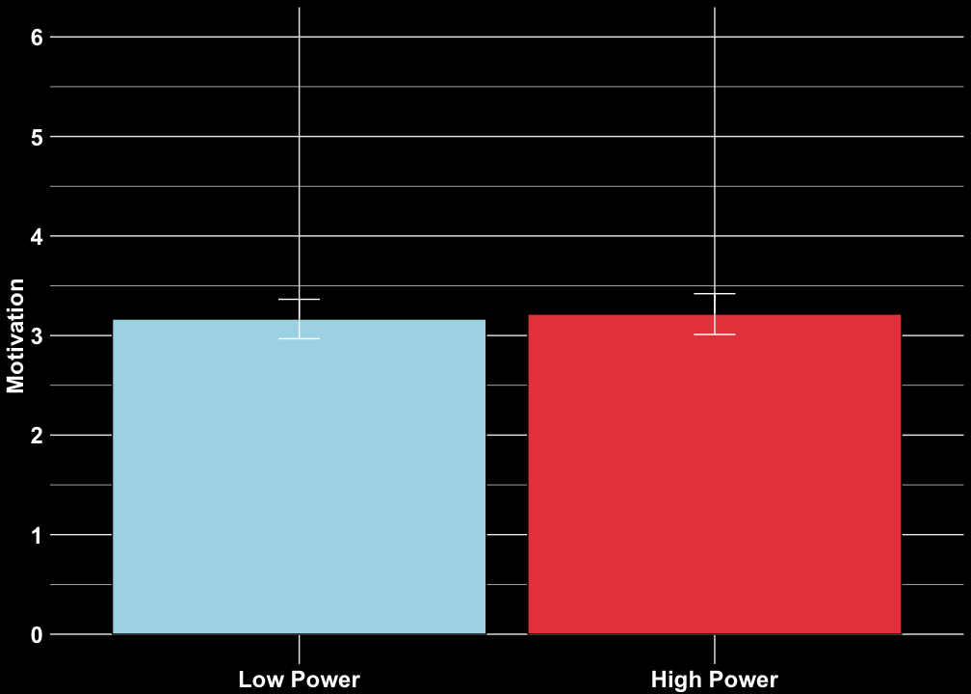
Midpoint
Error bars
95% CIs
t(99) = 1.66, p = .09927
t(197.77) = -0.35, p = .7299
t(99) = 2.09, p = .03929

Slide 17
Study 1b
Manipulation
Measures
200 people randomly assigned to feel more powerful or to feel powerless
Self-reported motivation
Self-reported positive affect

Slide 18
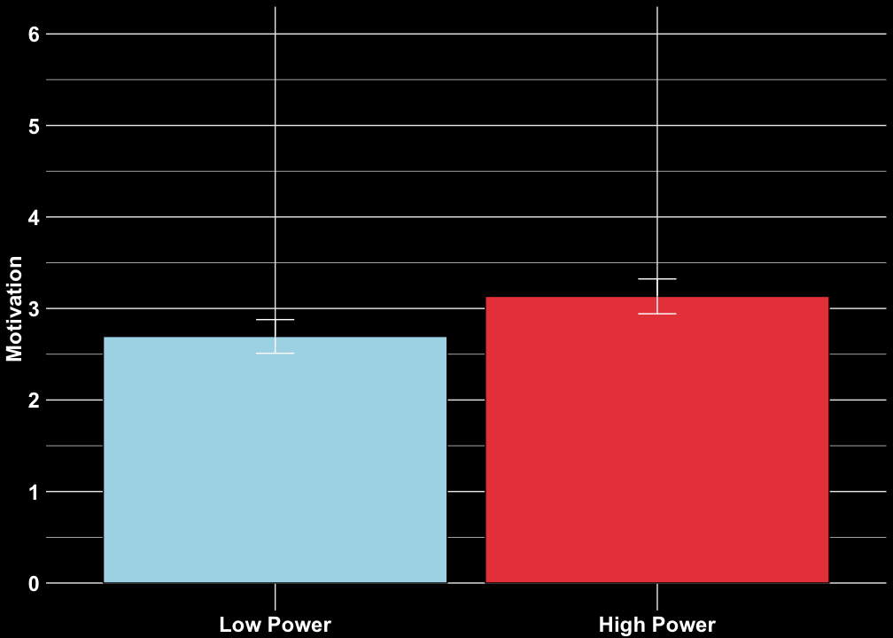
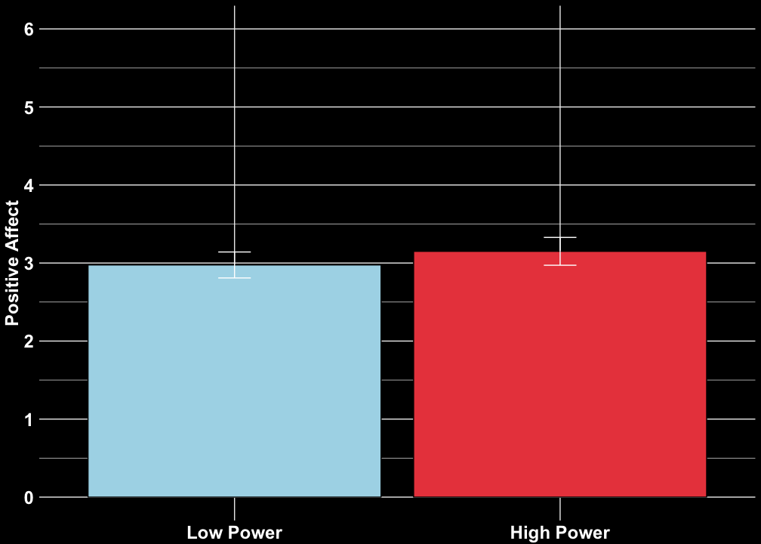
t(197.77) = -3.28, p = .001216
t(195.31) = -1.63, p = .104
Error bars
95% CIs

Slide 19
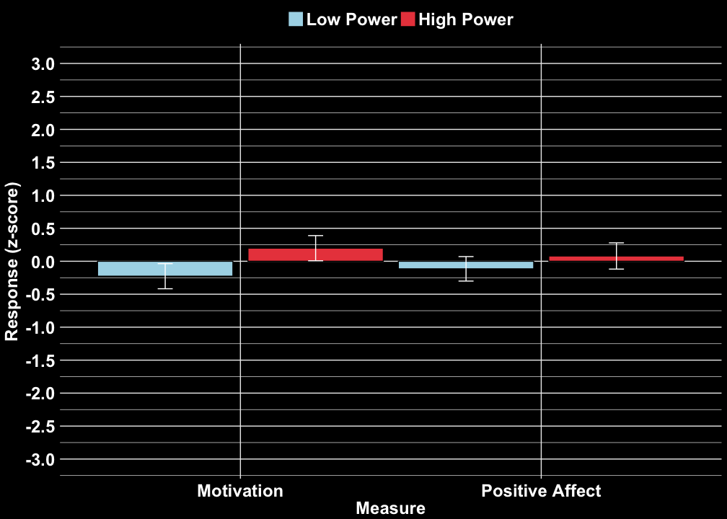
Error bars
95% CIs
t(194.29) = -1.0883, p = .2778

Slide 20
Study 2
Hypothesis
Manipulations and Measures
Feeling powerful increases motivation even for people feel less self-effective
400 people randomly assigned to feel more powerful or powerless and to feel more effective or less effective
Measured self-reported motivation

Slide 21
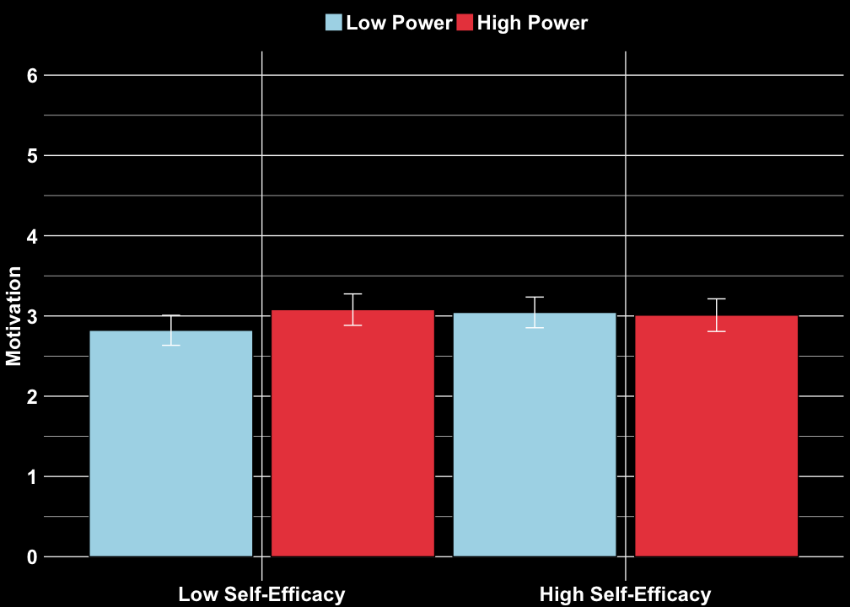
Error bars
95% CIs
t(197.29) = 0.24254, p = .8086
t(197.97) = -2.0645, p = .04028
t(395.18) = -1.62, p = . 10543833

Slide 22
Study 3
Hypothesis
Manipulations and Measures
Greater self-efficacy (not self-esteem) correlates with greater negotiation performance when people feel powerless but not when people feel powerful.
200 people randomly assigned to feel more powerful or powerless
Measured negotiation performance and self-reported self-efficacy and self-esteem

Slide 23
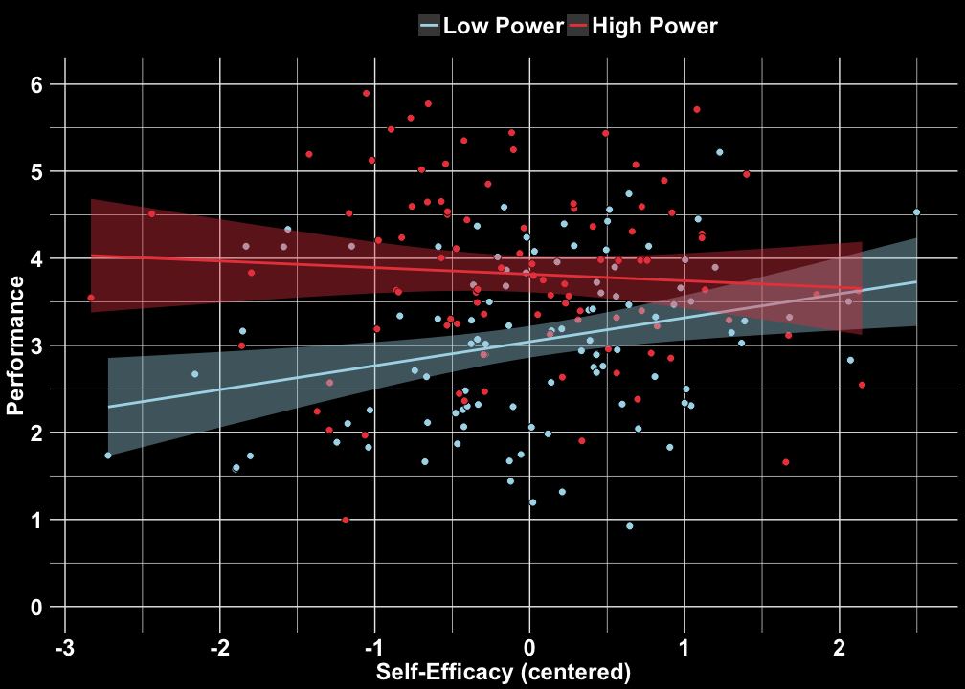
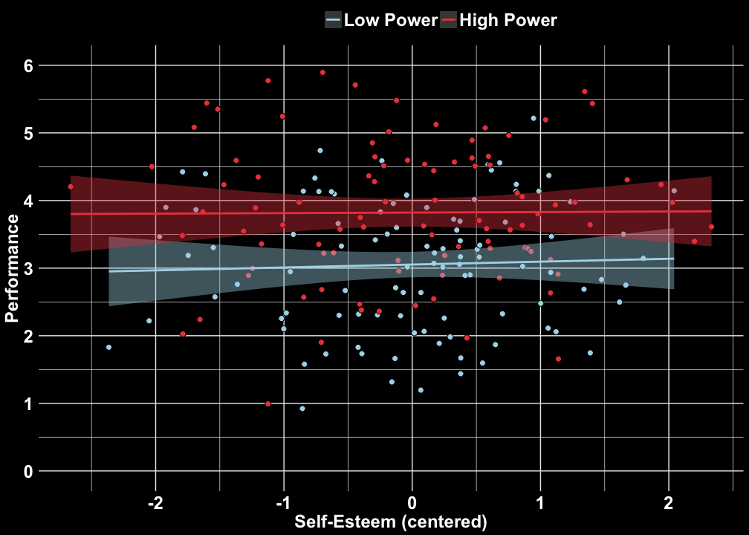
Separate: z = -2.063, p = 0.039
Seperate: z = 0.254, p = .799
Difference in 2-way interactions: z = -1.621, p = .105
Together: z = -2.318, p = 0.02
Together: z = 0.159, p = 0.874

Slide 24
Study 4
Hypothesis
Manipulations and Measures
For those lower in self-efficacy, power increases motivation which improves negotiation performance
Recruited 200 people pre-screened for low self-efficacy
Randomly assigned to feel more powerful or powerless
Measured motivation and negotiation performance

Slide 25
Preacher & Hayes (2008)
Indirect motivation = 0.058, 95% CI [0.012, 0.105]
Motivation
a1 = -0.047
b1 = -0.166
Low Power = -1, High Power = 1
Performance
a2 = 0.273
b2 = 0.214
Positive Affect
Indirect positive affect = 0.008, 95% CI [-0.014, 0.030]
Motivation – positive affect = 0.08, 95% CI [-0.102, 0.001]

Slide 26
On full and partial mediation…
‘As Rucker et al. (2011) nicely illustrated, the problem with this reasoning is that establishing that some variable M completely mediates the effect of X on Y says nothing whatsoever about the existence or absence of other possible mediators of X’s effect. Even if you can say you’ve completely accounted for the effect of X on Y with your favored mediator, this does not preclude another investigator from being able to make the same claim as you, but using an entirely different mediator. If there are multiple mediators that completely mediate X’s effect when considered in isolation, then what value is there to claiming that your favored mediator does? It is an empty claim, with no real value or meaning and nothing especially worthy of celebration much less even hypothesizing in the first place.’
Andrew Hayes, 2013

Slide 27
Are we setting the bar too high if we expect researchers to test complex contrasts (e.g. test difference between 2 two-way interactions)?
Do researchers make claims about contrasts and interactions in their data without formally testing those claims?

Slide 28
A different way to distinguish among patterns of interactions
Widaman, K. F., Helm, J. L., Castro-Schilo, L., Pluess, M., Stallings, M. C., & Belsky, J. (2012). Distinguishing ordinal and disordinal interactions. Psychological Methods, 17(4), 615-622.

Slide 29
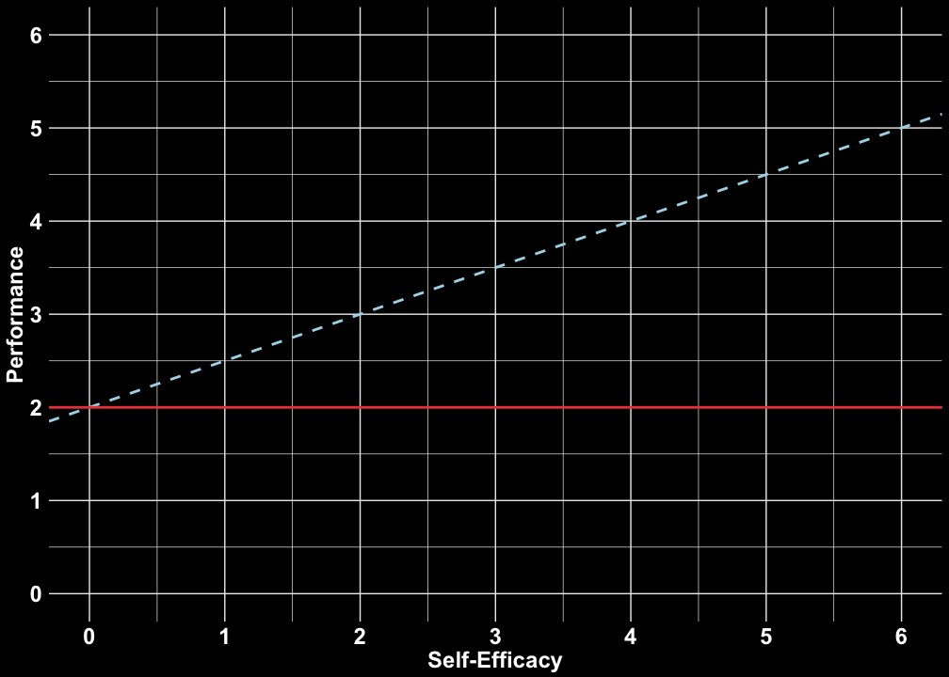

Slide 30
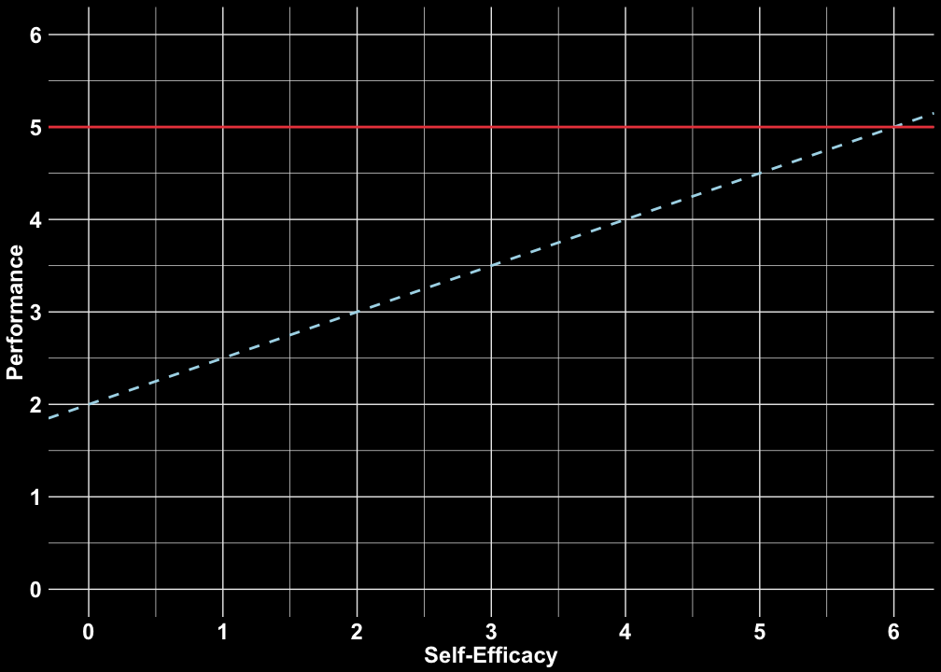

Slide 31
Study 3a again
High power slope
z = 2.470, p = 0.01
Low power slope
z = -0.440, p = 0.660

Slide 32
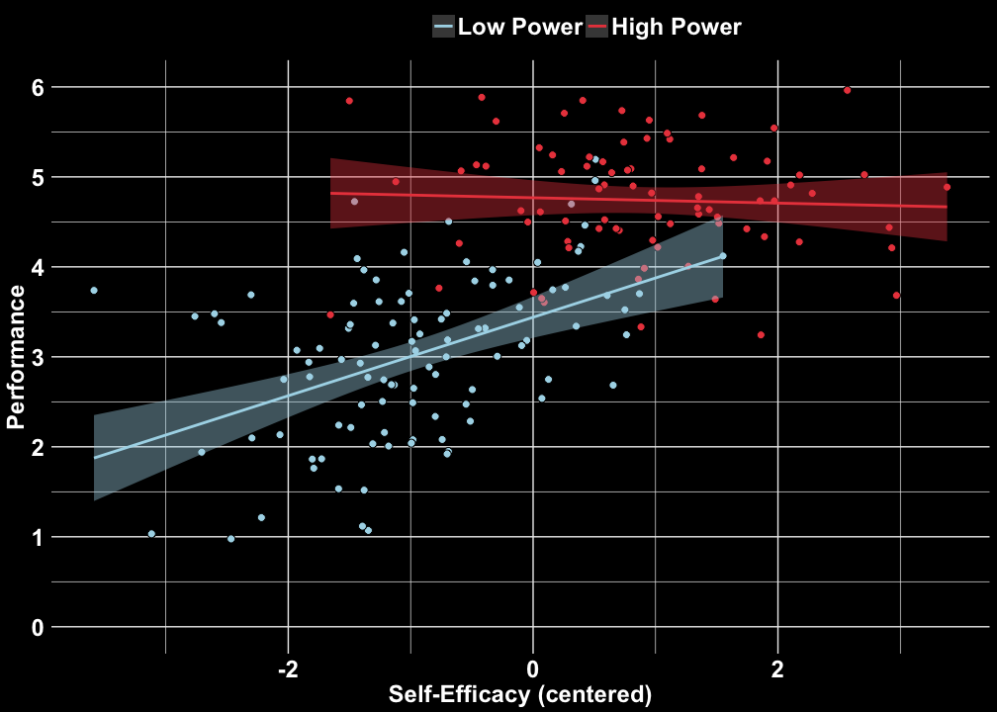
Study 3b (replication)
High power slope
z = -0.486, p = .627
Low power slope
z = 7.56, p < .0001

Slide 33







$Y= β_{0}$ + $β_{1}X_{1}$ + $β_{2}X_{2}$ + $β_{3}{(X}_{1}$*$X_{2})$
$X_{2}$= 0
$X_{2}$= 1
$β_{0}$ + $β_{1}X_{1}$ + $β_{2}(X_{2}∗0)$ + $β_{3}{(X}_{1}$*$X_{2}∗0) = β_{0}$ + $β_{1}X_{1}$ + $β_{2}{(X}_{2}∗1)$ + $β_{3}{(X}_{1}$*$X_{2}∗1)$
$0$ $= β_{2}{(X}_{2}∗1)$ + $β_{3}{(X}_{1}$*$X_{2}∗1)$
$β_{3}{(X}_{1}$*$X_{2})= β_{2}X_{2}$
$$X_{1}=−\frac{β_{3}}{β_{2}}$$
Widaman, Helm, Castro-Schilo, Pluess, Stallings, & Belsky (2012)

Slide 34

Cross-over point estimate
$$X_{1}=−\frac{β_{3}}{β_{2}}$$
Widaman, Helm, Castro-Schilo, Pluess, Stallings, & Belsky (2012)

Slide 35
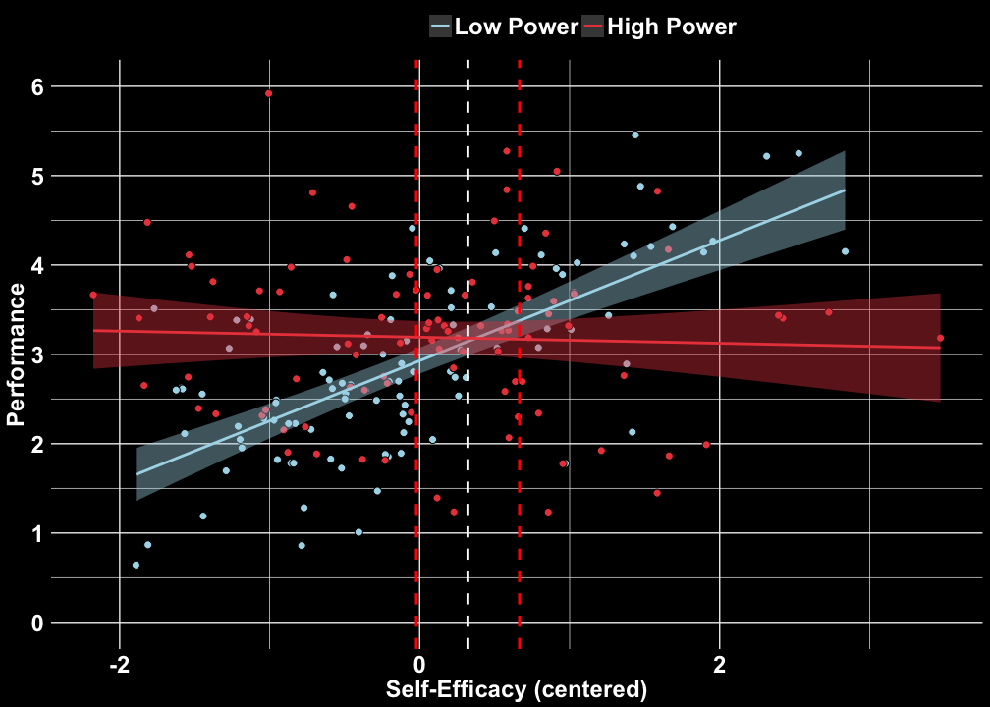
Study 3c (replication)
High power slope
z = 0.486, p = .627
Low power slope
z = 7.56, p < .0001
Cross-over
b = 0.321, 95% CI [-0.22, 0.625]

Slide 36
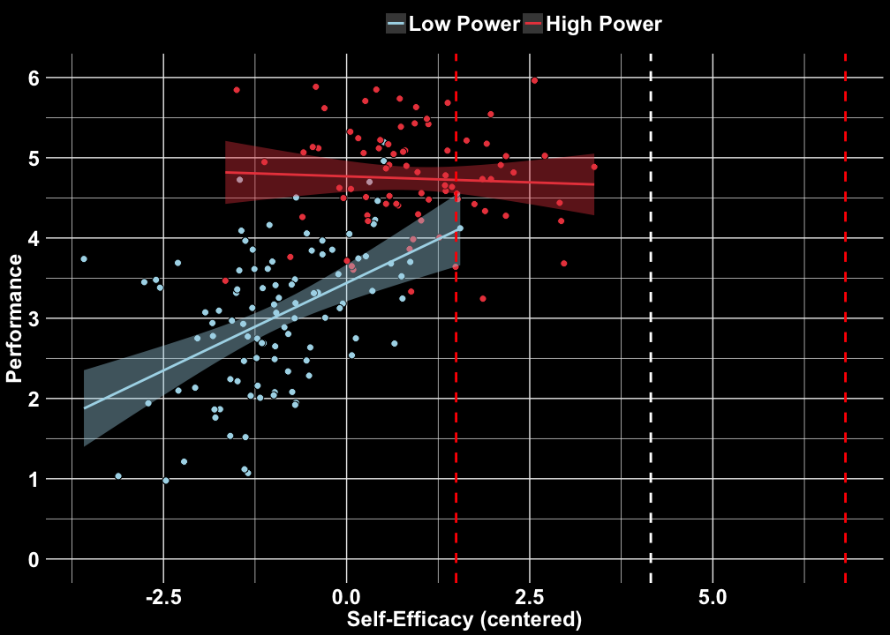
High power slope
z = 0.534, p = .593
Low power slope
z = 5.35, p < .0001
Cross-over
b = 4.15, 95% CI [1.50, 6.81]

Slide 37
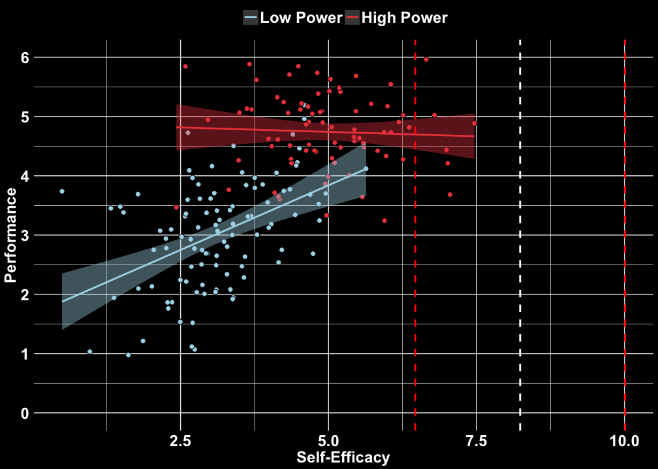
High power slope
z = 0.770, p = .442
Low power slope
z = 5.48, p < .0001
Cross-over
b = 8.24, 95% CI [6.46, 10.00]

Slide 38
Can statistics help us test more specific (more falsifiable) hypotheses?
Or is falsifiability determined at the design stage?

Slide 39
Thank you
nickmm@umich.edu
OSF profile: https://osf.io/gb5xj/

Slide 40
contact: nickmm@umich.edu
OSF profile: https://osf.io/gb5xj/

