Slide 1

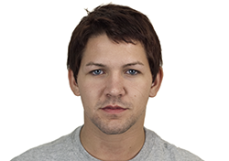
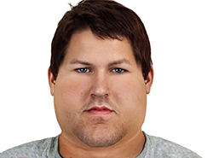
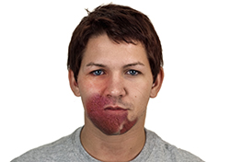

Infectious disease has many faces: Are they all the same?
Nicholas M. Michalak¹ & Joshua M. Ackerman¹
Evolutionary Social Psychology Lab
¹The University of Michigan
Introduction
Study 1 & 2 Harmless-Infectious IAT
Study 1 & 2 Results
People evolved perceptual and cognitive systems to detect and reduce pathogen threats.
People use physically anomalous cues perceivable in others to assess risk of pathogenic infection from contact.
Often, these cues superficially resemble true signs of infectious disease.
Research Question
Do perceivers equally associate all anomalous physical features with infection?
Word Type
+Harmless
+Infectious
Average or Infectious
Disfigured or Harmless
Study 1
Study 1
Study 2
3.0
Disfigured Cue Only
Obese Cue Only
Both Cues
2.5
2.0
Study 1: Participants saw No Obese Cues
8 unique targets crossed with Cue Type
1.5
Average Target
1.0
0.5
0.0
3.0
2.5
2.0
1.5
Study 1 & 2 Samples
Average or Infectious
Obese or Harmless
Reaction Time
Disfigured Target
Obese or Harmless
1.0
Study 1
N = 268 (n_{Obese} = 135; n_{Disfigured} = 129) Michigan Psychology Undergraduates
157 Women; 110 Men; 1 “Other”
M_{age} = 18.93; SD_{age} = 2.21
Study 2
N = 221 Michigan Psychology Undergraduates
113 Women; 87 Men
M_{age} = 18.91; SD_{age} = 1.15
0.5
0.0
3.0
2.5
Study 1: Participants saw No Disfigured Cues
8 unique targets crossed with Cue Type
2.0
1.5
Obese Target
1.0
0.5
0.0
+Harmless
+Infectious
+Harmless
+Infectious
+Harmless
+Infectious
Notes. Error bars represent 95% Confidence Intervals. Congruent, p < .001 and Congruent x Face Type interaction, p < .001 (Both studies)
Obese or Infectious
Disfigured or Harmless
Study 1 & 2 Design
Discussion
References
Study 1 IAT
Physical cues - (1) Average vs. Obese or (2) Average vs. Disfigured
Words
Harmless: Tape, Cardboard, Typewriter, Dryer, Bran, Teaspoon, Sod, Ground
Infectious: Epidemic, Germs, Plague, Contagion, Flu, Virus, Parasite, Bacteria
Study 2 IAT
Obese vs. Disfigured only. Same words.
Questionnaires: Perceived Vulnerability to Disease, Three Domain Disgust, Anti-Fat Attitudes, Big Five Inventory-2
Study 2: Participants saw Both Obese and Disfigured Cues
Automatic associations exist between infectious concepts and superficial cues (Studies 1 & 2)
Stronger associations exist between Infectious concepts and Disfigured cues compared to Obese cues (Studies 1 & 2)
In the presence of Disfigurement, weaker associations emerge between Obese cues and Infectious concepts compared to Harmless concepts (Study 2)
The association between obesity and infection may be disrupted in the presence of a more representative infectious disease cue such as facial disfigurement.
Schaller, M. (2016). The behavioral immune system. In D. M. Buss (Ed.), The handbook of evolutionary psychology (2nd ed., Vol. 1) (pp. 88–114). Hoboken, NJ: Wiley.
van Leeuwen, F., Hunt, D. F., & Park, J. H. (2015). Is obesity stigma based on perceptions of appearance or character? Theory, evidence, and directions for further study. Evolutionary Psychology, 13(3), 1474704915600565.
van Leeuwen, F., & Petersen, M. B. (2017). The behavioral immune system is designed to avoid infected individuals, not outgroups. Evolution and Human Behavior.
Wolsiefer, K., Westfall, J., & Judd, C. M. (2017). Modeling stimulus variation in three common implicit attitude tasks. Behavior Research Methods, 49(4), 1193-1209.
8 unique targets crossed with Cue Type
Model R Code
lmer(rtd ~ congruent * (wordcue + wordtype + cuetype) + (1 + congruent | subject) + (1 + congruent | target), data = iatdata)
nickmm@umich.edu
@nmmichalak
nickmichalak.com
https://osf.io/2d96k/

