Slide 1
ML@NOVA: 57672_60599_67548
Semi-Supervised Learning for Predicting Survival Time in Multiple Myeloma Patients

Slide 2
Team identification
Name 1: Nuno Nogueira
Number 1: 60599
Name 2: João Palma
Number 2: 57672
Name 3: Francisco Silva
Number 3: 67548
Final score:
Leaderboard ranking:

Slide 3
Data analysis and preprocessing
Preprocessing techniques applied included scalers and encoders for numerical and categorical data, respectively:
Imputers (more about this in the next slide)
Scaling and encoding
StandardScaler, for numerical data
OrdinalEncoder, for categorical data
Dimensionality reduction
sklearn’s PCA or Isomap
Alternatively, statsmodels’ PCA was used to fulfill these 3 roles for a given model

Slide 4
Missing data completion
Missing data was handled in one of four methods for multiple combinations of models and transformers in the pipeline:
Single Imputer
Iterative Imputer
KNN Imputer
statsmodels’ PCA “fill-em”

Slide 5
Semi-supervised learning
Semi-supervised learning techniques were applied by fitting a transformer with all of the labeled and unlabeled data and using that transformer with models that trained on only the labeled data.
Things not available in semi-supervised models:
The use of statsmodels’ PCA, since the transformer is built-in, which led to the supervised models having better performance in the end.
HistGradientBoostingRegressor, this model handles data completion directly but the transformers used for semi-supervised learning do not
There were also implemented models that were purely supervised and all the semi-supervised models have a supervised variant.

Slide 6
Handling missing data without imputation
For handling missing data without imputation, only one method was used which was sklearn’s HistGradientBoostingRegressor.
It yielded a better performance than other combinations of tree models and transformers but tended to overfit the data.
Note: Other models that could have been used as well were XGBoost and LightGBM.

Slide 7
Model development and validation
Models experimented with: Linear Regression, RidgeRegression, KNeighboursRegressor, DecisionTreeRegressor, RandomForestRegressor, HistGradientBoostingRegressor, SVR
The cross-validation technique used involved dividing the labeled dataset into a test set and another set, stratified on the censored column. The latter set would then be used for stratified 5 fold cross-validation also stratified on the censored column to lead to more accurate results in the provided custom metric (cMSE).

Slide 8
General architecture of the final solution

Slide 9
Feature analysis and model interpretation
Since the best semi-supervised model uses dimensionality reduction on the data it is difficult to provide accurate representation of the features’ importance, so instead the analysis shown will include only the best supervised linear and ridge regression models:
This table represents the coefficients of the given models. These models were very similar in performance and it shows in their coefficient values. The most valued feature for these models is the treatment type for the given patient.
Following this data, it could be said that in the context of clinical applicability the most important feature to determine the survival time of a patient would be the treatment given to them.

Slide 10
Comparison and insights
The models that generated the best results were mostly linear regression models and ridge regression models, using either:
A simple imputer to handle missing data and applying sklearn’s PCA dimensionality reduction
statsmodels’ PCA built-in transformer for scaling and handling missing data without applying dimensionality reduction.
Since the some of the best models were using data that was reduced to 2 dimensions it is possible to see why linear regression and ridge regression were favored in the end.
Leveraging unlabeled data did not turn out to be a massive improvement, and the best model did not use it.
In the following 2 slides will be a chart of training and validation errors (cMSE) for various models, purely supervised and semi-supervised, respectively. (Do note that linear and regression models have very similar errors and might overwrite one another in the graph)

Slide 11
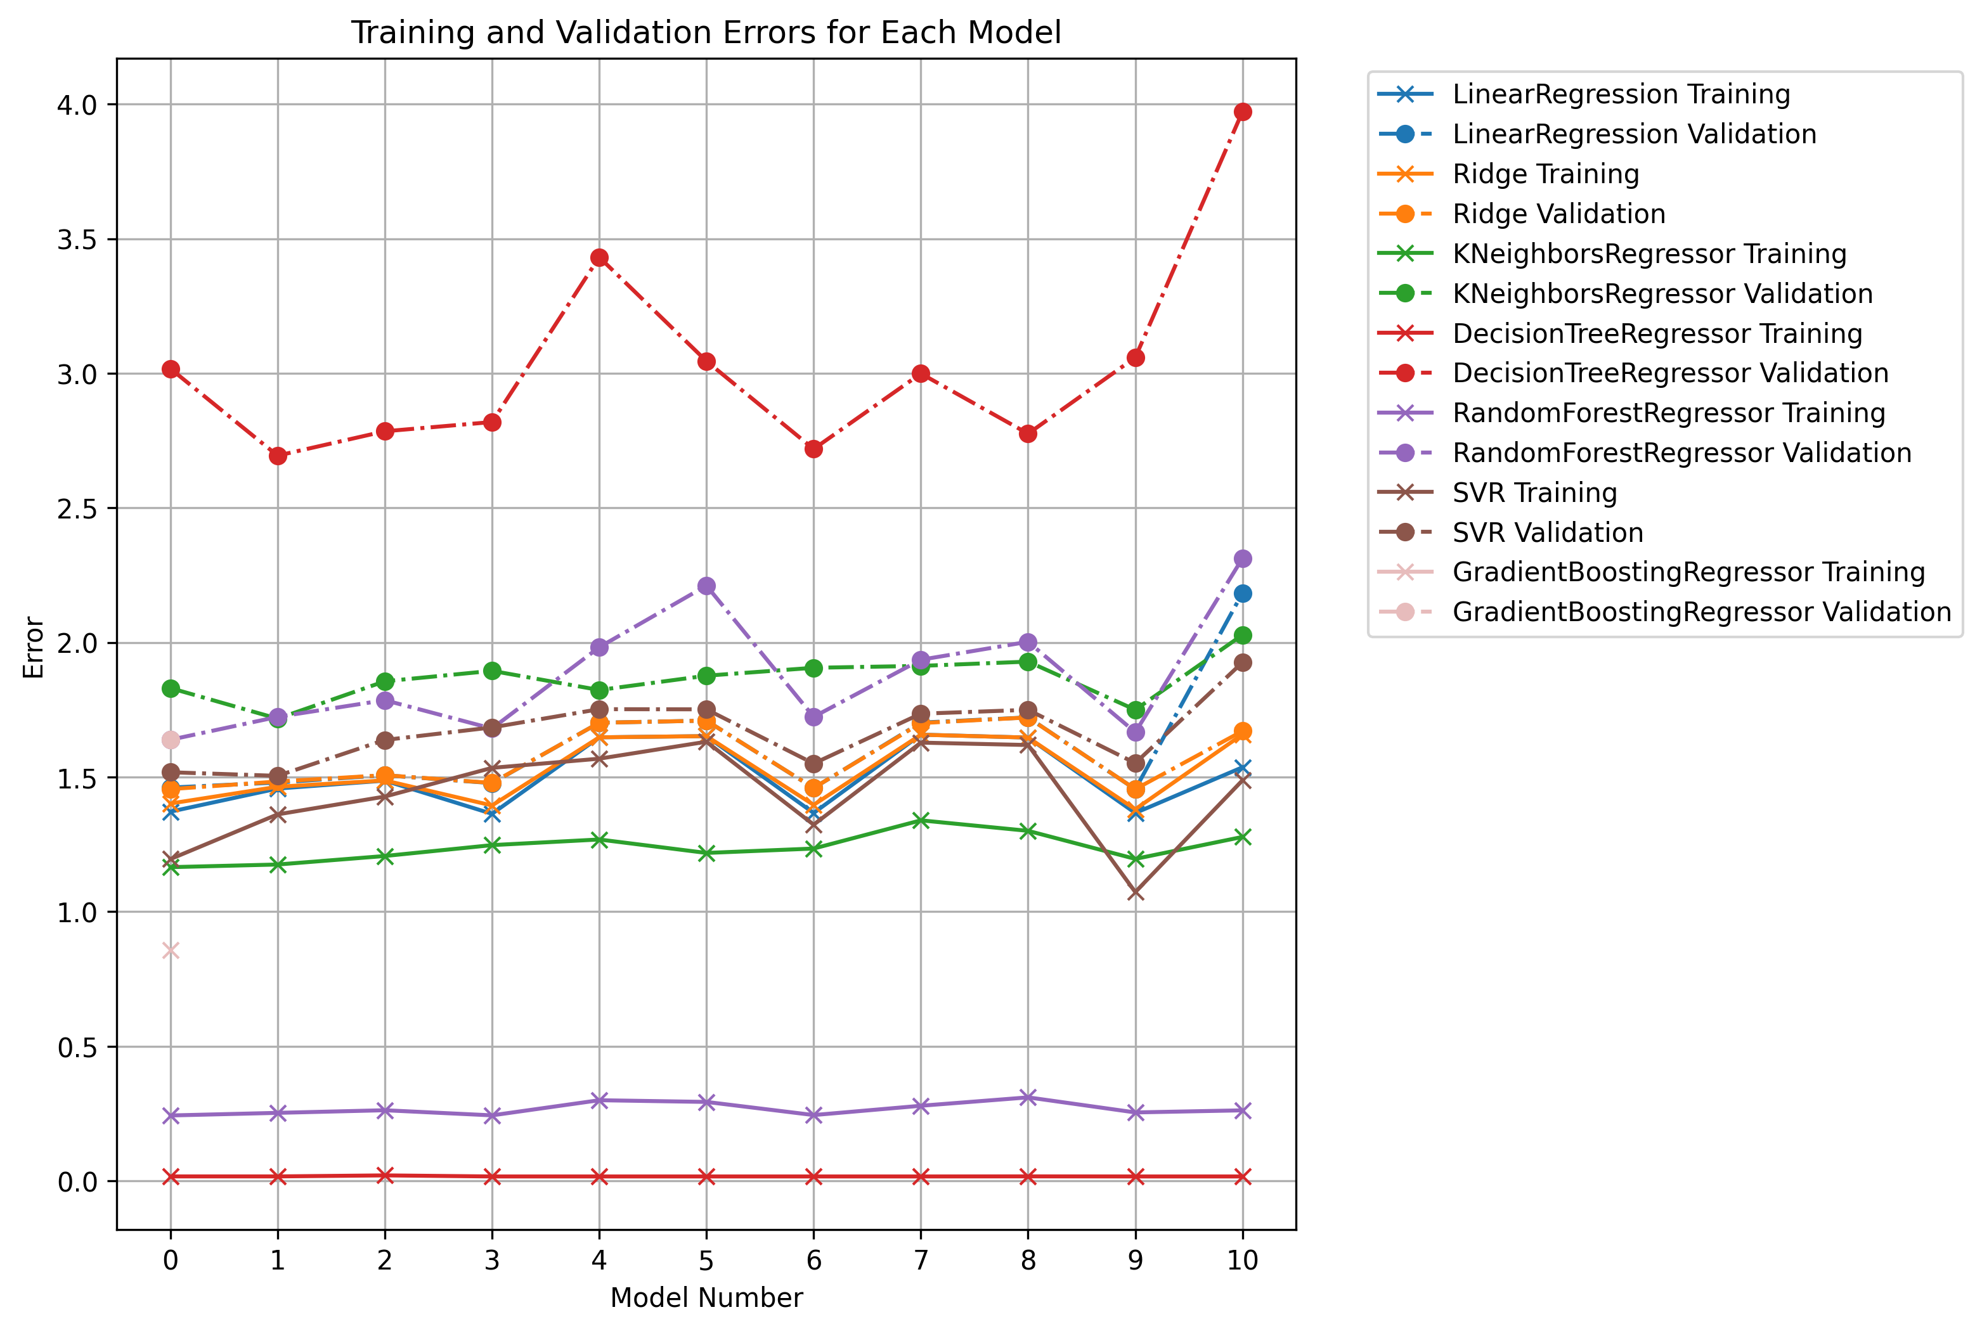
Supervised performance

Slide 12
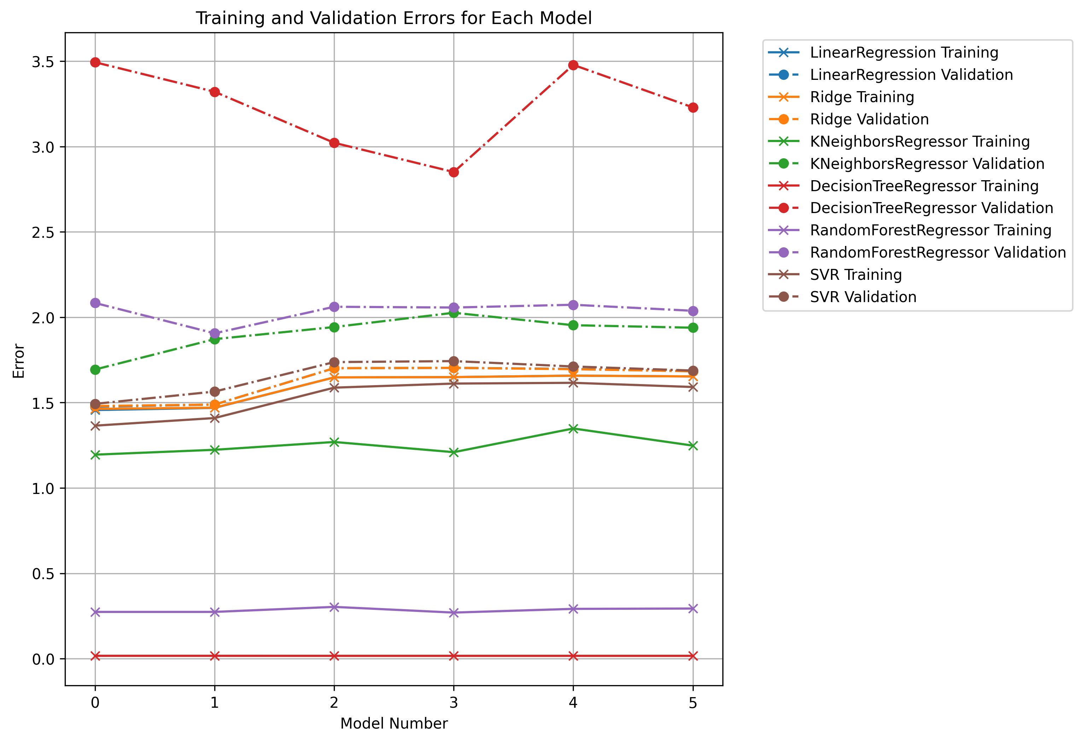
Semi-supervised performance

Slide 13
What went wrong
Clustering was not experimented with
Tree models (RandomForestRegressor and DecistionTreeRegressor) tended to overfit the data
For some reason, using statsmodels’ PCA results in a worse performance than other models that do not use it when using it to perform its role in dimensionality reduction. However, when using it for its built-in scaling on the data only we obtained the best results. This may be to an oversight in the current implementation
For the final prediction, a single model was used that was fitted with all the labeled data. This could have been improved in other ways, like using an ensemble of models or using different models depending on if the sample to predict was a censored one or not (by training a classifier to predict if a sample is censored or not in the test data
Besides statsmodels’ PCA, the only preprocessing done to the data in terms of scaling and encoding was with the use of StandardScaler and OrdinalEncoder only, respectively. This was due to complications of how certain combinations of transformers and models worked

Slide 14
What went great
With the teacher’s help, we were able to use the statsmodels’ PCA through a wrapper class to be used in a sklearn pipeline
The same was also applied to a wrapper class for a transformer that was fit on the unlabeled data as well as the labeled data.
Appropriate cross validation was applied which was shown in the Kaggle competition scores since our score did not drop after the competition closed

