Slide 1
Teradata Business Value Framework
Finance Industry
V1.0

Slide 2
Business Value Framework – Internal Notice and Instructions
Slides 2-3 are for internal use. They should be deleted before the presentation is used with external audiences.
Please note that some parts of this initial 1.0 Release of BVF are not yet complete, particularly:
Risk Management& Regulation
Legal & Regulatory Compliance
Security & Fraud
The links to any areas which are not complete are highlighted in red (missing) or orange (untidy – needs review/clean-up). The remaining content for these functions will be completed as soon as possible. Please ensure that you are familiar with the parts which are not yet fully complete before using in client situations.

Slide 3
Intellectual Property Warning
This Business Value Framework (BVF) constitutes a major investment in Intellectual Property. It should not be sent to, or left with clients, prospects or partners, either in electronic or printed format.
Please contact your Industry Business Value Framework lead if you have any questions on usage of the BVF.

Slide 4
Financial Services are facing Challenges
Digitalisation
Changes in customer expectations, channel usage and buying behaviour driven by rapid digital adoption.
Macroeconomic Environment
Uncertainty over the global economy; high levels of sovereign, corporate and personal debt; future of interest rates.
Regulation and Compliance
Continued increases in the volume and complexity of regulation is placing a heavy cost and change burden on organisations.
Technology Complexity and Legacy
Many Financial Services organisations have highly complex technology infrastructure, often containing substantial legacy platforms and applications.
BUSINESS
MANAGEMENT
BANK
GROWTH
COSTS

Slide 5
Pressures Are Mounting…
“Deliver Growth with More Efficient Processes and Less Overhead”
Expense management to meet margins
Greater financial performance transparency
Enhanced risk and financial management
Respond to competitive threats
Meet Regulatory & Compliance demands
Talent development
Understand and orchestrate frictionless omni-channel customer journeys
Improve client satisfaction through focus on customer experience
More relevant cross/up selling with new products and capabilities
Improve service delivery across emerging channels
Agile infrastructure to speed up new proposition development
Support and integrate across multiple new channels
Measure, manage and price based on customer value, and potential
Exploit simpler configurable products
BUSINESS
MANAGEMENT
Simplify Technology, rationalize teams and support costs while funding new investments
Eliminating redundancies in back-end support and infrastructure
Identify efficiencies in the midst of complex and rapidly changing organization
BANK
GROWTH
COSTS

Slide 6







…And Threats Are Advancing
NEW ENTRANTS ARE CHANGING THE BUSINESS LANDSCAPE
Customers are demanding greater convenience, ease of use, and relevant engagement
Niche competitors and Fintechs without the complexity and legacy infrastructure of traditional banks can price competitively whilst achieving higher profits
Commoditized products are delivered by many more competitors with few discernible differences
Customers with high profitability and/or potential are being cherry-picked

Slide 7
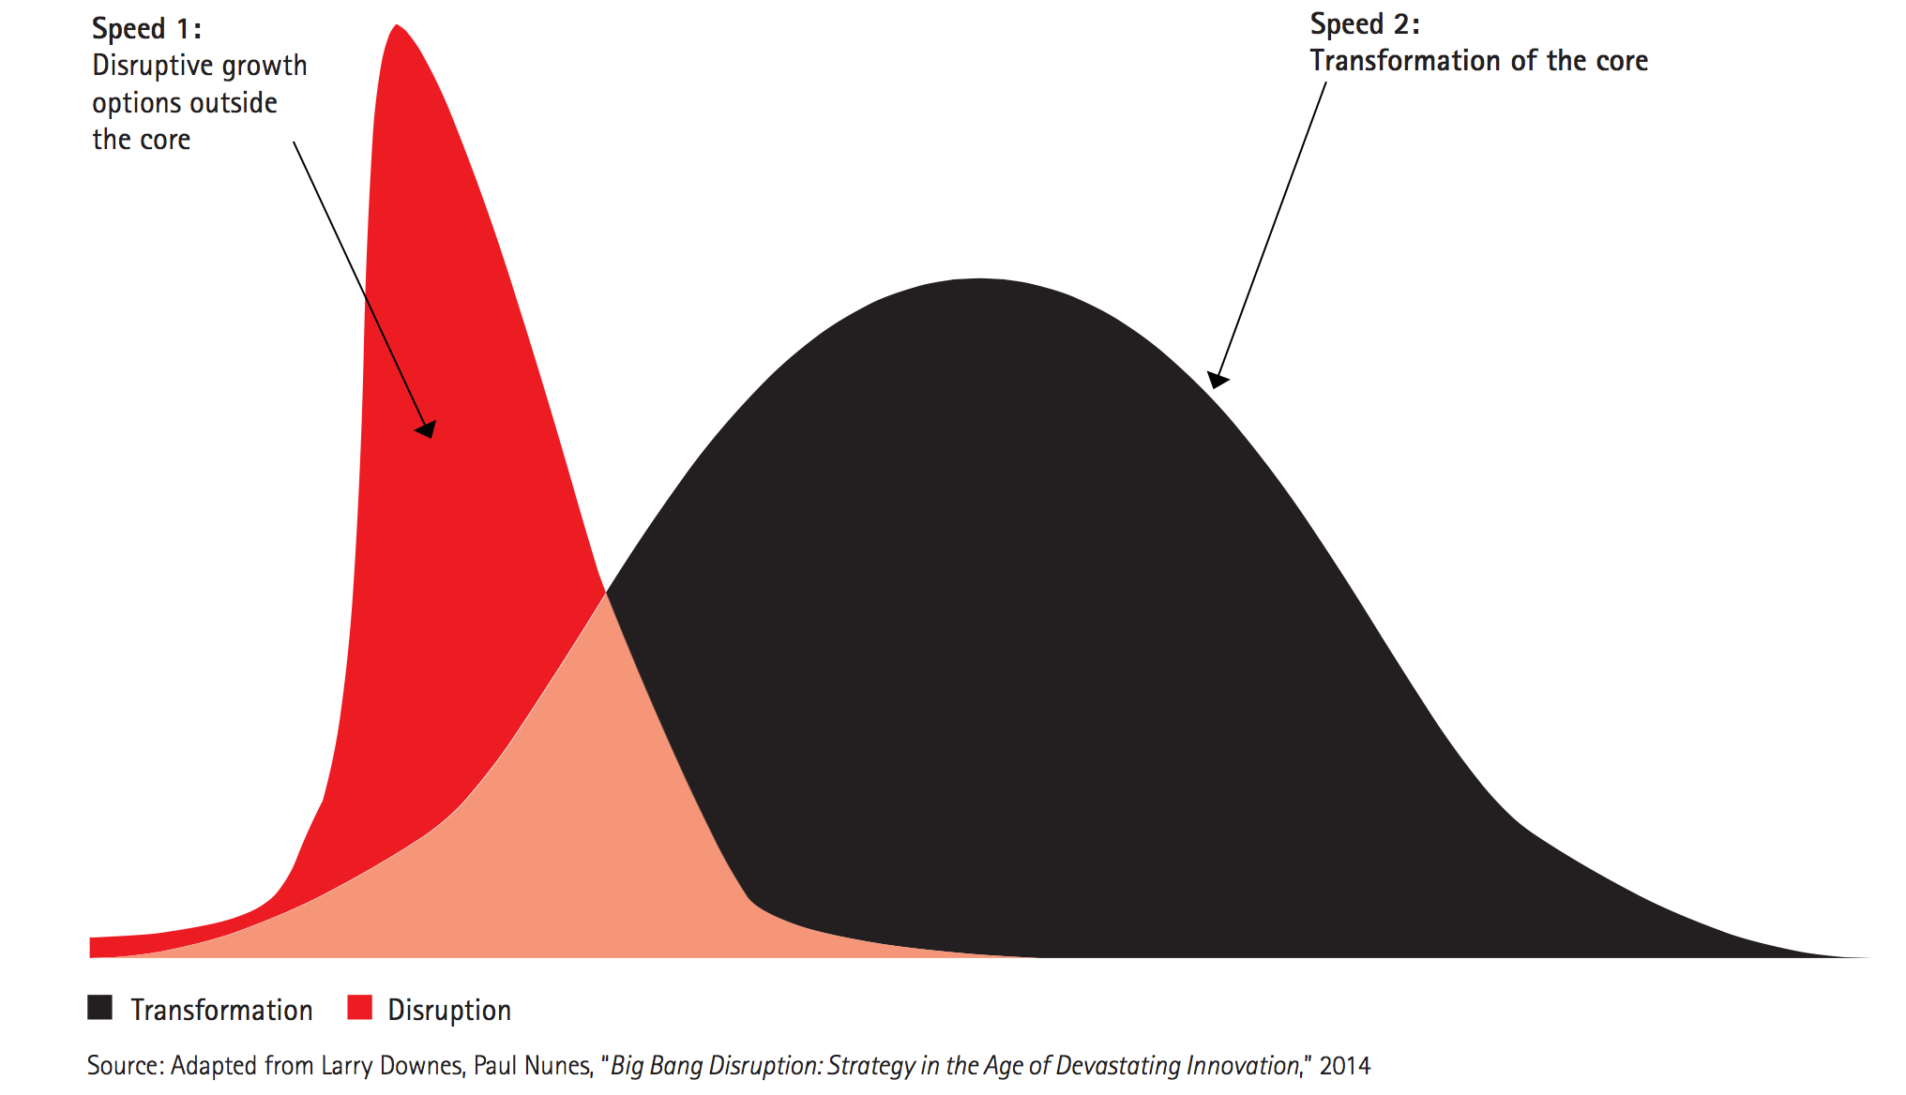
Change will happen at 2 speeds – to disrupt and transform traditional business models
Disruptive: The rapid adoption of new options for business growth - such as launching a new mobile payment service and establishing the accompanying ecosystem.
Transformational: Change required in the core business of banking - reshaping digital customer, enterprise and operational banking strategies.

Slide 8
These Challenges Are Forcing Re-invention…
Grow through:
Really knowing the customer
Identifying actual customer needs, not just product gaps.
Optimise and personalise offers and pricing.
Ascertain the right moment and channel to interact.
Reduce Costs by:
Using analytics to re-engineer and automate processes - reducing complexity, time and costs.
Reducing Information Management complexity, data duplication and manual processes.
Bringing the right analytical techniques to more granular integrated data
Improve Business Management with:
Detailed, accurate and timely information-driven decision making.
Effective performance management aligned to business objectives.
Full transparency between financial performance, business decisions and operational activities and drivers.

Slide 9
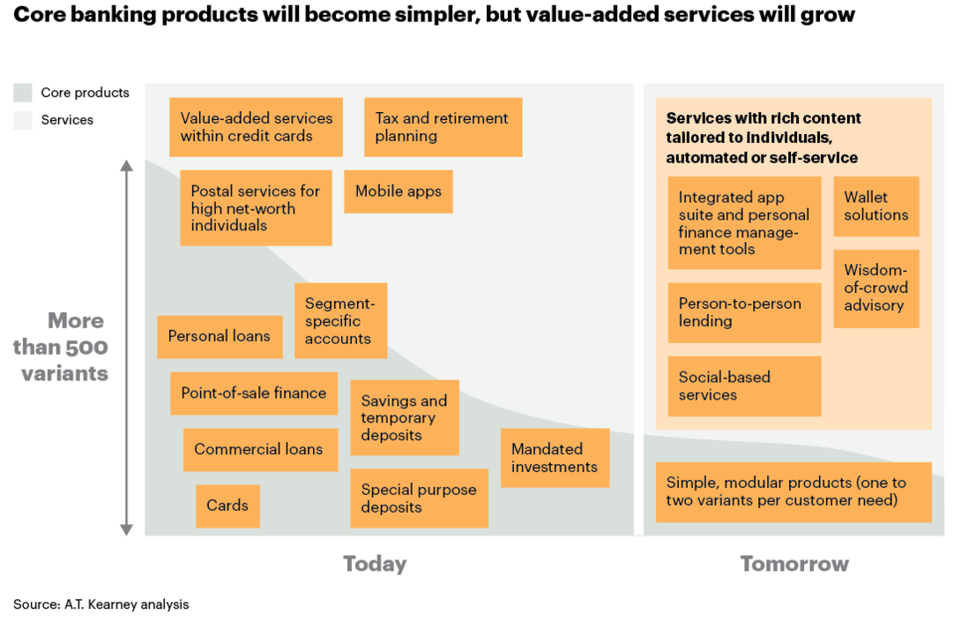
Analytics will have a critical role in driving growth and shaping future banking models
“Banks should become data driven organisations in order to deliver knowledge banking: new and better financial products and services, based on information and better suited to every customer’s needs and expectations.”
Francisco González,
BBVA Chairman & CEO

Slide 10
Finance Industry Business Value Framework
Spacer
Data and analytics capabilities driving value across the organisation
Marketing & Customer Experience
Risk Management & Mitigation
Legal & Regulatory Compliance
Business Functions
Security & Fraud
Finance & Performance Management
Product Management
Analytic Infrastructure
Data Sources

Slide 11
Finance Industry Business Value Framework
Data and analytics capabilities driving value across the organisation
Marketing & Customer Experience
Risk Management & Mitigation
Legal & Regulatory Compliance
Business Functions
Security & Fraud
Finance & Performance Management
Product Management
Data Lake for Landing, Storage & Archive
Structured data for integration & reuse
Analytical tools for Discovery & Creation of Insight
Decisioning & Delivery of Insight to Channels
Analytic Infrastructure
Data Sources

Slide 12
Finance Industry Business Value Framework
Data and analytics capabilities driving value across the organisation
Marketing & Customer Experience
Risk Management & Mitigation
Legal & Regulatory Compliance
Business Functions
Security & Fraud
Finance & Performance Management
Product Management
Data Lake for Landing, Storage & Archive
Structured data for integration & reuse
Analytical tools for Discovery & Creation of Insight
Decisioning & Delivery of Insight to Channels
Analytic Infrastructure
Data Sources
360º Customer View
Demographics & Preferences
Account, Policy & Service Details
Balances & Interest Rates
Transactions & Interactions
Limits, Collateral, Provisions
General Ledger & ERP
Multi-structured Data
Master & Reference Data

