Slide 1
Product Management Use Cases

Slide 2
Product Development and Packaging
Product Development
References
Thought Leadership
Use Case Summary
Objective / Problem Statement
Increase speed to market with new and innovative products aligned with a fact market need that will provide a significant risk adjusted rate of return on the investment
Business Benefit
Increased sales from Improved Product Design
Improved accuracy in product price adjusted for return on capital and expense
Increase market size and position
Source Data
Product Usage data
Demographic data
Competitive information
Customer/Prospect data
Methodology / Analytic Technique
Segment/Cluster product usage across a variety of dimensions (geographic, demographic…)
Predictive product/component failure (propensity or time to fail)
Collaborative filtering to understand component that fail together (or closely)
Expected Outcome
Define new and/or extended product offers in response to market analysis and trends
Develop product collateral and pricing guidelines
Deploy new product to select market and review for any adjustments
Shorter time to market for new product offers
Ability to anticipate the needs of the consumer, and align products to that need
Deeper understanding of how to best position new product
Challenges
Collection, storage and analysis of a large volumes of data
Integrating data from disparate sources
Privacy Policies / Customer Opt-in
Success Criteria
RACE Relevant
Analytic Prototype using traditional and product usage data to improve design
Quantify potential for increased sales
Full Engagement Deliverables
Production grade analytics, integrated into existing design processes, and use by the product design teams
Notes:
3
Owner is anonymous?
The colours of the triangles indicate the type of Use Case:
Orange = Traditional Teradata / Data Warehouse
Red = ‘Big Data’ / Advanced Analytics
Blue = Non-Analytical Hadoop / Data Lake use case (e.g. Archiving)

Slide 3
Relationship Mgt. and Optimization (Product Usage)
Product Development
References
IC Andrew Johnston
Use Case Summary
Objective / Problem Statement
There are many different “objects” within a bank: customer, products, contracts, client adviser, transactions, etc..
They are all related to each other in some specific ways: a client advisor is responsible for a group of customer, each customer has signed different contracts with the bank and holds different products, etc..
Being able to analyze these “objects” and their relationships with changing focus allows the dynamic comparison between objects and relationships in regard to optimization potential
Business Benefit
Evaluate the impact of business initiatives in a holistic manner
Source Data
“Objects” within a bank: information on customer, client advisor, product, transaction, contract, etc..
Relationships between objects: information on which customer has signed which contracts and holds which products, etc..
Methodology / Analytic Technique
Dynamic Graph analysis of all available information
Powerful visualization of graph analysis results
Expected Outcome
Definition of average benchmark relationships between objects:
Typical changes within a portfolio content after a bank wide initiative
Typical reaction of customer to an event (external or internal)
Optimisation of relationships between objects in regard to defined benchmarks:
Identification of positive or negative individual client advisor behavior
Challenges
Can be difficult to identify cause and effect of specific actions
Success Criteria
Understand optimum customer client relationships and deviation from average relationships
Understand how initiatives cause changes in relationship behavior
Notes:
The colours of the triangles indicate the type of Use Case:
Orange = Traditional Teradata / Data Warehouse
Red = ‘Big Data’ / Advanced Analytics
Blue = Non-Analytical Hadoop / Data Lake use case (e.g. Archiving)

Slide 4
Merchant Acquiring Insights
Product Development
References
IC Andrew Johnston
Use Case Summary
Objective / Problem Statement
Making data available to merchant acquirers on customer usage and profile information
Tapping into the Transaction data, product, and competitive intelligence aspects of card data opens new revenue sources for both the providers and the merchants.
Business Benefit
New revenue source if value added services can be sold to merchants
Differentiated service to existing and potential existing business customers using merchant services
Source Data
Customer data From the data warehouse
Card transaction data
Merchant data such as classifications and locations
Methodology / Analytic Technique
Merchant Analysis to identify the types of spend for each customers and the brand share of that spend
Segmentation to identify the which customers would best suit each merchant offer based on shopping behavior
Expected Outcome
Identifying new potential Cobranding/Affinity partnership.
Increase revenue from Merchant acquiring and Issuer interchange fee income
“Monetizing” Big Data selling services to merchants:
Customer insights.
Competition / market insights
Cross branding promotions.
Undertaking marketing campaigns on the merchants behalf
Challenges
Requires sufficient critical mass (proportion of total payments) to provide meaningful aggregated insight – by geography and industry sector
Success Criteria
Ability to create new merchant propositions and sell as value added services
Notes:
The colours of the triangles indicate the type of Use Case:
Orange = Traditional Teradata / Data Warehouse
Red = ‘Big Data’ / Advanced Analytics
Blue = Non-Analytical Hadoop / Data Lake use case (e.g. Archiving)

Slide 5
Credit/Debit Card Spend Stimulation
Product Development
References
IC Andrew Johnston
Use Case Summary
Objective / Problem Statement
Target cardholders with higher spending potential who are not utilising banks card as their primary card
Increase in utilisation, spend on credit/debit cards increasing interchange, interest and fee income.
Business Benefit
Increased interchange income from increased card usage
Increased share of card spend as more customers use as primary card
Reduced dormancy and churn
Source Data
Customer
Cards Account and Transaction
Transacting Account and transactions
Previous Merchant Offer effectiveness (for validation)
Methodology / Analytic Technique
Collaborative filtering analysis for spend pattern detection to drive usage among targeted customer segments
Classification model to determine which customers have a propensity to activate and spend, to drive usage among targeted customer segments
Expected Outcome
Identified likely cardholders to drive higher usage of Credit Cards
Identification of card holders with spending potential through analysis of previous/current CC activity, as well as customer demographics and product holdings
Merchant offer and customer matching based upon activity analysis
Both Small and Large purchase prediction through specific Merchant Codes/Categories
Challenges
May require extended history of card transactional data to execute use case
Success Criteria
Ability to identify a segment of customers who are likely to be receptive to card spend based offers
Identify suitable merchant offers relevant to their profile and segment characteristics
Notes:
The colours of the triangles indicate the type of Use Case:
Orange = Traditional Teradata / Data Warehouse
Red = ‘Big Data’ / Advanced Analytics
Blue = Non-Analytical Hadoop / Data Lake use case (e.g. Archiving)

Slide 6
Individualized Merchants Recommendation
Product Development
References
Banking
IC Andrew Johnston
Use Case Summary
Objective / Problem Statement
In highly competitive Credit Card markets, more personalized services based on customers’ credit card usage are required
But, it was not easy to recommend to each individual the most appropriate merchants.
Also, marketers need to verify whether credit cards were properly used for original product purpose.
Business Benefit
Increased card activity and spend
Increased share of customer’s credit card spend
Reduced card churn and dormancy
Source Data
Customer data
Credit Card TX data to understand customers’ individual buying behaviors
Credit Card merchants Data
Methodology / Analytic Technique
C-Filters & Basket Gen to understand the linkage among merchants based on credit card usage
Graph analysis to visualize interaction
Expected Outcome
Identify linkage among merchants based on customers’ card usage pattern
Verify the original purpose of credit card products and develop new products fitting for customer preference
Develop Individualized Merchants Recommendation Index
Challenges
Collaborating with merchants
Developing new offers
Data availability
Data preparation
Success Criteria
Creation of new credit card propositions and offers based on patterns of merchant spend behavior (E.g. cash back)
Create analytical framework to calculate and deploy individual merchant recommendation offers
Notes:
The colours of the triangles indicate the type of Use Case:
Orange = Traditional Teradata / Data Warehouse
Red = ‘Big Data’ / Advanced Analytics
Blue = Non-Analytical Hadoop / Data Lake use case (e.g. Archiving)

Slide 7
Improvement in Risk Scoring Models
Product Development
References
IC Dominic Ligot
Use Case Summary
Objective / Problem Statement
Risk management department uses various behavioral and application risk models and scorecards to predict and make improvements in risk management. Bank want to include insights from historical transactional data to have better risk scoring models.
Due to the regulations in some markets banks are not able to develop new risk scoring models so the challenge is to do discovery on transactional data to understand path to default, path to collections, connection risks to find new attributes to be added to the current model for improved risk scores.
Business Benefit
Improved scoring model accuracy
Regulatory compliance
Source Data
Credit Bureau data
All Transactional data for different products & channels
Customer Demographics
Methodology / Analytic Technique
Build current risk scoring model on Aster
Discovery on transactional data to find new risk attributes.
Use nPath, SAX and SNA for discovery purpose
Recreate models and run «out of sample» test to verify improvements on scores.
Expected Outcome
Value proposition around improving accuracy whilst identifying tangible reasons to undertake meaningful customer dialogue
Key to successful delivery is always the prompt to have a relevant right-time conversation
Resulting lower losses, improved retention, future value and sales
Challenges
Determining new data points to incorporate into risk models
Success Criteria
Successful validation of increase in scoring model accuracy and effectiveness
Some common measures are Gini, ROC, K-S, and Accuracy Ratio
Notes:
The colours of the triangles indicate the type of Use Case:
Orange = Traditional Teradata / Data Warehouse
Red = ‘Big Data’ / Advanced Analytics
Blue = Non-Analytical Hadoop / Data Lake use case (e.g. Archiving)

Slide 8
Multivariate Testing
Product Development
References
Web Based Retailers
DS: Yasmeen Ahmed
Use Case Summary
Objective / Problem Statement
One of the key areas that Marketers focus on is how to improve web site performance & optimise sales conversion rates.
Multivariate testing is an important way of testing how different page layouts can improve conversion rates
Business Benefit
Improved sales conversion rates by optimising website content, layout and navigation based on Customer behavior feedback
Improved Customer on line experience
Source Data
Weblog data from website using tools such as Celebrus
Online sales transactions
Methodology / Analytic Technique
Path analysis using Npath
Analysis of conversion rates through each variation
Expected Outcome
An understanding of how different variations of website content, layout and navigation impacts Customer on line behavior and ultimately on sales conversion rates
More streamlined and effective Customer journey leading to increased sales and more repeat visits
Challenges
The collection, storage and analysis of large volume of data
The ability to test and fulfilll the impacts of multiple variations of webpages to determine the optimum version
Success Criteria
Ability to rapidly test and analyze the impact of multiple versions of web page content, layout and navigation on real” Customers
Capture of Customer journeys through tested web pages
Visualising at session level and between test and control groups ensures the most effective versions are chosen
Notes:
The colours of the triangles indicate the type of Use Case:
Orange = Traditional Teradata / Data Warehouse
Red = ‘Big Data’ / Advanced Analytics
Blue = Non-Analytical Hadoop / Data Lake use case (e.g. Archiving)

Slide 9
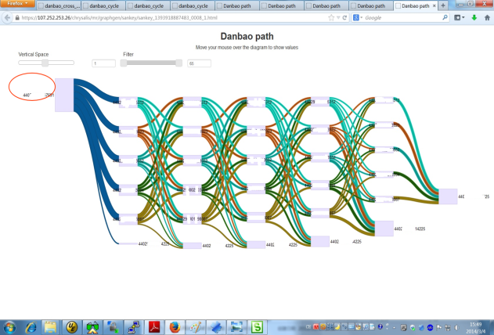
Multivariate Testing
Product Development
References
Web Based Retailers
DS: Yasmeen Ahmed
Objective / Problem Statement
One of the key areas that Marketers focus on is how to improve web site performance & optimise sales conversion rates.
Multivariate testing is an important way of testing how different page layouts can improve conversion rates
Expected Outcome
An understanding of how different variations of website content, layout and navigation impacts Customer on line behavior and ultimately on sales conversion rates
More streamlined and effective Customer journey leading to increased sales and more repeat visits
Example Analytic: NPath
Notes:
The colours of the triangles indicate the type of Use Case:
Orange = Traditional Teradata / Data Warehouse
Red = ‘Big Data’ / Advanced Analytics
Blue = Non-Analytical Hadoop / Data Lake use case (e.g. Archiving)

Slide 10
Competitor Analysis
Product Introduction
References
IC Andrew Johnston
Use Case Summary
Objective / Problem Statement
When creating marketing plans, limited information about competitors can be taken into account
The inability to have integrated, up-to-date information about competitors and their marketing programs means lack of insight & analysis to protect/increase market share
The challenge is capturing competitors data including their activities which are mainly available from the web
Business Benefit
Improved breadth and depth of competitor intelligence improves quality of internal decision making
Automated collection and identification of competitor activity allows internal decisions to be made faster
Source Data
Competitors products, pricings, marketing program data from competitors websites
Customer data to identify target segment and their behavior
Weblog data from public website (e.g. online news) on current marketing plan of the competitors
Social media data to identify market sentiment
Methodology / Analytic Technique
Behavior-based segmentation to segment customers
Text mining to identify certain key words of competitors and their current marketing programs (e.g. Bank x and travel category). Text mining to identify market sentiment
Expected Outcome
Improved market acceptance and market share by becoming more competitive
Optimized marketing budget by understanding which area to focus on and how much budget to allocate based on the competitions
Challenges
Can be challenging to match different sources of 3rd party data without hard match keys. Text analytics can be utilised to perform fuzzy match on different data sources
Success Criteria
Ability to automate the collection and identification of key competitor market activity
Ability to integrate data from different sources to create a more comprehensive view of competitor activity and trends
Notes:
The colours of the triangles indicate the type of Use Case:
Orange = Traditional Teradata / Data Warehouse
Red = ‘Big Data’ / Advanced Analytics
Blue = Non-Analytical Hadoop / Data Lake use case (e.g. Archiving)

Slide 11
Advanced Risk and Pricing Insights
Pricing and Promotion
References
IC Vince Leat & Tim Dickson
Use Case Summary
Objective / Problem Statement
Improve risk assessments and premium pricing
Adverse selection in Property insurance occurs when decisions are based heavily on post/zip codes
Most damage occurs from the storm surge from hurricanes
Business Benefit
Improved profitability from reduction in claims and better pricing of policies
Improved customer experience in policy appraisal and claims
Source Data
Geospatial provides detail parcel level accuracy
Past claims data
Historical weather data
Historical storm data and patterns
Government data on damages, planning and zoning
Methodology / Analytic Technique
Risk scores are calculated based on wind speed, hurricane speed, direction, biometric pressure, tide, and bathymetric to calculate surge height and range
Overlay surge data on property elevation to determine accurate risk score
Expected Outcome
More accurate risk pricing
Reduction in risk severity will lead to lower loss ratio in the portfolio
Challenges
Data and Data preparation
Accessing external data sources for historical weather patterns
Success Criteria
Reduction in claims
Improved profitability
Improved customer experience and NPS via better advice and service
Notes:
The colours of the triangles indicate the type of Use Case:
Orange = Traditional Teradata / Data Warehouse
Red = ‘Big Data’ / Advanced Analytics
Blue = Non-Analytical Hadoop / Data Lake use case (e.g. Archiving)

Slide 12
Behavioral-Based Pricing with Telematics Data
Pricing and Promotion
References
IC Vince Leat & Tim Dickson
Use Case Summary
Objective / Problem Statement
Improve risk assessments and premium pricing
Identify aggressive driving behaviors in time series data
Create expanded risk segmentation to match driving patterns with pricing and vehicle type
Provide customers with risk messaging to improve driving behavior
Business Benefit
Reduced losses
Increase sales
Source Data
Telematics data
Customer data
Claims data
Methodology / Analytic Technique
Pattern matching to identify premium costs and risk messaging based on driving attributes (comparisons can be done in multiple ways, e.g., by individual VIN, across class of vehicles, by garaging location, etc..)
nPath to identify common driving traits likely to lead to accident/claim
Expected Outcome
Expand pricing variables based on real driving
Create right pricing for the right customer driver score and vehicle type
Underwriting predictability
Provide deeper analytics to create a carrier’s “secret sauce”
Challenges
Data availability
Data Preparation
Success Criteria
Reduced losses
Improved NPS
Notes:
The colours of the triangles indicate the type of Use Case:
Orange = Traditional Teradata / Data Warehouse
Red = ‘Big Data’ / Advanced Analytics
Blue = Non-Analytical Hadoop / Data Lake use case (e.g. Archiving)

Slide 13
Credit Risk Models for ‘New-to-Lending’ Customers
Pricing and Promotion
References
IC Dominic Ligot
Use Case Summary
Objective / Problem Statement
Lending to individuals with no current loan relationship and no prior lending history in bureau. Bank has little information to make sound lending decisions.
Customers are treated conservatively with default terms-of-business e.g. either decline, or accept with low limits/high pricing.
Third-party sources of ‘big-data’ for new data for credit modeling. Alternatively, mutual partnerships with third party suppliers can be made to leverage supplier platforms to solicit business e.g. Rewards cards to retail customers, credit offers to mobile phone customers
Business Benefit
Reduced credit risk and increased new business pipeline
Improved understanding of customers
Facilitates better underwriting processes
Source Data
External party’s provision of data, and/or potential solicitation partnering. -e.g. credit services through mobile phones
Telecommunications e.g. mobile usage, payment patterns to predict loan repayment
Utilities e.g. payment patterns & usage to predict loan repayment
Wholesale & Retailers e.g. customer , POS, product
Internal data – e.g. Weblog data on non-lending customers
Traditional credit scoring data – Applicant, customer, bureau
Expected Outcome
Increased acceptance and improved terms-of-business for credit applicants – bring more facilities on-book, provide more applicable limits, more relevant pricing
Solicitation of new customers – through third-party partnerships, solicit customers previously not touched by marketing efforts
Decreased loss rates - by better identification of risk on applicants with limited information
Methodology / Analytic Technique
Data mining and aggregation of ‘big data’ into risk modeling data set
Credit modeling – traditional linear and logistic vs. alternatives
Model deployment and Champion/Challenger testing
Challenges
Data quality and completeness Integrating various data points from siloed data sources Lack of reliable third party data .Regulatory challenges with data sharing Costs of purchasing data Striking mutually beneficial partnerships with third parties. Deployment and monitoring
Success Criteria
Successful validation of new-to-lending rules and credit risk criteria
Notes:
The colours of the triangles indicate the type of Use Case:
Orange = Traditional Teradata / Data Warehouse
Red = ‘Big Data’ / Advanced Analytics
Blue = Non-Analytical Hadoop / Data Lake use case (e.g. Archiving)

Slide 14
Understanding Sales Across All Channels
Product Performance
References
Thought Leadership
Owner: Nick Campbell
Use Case Summary
Objective / Problem Statement
Understand customer purchase behavior across channels leveraging all available transaction data..In store, Web, Mobile and Social
Understand impact of digital couponing and social media promotions on in-store behavior
Develop segmentation strategies that include all channels of sales
Business Benefit
Improved sales/margin $ per customer
Increased market basket spend
Higher conversion rates
Improved targeting of promotions and messaging
Deeper understanding of customer purchase behavior across all channels of business
Source Data
Transaction, detail (POS and On Line)
Activity data of all customer touch points – mobile, web, web-site, store, POS, Kiosk
Enable near real time data capture to support timely, targeted offers to customers
Methodology / Analytic Technique
Leveraging a discovery platform to perform “Path and Graph Analysis”
Key Metrics; Conversion rate - Web, Store, Mobile, Social, Sales and Margin $
Channel segmentation
Expected Outcome
Identify Omni-Channel purchase patterns to better understand customer behavior and spend preference
Segment customers across all channels to define and personalize relevant target offers
Understand the impact of digital couponing on promotional effectiveness
Full Engagement Deliverables
Production grade analytics, integrated into campaign delivery or advertising
Challenges
Large sets of multi structured data
Data discovery can require specialized skills
Online browsing data hard to gather
Proper tagging of digital attributes
Success Criteria
Not eligible for RACE
Document Omni-Channel purchase patterns to better understand customer behavior and spend preference, digital coupon influence
Measure impact of promotion activity and spend patterns to fine-tune sales planning and optimize results
Segment customers across all channels to define and personalize targeting approach
Notes:
The colours of the triangles indicate the type of Use Case:
Orange = Traditional Teradata / Data Warehouse
Red = ‘Big Data’ / Advanced Analytics
Blue = Non-Analytical Hadoop / Data Lake use case (e.g. Archiving)

Slide 15
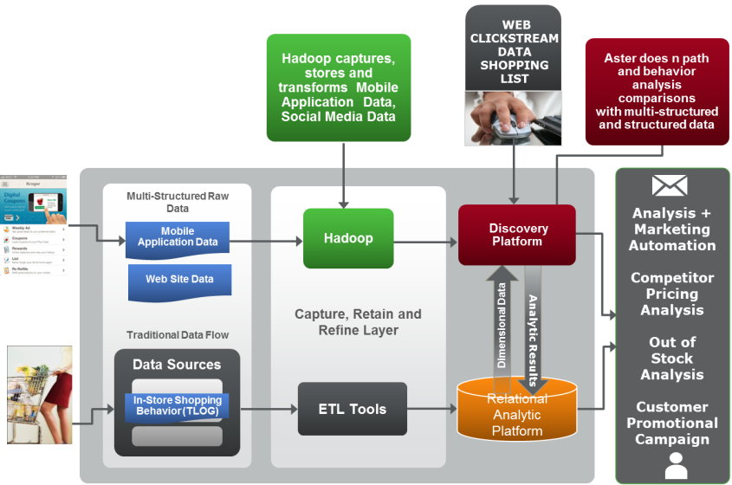
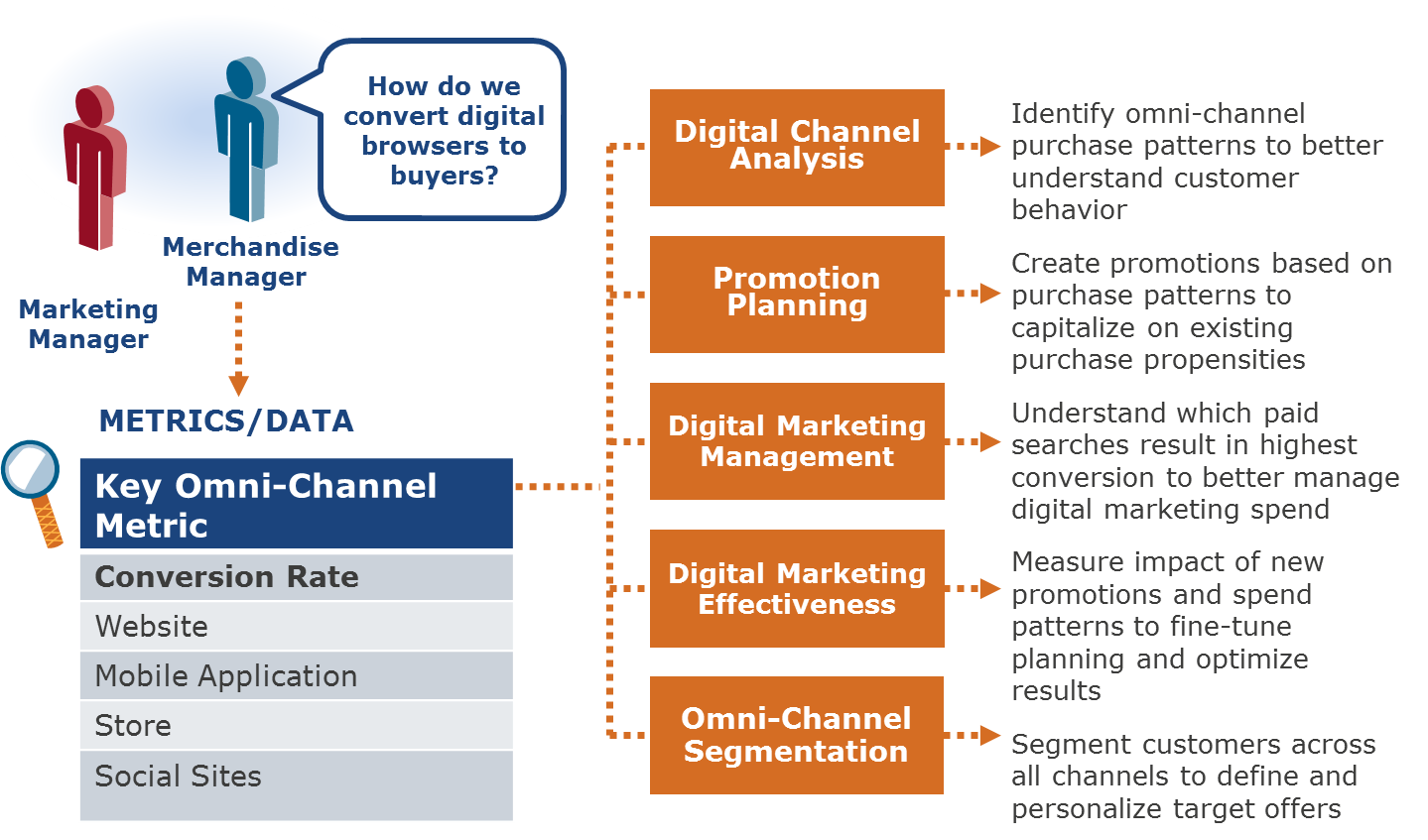
Understanding Sales Across All Channels
Product Performance
References
Thought Leadership
Owner: Nick Campbell
Analysis Detail:
Centralize data from all customer interactions (Transaction, detail (POS and On Line)
Leverage “Path and Graph” Analysis to understand the path to purchase and commonality in purchase path activity
Utilize Logistic regression to determine the relative importance of each touch point to high-$ customer vs. a low-$ customer
Leverage results to determine action plans for future promotions, targeting, segmentation driving sales and margin
Example Analytic output:
Example analytic flow:
Notes:
The colours of the triangles indicate the type of Use Case:
Orange = Traditional Teradata / Data Warehouse
Red = ‘Big Data’ / Advanced Analytics
Blue = Non-Analytical Hadoop / Data Lake use case (e.g. Archiving)

Slide 16
Compare Portfolio to Benchmark
Product Performance
References
Banking
Owner: Simon Axon, Terence Kong
Use Case Summary
Objective / Problem Statement
Financial Advisors are expected to proactively manage risks for customers
Requires analytics to look at a portfolio of financial products compared to a benchmark portfolio, in order to make recommendations on adjustments to the portfolio to align with a clients age or risk tolerance.
Business Benefit
Exception reporting allows Financial Managers to focus on at-risk portfolios
Source Data
Portfolio holdings
Average or Benchmark Portfolio
Methodology / Analytic Technique
Calculated variance of key metrics for portfolios against benchmarks
Visualization of outliers
Expected Outcome
Identification of risky portfolios that differ significantly from benchmarks
Target for conversation with customer or education about risk
Reduced losses
Increased customer satisfaction with advisory services
Challenges
High number of portfolios to review and manage
Dynamic nature of portfolio values requires real time data and exception reporting
Success Criteria
RACE Relevant
Demonstration of prototype dashboard
Quantification of estimated benefits
Notes:
The colours of the triangles indicate the type of Use Case:
Orange = Traditional Teradata / Data Warehouse
Red = ‘Big Data’ / Advanced Analytics
Blue = Non-Analytical Hadoop / Data Lake use case (e.g. Archiving)

Slide 17

Discover
Driving Further Innovation at Discover
Challenge
Vision was to create a centralized repository for clean, reliable and consistent data that could be used for risk analytics and decision support.
Solution
Teradata Integrated Data Warehouse
All of the LOBs are represented in the data warehouse, allowing the analysts to perform previously impossible cross-LOB analysis (credit authorization, new account and merchant systems)
Results
Higher revenues, expense takeout and improved customer satisfaction
Better identify customer and market trends
IT organization is now more focused on data generation than supporting analyst queries and data requests
Sales representatives will be able to provide specific products and services tailored to a particular individual's needs
Phone representatives will soon have next-best-offer information
http://www.teradatamagazine.com/v09n01/Features/Cache-Back/
Notes:
Q1-2009
Cache Back
Enterprise Data Warehouse Helps Drive Further Innovation at Discover
by Cheryl D. Krivda
Engaging in innovative business practices can lead to tremendous market advantage, especially for companies willing to take the risks involved in blazing a new path. Just ask Discover Financial Services. One of the world's leading credit card issuers and a pioneer of cash rewards, Discover understands firsthand the benefits of developing a pioneering corporate culture.
As part of its effort to continually enhance customer service and satisfaction, Discover has used analytic tools from SAS extensively. Yet the company spotted an opportunity to improve the caliber of its analysis by initiating a cultural change in the relationship between business users and IT. By bringing together its analytic tools with an enterprise data warehouse (EDW) from Teradata, Discover aimed to give analysts in its customer information and decision management group the ability to generate new insights and understanding of critical market and consumer trends.
Today, Discover analysts use SAS and other tools to perform cross-line-of-business (LOB) analysis on data stored in the EDW. It is providing the company with leading-edge decision support capabilities, which are helping analysts identify innovative new revenue and customer service opportunities. This integrated platform has resulted in significant savings through cost takeout, revenue generation, enhanced productivity and reduced IT run rates. All of which help keep Discover at the top of the card industry.
Opportunity for new insight
Discover's vision was to create a centralized repository for clean, reliable and consistent data that could be used for risk analytics and decision support. Executives therefore decided an EDW was core to the success of this direction. The EDW would be the central location for analytic data and feed daily operational decisions. Utilizing data in this capacity required the EDW solution to optimize the timeliness, accuracy, quality and consistency of Discover's risk decision making.
The company also knew it needed a solution that provided superior performance, availability and scalability. In March 2005, Discover deployed its new data warehouse from Teradata.
Cultural evolution
Implementing the infrastructure so that the Teradata and SAS technologies could work together was a challenging process. Discover's IT group began to consolidate and integrate data needed to perform risk analytics, systematically integrating frequently used subject areas into the EDW. These steps eliminated the need for multiple sources and simplified data access. IT has also built necessary balance and control functions to ensure data integrity.
To enhance the risk analytics process, the IT group created a centralized and reusable set of analytic data that could be shared among users. They did so by identifying the most frequently used predictive variables and loading those into the data warehouse. Other subject areas were similarly designed and deployed.
To maximize the new system's benefits, Discover executives decided to give analysts a way to retrieve their own information, thereby minimizing the workload they passed to IT. "To do this, we had to deploy the technology in a way that allowed the analysts easy access to the data and maintained our change management policies," explains Glenn Schneider, senior vice president and chief information officer of Business Technology at Discover. "We needed to create a cultural evolution-a change that would integrate the analytical culture into the system and provide the analysts with the right level of technology training."
Discover worked with Teradata Professional Services to develop a customized education curriculum. Teradata provided a curriculum writer who created training sessions and materials that referenced Discover's specific tables and attributes. This helped the analysts learn how to leverage the data warehouse for better analysis.
SIDEBAR: Responding to disaster
Understanding the benefits of Discover's new Teradata/SAS environment didn't take long. A few months after the new data warehouse was launched, Hurricane Katrina struck the Gulf Coast of the United States.
Within 90 minutes, Discover analysts were supplying metrics to decision makers to help determine the cost and risk of extending credit to cardholders in the affected areas.
"Even with the limited information we had in our database at that time, we were quickly able to identify that population of our cardholders, bringing together sales, activation, performance and bankruptcy data and their active status," says Aldo Mancini, who managed the project for Discover. "We provided significant support to help these people when they needed it most." - C.K.
Under (peer) pressure
Next, Discover's team surveyed the analysts to understand their skill set.
Analysts with both SAS and structured query language (SQL) experience became power users. These analysts underwent Teradata training that included education on data models, data warehouse construction, sources and targets, and transformations. The course also showed analysts how these elements tied to Discover's financials systems.
A second course, for analysts with no Teradata or SQL experience, explained how Teradata systems are built and how SQL is used. The third course addressed the marriage of the SAS and Teradata tools, discussing how SAS users could access the data warehouse. The final course offered more advanced SQL/SAS education, teaching analysts how to create multiple steps in a job, extract data from a table and perform SAS statistical analysis on the data.
As successive groups of analysts were trained, the team used their feedback to further refine and customize the courses. To promote widespread education on the system, users were not issued a system ID until they underwent instruction. Once training was complete, analysts were assigned a power-user buddy to answer questions.
The power users also played another role: evangelist. "Their job was to propagate the utility of this environment," says Aldo Mancini, who managed the project for Discover. "Analysts could go to their bosses with the right information, validated by the financials systems, much faster than ever before."
SIDEBAR: At a glance
Headquarters: Riverwoods, Ill.
Vision: To be the most rewarding relationship consumers and businesses have with a financial services company
Market position: A leading card issuer in the U.S.
Businesses: Credit cards (Discover Card and others), electronic payment services (Discover Network, PULSE and Diners Club International), banking (Discover Bank and Bank of New Castle)
Employees: 12,000-plus
Network volume: $185.5 billion in 2007
Stock symbol: DFS (NYSE)
Founded: 1986
Web site: www.discoverfinancial.com
Ask better questions
Discover is realizing considerable value from its Teradata/SAS environment. All of the LOBs are represented in the data warehouse, allowing the analysts to perform previously impossible cross-LOB analysis.
For example, if Discover analysts recognized that cash usage rates were down, they could use Teradata and SAS to find out why. By querying the authorization, new account and merchant systems, they could investigate potential problems: Are consumers receiving adequate materials to understand how they can use their Discover Card to get cash at a merchant or ATM? Is the price of obtaining the cash right for the market? Which merchants are most successful in offering cash to consumers and why?
Pursue new frontiers
By using the new system, not only can risk management analysts better identify customer and market trends but the IT organization can also better serve the business. "IT is now more focused on data generation than on supporting analyst queries and data requests," explains Schneider. As a result, "IT can interact more with the business, which helps us rapidly identify business needs and implement those solutions quickly."
"Although it is difficult to pinpoint the precise value delivered to Discover by the new system, we have clearly seen benefit in the form of higher revenues, expense takeout and improved customer satisfaction," says Schneider. The run rate and support requirements of the data warehouse are much less when compared with the predecessor environment. The new method of preparing the data in the EDW allows users to accelerate development of analytics through SAS.
Then there are the harder-to-measure benefits. "This technology is enabling the business to think differently," notes Schneider. "The focus is on getting more data into the environment as quickly as possible, not only for analytics but also for decision support. Now that we have all of this data available, the challenge is to optimize our ability to leverage it."
“IT can interact more with the business, which helps us rapidly identify business needs and implement those solutions quickly.”
- Glenn Schneider, Discover Financial Services
Path to active data warehousing
Looking forward, Discover will continue to expand its data warehouse to support its growing business needs. For example, making the Teradata environment available in real time is planned through the enablement of Discover's new customer contact strategy. Company sales representatives will be able to accurately and efficiently serve customers with specific products and services tailored to a particular individual's needs. Phone representatives will soon have next-best-offer information available on the spot, which will help them provide even more effective customer service and drive increased revenues.

