Slide 1
Security & Fraud Use Cases

Slide 2
Analytics for Real-time Threat Detection and Mitigation
Common Core for Fraud Analytics
References
Owner:
Use Case Summary
Objective / Problem Statement
Point 1
Business Benefit
Point 1
Source Data
Point 1
Methodology / Analytic Technique
Point 1
Expected Outcome
Point 1
Challenges
Point 1
POV Success Criteria
Point 1

Slide 3
Intelligent Fraud Risk Assessment
Common Core for Fraud Analytics
References
Owner:
Use Case Summary
Objective / Problem Statement
Point 1
Business Benefit
Point 1
Source Data
Point 1
Methodology / Analytic Technique
Point 1
Expected Outcome
Point 1
Challenges
Point 1
POV Success Criteria
Point 1

Slide 4
Analytics for Fraud Incident Management
Common Core for Fraud Analytics
References
Owner:
Use Case Summary
Objective / Problem Statement
Point 1
Business Benefit
Point 1
Source Data
Point 1
Methodology / Analytic Technique
Point 1
Expected Outcome
Point 1
Challenges
Point 1
POV Success Criteria
Point 1

Slide 5
Analytics for Fraud Investigations and Forensics
Common Core for Fraud Analytics
References
Owner:
Use Case Summary
Objective / Problem Statement
Point 1
Business Benefit
Point 1
Source Data
Point 1
Methodology / Analytic Technique
Point 1
Expected Outcome
Point 1
Challenges
Point 1
POV Success Criteria
Point 1

Slide 6
Analytics and Sizing for Fraud Loss Recovery
Common Core for Fraud Analytics
References
Owner:
Use Case Summary
Objective / Problem Statement
Point 1
Business Benefit
Point 1
Source Data
Point 1
Methodology / Analytic Technique
Point 1
Expected Outcome
Point 1
Challenges
Point 1
POV Success Criteria
Point 1

Slide 7
Fraud Networks
Common Core for Fraud Analytics
References
Owner:
Use Case Summary
Objective / Problem Statement
Point 1
Business Benefit
Point 1
Source Data
Point 1
Methodology / Analytic Technique
Point 1
Expected Outcome
Point 1
Challenges
Point 1
POV Success Criteria
Point 1

Slide 8
Connections Risk – Consumer and B2B Networks
Common Core for Fraud Analytics
References
Owner:
Use Case Summary
Objective / Problem Statement
Point 1
Business Benefit
Point 1
Source Data
Point 1
Methodology / Analytic Technique
Point 1
Expected Outcome
Point 1
Challenges
Point 1
POV Success Criteria
Point 1

Slide 9
False Positive Detection
Common Core for Fraud Analytics
References
Owner:
Use Case Summary
Objective / Problem Statement
Point 1
Business Benefit
Point 1
Source Data
Point 1
Methodology / Analytic Technique
Point 1
Expected Outcome
Point 1
Challenges
Point 1
POV Success Criteria
Point 1

Slide 10
Fraud Flag Automation
Common Core for Fraud Analytics
References
Owner:
Use Case Summary
Objective / Problem Statement
Point 1
Business Benefit
Point 1
Source Data
Point 1
Methodology / Analytic Technique
Point 1
Expected Outcome
Point 1
Challenges
Point 1
POV Success Criteria
Point 1

Slide 11
Path to Fraud
Common Core for Fraud Analytics
References
Owner:
Use Case Summary
Objective / Problem Statement
Point 1
Business Benefit
Point 1
Source Data
Point 1
Methodology / Analytic Technique
Point 1
Expected Outcome
Point 1
Challenges
Point 1
POV Success Criteria
Point 1

Slide 12
Insurance Broker Fraud
Employee Fraud
References
Owner:
Use Case Summary
Objective / Problem Statement
Point 1
Business Benefit
Point 1
Source Data
Point 1
Methodology / Analytic Technique
Point 1
Expected Outcome
Point 1
Challenges
Point 1
POV Success Criteria
Point 1

Slide 13
Undisclosed Commission
Employee Fraud
References
Owner:
Use Case Summary
Objective / Problem Statement
Point 1
Business Benefit
Point 1
Source Data
Point 1
Methodology / Analytic Technique
Point 1
Expected Outcome
Point 1
Challenges
Point 1
POV Success Criteria
Point 1

Slide 14
“Internal Fraud Detection”
Employee Fraud
References
Owner:
Use Case Summary
Objective / Problem Statement
Point 1
Business Benefit
Point 1
Source Data
Point 1
Methodology / Analytic Technique
Point 1
Expected Outcome
Point 1
Challenges
Point 1
POV Success Criteria
Point 1

Slide 15
Loyalty Card / Member Fraud
Employee Fraud
References
Owner:
Use Case Summary
Objective / Problem Statement
Point 1
Business Benefit
Point 1
Source Data
Point 1
Methodology / Analytic Technique
Point 1
Expected Outcome
Point 1
Challenges
Point 1
POV Success Criteria
Point 1

Slide 16
Insider Trading
Employee Fraud
References
Owner:
Use Case Summary
Objective / Problem Statement
Point 1
Business Benefit
Point 1
Source Data
Point 1
Methodology / Analytic Technique
Point 1
Expected Outcome
Point 1
Challenges
Point 1
POV Success Criteria
Point 1

Slide 17
Document Fraud
Employee Fraud
References
Owner:
Use Case Summary
Objective / Problem Statement
Point 1
Business Benefit
Point 1
Source Data
Point 1
Methodology / Analytic Technique
Point 1
Expected Outcome
Point 1
Challenges
Point 1
POV Success Criteria
Point 1

Slide 18
Manipulation of Marketing Spend
Employee Fraud
References
Owner:
Use Case Summary
Objective / Problem Statement
Point 1
Business Benefit
Point 1
Source Data
Point 1
Methodology / Analytic Technique
Point 1
Expected Outcome
Point 1
Challenges
Point 1
POV Success Criteria
Point 1

Slide 19
Staff Fraud (Internal Process Audit)
Employee Fraud
References
Owner:
Use Case Summary
Objective / Problem Statement
Point 1
Business Benefit
Point 1
Source Data
Point 1
Methodology / Analytic Technique
Point 1
Expected Outcome
Point 1
Challenges
Point 1
POV Success Criteria
Point 1

Slide 20
Insider Threat Identification
Employee Fraud
References
Owner:
Use Case Summary
Objective / Problem Statement
Point 1
Business Benefit
Point 1
Source Data
Point 1
Methodology / Analytic Technique
Point 1
Expected Outcome
Point 1
Challenges
Point 1
POV Success Criteria
Point 1

Slide 21
Time and Expense Reporting
Employee Fraud
References
Owner:
Use Case Summary
Objective / Problem Statement
Point 1
Business Benefit
Point 1
Source Data
Point 1
Methodology / Analytic Technique
Point 1
Expected Outcome
Point 1
Challenges
Point 1
POV Success Criteria
Point 1

Slide 22
Worker’s Compensation
Employee Fraud
References
Owner:
Use Case Summary
Objective / Problem Statement
Point 1
Business Benefit
Point 1
Source Data
Point 1
Methodology / Analytic Technique
Point 1
Expected Outcome
Point 1
Challenges
Point 1
POV Success Criteria
Point 1

Slide 23
Data Leakage - Exfiltration
Employee Fraud
References
Owner:
Use Case Summary
Objective / Problem Statement
Point 1
Business Benefit
Point 1
Source Data
Point 1
Methodology / Analytic Technique
Point 1
Expected Outcome
Point 1
Challenges
Point 1
POV Success Criteria
Point 1

Slide 24
Early Detection of Fraud
Employee Fraud
References
Owner:
Use Case Summary
Objective / Problem Statement
Point 1
Business Benefit
Point 1
Source Data
Point 1
Methodology / Analytic Technique
Point 1
Expected Outcome
Point 1
Challenges
Point 1
POV Success Criteria
Point 1

Slide 25
Merchant or ATM System Compromise
Customer or Third-Party Fraud
References
Owner:
Use Case Summary
Objective / Problem Statement
Point 1
Business Benefit
Point 1
Source Data
Point 1
Methodology / Analytic Technique
Point 1
Expected Outcome
Point 1
Challenges
Point 1
POV Success Criteria
Point 1

Slide 26
Application Fraud (Loan)
Customer or Third-Party Fraud
References
Owner:
Use Case Summary
Objective / Problem Statement
Point 1
Business Benefit
Point 1
Source Data
Point 1
Methodology / Analytic Technique
Point 1
Expected Outcome
Point 1
Challenges
Point 1
POV Success Criteria
Point 1

Slide 27
Credit Card and Payment Fraud
Customer or Third-Party Fraud
References
Thought Leadership
ICs: Jon Penrose, L. Laisney
Use Case Summary
Objective / Problem Statement
Credit Card Fraud occurs when someone uses a credit card as a fraudulent source of funds in a transaction to obtain goods without paying or to obtain unauthorized funds from an account.
Original card holder receives their bill and notices the charges, they’ll typically dispute the charges and refuse to pay.
Business Benefit
React quickly on Fraud happening just after any new subscription to reduce revenue loss
Identify internal and external potential Fraudsters impacting business
Source Data
Customer Details
Daily Activation Report
CDRs
Methodology / Analytic Technique
Discovery process based on 3 analysis:
Initial analysis based on default KPIs (28)
Initial insights used to define key dimensions and KPIs for further analysis
Expected Outcome
Help to detect and limit amount of payment which can be made through a credit card, as well as monitor the payments of multiple bills using the same credit card number
Challenges
Iterative process requiring strong involvement of customer Fraud team on initial insights (analysis/validation of initial outliers, selected KPIs, …)
Definition of the propensity score requires several passes and validation
Success Criteria
Identify an initial list of potential Fraudsters for validation by the Fraud team
Confirmation of new Fraudsters detected
Notes:
The colours of the triangles indicate the type of Use Case:
Orange = Traditional Teradata / Data Warehouse
Red = ‘Big Data’ / Advanced Analytics
Blue = Non-Analytical Hadoop / Data Lake use case (e.g. Archiving)

Slide 28
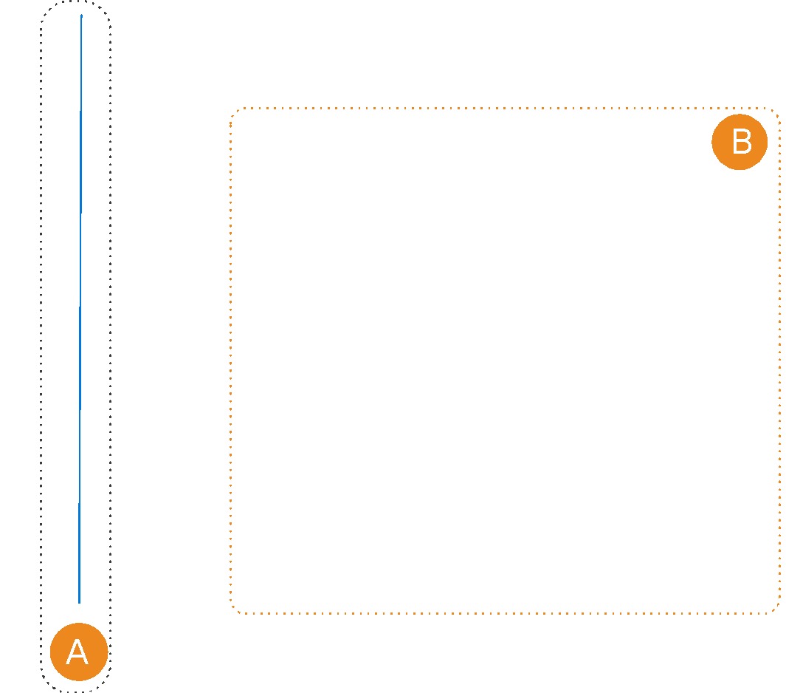
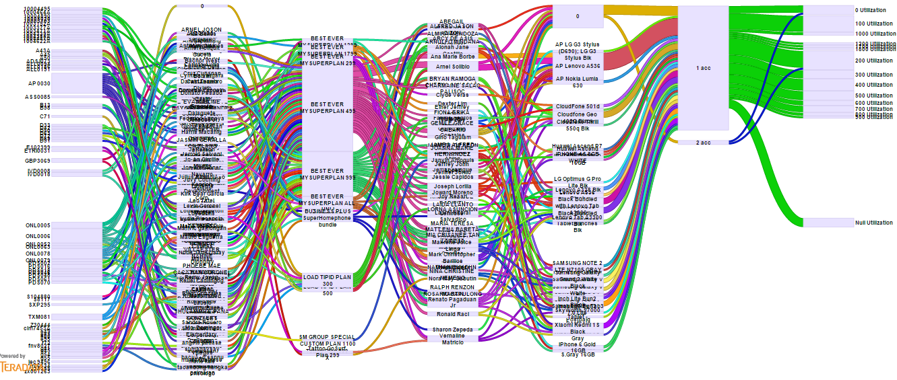
Credit Card and Payment Fraud
Customer or Third-Party Fraud
References
Thought Leadership
ICs: Jon Penrose, L. Laisney
Objective / Problem Statement
Credit Card Fraud occurs when someone uses a credit card as a fraudulent source of funds in a transaction to obtain goods without paying or to obtain unauthorized funds from an account.
Original card holder receives their bill and notices the charges, they’ll typically dispute the charges and refuse to pay.
Expected Outcome
Help to detect and limit amount of payment which can be made through a credit card, as well as monitor the payments of multiple bills using the same credit card number
Example:
Example Output: Analysis of main transactions witin 3 days after account activation
Customers who got high Value Handset
High exposure if Customer has minimum down payment
Subscription plans that has unlimited or incentives to use Voice
Various paths can be compared and investigated
A - No Activity for 3 weeks (634)
B - High Activity of usage during 3 weeks (84)
Notes:
The colours of the triangles indicate the type of Use Case:
Orange = Traditional Teradata / Data Warehouse
Red = ‘Big Data’ / Advanced Analytics
Blue = Non-Analytical Hadoop / Data Lake use case (e.g. Archiving)

Slide 29
Provider and Supplier Fraud
Customer or Third-Party Fraud
References
Owner:
Use Case Summary
Objective / Problem Statement
Point 1
Business Benefit
Point 1
Source Data
Point 1
Methodology / Analytic Technique
Point 1
Expected Outcome
Point 1
Challenges
Point 1
POV Success Criteria
Point 1

Slide 30
Payment Fraud – Synthetic Identity
Customer or Third-Party Fraud
References
Owner:
Use Case Summary
Objective / Problem Statement
Point 1
Business Benefit
Point 1
Source Data
Point 1
Methodology / Analytic Technique
Point 1
Expected Outcome
Point 1
Challenges
Point 1
POV Success Criteria
Point 1

Slide 31
Account Takeover Fraud Detection
Customer or Third-Party Fraud
References
Owner:
Use Case Summary
Objective / Problem Statement
Point 1
Business Benefit
Point 1
Source Data
Point 1
Methodology / Analytic Technique
Point 1
Expected Outcome
Point 1
Challenges
Point 1
POV Success Criteria
Point 1

Slide 32
Identity Fraud Insights
Customer or Third-Party Fraud
References
Owner:
Use Case Summary
Objective / Problem Statement
Point 1
Business Benefit
Point 1
Source Data
Point 1
Methodology / Analytic Technique
Point 1
Expected Outcome
Point 1
Challenges
Point 1
POV Success Criteria
Point 1

Slide 33
On-Line Fraud
Customer or Third-Party Fraud
References
Owner: Yasmeen Ahmed/ Karen Layfield
Use Case Summary
Objective / Problem Statement
On-line Fraud (OFD) spans web, mobile, call center, and voice response transaction activity
Companies want to identify unusual behavior patterns which proactively highlight potential fraudulent activities so actions can be taken to prevent further loss . Want the ability to continuously monitor and profile users, accounts
Business Benefit
Reduction in levels of fraud
Increase revenue and profitability
Identify offenders and suspend transaction prior to completion
Source Data
Web log browsing data (e.g. Celebrus)
Customer profile data
Customer Purchase History
Geospatial (geolocation)
Phishing (fraudulent emails)
Public records e.g. credit reports
Methodology / Analytic Technique
Npath analysis of browsing and shopping behaviour to identify potential fraudulent behaviour (e.g. overnight shipping requests)
Machine Learning
Ngrams – (Text and speech patterns)
Expected Outcome
Suspend transactions if behavior outside of range of typical behavior patterns(outliers)
Trigger contact to the purchases to validate authenticity of the purchasers and intended purchase
Ability to detect new accounts set up by existing user
Ability to detect when someone’s account information has been stolen
Set purchase limits
Challenges
The capture, storage and analysis of large volumes of web log data
The need for real time information
The identification of new fraudulent behaviors and patterns that commonly lead to fraud
POV Success Criteria
Race Relevant deliverables – in order for the POV to be done a short period of time the initial scope should be contained to a small subset of the customer base or for customers intending to purchase certain high theft product / product lines
For the subset agreed upon, will identify typical behavior, so to outliers can be flagged
Typical Engagements
Expand scope to larger segments of product lines and customers
Notes:
The colours of the triangles indicate the type of Use Case:
Orange = Traditional Teradata / Data Warehouse
Red = ‘Big Data’ / Advanced Analytics
Blue = Non-Analytical Hadoop / Data Lake use case (e.g. Archiving)
Wikipedia define an n-gram model as a type of probabilistic language model for predicting the next item in a sequence.^{[2]} n-gram models are now widely used in probability, communication theory, computational linguistics (for instance, statistical natural language processing), computational biology (for instance, biological sequence analysis), and data compression..

Slide 34
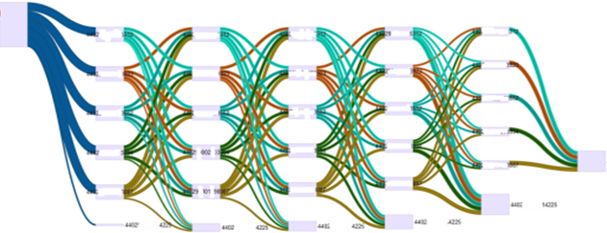
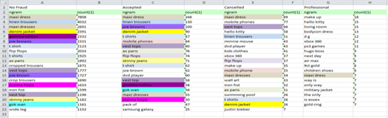
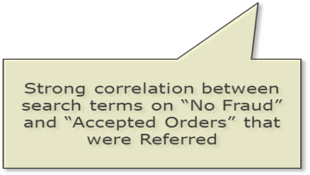
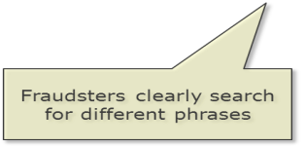
On-Line Fraud
Customer or Third-Party Fraud
References
Owner: Yasmeen Ahmed / Karen Layfield
Analysis Detail: -
Npath analysis of browsing and shopping behaviour to identify potential fraudulent behavior
Identify complex patterns of behavior and interactions between individuals to determine
Common approaches to fraud
Patterns of geographic locations associated with fraud (multiple accounts accessed from same IP address)
Ngrams – (Text and speech patterns) – search terms highly correlated to deceptive activity
Use Case Detail
Example Analytic output:
Use Case Results
Example analytic Output:
Notes:
The colours of the triangles indicate the type of Use Case:
Orange = Traditional Teradata / Data Warehouse
Red = ‘Big Data’ / Advanced Analytics
Blue = Non-Analytical Hadoop / Data Lake use case (e.g. Archiving)

Slide 35
Claims Fraud – Auto
Customer or Third-Party Fraud
References
Owner:
Use Case Summary
Objective / Problem Statement
Point 1
Business Benefit
Point 1
Source Data
Point 1
Methodology / Analytic Technique
Point 1
Expected Outcome
Point 1
Challenges
Point 1
POV Success Criteria
Point 1

Slide 36
Claim Fraud – Text Analytics for Property and Casualty
Customer or Third-Party Fraud
References
Owner:
Use Case Summary
Objective / Problem Statement
Point 1
Business Benefit
Point 1
Source Data
Point 1
Methodology / Analytic Technique
Point 1
Expected Outcome
Point 1
Challenges
Point 1
POV Success Criteria
Point 1

Slide 37
Data Leakage - Exfiltration
Information and Cyber Security
References
Owner:
Use Case Summary
Objective / Problem Statement
Point 1
Business Benefit
Point 1
Source Data
Point 1
Methodology / Analytic Technique
Point 1
Expected Outcome
Point 1
Challenges
Point 1
POV Success Criteria
Point 1

Slide 38
Vulnerability, Analysis and Remediation
Information and Cyber Security
References
Owner:
Use Case Summary
Objective / Problem Statement
Point 1
Business Benefit
Point 1
Source Data
Point 1
Methodology / Analytic Technique
Point 1
Expected Outcome
Point 1
Challenges
Point 1
POV Success Criteria
Point 1

Slide 39
Stolen Credentials
Information and Cyber Security
References
Owner:
Use Case Summary
Objective / Problem Statement
Point 1
Business Benefit
Point 1
Source Data
Point 1
Methodology / Analytic Technique
Point 1
Expected Outcome
Point 1
Challenges
Point 1
POV Success Criteria
Point 1

Slide 40
Packet Capture and Detection
Information and Cyber Security
References
Owner:
Use Case Summary
Objective / Problem Statement
Point 1
Business Benefit
Point 1
Source Data
Point 1
Methodology / Analytic Technique
Point 1
Expected Outcome
Point 1
Challenges
Point 1
POV Success Criteria
Point 1

Slide 41
Cyber Security
Information and Cyber Security
References
Owner:
Use Case Summary
Objective / Problem Statement
Point 1
Business Benefit
Point 1
Source Data
Point 1
Methodology / Analytic Technique
Point 1
Expected Outcome
Point 1
Challenges
Point 1
POV Success Criteria
Point 1

