Slide 1
Banking Analytics & Data Strategy
Business Value Framework for Financial Services
Powered by Teradata FSDM — Pakistan Banking Edition
Notes:
Welcome to the Banking Analytics and Data Strategy presentation. This framework maps 112 analytical capabilities to Teradata's FSDM with 3,917 entities.
Pakistan's banking sector manages PKR 32+ trillion in assets. Most banks operate at BACR maturity Level 2 (Developing) for analytics.
The Business Value Framework provides a concrete roadmap from raw data to actionable business decisions, covering all six core banking functions.

Slide 2
Executive Summary — Why This Matters
Pakistan’s banking sector manages PKR 32+ trillion in assets across 30+ commercial banks, 5 Islamic banks, and 11 microfinance banks. Yet most banks operate at BACR maturity Level 2 (Developing) across data analytics capabilities.
This framework maps 112 analytical capabilities across 6 business functions to Teradata’s Financial Services Data Model (FSDM) with 3,917 entities — providing a concrete implementation roadmap from data to decision.
Key numbers:
360 BVF-to-FSDM entity mappings validated
16 FSDM data domains covering full banking value chain
11-table profitability star schema (1 fact + 7 dims + 2 aggs + 1 bridge)
21 gap extension tables for Pakistan-specific requirements
771 BACR assessment questions across 8 maturity categories
Notes:
The executive summary highlights why data analytics is critical for Pakistan's banking sector: 360 BVF-to-FSDM mappings, 16 data domains, and 21 gap extension tables for local requirements.
SBP's Digital Banking Regulations 2022 require banks to modernize data infrastructure. The 11-table profitability star schema enables account-level customer profitability analysis.
Key differentiator: This framework bridges the gap between generic analytics frameworks and Pakistan-specific banking needs including KIBOR rates, WHT calculations, Zakat deductions, and Islamic banking products.

Slide 3
Framework Coverage
1. Industry Challenges — Digital disruption, regulation, fintech competition
2. Marketing & Customer Experience — 4 capability groups, 40+ use cases
3. Finance & Performance Management — Profitability, Treasury, FTP, Reporting
4. Risk Management & Mitigation — Credit, Market, Operational, Collections
5. Security & Fraud — Cyber, Employee Fraud, Customer Fraud, AML integration
6. Legal & Regulatory Compliance — SBP, Basel III, IFRS 9, AML/CFT
7. Product Management — Development, Pricing, Performance, End-of-Life
8. Analytic Infrastructure — FSDM data model, Star Schema, Gap Extensions
Notes:
The framework covers 8 major areas from Industry Challenges through Analytic Infrastructure. Each section maps directly to FSDM entities and BVF capabilities.
Note the progression: we start with understanding market pressures, then show how analytics addresses each business function, and conclude with the technical data architecture.
BACR assessment (771 questions, 8 categories) provides a maturity scoring mechanism. Most Pakistani banks score Level 2; the target is Level 4 (Optimized).

Slide 4
Pakistan Banking Sector — Converging Challenges
Digitalisation & Digital Payments Revolution
RAAST P2P/P2M processed PKR 9.8 trillion in FY2024. JazzCash + Easypaisa: 100M+ mobile wallets. Roshan Digital Accounts: $7.5B+ diaspora inflows. SBP mandating open banking APIs by 2025.
Macroeconomic Pressures
Policy rate peaked at 22% (Jun 2023), now at 17.5% — KIBOR volatility. PKR managed float regime. Sovereign debt restructuring and IMF Stand-By Arrangement. Inflation moderating from 38% peak to 12% — NIM compression ahead.
Regulatory Tsunami
IFRS 9 ECL provisioning (Stage 1/2/3) fully enforced since Jan 2024. Basel III Capital Conservation Buffer at 2.5%. SBP AML/CFT aligned with FATF grey list remediation. Minimum capital raised to PKR 20 billion by Dec 2026.
Technology Debt & Legacy Burden
60%+ banks still on monolithic core banking (CTL, Temenos, Oracle FLEXCUBE). Average bank runs 4-5 separate core systems without unified data layer. Manual reconciliation consuming 30%+ of operations FTEs.
BUSINESS
MANAGEMENT
BANK
GROWTH
COSTS
Notes:
Pakistan faces four converging challenges: digital payments revolution (RAAST processed 500M+ transactions in 2024), macroeconomic pressures (KIBOR peaked at 22%), regulatory tsunami (IFRS 9, Basel III), and technology debt.
The RAAST instant payment system launched by SBP is fundamentally changing how retail banking works. JazzCash and Easypaisa together serve 70M+ mobile wallet users.
FSDM entities supporting this analysis: EVNT (Event domain, 38 entities), CHNL (Channel domain, 12 entities), RGLTRY_RPTG (Regulatory Reporting domain, 25 entities).

Slide 5
Mounting Pressures on Pakistan’s Banking Sector
“Financial inclusion at 30% — Banks must grow, cut costs, and manage complexity simultaneously”
200+ regulatory reports due monthly/quarterly to SBP
Greater IFRS 9 ECL models with 3 macroeconomic scenarios
Enhanced FTP accuracy critical — 10bps error = PKR billions
Respond to customer profitability invisible: 80/20 rule unknown
Meet regulatory compliance consuming 15-20% of technology budgets
5 digital-only bank licenses creating new competition
Understand and orchestrate financial inclusion (30% → SBP target 50% by 2028)
Improve SME lending < 8% of total advances — massive untapped market
Agriculture credit gap: PKR 300B+ shortfall in disbursement
Cross-sell ratios 1.3 products/customer vs. 4.5 in mature markets
Digital-only banking licenses (5 awarded by SBP) creating new competition
Diaspora remittances $30B+/year with RDA capturing $7.5B+
Measure, manage and price based on data-driven customer insights and personalization
Exploit Islamic banking products — growing at 25% CAGR
BUSINESS
MANAGEMENT
Cost-to-income ratios averaging 55-65% (target: <45%)
Branch network costs PKR 50-80M/branch/year — digital at 1/10th
Manual trade finance costing $150-200 per transaction
BANK
GROWTH
COSTS
Notes:
Three pressure categories map to specific BVF capabilities: Business Management requires 200+ regulatory reports, Cost Management addresses 55-65% cost-to-income ratios, Growth targets 100M+ unbanked adults.
SBP's Financial Inclusion Strategy targets 65% adult account ownership by 2028, up from 30% currently. Agriculture credit mandate: 20% of total advances.
The profitability star schema (FACT_CUSTOMER_PROFITABILITY) directly addresses the cost transparency challenge. FTP based on KIBOR term structure provides true cost-of-funds visibility.

Slide 6







New Entrants Reshaping Pakistan’s Financial Landscape
DIGITAL DISRUPTORS, TELECOM-LED BANKING & REGIONAL THREATS
SadaPay, NayaPay: Zero-fee accounts capturing Gen-Z (8M+ users). Finja: Digital lending with instant credit scoring. Tag CBS: Cloud-native Islamic banking platform
JazzCash (Mobilink Microfinance Bank): 40M+ wallets. Easypaisa (Telenor Microfinance Bank): 30M+ wallets. Both now offering savings, insurance, and micro-lending
India’s UPI success creating pressure for RAAST acceleration. Chinese fintech (Ant Group, WeBank) eyeing CPEC corridor banking
Banks that cannot provide a unified, data-driven customer experience will lose their most profitable customers to digital-first competitors
Notes:
Digital disruptors are reshaping Pakistan's financial landscape. SadaPay and NayaPay have captured 8M+ users with zero-fee accounts targeting Gen-Z customers.
Telecom-led banking (JazzCash: 40M+ wallets, Easypaisa: 30M+ wallets) is the primary threat. Both now offer savings, insurance, and micro-lending beyond basic payments.
India's UPI processing 10B+ monthly transactions creates competitive pressure for RAAST acceleration. Chinese fintech eyeing CPEC corridor banking adds regional dimension.

Slide 7
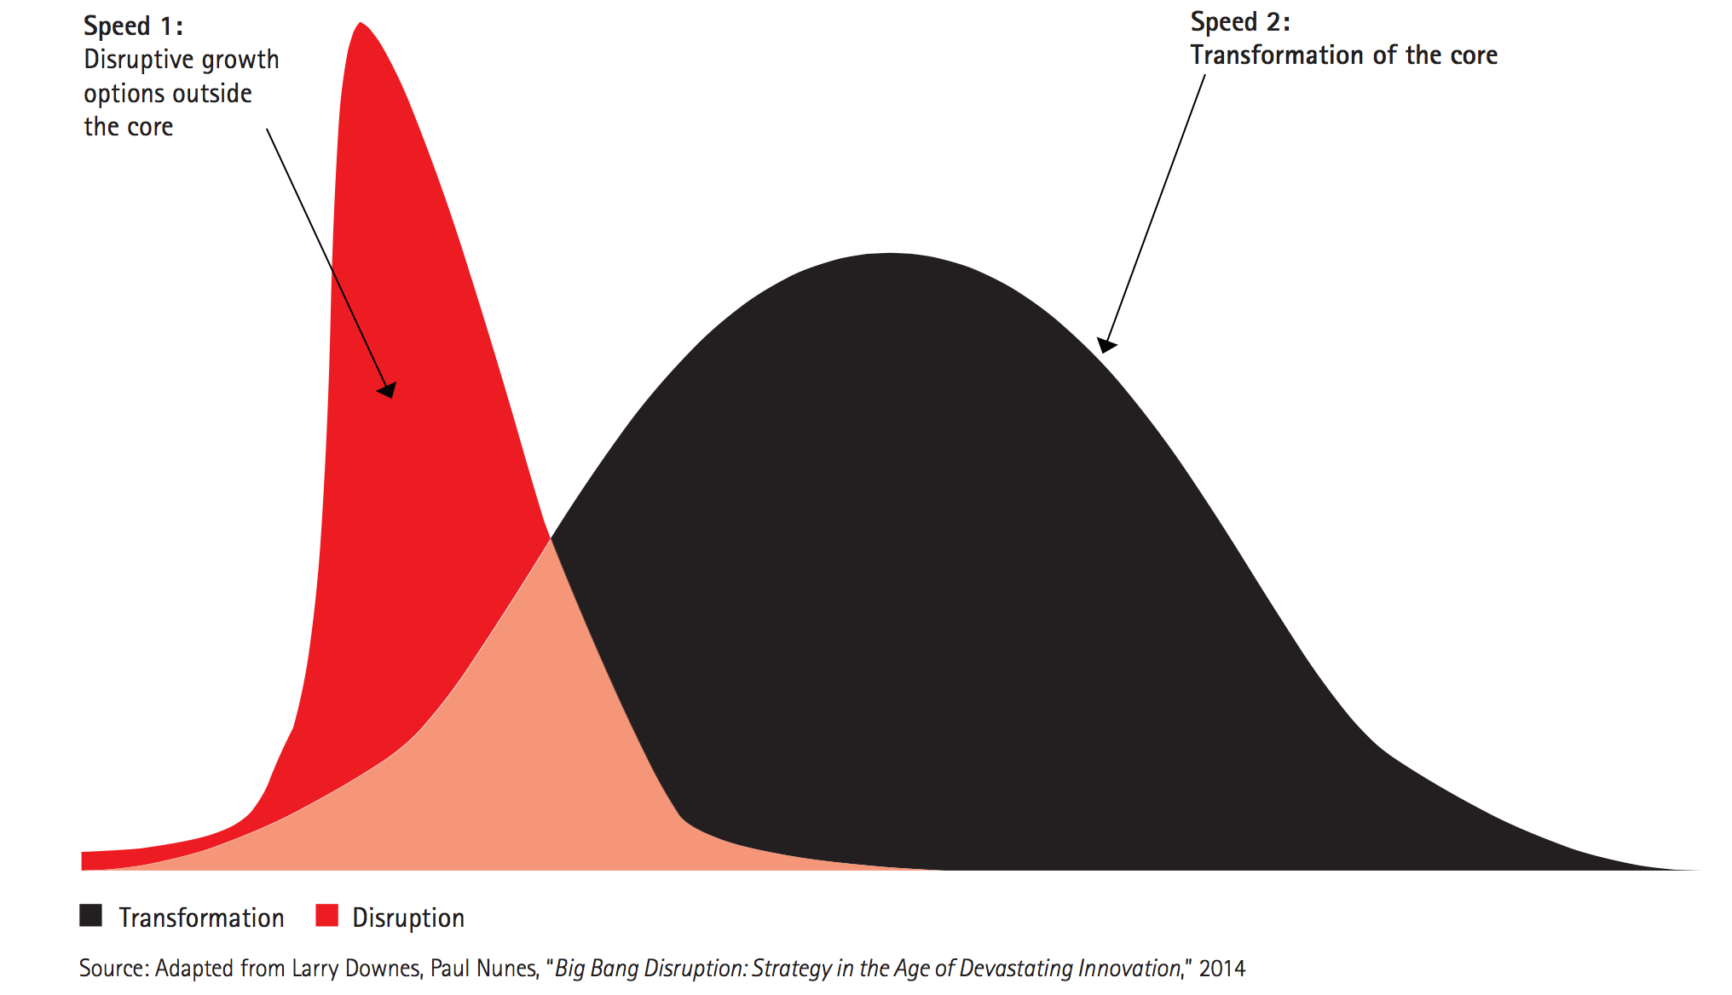
Two Speeds of Transformation in Banking
Disruptive (6-18 months): Real-time personalization engine, AI-driven credit scoring for unbanked segments, instant cross-border remittances via RAAST + RDA, dynamic pricing using customer profitability analytics.
Transformational (18-36 months): Build enterprise data warehouse on FSDM with 3,917 entities. Implement Activity-Based Costing. Deploy IFRS 9 ECL engine. Create unified FTP based on KIBOR term structure. Customer profitability at account level.
Notes:
Two speeds of transformation: Disruptive (6-18 months) focuses on quick wins like real-time personalization and AI credit scoring. Transformational (18-36 months) builds the enterprise data warehouse on FSDM.
The disruptive track leverages existing data through customer 360-degree views and ML models. The transformational track requires FSDM implementation with all 3,917 entities across 16 domains.
Both tracks require the same foundational data layer. Starting with FSDM ensures the disruptive initiatives don't create more data silos while enabling the long-term vision.

Slide 8
Data-Driven Re-invention — The Only Path Forward
Grow Through Customer Intelligence:
Build Multi-Dimensional Customer View (FSDM: INDVDL, ACCT, CNTCT, EVNT across 16 domains)
Identify actual needs through transaction classification and behavioral segmentation
Optimize offers using profitability-aware Next Best Action engines
Target the right moment via event-driven marketing (FSDM Event domain: 109 entities)
Reduce Costs Through Analytics Automation:
Replace manual reconciliation with automated matching engines
Reduce regulatory reporting from weeks to hours via integrated data layer
Deploy straight-through-processing for trade finance and payments
Improve Management Through Transparency:
FACT_CUSTOMER_PROFITABILITY: Revenue - Direct Cost - Allocated Cost - Risk Cost
7-dimensional analysis: Customer x Product x Channel x Branch x Time x Segment x Business
Funds Transfer Pricing providing true cost-of-funds at account level using KIBOR term structure
Notes:
Data-driven re-invention across three axes: Grow (customer intelligence using FSDM entities INDVDL, ACCT, CNTCT, EVNT), Reduce Costs (analytics automation), Improve Management (transparency).
The FACT_CUSTOMER_PROFITABILITY formula: Revenue minus Direct Cost minus Allocated Cost minus Risk Cost. Seven dimensions enable drill-through analysis at any level.
FTP based on KIBOR term structure provides true cost-of-funds at account level, replacing the current flat-rate allocation methods used by most Pakistani banks.

Slide 9
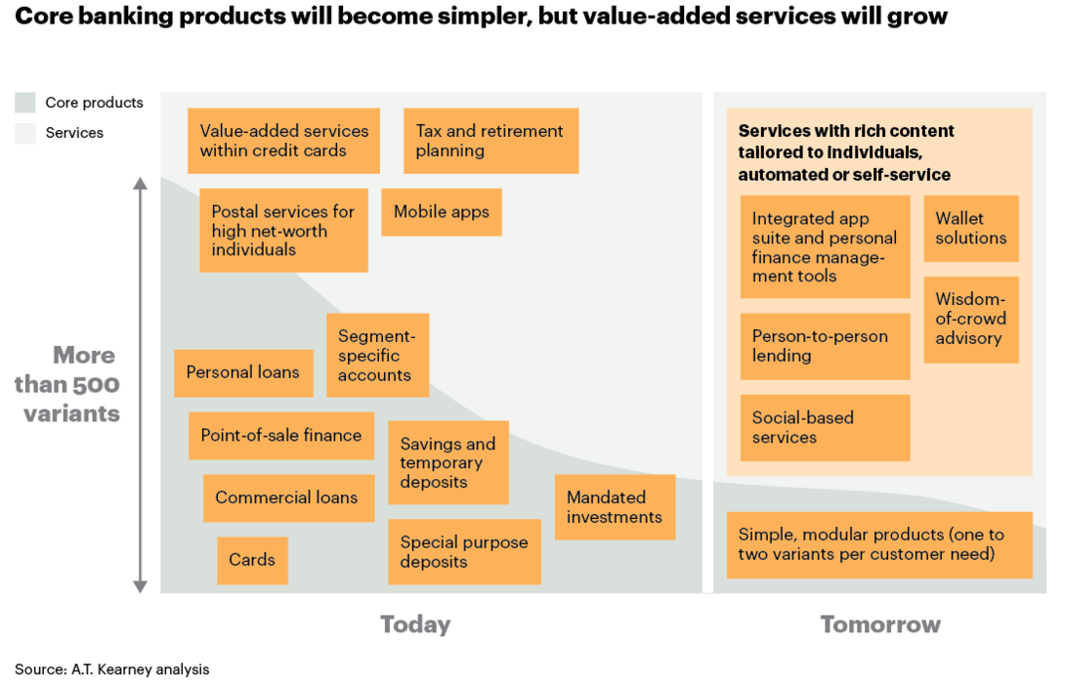
Analytics — The Core Competitive Advantage
“The future of banking belongs to institutions that can transform data into decisions at the speed of customer expectation. In Pakistan, where 70% of adults remain unbanked, the opportunity for data-driven financial inclusion is unprecedented.”
Pakistan banking analytics maturity: Level 2.1 average (BACR assessment)
FSDM: 3,917 entities | BVF: 112 capabilities | Gap: data-rich vs. data-poor
Notes:
Analytics is the core competitive advantage for banks in Pakistan. Global analytics spending in banking exceeds USD 25B annually, growing at 15% CAGR.
BACR assessment shows Pakistani banks average Level 2.1 maturity. Banks with mature analytics programs globally achieve 2.5x higher ROE than peers.
FSDM provides the canonical data foundation: 3,917 entities across 16 domains. BVF maps all 112 analytical capabilities to specific FSDM entities, eliminating guesswork in data warehouse design.

Slide 10
Banking Business Value Framework — 6 Functions, 112 Capabilities
Spacer
Analytic Infrastructure: Teradata FSDM v16 | 16 Domains | 3,917 Entities
Marketing & Customer Experience
Risk Management & Mitigation
Legal & Regulatory Compliance
Business Functions
Security & Fraud
Finance & Performance Management
Product Management
Analytic Infrastructure
Data Sources
Notes:
Six business functions with 112 total capabilities: Marketing and Customer Experience (40), Finance and Performance Management (26), Risk Management (18), Security and Fraud (14), Legal and Regulatory (12), Product Management (12).
Each function maps to specific FSDM domains. Marketing uses Customer, Event, Product, Channel domains (420+ entities). Finance uses Finance, Account, GL domains (350+ entities).
The BVF is not theoretical. Each capability has been mapped to concrete FSDM entities through 360 validated BVF-to-FSDM entity mappings.

Slide 11
Banking Business Value Framework — 6 Functions, 112 Capabilities
Analytic Infrastructure: Teradata FSDM v16 | 16 Domains | 3,917 Entities
Marketing & Customer Experience
Risk Management & Mitigation
Legal & Regulatory Compliance
Business Functions
Security & Fraud
Finance & Performance Management
Product Management
Data Lake: Core Banking, Cards, Treasury, Trade & Islamic
FSDM v16: 3,917 Entities | Star Schema | Gap Extensions
Profitability Engine, ML Models & BACR Assessment
Real-time Offers, SBP Reporting & Executive Dashboards
Analytic Infrastructure
Data Sources
Notes:
The analytic infrastructure has four layers: Data Lake (raw ingestion from core banking, cards, treasury, trade, Islamic systems), Structured Data (FSDM v16), Analytics (profitability engine, ML models), and Decisioning (real-time channels).
FSDM v16 provides 3,917 entities in 3NF with Teradata-optimized DDL. The star schema adds FACT_CUSTOMER_PROFITABILITY with 7 dimensions and 2 aggregates for fast analytics.
21 gap extension tables address Pakistan-specific requirements: KIBOR rate curves, withholding tax calculations, Zakat deductions, Islamic profit rate structures, SBP regulatory code mappings.

Slide 12
Banking Business Value Framework — 6 Functions, 112 Capabilities
Analytic Infrastructure: Teradata FSDM v16 | 16 Domains | 3,917 Entities
Marketing & Customer Experience
Risk Management & Mitigation
Legal & Regulatory Compliance
Business Functions
Security & Fraud
Finance & Performance Management
Product Management
Data Lake: Core Banking, Cards, Treasury, Trade & Islamic
FSDM v16: 3,917 Entities | Star Schema | Gap Extensions
Profitability Engine, ML Models & BACR Assessment
Real-time Offers, SBP Reporting & Executive Dashboards
Analytic Infrastructure
Data Sources
360° Customer View (CNIC-linked)
NADRA Data & Geo-location
CASA, Loans, Cards & Islamic Products
Balances & KIBOR Rates
IBFT, RAAST, ATM & POS
Limits, Collateral & IFRS 9 ECL
GL, Cost Centers & Branch P&L
CNIC Scans, Biometrics, Digital Signatures
SBP Codes, SWIFT, KIBOR Structure
Notes:
Nine data source categories feed the framework: 360-degree Customer View (CNIC-linked), Demographics (NADRA), Accounts (CASA, loans, cards, Islamic products), Balances (KIBOR-linked), Transactions (IBFT, RAAST, ATM, POS).
Additional sources: Limits and Collateral (IFRS 9 ECL stages), General Ledger (chart of accounts, branch P&L), Multi-structured Data (scanned CNIC, biometrics), Master Data (SBP codes, SWIFT/BIC, KIBOR curves).
The CNIC serves as the universal key for customer identity in Pakistan, enabling true 360-degree view across all banking relationships. FSDM's INDVDL and PRTY entities are designed for this exact pattern.

