Slide 1
Continuous integration Continuous delivery (CI/CD)
Group I:
- Nguyễn Quốc Việt
- Nguyễn Minh Nhựt

Slide 2
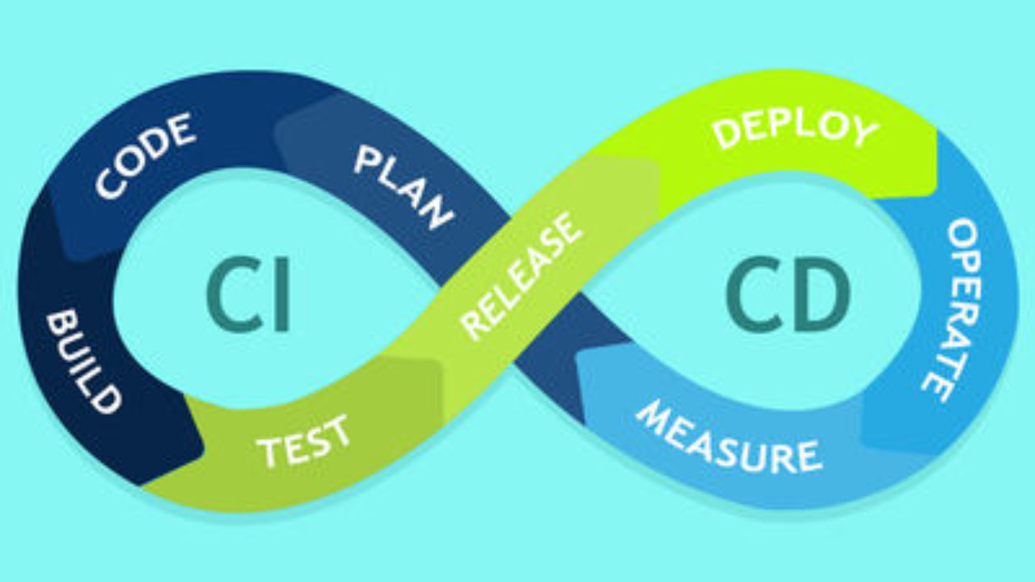
The big picture

Slide 3
Integration: the old way vs the continuous one
Millions of lines of code?
all features are done
merge altogether
test
rollback or continue
a new feature
git push
automated test
fix or merge
pull request
New way

Slide 4
What is CI?
a new feature
git push
automated test
fix or merge
pull request
- Integrate code into a shared repository several times a day
- Code verified by automated tests
--> Quick & early feedback
Quick problem detection Faster integration

Slide 5
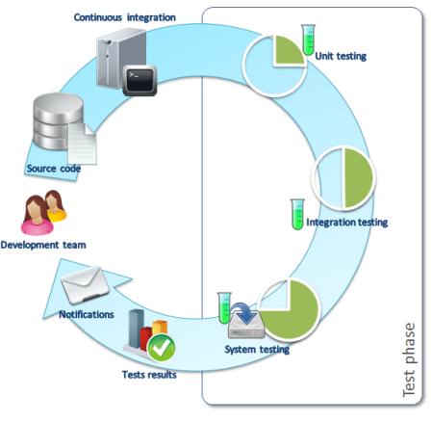
Key points of CI
Put and merge to 'master'/'dev' --> version control tools
'master'/'dev' is the branch of most updated working code, and is supposed to have no conflicts
Heavily rely on automation testing
heavy unit testing & light integration testing
carefully designed and updated tests
testing should not take too long ('continuous' --> many integrations a day)
Prioritize fixing a build over developing new build

Slide 6
Delivery: the old way vs the continuous one
Complex architecture?
Multiservice?
all features are done
INTEGRATION
manual building
manual deploy
a new feature
CONTINUOUS INTEGRATION
staging and review
automated deployment
automated build
New way

Slide 7
What is CD?
a new feature
CONTINUOUS INTEGRATION
staging and review
automated deployment
automated build
- Develop, build, test, and release software in short cycles.
- Rely on automated tasks
--> Quick delivery of new version to users
Reliable product quality
No bottleneck in releasing (e.g microservice architecture) and mitigate incidents

Slide 8
Key points of CD
- Building, testing and releasing are all automated
- Frequent small deployments (such as in Agile methods)
- All deployments go through regression testing

Slide 9









CI/CD services
Jenkins
TeamCity
Travis CI
Circle CI
Github Actions
Gitlab CI
Bitbucket Pipelines
Codeship
Docker

Slide 10
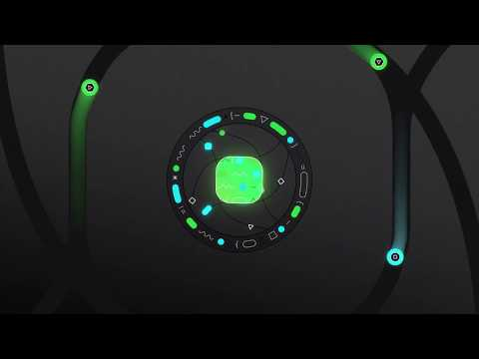
CircleCI
What?
VCS integration
Automated testing in clean container
Notifications
Automated deployment
Why?
Best ad
Free tier
Good UI/UX
Many features

Slide 11
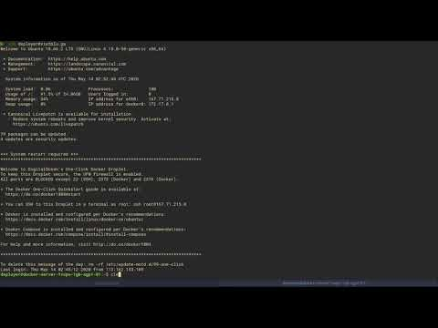
Manual flow
Code
Do manual tests
Run automated tests
Commit and push
Clear system
Checkout
Build
Deploy

Slide 12
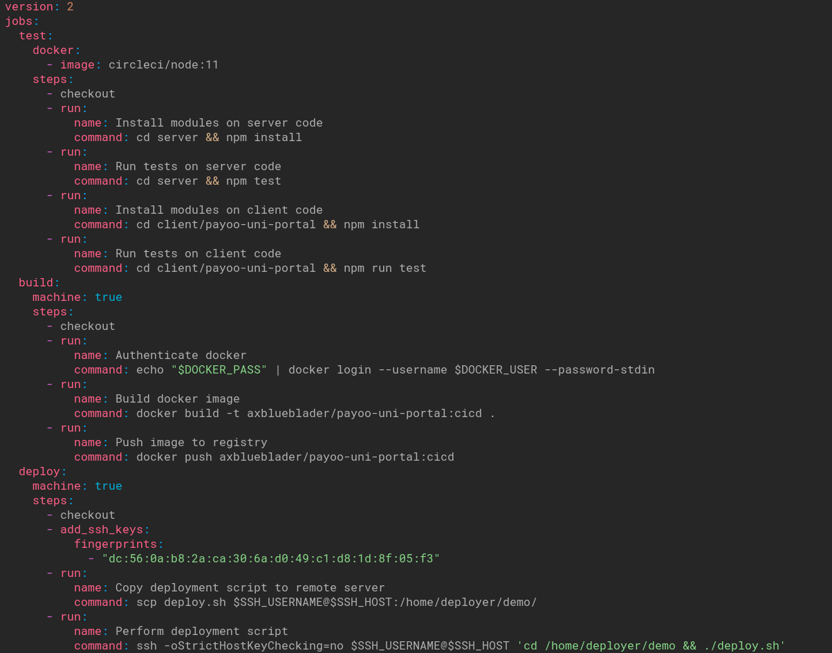
Config file
Defining 'jobs' and 'steps'
https://circleci.com/docs/2.0/configuration-reference/

Slide 13
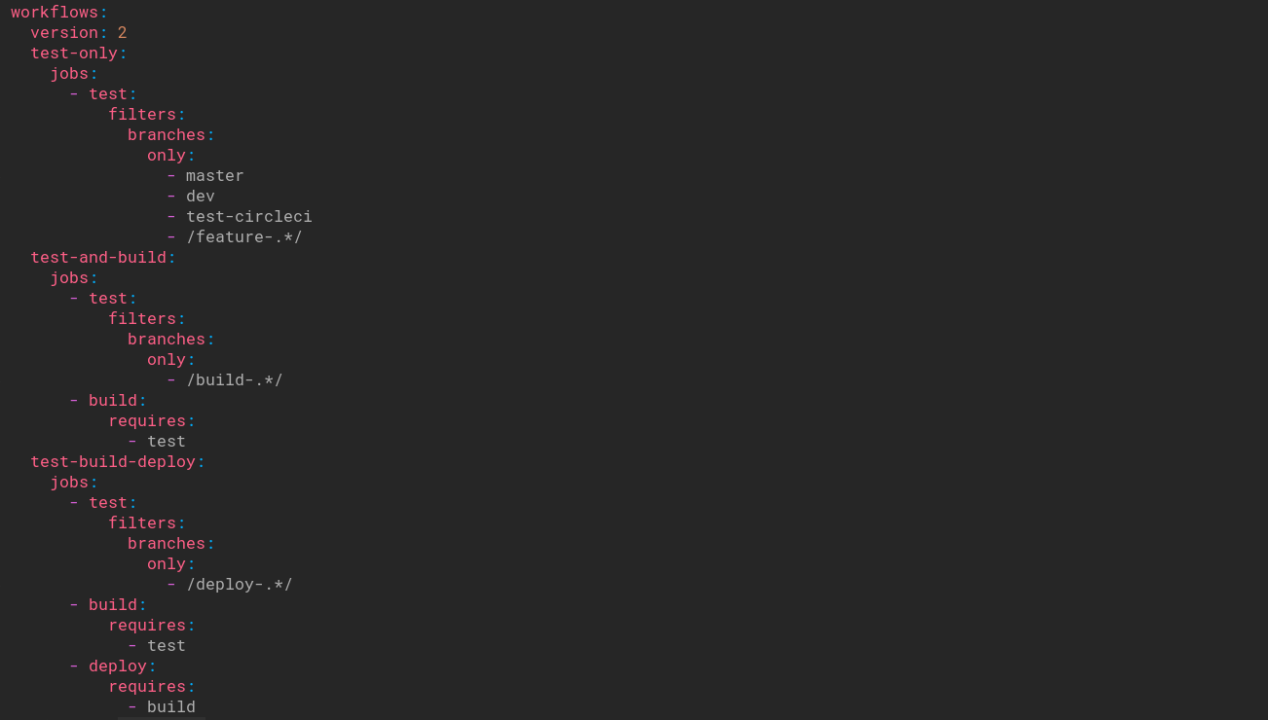
Config file
Defining 'workflows'
https://circleci.com/docs/2.0/configuration-reference/

Slide 14
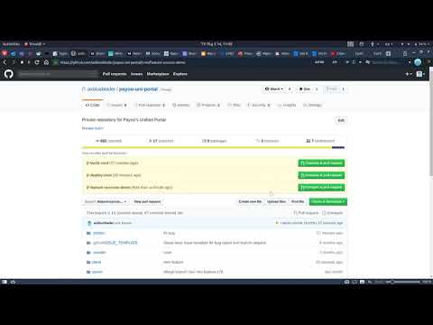
Automated flow
Success flow
Code
Commit and push
Do something else
Come back check for status
If fail => go to step 1
If success => pull request
Go home

Slide 15
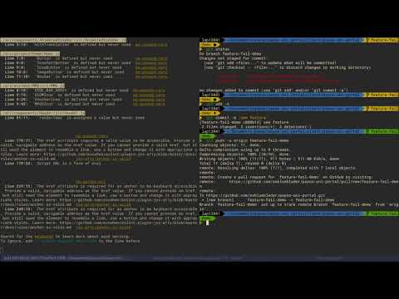
Automated flow
Fail flow
Code
Commit and push
Do something else
Come back check for status
If fail => go to step 1
If success => pull request
Go home

Slide 16
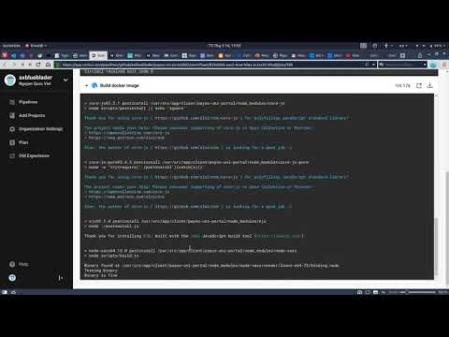
Automated flow
Full flow
Code
Commit and push
Do something else
Come back check for status
If fail => go to step 1
If success => pull request
Go home

Slide 17
Conclusion
CI : merge code several times a day + automatic test
CD : build, test and deploy automatically, usually go with CI
Heavily depends on disciplined coding, managing and testing practices.
CI/CD services:
VCS integration
Automated tests and builds
Notifications
Automated deployments

