Slide 1

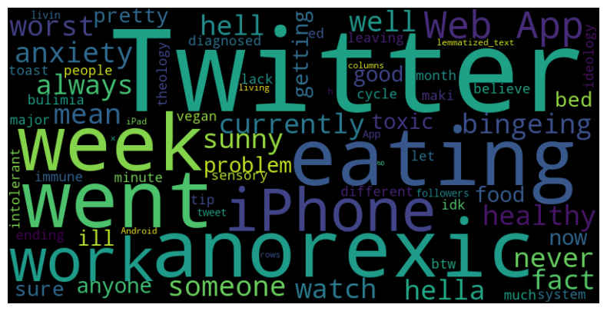
Social Media & Eating Disorders: Measured through Sentiment and Correlation Analysis

Slide 2
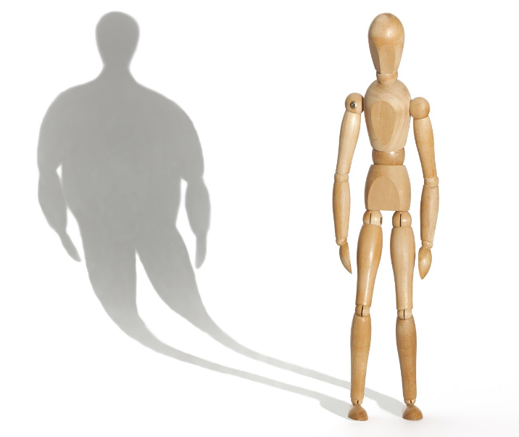
Background
Defined
Types
Estimated 30 million Americans suffer from an Eating Disorder:
20 Million Female
10 Million Male

Slide 3
Research Questions:
H0: There is no significant correlation between users with over five thousand followers and negative tweet sentiment
H0: There is no significant correlation between users with over five thousand and positive tweet sentiment
H0: There is no significant correlation between 2009-2013 total prevalence population (United States, Canada, Mexico, Brazil) and negative and neutral tweet sentiment
H0: There is no significant correlation between 2009-2013 total prevalence population (Russia, Nigeria, India, China) and negative and neutral tweet sentiment.

Slide 4
Methodology & Approach
Datasets:
Eating Disorder Tweets: https://www.kaggle.com/datasets/jabenitez88/eating-disorders-tweets
Prevalence-of-eating-disorders-in-males-vs-females: https://www.kaggle.com/datasets/valchovalev/prevalenceofeatingdisordersinmalesvsfemales
Challenges:
Geo location data was limited
Prevalence data is dated
Tweet Data:
2 Groups
> = 5 Thousand followers
< 5 Thousand followers
Randomly Sampled (sample_percentage = 1)
Tweet Data: 4,900. Sample significance: 337
Prevalence Data:
2009-2013
Eight nations: US, Brazil, Canada, Mexico, Russia, China, Nigeria & India

Slide 5
Methodology & Approach
Descriptive Visualizations:
Population Prevalence 2009 -2013
Geospatial Global Prevalence 2013
Sentiment Analysis on Tweet Data:
Word cloud
Vader Sentiment Analysis
Chi2:
2 H0
> = 1 Million followers
Negative sentiment
Positive sentiment
Pearsons Correlation Coefficient:
2 H0
Negative and Neutral Sentiment
Western Block Nations (US, Canada, Mexico & Brazil) Total ED Prevalence Population
Eastern Block Nations (Russia, Nigeria, China & India) Total ED Prevalence Population
2009-2013

Slide 6
Visualizations

Slide 7
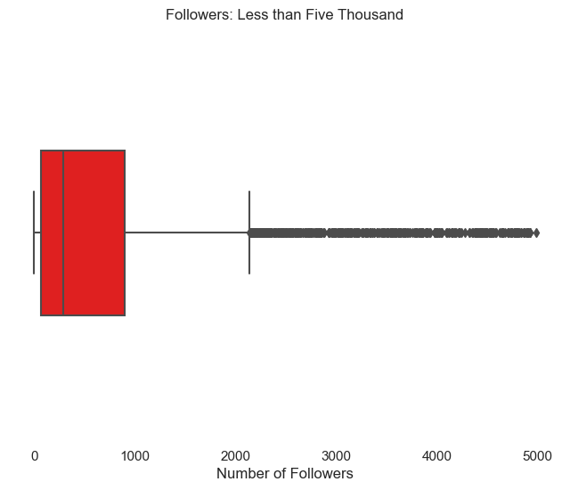
Spread of Tweet Followers

Slide 8
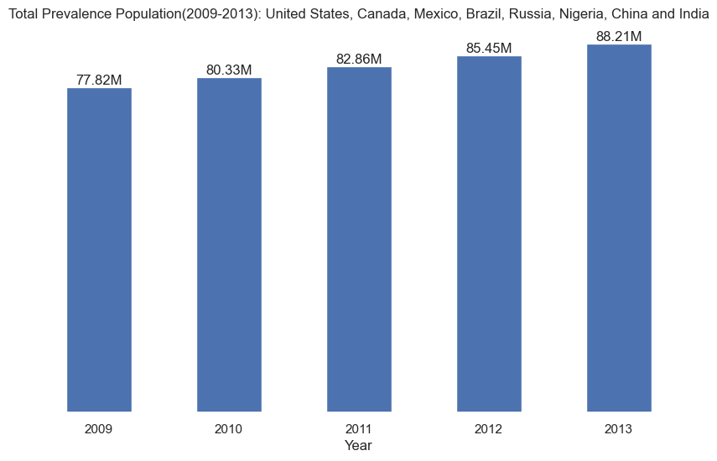
Eating Disorder Prevalence 2009-2013

Slide 9
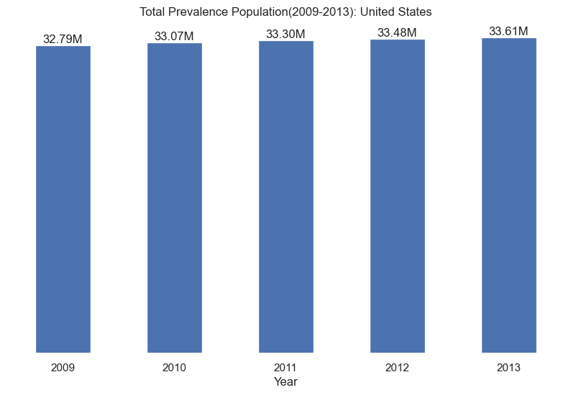
Eating Disorder Prevalence 2009-2013

Slide 10
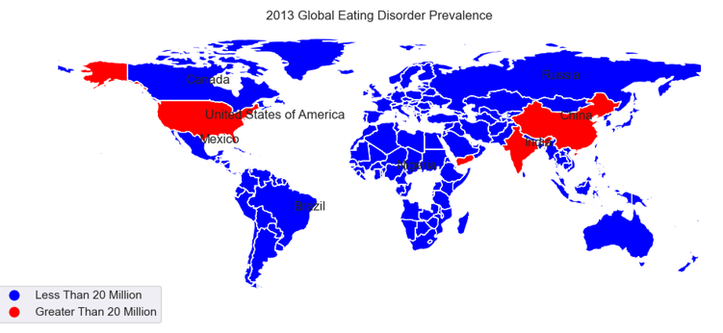
Geospatial Global Prevalence 2013

Slide 11
Analysis & Results

Slide 12

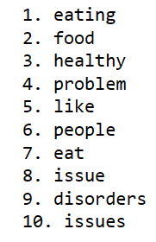
Sentiment Analysis

Slide 13
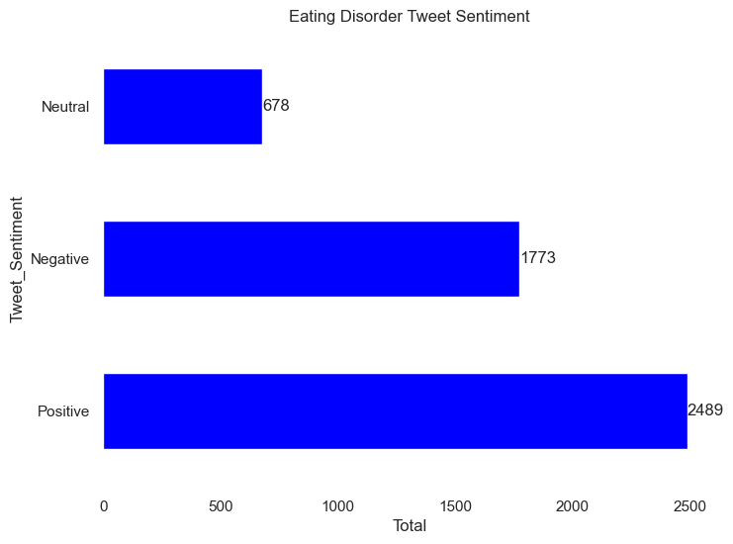
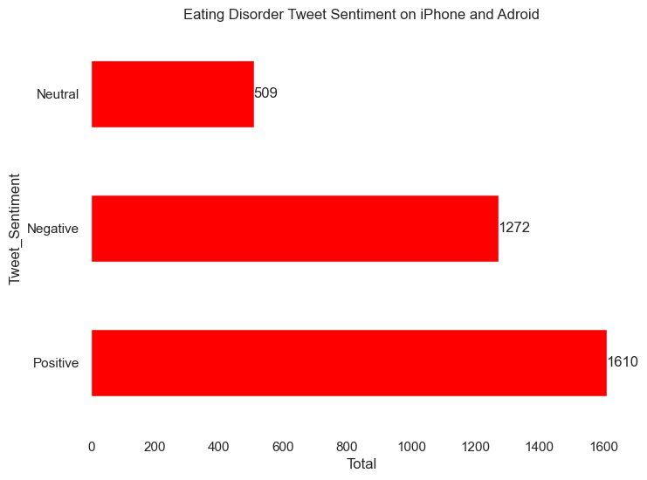
Vader Sentiment Analysis

Slide 14
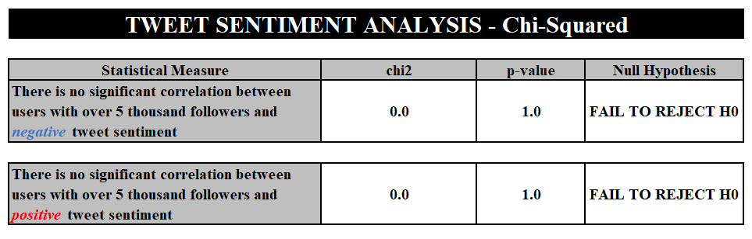
Results: Tweet Sentiment

Slide 15
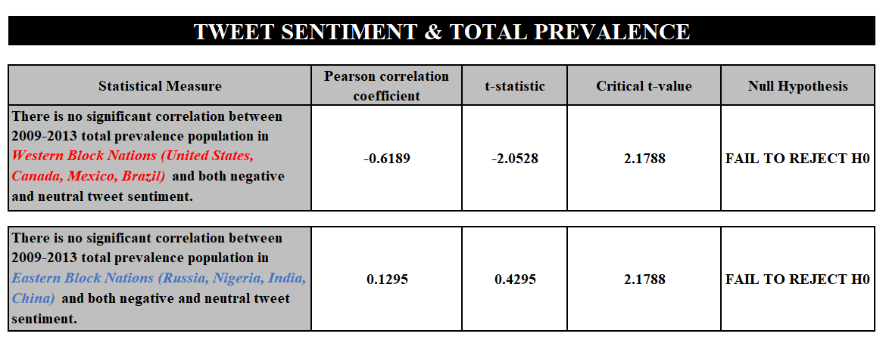
Results: Tweet & Prevalence

Slide 16

Conclusion &Resources:
GitHub: https://github.com/nmoll1776/Practicum-2/tree/main
LinkedIn: https://www.linkedin.com/in/nick-molliconi-mba-ms-46b74619/
Eating Disorder Information: https://www.nationaleatingdisorders.org/what-are-eating-disorders
Emergency/Crisis: Dial 988 or text Crisis Text Line by texting “NEDA” to 741741

Slide 17
Thank you

Slide 18
References:
Alberto, J., Andrades, B. (2021). Eating Disorder Tweets. www.kaggle.com. Retrieved on October 23, 2023 from https://www.kaggle.com/datasets/jabenitez88/eating-disorders-tweets.
Alex,. (2017, October 18). Python geopy get city and country. www.stackoverflow.com. Retrieved on November 7, 2023 fromhttps://stackoverflow.com/questions/46809525/python-geopy-get-city-and-country.
Aakarsha_Chugh,. (2023, April, 18). Label Encoding in Python. www.geeksforgeeks.com. Retrieved on November 17, 2023 from https://www.geeksforgeeks.org/ml-label-encoding-of-datasets-in-python/.
Ankthon,. (2021, October 7). Python | Sentiment Analysis using VADER. www.geeksforgeeks.com. Retrieved on November 1, 2023 from https://www.geeksforgeeks.org/python-sentiment-analysis-using-vader/.
Ekern, J,. MS, LPC. The National Eating Disorders Association (NEDA). www.eatingdisorderhope.com. (2021, January 6). Retrieved on November 25, 2023 from https://www.eatingdisorderhope.com/information/help-overcome-eating-disorders/neda.
George, N. PhD. (2019, November 6). Week 2 Assignment Walkthrough. www.youtube.com. Regis University. https://www.youtube.com/watch?v=NaeyhIBIJZE.
Huerta, J. (2022, April 14). Python: re.sub('[^A-Za-z]', ' ', string) for a list. www.stackoverflow.com. Retrieved on October 29, 2023 from https://stackoverflow.com/questions/71878621/python-re-suba-za-z-string-for-a-list.
Jacobperalta,. (2023, November 24). www.geeksforgeeks. Text Preprocessing in Python. Retrieved on October 28, 2023 from https://www.geeksforgeeks.org/text-preprocessing-in-python-set-1/.
Mchangun,. (2013, October 24). Faster way to remove stop words in Python. www.stackoverflow.com. Retrieved on October 29, 2023 from https://stackoverflow.com/questions/19560498/faster-way-to-remove-stop-words-in-python.
mGalarnyk. (2018). Python_Tutorials/Statistics/boxplot
/Box_plot_interpretation.ipynb. www.github.com. Retrieved on November 25, 2023 from https://github.com/mGalarnyk/Python_Tutorials/blob/master/Statistics/boxplot/Box_plot_interpretation.ipynb.
n.a. (2019, March 31). Remove meaningless words from dataframe column. www.stackoverflow.com. Retrieved on November 7, 2023 from https://stackoverflow.com/questions/55443298/remove-meaningless-words-from-dataframe-column.
n.a. (2022). What are eating disorders? www.nationaleatingdisorders.org. Retrieved on November 25, 2023 from https://www.nationaleatingdisorders.org/what-are-eating-disorders.

Slide 19
References:
Sidani JE, Shensa A, Hoffman B, Hanmer J, Primack BA. The Association between Social Media Use and Eating Concerns among US Young Adults. J Acad Nutr Diet. 2016 Sep;116(9):1465-1472. doi: 10.1016/j.jand.2016.03.021. Epub 2016 May 5. PMID: 27161027; PMCID: PMC5003636.
Tyle, K. (2023). Interactive data visualization in Python: Geopandas. www.atmos.albany.edu. Retrieved on November 3, 2023 from https://www.atmos.albany.edu/facstaff/ktyle/atm533/core/week4/geopandas.html#:~:text=You%20can%20do%20this%20before%20starting%20the%20Python,Shapely%20by%20default%2C%20even%20if%20PyGEOS%20is%20installed.
Valex, V. (2021). Prevalence of eating disorders in males vs females. www.kaggle.com. Retrieved on October 23, 2023 from https://www.kaggle.com/datasets/valchovalev/prevalenceofeatingdisordersinmalesvsfemales.
Vu, D. (2023, February). Generating WordClouds in Python Tutorial. www.datacamp.com. Retrieved on October 30, 2023 from https://www.datacamp.com/tutorial/wordcloud-python.
Yamuca, L. (2021, April 30). How to use t.ppf()? which are the arguments? www.stackoverflow.com. Retrieved on November 23, 2023 from https://stackoverflow.com/questions/67340028/how-to-use-t-ppf-which-are-the-arguments.

