Slide 1
Stegoshares
Fahd Humayun : fh186
Nathan Morgenstern : ncm74
Guy Rubinstein : gr311

Slide 2




Securely distribute recovery phrase
Recovery phrase, or wallet seed allows backing up of wallet with multiple applications-hardware, mobile and desktop wallets.
Make storing seed safe in the event of fire, natural disaster, home robbery.
Easy to remember which images have (encrypted ?) shares in them.
Ability to recover contents anywhere with an internet connection.

Slide 3
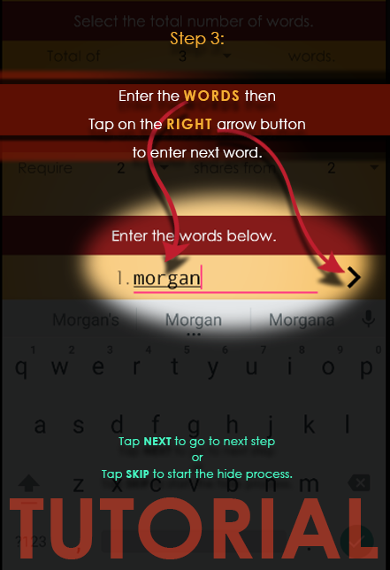
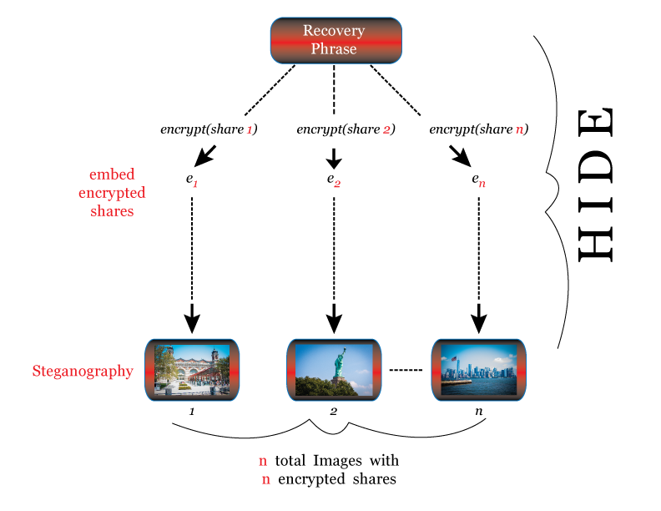
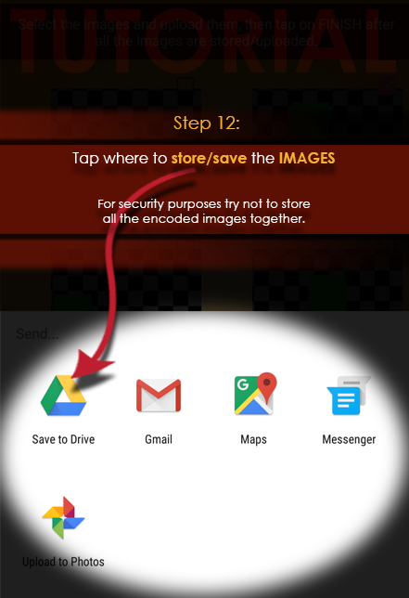
Phrase Hiding

Slide 4
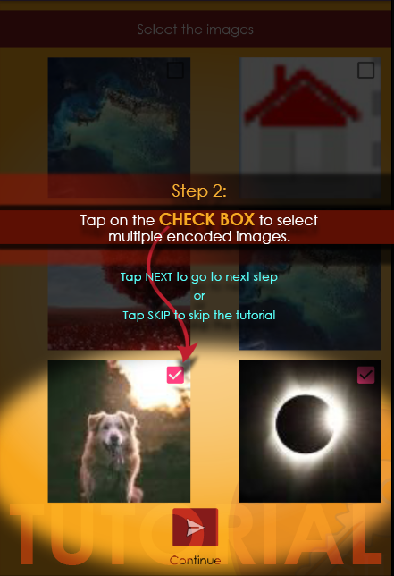
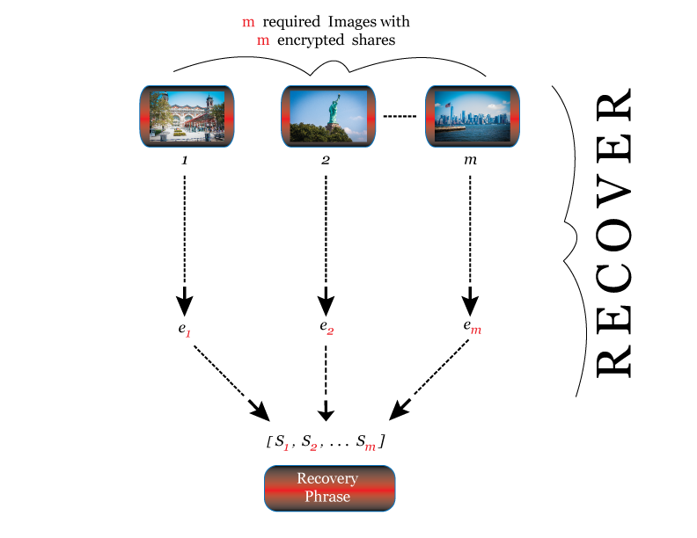
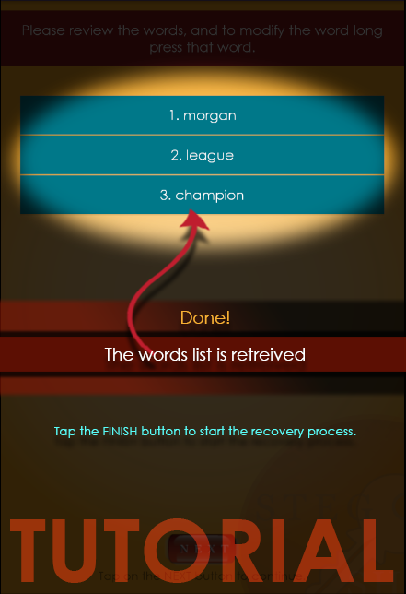
Phrase Recovery

