Slide 1
Critical Design Review
Guitar Pitch Shifter 1 (GuPS1)
March XX, 2015
David Eisen
Mattew Massimilla
Natalie Morningstar
Jonathan Peevy

Slide 2
Recap/Outline
Where we were last time we talked
Where we are now…
Outline for today…

Slide 3
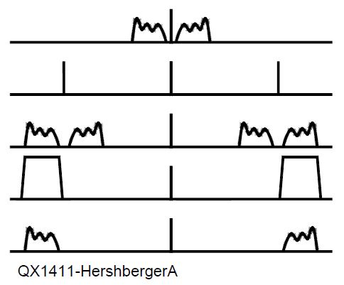
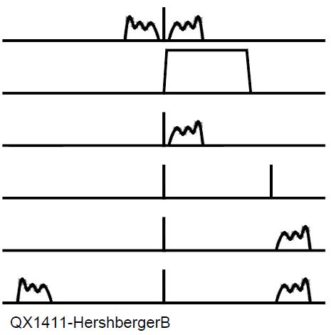
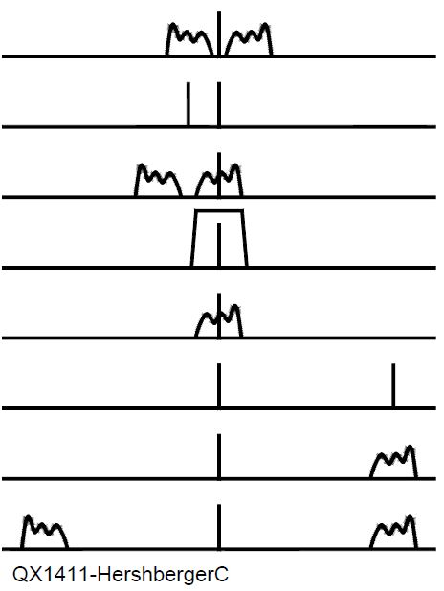
(D) Pitch Shift Algorithm[1] (Natalie)
Filter Method
Hilbert Transform Method
Weaver Method
Notes:
Explain the basic idea with block diagram
FIR Filter Bank, Hilbert, Complex Exponential Shift and Sum
D. L. Hershberger, "Controlled Envelope Single Sideband", American Radio Relay League QEX: A Forum for Communications Experimenters, December 2014.

Slide 4
(D) Filter Design (Natalie/Dave?)
FIR/IIR
Bode
frequency response plots

Slide 5
(M/D) FPGA Implementation (Natalie)
Data flow design, explain it with block diagrams
Take MATLAB generated coefficients into Xilinx
Present methodology for implementation as-is now, but also discuss concerns and other implementations that might be necessary.

Slide 6
(D) Filter Generation Process (Dave)
Dave’s MATALB automation stuff
Explain it with a Logic Flow diagram
Reload coefficients
Concern: Design theoretical vs realistic
Filter quantizations

Slide 7
(M) Software Testing (Dave)
iSim/xSim Waveforms
MATLAB Tests FFTs
Audibility
How do we know the algorithm works

Slide 8
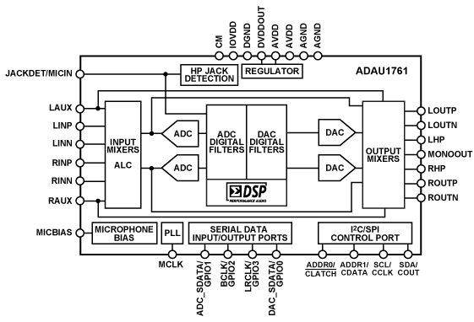
(D) Input/Output (Jon)

Slide 9
(M) Hardware Testing (Jon)
Maybe put the waveforms here??

Slide 10
(M) Pre-amplifier Electric Design (Jon)
Schematic + picture of current preamp

Slide 11
(M) System Performance Est. (Jon)
Software Performance
something
Hardware Performance
Something
Area utilization, pie/graph charts?
Speed optimization, pie/graph charts?

Slide 12
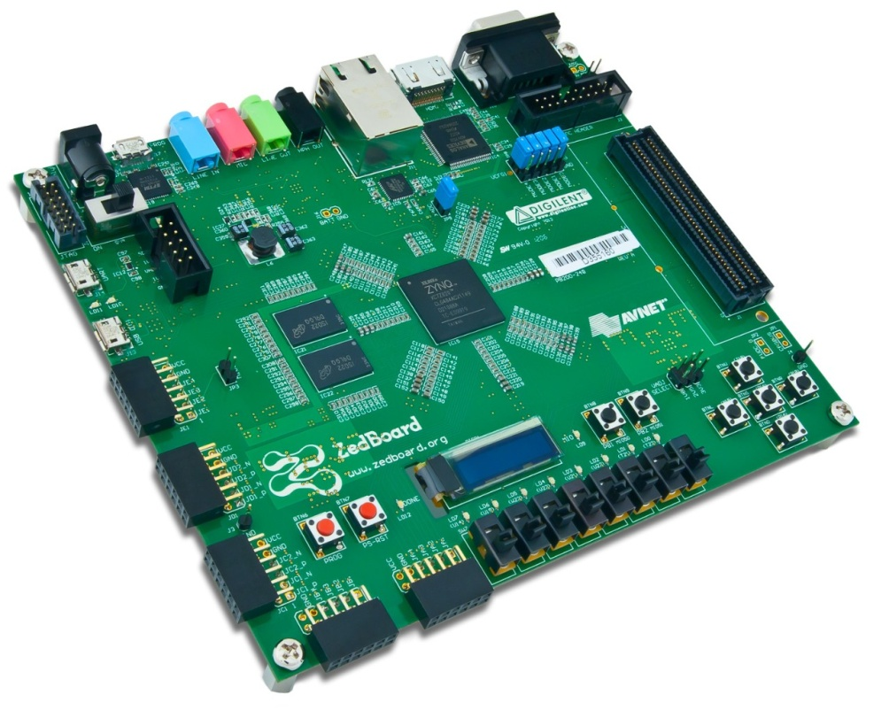
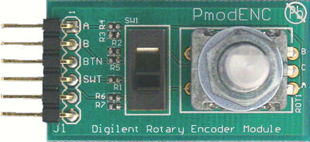
(D) User Interface Design (Matt)
Put a picture of a the pedal case, knobs, pedal …. (prob remove the pmod picture above).

Slide 13
(M) User Interface Design (Matt)
Detailed design ideas….
Schematic
Logic flow?
MUST mention the words “mechanical design”…

Slide 14
(D) Remaining Schedule (Matt)
Discuss what we accomplished and how for we have to go
Show GitHub Milestone list, if we add all our benchmarks to it, it’s basically our remaining schedule mapped out ☺

Slide 15
References
[1] D. L. Hershberger, "Controlled Envelope Single Sideband", American Radio Relay League QEX: A Forum for Communications Experimenters, December 2014.

