Slide 1


Axiomatic Hardware-Software Contracts for Security
Nicholas Mosier¹, Hanna Lachnitt¹, Hamed Nemati^{1,2}, Caroline Trippel¹
49th International Symposium on Computer Architecture – ISCA 2022
¹
²
Notes:
Hi, I'm Nick Mosier, and I’m a PhD student at Stanford University advised by Caroline Trippel.
Today, I’ll be presenting our work on designing new hardware-software contracts called “Leakage Containment Models” which expose microarchitectural leakage to software.

Slide 2


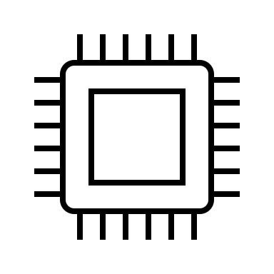






Hardware underpins software security
If one considers the union of all optimizations on this slide, no instruction operand/result or data at rest is safe [Vicarte+, ISCA’21].
Indirect memory prefetchers [Vicarte+, ISCA ‘21]
Subnormal floating point [Andrysco+, S&P ‘15]
DRAM
[Google Project Zero ‘15]
Register-file compression [Vicarte+, ISCA ‘21]
Caches
[Osvik+, CT-RSA ’06] [Yarom+, USENIX ’14]
Coherence
[Guanciale+, Oakland ‘16]
Compressed Caches [Tsai+, ISCA ‘20]
Silent stores [Vicarte+, ISCA ‘21]
Division early exit [Coppens, S&P ‘09]
Value prediction [Vicarte+, ISCA ‘21]
Digit-serial multiplication [Großschäd+, ISISC ‘09]
Speculation
[Kocher+, S&P ‘19]
Computation reuse [Vicarte+, ISCA ‘21]
OoO Execution
[Lipp+, USENIX ‘18]
Notes:
It’s becoming increasingly clear that the security of modern software ultimately depends on the hardware on which it is run.
*** Here's a sampling of hardware optimizations that can leak the data they process via hardware side channels.

Slide 3


Hardware underpins software security
memory models
hardware-software contracts
security contracts
Lay the foundation for LCMs!
Leakage Containment Models (LCMs)
Notes:
As a result, its critical that hardware designers expose security-relevant implementation details to application developers via hardware-software contracts.
*** In particular, we need security contracts to precisely define what information programs may leak when run on a particular microarchitecture.
*** In this work, we propose a new class of security contracts, called Leakage Containment Models, or LCMs for short.
*** And as I’ll demonstrate, memory consistency models lay the foundation for LCMs by defining a subset of a program’s execution behaviors .
--
TODO: maybe update titles like you had before
TODO: make sure you remove sound from slides

Slide 4
Roadmap
Background: Memory Consistency Models (MCMs)
Leakage Containment Models (LCMs): Modeling Microarchitectural Leakage
Clou: Detecting and Mitigating Microarchitectural Leakage in Programs
Notes:
Here’s a roadmap for the rest of the talk.
I’ll first provide background on memory consistency models.
Next, I'll present leakage containment models, a new security contract which we derive from MCMs, and I’ll demonstrate how we use LCMs to reason about microarchitectural leakage in programs.
Finally, I present Clou, a static analysis tool based on LCMs which we use to detect and mitigate microarchitectural leakage in crypto-libraries.
--
TODO: I shortened this

Slide 5







Execution Graph
instruction
control-flow
data-flow
Architectural Executions
MCMs:
Define the legal ordering + visibility of shared memory accesses
Axiomatic MCMs:
Model architectural executions of a program as directed graphs
Nodes: instructions
Directed edges: happens-before relations
Consistency predicate defines legal executions
Axiomatic Memory Consistency Model (MCM)
$$e_{0}$$
$$e_{4}$$
permitted
$$e_{3}$$
$$e_{2}$$
forbidden
$$e_{1}$$
Used by LCMs to define software-visible execution behaviors of a program
Consistency Predicate
Notes:
TODO: add pop-up
### As I'll show, we design leakage containment models by directly extending memory consistency models.
An MCM defines the legal ordering and visibility of shared memory accesses in a parallel program.
*** We're going to specifically consider axiomatic MCMs, which
*** model the architectural executions of a program as directed graphs.
Nodes represent instructions and edges represent types of happens-before relationships between instructions.
*** Axiomatic MCMs define a consistency predicate which partitions the space of all candidate program executions into those which are permitted and those which are forbidden.
*** MCMs will be useful for us because they encode the software-visible ways a program execute, which will be necessary for detecting microarchitectural leakage with LCMs.

Slide 6
Modeling program executions axiomatically with control- and data-flow happens-before relations
A; B;
if (cc) L1 else L2
control-flow
A
BR cc, L1, L2
BR cc, L1, L2
po
po
po
- or -
po
Encodes branch outcomes.
B
L1
L2
data-flow
dependencies
rf, co, fr
addr, data, ctrl
Encodes dynamic data-flow through memory.
Encodes syntactic data-flow through registers.
x = 0;
... = x;
x = 0;
x = 1;
... = A[x]
LD r1, [x]
ST [x], 0
ST [x], 0
addr
rf
co
...
...
...
Used later on for classifying leakage by severity
LD/ST r2, [A + r1]
LD r1, [x]
ST [x], 1
reads-from (rf) relates store→load if load reads from store
coherence order (co)
constructs a total order on same-address stores
address dependency (addr): relates load→access where accesses uses load in address computation
Notes:
Now I'll introduce the 3 most relevant categories of happens-before relations instantiated in the execution graphs of an axiomatic MCM.
*** First, there's a control-flow relation “program order”, or po for short.
It encodes the outcomes of branches in a particular execution of a program.
*** For example, sequential code results in a single instantiation of the po relation,
*** whereas a conditional branch results in two options for instantiating the po relation.
Next we have some data-flow relations which encode the dynamic flow of data between instructions through memory.
Two important ones are
*** Reads-from (or rf) relates a store to a load when the load reads the stored value.
*** Coherence order (or co) defines a total order on all stores to the same address.
*** Finally, dependency relations encode syntactic dependencies between memory instructions through registers.
We'll focus on address dependencies,
which occur when a load’s result is used to compute the address operand of a subsequent memory access.
*** Address dependencies will come in handy later when we’re trying to categorize microarchitectural leakage by severity.
--
TODO – more animations to help here, also dependencies should be in PO; pop up for “categorizing according to severity”

Slide 7
Roadmap
Background: Memory Consistency Models (MCMs)
Leakage Containment Models (LCMs): Modeling Microarchitectural Leakage
Clou: Detecting and Mitigating Microarchitectural Leakage in Programs
Notes:
Okay, so let’s break down a simple example of microarchitectural leakage so that we can see how the principles established by MCMs can help.

Slide 8
Microarchitectural data-flow enables leakage
Program 1
Program 2
y = A[x];
z = A[3];
Cache
Ingredients for modeling microarchitectural leakage:
Instructions exhibit >1 different executions.
Which execution is realized depends on hardware information flows.
y = A[3]
Address
Data
- | -
- | -
- | -
- | -
- | -
z = A[3]
Notes:
So why is microarchitectural leakage possible in the first place.
*** First, on modern hardware implementations, a single instruction can microarchitecturally execute in detectibly different ways.
For example, a memory access experiencing a cache miss versus a cache hit.
*** Second, which microarchitectural execution takes place for a given instruction typically depends on the outcomes of microarchitectural information flows.
*** For example, Program 1 is able to leak some information about the value of x to Program 2 when both programs share a cache.

Slide 9
Microarchitectural data-flow enables leakage
Program 1
Program 2
y = A[x];
z = A[3];
transmitter
Cache
Ingredients for modeling microarchitectural leakage:
Instructions exhibit >1 different executions.
Which execution is realized depends on hardware information flows.
y = A[3]
😇
A[3]
write
Address
Data
- | -
A+3 | ………………
- | -
- | -
- | -
microarchitectural
data-flow
read
😈
z = A[3]
receiver
cache hit (5 ns)
leaks: x = 3
Notes:
Suppose x = 3, so program 1 reads A[3].
This results in a microarchitectural write to the cachel ine that A[3] maps to.
*** Now suppose program 2 performs a read of A[3].
*** Program 2's read experienced a cache hit, and microarchitecturally read from the cache line written by Program 1.
*** This constitutes microarchitectural dataflow between program 1 and 2.
*** We call program 1's instruction a transmitter – it’s writing microarchitectural state as a function of its address operand .
We represent the transmitter with the angel emoji since it executes on behalf of the victim.
*** we call program 2's instruction a receiver, which microarchitecturally reads the address bits written into the cache by the transmitter.
We represent the receiver with a devil emoji since it's generally executes on behalf of the attacker.

Slide 10
Microarchitectural data-flow enables leakage
Program 1
Program 2
y = A[x];
z = A[3];
transmitter
Cache
Cache
y = A[3]
😇
A[3]
write
Address
Data
Address
Data
- | -
A+3 | ………………
- | -
- | -
- | -
y = A[5]
- | -
- | -
- | -
- | -
- | -
microarchitectural
data-flow
read
😈
z = A[3]
z = A[3]
receiver
cache hit (5 ns)
leaks: x = 3
Notes:
Now let's see what would've happened if x didn't equal 3. Say it equals 5.

Slide 11

Microarchitectural data-flow enables leakage
Program 1
Program 2
y = A[x];
z = A[3];
transmitter
😇
$$⊤$$
transmitter
Cache
microarchitectural
data-flow
Cache
y = A[3]
😇
A[3]
write
Address
Data
Address
Data
- | -
A+3 | ………………
- | -
- | -
- | -
y = A[5]
- | -
- | -
- | -
A+5 | ………………
- | -
microarchitectural
data-flow
write
read
😈
z = A[3]
z = A[3]
read
😈
receiver
receiver
cache hit (5 ns)
cache miss (50 ns)
leaks: x = 3
leaks: x ≠ 3
Notes:
In this case, Program 2 reads from a different cache line than the one written by Program 1,
*** experiencing a cache miss.
*** Instead, Program 2 microarchitecturally reads from the initial state of the cache.
### [Whichever access wrote the cache line is considered to be the transmitter instruction.]
*** In this case the attacker learns that x is not equal to 3.
Notably, an attacker can distinguish between the two microarchitectural data-flow scenarios by timing the latency of Program 2's load (to determine whether it was a cache hit or miss).
If there's a microarchitectural data-flow from program 1 to 2, the attacker learns that x = 3; otherwise, they learn x ≠ 3.

Slide 12
Microarchitectural control flow increases leakage scope
Spectre v1: Bounds Check Bypass
1:
// idx out-of-bounds if (idx < A_size) { char secret = A[idx];
tmp = B[secret];
}
mispredicted branch
2:
3:
4:
Modern hardware predicts branch outcomes and speculatively executes instructions along predicted paths.
Notes:
That was a simple example which demonstrated that microarchitectural data-flow is a key building block of leakage.
Now, let's take a look at how microarchitectural control-flow -- specifically transient execution -- can increase scope of what’s leaking.
Here is the canonical Spectre v1 gadget.
*** When the index is out-of-bounds, the bounds check on line 2 architecturally evaluates to false, but the hardware may predict that the index is in-bounds and speculatively execute the if-body.

Slide 13
Microarchitectural control flow increases leakage scope
Cache
Spectre v1: Bounds Check Bypass
Address
Data
1:
- | -
- | -
- | -
- | -
- | -
B+42 | ………………
- | -
- | -
- | -
- | -
// idx out-of-bounds if (idx < A_size) { char secret = A[idx];
tmp = B[secret];
}
mispredicted branch
2:
out-of-bounds load
3:
secret-dependent load
4:
😇
write
array B
microarchitectural
data-flow
void attacker() {
x = B[0];
x = B[1];
...
x = B[42];
}
read
😈
Cache hit! Leaks secret = 42
Modern hardware predicts branch outcomes and speculatively executes instructions along predicted paths.
Notes:
This can result in a speculative out-of-bounds access to array A, which may read a secret.
*** The secret may be used to index into array B
*** which causes the corresponding secret-dependent cache line to be written into the cache.
*** An attacker can subsequently probe the cache by loading each of the entries of B and timing each access to determine which load features a microarchitectural data-flow with the victim's transmitter.
The array index of such an entry reveals the secret value.

Slide 14


MCMs lay the foundation for LCMs but fall short for modeling microarchitectural leakage
$$⊤$$
rf
po
LD r0, [idx]
LD r1, [A_size]
BR r0 >= r1, end
LD r2, [A+r0]
LD r3, [B+r2]
rf
po
if (idx < A_size) { char secret = A[idx];
tmp = B[secret];
}
applying MCM axioms
po
To model microarchitectural leakage, we need:
Architectural semantics (MCMs)
Microarchitectural semantics (???)
transmitter
po
😇
microarchitectural data-flow (missing in MCMs)
LCMs
$$⊤$$
😈
receiver
MCMs do not capture microarchitectural control-flow or microarchitectural data-flow
… but they tell us how to construct a model that does!
Notes:
TODO: highlight top + bottom
Let’s see if we can use MCMs to detect the leakage we saw in the previous examples.
The graph on the right describes the Spectre execution we just saw.
*** The “top” symbol represents all initialization writes that precede the program’s execution.
*** The ”bottom” symbol represents an external receiver’s observation of all the microarchitectural writes due to the program’s execution.
*** looking at the execution graph, it’s not clear what, if anything, is leaking.
*** This is because MCMs only model architectural control- and data-flow, but we also need to reason about microarchitectural control- and data-flow to detect leakage.
----
We also saw that MCMs do capture *some* control- and data-flow relationships between instructions when they execute
So let's see if we can use axiomatic MCMs to detect the kinds of microarchitectural leakage we just saw.
The graph on the right describes the Spectre execution that we stepped through on the last slide.
The Top symbol is used to model all initialization accesses that precede the program’s execution, while the Bottom symbol represents all accesses on behalf of an external receiver that may detect microarchitectural state perturbations induced by the program’s execution.
Looking at the execution graph, it’s not clear what, if anything, is leaking.
This is because while MCMs do indeed model control- and data-flow they do so with respect to the *architectural* behavior of a program.
To model microarchitectural leakage, we need to additionally reason about microarchitectural control-/data-flow.
---
TODO: draw attention to “top” and “bottom” when you talk about them

Slide 15
Deriving a microarchitectural semantics from architectural MCMs
 | MCMs / LCMs Arch. Semantics | LCMs Microarch. Semantics
abstraction level | architecture | microarchitecture
communication medium | memory locations | xstate
control-flow | po | tfo
data-flow | rf, co | rfx, cox
legal executions | consistency predicate | confidentiality predicate
encodes software-visible executions
encodes hardware-specific executions
Notes:
In a nutshell, LCMs leverage both an architectural and microarchitectural semantics to support automatically reasoning about hardware-induced leakage in programs.
*** The architectural semantics describe the software-visible ways in which programs can execute, and it's directly borrowed from MCMs.
*** The microarchitectural semantics describe the hardware-specific ways in which programs can execute. This microarchitectural semantics is new in this work and features all of the components highlighted in yellow here.
*** Since we can't cover every new LCM primitive in this talk, we’ve decided to focus on describing how LCMs model microarchitectural data-flow between instructions similar to how MCMs model architectural dataflow.
--

Slide 16






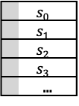
LCMs model microarchitectural data-flow through xstate
xstate¹: any non-architectural state in a microarchitecture
xstate variables represent hardware state elements which:
facilitate microarchitectural data-flow between instructions
be read from and written to by instructions
Instructions may read and/or write xstate variable(s)
xstate facilitates microarchitectural dataflow
microarchitectural
data-flow
😇
write
- | -
A+3 | ………………
- | -
- | -
- | -
rfx “reads-from xstate”
$$s_{0}$$
read
😈
xstate examples
LD r2, [$A_{0}$] $\left\{{s_{0}}_{}^{R}\right\}$
hit
 | $$s_{0}$$
 | $$s_{1}$$
 | $$s_{2}$$
 | $$s_{3}$$
 | …
$$s_{0}$$
$$s_{0}$$
LD r2, [$A_{1}$] $\left\{{s_{1}}_{W}^{R}\right\}$
$$s_{1}$$
$$s_{1}$$
miss
$$s_{2}$$
$$s_{2}$$
…
$$s_{3}$$
caches
…
branch predictors
Image source: Evtyushkin+ SIGPLAN’18
…
load-store queue
¹ The term extra-architectural state was coined in prior work [Lowe-Power+ HASP’18]; however, we assign it a different meaning in this paper.
We’ll only focus on modeling cache xstate in this presentation.
Notes:
TODO: add footnote about xstate from paper
Specifically, LCMs rely on an abstraction of microarchitectural state called xstate.
*** xstate consists of any non-architectural state in a microarchitecture.
*** More specifically, we're interested in microarchitectural state elements which can facilitate dataflow between instructions.
These are elements are read from by some instructions and written to by others.
*** We can abstract away the implementation details of xstate by referring to particular groups of xstate elements via symbolic xstate variables.
*** Some examples of xstate variables are
*** cache lines,
*** branch predictor entries,
*** load-store-queue entries,
*** and so on.
Along with identifying relevant groups of xstate, an LCM defines under what execution contexts instructions read or write xstate.
*** For example, an LCM modeling cache xstate would say these load instructions access different xstate if their address operands map to distinct cache lines.
*** If a load experiences a cache hit, it only reads xstate.
*** If it's a miss, it reads and writes xstate.
In the paper, we introduce new microarchitectural data-flow relations that model data-flow through xstate.
*** One such relation is rfx, short for “reads-from xstate”, which relates xstate writes to subsequent xstate reads.
*** For this talk, we’ll just focus on modeling leakage via cache xstate.
But keep in mind LCMs can model arbitrary xstate, and we consider more than just cache xstate in the paper.
---
TODO, more animations, also

Slide 17
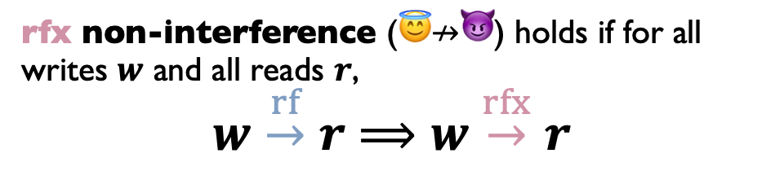
Detecting Leakage in Programs with LCMs
Key idea: apply the standard notion of conditional non-interference using rf and rfx to represent architectural and microarchitectural observations, respectively.
High level leakage definition:
else, microarchitectural leakage
architectural
non-interference
microarchitectural
non-interference
⟹
Observation: searching for instances of microarchitectural leakage in programs can be reduced to searching for violations of three non-interference rules.
Example rule:
rfx non-interference (😇$↛$😈) holds if for all writes $w$ and all reads $r$,
$$w\overset{rf}{\underset{}{→}}r⟹w\overset{rfx}{\underset{}{→}}r$$
😇
😈
Else, there is an interfering transmitter $w^{′}$ where $w^{′}\overset{rfx}{→}r$
Notes:
TODO: say more crisply – looking forexecutionswher earch. non-inerference hold but microarchitectural non-interference doesn’t
LCMs provide a way to model the various architectural and microarchitectural executions of a program.
At a high level, we can detect microarchitectural leakage by finding executions where architectural non-interference holds but microarchitectural non-interference doesn’t.
*** Note that we derive this leakage definition from the standard notion of conditional non-interference, using rf and rfx to represent architectural and microarchitectural observations.
*** In the paper we observe that searching for such violations of this leakage definition can be reduced to searching for violations of 3 non-interference rules.
*** One such rule is called “rfx non-interference”,
which holds for a particular microarchitectural execution if every rf edge is matched by a consistent rfx edge.
Concretely, *** if some write w sources some read r architecturally, *** w should source r microarchitecturally though the cache in the absence of interference.
*** Otherwise, there’s some interfering transmitter w’ causing leakage.

Slide 18




rfx non-interference detects Spectre v1 leakage
Architectural execution
Microarchitectural execution
$$⊤$$
$$⊤$$
rf
rfx
cox
po
tfo
po
tfo
po
tfo
LD r0, [&idx]
LD r1, [&A_size]
BR r0 >= r1, end
LD r2, [array1+r0]
LD r3, [array2+r2]
LD r0, [&idx] {s0}
LD r1, [&A_size] {s1}
BR r0 >= r1, end
LD r2, [A+r0] {s2}
LD r3, [B+r2] {s3}
po
tfo
rfx
tfo
$$⊥$$
$$⊥$$
tfo
Transient fetch order (tfo) is used to model transient execution paths of a program.
Notes:
Let’s apply rfx non-interference to the Spectre v1 example.
On the left is an architectural execution graph; on the right is a possible corresponding microarchitectural execution graph.
----
TODO – why can’t you go back while presenting?

Slide 19
rfx non-interference detects Spectre v1 leakage
Architectural execution
Microarchitectural execution
$$⊤$$
$$⊤$$
rf
rfx
cox
po
😇
tfo
po
rfx non-interference violation
😇
tfo
po
tfo
LD r0, [&idx]
LD r1, [&A_size]
BR r0 >= r1, end
LD r2, [array1+r0]
LD r3, [array2+r2]
LD r0, [&idx] {s0}
LD r1, [&A_size] {s1}
BR r0 >= r1, end
LD r2, [A+r0] {s2}
LD r3, [B+r2] {s3}
po
tfo
😇
rfx
tfo
😇
$$⊥$$
$$⊥$$
tfo
😈
Transient fetch order (tfo) is used to model transient execution paths of a program.
Notes:
TODO: remove arrow animation
Now, consider the dashed rf edge on the left from Top to Bottom.
It doesn't have a corresponding rfx edge in the right graph.
*** Instead, the Bottom symbol – which represents a receiver – reads xstate from four loads in the microarchitectural execution, resulting in leakage.

Slide 20
rfx non-interference detects Spectre v1 leakage
Architectural execution
Microarchitectural execution
$$⊤$$
$$⊤$$
rf
rfx
cox
po
😇
tfo
po
rfx non-interference violation
😇
tfo
po
tfo
LD r0, [&idx]
LD r1, [&A_size]
BR r0 >= r1, end
LD r2, [array1+r0]
LD r3, [array2+r2]
LD r0, [&idx] {s0}
LD r1, [&A_size] {s1}
BR r0 >= r1, end
LD r2, [A+r0] {s2}
LD r3, [B+r2] {s3}
po
tfo
😇
rfx
tfo
😇
$$⊥$$
$$⊥$$
tfo
😈
Transient fetch order (tfo) is used to model transient execution paths of a program.
Notes:
Since the cache xstate accessed by a load instruction depends on its address, these loads leak a function of their address operand.
In the paper, we call these four load instructions xstate transmitters or more specifically "address transmitters".

Slide 21

A taxonomy for classifying transmitters by severity
Spectre v1 leaks arbitrary data in memory
microarchitectural execution
$$⊤$$
int victim_function(int idx) {
// index out-of-bounds if (idx < A_size) { uint8_t secret = A[idx];
return B[secret];
}
return 0;
}
😇
tfo
address transmitter (!)
LD r0, [&idx] {s0}
addr
tfo
😇
LD r1, [&A_size] {s1}
address transmitter (!)
addr
tfo
(!!!)
BR r0 >= r1, end
addr
😇
tfo
address transmitter (!)
LD r2, [A+r0] {s2}
tfo
addr
😇
LD r3, [B+r2] {s3}
address transmitter (!)
Taxonomy
tfo
address transmitter | (!) | 0 addr
data transmitter | (!!) | 1 addr
universal data transmitter | (!!!) | 2 addr
😈
$$⊥$$
(!)
rfx
😇
😈
address
transmitter
receiver
Notes:
So we just saw that LCMs flag all four loads in Spectre as
*** “address transmitters”.
However, Spectre is interesting not because it features address leakage but because it features leakage of arbitrary data at rest in memory.
The challenge is, how can we augment LCMs to distinguish between these different kinds of leakage?
In the paper, we introduce a new taxonomy for classifying cache xstate transmitters by their severity using address dependencies provided by MCMs.
*** Here are the two address dependencies present in Spectre.
*** We define three classes of transmitters based on the number of address dependencies we can trace back from the transmitter.
*** We’ve already discussed the first and least severe kind, called “address transmitters”, which are memory instructions that leak their address operand through cache xstate.
*** Now, note that since an address transmitter leaks its address operand, it also leaks the data sources used to compute that address.
This is exactly what address dependencies encode.

Slide 22
A taxonomy for classifying transmitters by severity
Spectre v1 leaks arbitrary data in memory
microarchitectural execution
$$⊤$$
int victim_function(int idx) {
// index out-of-bounds if (idx < A_size) { uint8_t secret = A[idx];
return B[secret];
}
return 0;
}
tfo
address transmitter (!)
LD r0, [&idx] {s0}
addr
tfo
🎯
LD r1, [&A_size] {s1}
address transmitter (!)
addr
tfo
(!!!)
BR r0 >= r1, end
addr
😇+🎯
tfo
data transmitter (!!)
LD r2, [A+r0] {s2}
tfo
addr
😇
LD r3, [B+r2] {s3}
data transmitter (!!)
Taxonomy
tfo
address transmitter | (!) | 0 addr
data transmitter | (!!) | 1 addr
universal data transmitter | (!!!) | 2 addr
😈
$$⊥$$
(!!)
(!)
addr
rfx
🎯
😇
😈
secret access
data
transmitter
receiver
Notes:
Therefore, if we can trace back one address dependency from an address transmitter, we classify it as a ”data transmitter” that leaks the data source of the dependency, which we refer to here as a "secret access".
*** In Spectre, the third and fourth loads are data transmitters.
Data transmitters still have limited severity, since they only leak one fixed secret.

Slide 23
A taxonomy for classifying transmitters by severity
Spectre v1 leaks arbitrary data in memory
microarchitectural execution
$$⊤$$
int victim_function(int idx) {
// index out-of-bounds if (idx < A_size) { uint8_t secret = A[idx];
return B[secret];
}
return 0;
}
🏹
tfo
address transmitter (!)
LD r0, [&idx] {s0}
addr
tfo
LD r1, [&A_size] {s1}
address transmitter (!)
addr
tfo
(!!!)
BR r0 >= r1, end
addr
🎯
tfo
data transmitter (!!)
LD r2, [A+r0] {s2}
tfo
addr
😇
LD r3, [B+r2] {s3}
universal data transmitter (!!!)
Taxonomy
tfo
address transmitter | (!) | 0 addr
data transmitter | (!!) | 1 addr
universal data transmitter | (!!!) | 2 addr
😈
$$⊥$$
(!!!)
(!!)
(!)
addr
addr
rfx
🏹
🎯
😇
😈
attacker
index
secret access
universal data
transmitter
receiver
Notes:
However, if we can trace back an additional address dependency from a data transmitter, this means an attacker can control the address of which accessed secret is leaked, pointing it to any arbitrary location.
We call this a universal data transmitter, arguably the most severe kind of cache xstate transmitter.
*** The fourth load is a universal data transmitter that causes Spectre's leakage of arbitrary data at rest in memory.
LCMs and tools that use them are able to differentiate between these different categories of leakage.

Slide 24
Roadmap
Background: Memory Consistency Models (MCMs)
Leakage Containment Models (LCMs): Modeling Microarchitectural Leakage
Clou: Detecting and Mitigating Microarchitectural Leakage in Programs
Notes:
LCMs can help us reason about the susceptibility of a program to microarchitectural leakage in an automated manner.
To demonstrate this, we built a static analysis tool called Clou, which can detect and mitigate microarchitectural leakage in programs.

Slide 25







Clou: detecting and and mitigating speculative leakage with LCMs
configuration parameters
witness executions
symbolic abstract event graph
leakage detection engine
fence insertion
{}
source
LLVM-IR
repaired LLVM-IR
executable
clang
set of transmitters
hard-coded LCM
SMT solver
single-core, speculative, out-of-order, cache, ROB, LSQ
Notes:
Clou is implemented as an LLVM compiler pass for detecting speculative data transmitters and speculative universal data transmitters in programs.
As input, Clou accepts
*** C source code and
*** compiles it with "clang" into IR.
*** Next, Clou constructs a symbolic abstract event graph using a
*** hard-coded LCM and
*** configuration parameters.
*** The hard-coded LCM we study in the paper models a single-core, speculative, out-of-order microarchitecture with a cache, re-order buffer, and load-store queue.
*** Next, Clou passes the symbolic abstract event graph to the leakage detection engine, which queries an
*** SMT solver to find leakage.
After leakage detection, Clou can output
*** a set of witness executions exhibiting leakage and the
*** set of transmitters found.
Next, Clou repairs all discovered leaks through
*** fence insertion, to produce
*** repaired executable.

Slide 26
Clou is fast, scalable, and has found bugs in real-world code
Detects all leakage in benchmarks: PHT, STL, FWD, NEW
More scalable than previous tools:
Binsec/Haunted [Daniel+ NDSS21]
Pitchfork [Cauligi+ PLDI20])
Reported 7 new Spectre v4 vulnerabilities in Libsodium
Reported 5 new Spectre v1 vulnerabilities in OpenSSL
Runtimes (universal data leakage)
Benchmarks | BH runtime (s) | Clou runtime (s)
PHT | 20.9 | 2.8
STL | 6.1 | 4.3
FWD | 589.3 | 4.1
NEW | 32.5 | 1.0
tea | 18.8 | 1.14
donna | TO | 112052
secretbox | TO | 1008
ssl3-digest | TO | 1318
mee-cbc | TO | 95900
Crypto-library Analysis (universal data leakage)
Crypto library | % Functions analyzed | % LOC analyzed
libsodium API | 100% | 100%
OpenSSL API | 90% / 81% | 58% / 60%
Notes:
Clou successfully detects all universal data leakage in the 4 Spectre benchmark suites we evaluate.
*** Our experiments show that Clou is more scalable than the state-of-the-art tools for finding speculative leakage in programs.
*** We also ran Clou on two real-world crypto-libraries, [searching specifically for speculative universal data transmitters].
Clou analyzed libsodium’s API to completion and discovered 7 new Spectre v4 vulnerabilities.
*** Clou analyzed the majority of OpenSSL’s API and discovered 5 new Spectre v1 vulnerabilities, one of which appears to be exploitable.

Slide 27
LCMs: Additional Topics*
Universal control transmitters and control transmitters
Full non-interference definition
LCMs capture leakage on behalf of Spectre v4, Spectre-PSF, Indirect Memory Prefetchers, Silent Stores
fr, frx relations
Clou optimizations
Subrosa toolkit for formal LCM development and analyses
*Nicholas Mosier, Hanna Lachnitt, Hamed Nemati, and Caroline Trippel. “Axiomatic Hardware-Software Contracts for Security”. ISCA 2022.
Notes:
Please see the paper for more topics which we didn’t have time to cover here.
----
Here's a brief list of some of the topics we haven't been able to cover that are in the paper.
LCMs can also classify transmitters that leak secrets through control-flow.
We also provide a full non-interference definition for all data-flow relations.
We also demonstrate how LCMs can capture leakage on behalf other optimizations besides caches.
Finally, the paper presents LCMs’ full axiomatic vocabulary.

Slide 28
Key Takeaways
Microarchitectural data- and control-flow are key building blocks of microarchitectural leakage
LCMs support reasoning about the security implications of hardware on software with a leakage definition based on conditional non-interference
LCMs support classifying transmitters according to leakage scope/severity
Clou discovered 7 new Spectre v4 vulnerabilities in libsodium
Clou discovered 5 new Spectre v1 vulnerabilities in OpenSSL, confirmed by developers: https://www.openssl.org/blog/blog/2022/05/13/spectre-meltdown/
Nicholas Mosier, Hanna Lachnitt, Hamed Nemati, and Caroline Trippel. 2022. Axiomatic Hardware-Software Contracts for Security. In The 49th Annual International Symposium on Computer Architecture (ISCA ’22). https: //doi.org/10.1145/3470496.3527412
Title: “Axiomatic Hardware-Software Contracts For Security”
GitHub: nmosier/clou, nmosier/clou-bugs, ctrippel/subrosa
Email: nmosier@stanford.edu
Notes:
To conclude, we presented LCMs, a new hardware software contract for exposing microarchitectural leakage to software.
Using LCMs, we built Clou which found new Spectre vulnerabilities in Libsodium and OpenSSL, the latter of which were confirmed by developers.
Clou is open source, as well as Subrosa, which is a toolkit for simulating user-defined LCMs.
Thanks for listening. I’m now happy to take any questions.

Slide 30
Appendix Table of Contents
Clou: OpenSSL Vulnerability
Prior Security Contract Proposals
Modeling AES Side-Channel Leakage
Modeling Other Optimizations with LCMs
Clou: Results and Runtimes
Non-Interference / Microarchitectural Leakage Definitions
Microarchitectural Control-Flow Semantics
Microarchitectural Data-Flow Semantics
Clou: Additional Topics
Clou: New Type of Leakage
Axiomatic MCMs Ecosystem

Slide 31


Clou: OpenSSL Vulnerability
$$⊤$$
int SSL_get_shared_sigalgs(SSL *s, int idx,
int *psign, int *phash, int *psignhash,
unsigned char *rsig, unsigned char *rhash)
{
const SIGALG_LOOKUP *shsigalgs;
if (s->shared_sigalgs == NULL
|| idx < 0
|| idx >= (int)s->shared_sigalgslen
|| s->shared_sigalgslen > INT_MAX)
return 0;
shsigalgs = s->shared_sigalgs[idx];
if (phash != NULL)
*phash = shsigalgs->hash;
...
}
rf
// branch misprediction
addr
🏹
// secret accessed
🎯
addr
// secret leaked to cache
😇
rfx
$$⊥$$
😈
Notes:
Here is the vulnerability we found in OpenSSL.
This is a public API function featuring a classic Spectre v1 vulnerability.
Here there is branch on a bounds check of an attacker-controlled index.
If the hardware mispredicts the branch outcome, this results in the if-body being executed on an out-of-bounds index,
so that this array access speculatively reads from an attacker-controlled memory location containing a secret.
This secret is then leaked here when it is dereferenced as a pointer.
Finally, this vulnerability was confirmed by OpenSSL and will be covered in an upcoming blog post!

Slide 32
Clou: libsodium Vulnerabililty
static int
_sodium_base642bin_skip_padding(const char * const b64, const size_t b64_len,
size_t * const b64_pos_p,
const char * const ignore, size_t padding_len)
{
int c;
while (padding_len > 0) {
if (*b64_pos_p >= b64_len) {
errno = ERANGE;
return -1;
}
c = b64[*b64_pos_p]; // <<< speculative store bypass
if (c == '=') {
padding_len--;
} else if (ignore == NULL || strchr(ignore, c) == NULL) {
errno = EINVAL;
return -1;
}
(*b64_pos_p)++;
}
return 0;
}

Slide 33
Prior Security Contract Proposals
Proposed Contracts | Requires hardware enhancements | Restrict scope of hardware features | Solely expose transient leakage | Based on operational models
Cheang+ IEEE CSF19 |  | X | X | X
Disselkoen+ IEEE S&P19 |  | X | X
Mcilroy+ ARXIV19 |  | X | X | X
Yu+ NDSS19 | X |  |  | X
Zagieboylo+ CSF19 | X |  |  | X
Guarnieri+ IEEE S&P20 |  | X | X | X
Vassena+ ACM PL21 |  | X | X | X
Mosier+ ISCA22 |  | X
Notes:
Many researchers have recognized the need for security contracts, putting forth a variety of contract proposals summarized on this slide.
Some require hardware enhancements to explicitly track/enforce contract-level security primitives.
Other contracts restrict the scope of hardware features that they consider, for example, focusing on in-order or single-core processors.
Most state-of-the-art security contracts solely expose transient leakage through microarchitecture to.
Finally, most security contract contenders are based on operational models of processor designs which pose verification challenges.
In this work, we propose a new class of security contracts, called Leakage Containment Models, or LCMs for short. LCMs do not require hardware modifications and support automatically reasoning about both transient and non-transient leakage. They are designed support both out-of-order and multi-core microarchitectures. And most importantly, we choose to encode LCMs as axiomatic models.
We chose to define LCMs axiomatically, as opposed to operationally, since recent work has proposed a promising approach for synthesizing similar axiomatic models of hardware from RTL automatically. I will explain what axiomatic LCMs look like in more detail momentarily.

Slide 34
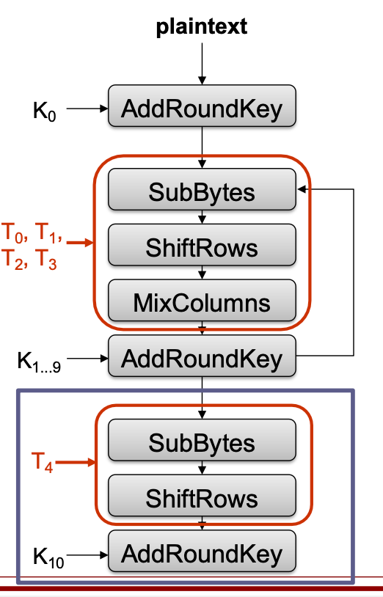

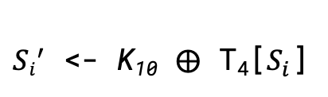
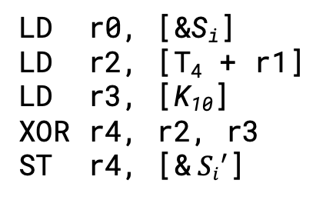
Modeling AES Side-Channel Leakage
S_{i} : ith byte of state after first 9 rounds (secret)
⊤
rf
po
tfo
LD r1, [&S_{i}] LD r2, [T₄ + r1] LD r3, [&K₁₀] XOR r4, r2, r3 ST r4, [& ${Si}^{′}$]
Pseudo-code
🎯
${Si}^{′}$ <- K₁₀ ⨁ T₄[$S_{i}$]
rfx
addr
po
tfo
😇
po
tfo
Assembly
LD r0, [&S_{i}] LD r2, [T₄ + r1] LD r3, [K₁₀] XOR r4, r2, r3 ST r4, [& ${Si}^{′}$]
po
tfo
data
po
tfo
po
tfo
⊥
3 address transmitters – benign
1 data transmitter – leaks secret!
😈
Notes:
----
T_4[secret] – addr dep
for (i = 0; i < len; ++i) {
state[i] = key[ state[i]
}
For each byte:
C:
state_i = round_key_10 \oplus T_4[state_i]
Assembly:
LD r1, [state_i]
LD r2, [T_4 + r1], r2
LD r3, [round_key_10]
XOR r4, r2, r3
ST r4, [state_i]
addr

Slide 35
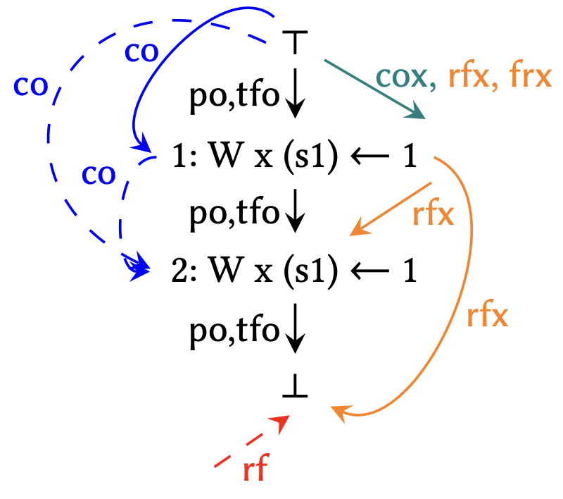
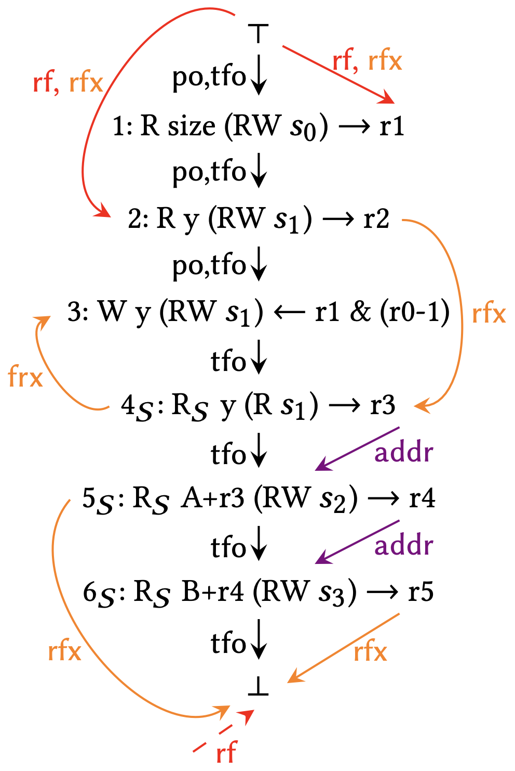
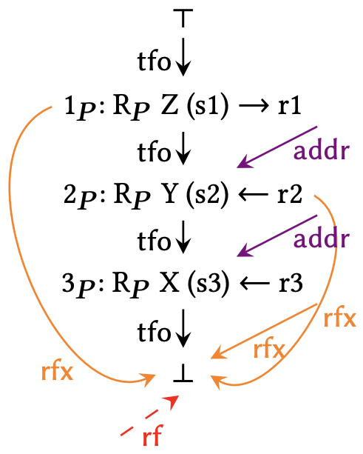
Modeling Other Optimizations with LCMs
Microarchitectural control-flow
Speculative store bypass (Spectre v4)
Indirect branch prediction (Spectre v2)
Predictive store forwarding (Spectre PSF)
Microarchitectural data-flow
Prefetching
Indirect Memory Prefetcher [Yu+ MICRO’15]
Branch predictor
Pattern History Table [Evtyushkin+ ASPLOS’18]
Branch Target Buffer
Micro-op cache [Ren+ ISCA’21]
Port contention
AVX
Silent stores [Lepak+ ISCA’00]
Silent Store
Spectre v4
Indirect Memory Prefetcher
Notes:
TODO: citation for AVX, micro-op cache
https://martinschwarzl.at/media/files/netspectre.pdf
https://ieeexplore.ieee.org/document/9499837

Slide 36
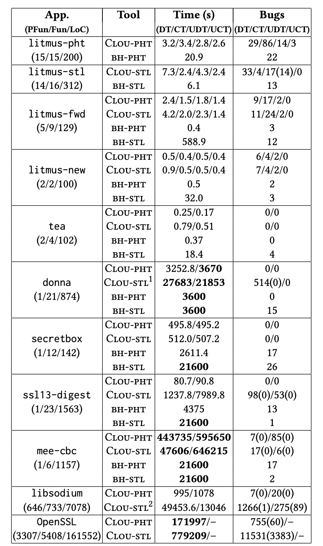
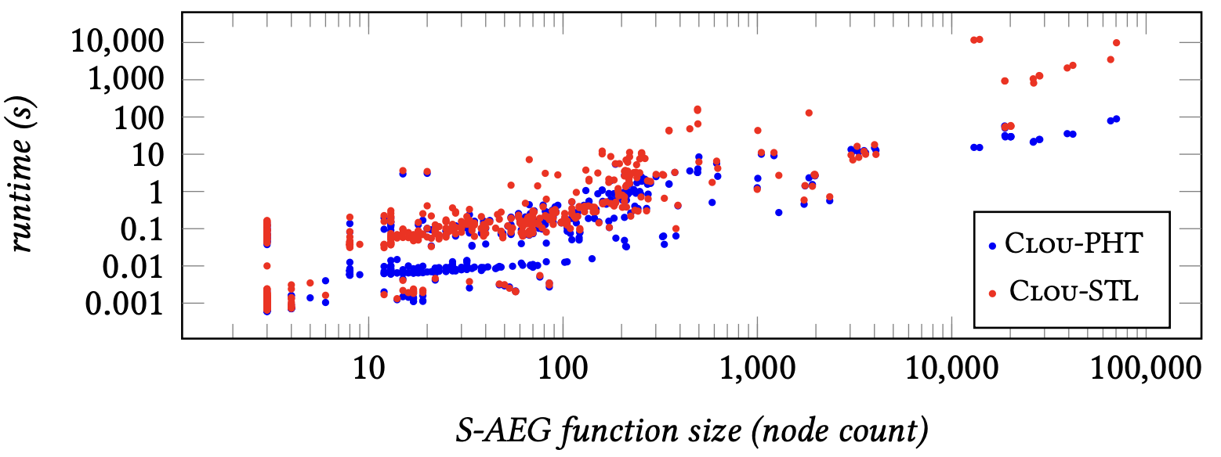
Clou Results
Serial CPU runtime vs. function size for Clou’s libsodium analysis (no functions time out)
Clou’s performance on various crypto benchmarks and libraries
Notes:
TODO: Backup slide with other cloue results, like the runtimes for libsodium functions

Slide 37
Non-interference
Definition 1: Non-interference. Given a state machine M, and its subjects S and S’, we say that S does not interfere with (or is non-interfering with) S’, if the actions S on M do not affect the observations of S’.
x = 0;
... = x;
Memory-related non-interference:
subjects S and S’ can perform actions {R loc, W loc},
the only shared memory locations between S and S’ are read-only (RO), and
subjects make architectural observations through rf edges involving actions.
ST [x], r2
rf
...
LD r1, [x]
reads-from (rf) relates store→load if load reads from store
Notes:
To make this point a bit more clear, and explain why we need both an arch/microarch semantics, let’s define microarchitectural leakage using the concept of non-interference.
We say that given a state machine M, and its subjects S and S’, S does not interfere with (or is non-interfering with) S’, if the actions S on M do not affect the observations of S’.
In this work, we’ve decided to focus on modeling/detecting microarchitectural leakage on behalf of hardware memory systems optimizations.
We can map this non-interference definition onto this modeling context as follow.
subjects S and S’ can perform actions {R loc, W loc},
the only shared memory locations between S and S’ are read-only (RO), and
subjects make architectural observations through rf edges involving actions.
---
Given a state machine M, and its subjects S and S’, if S is non-interfering with S’, then there is no information flow from S to S’.

Slide 38
Microarchitectural Leakage
Definition 2: Architectural non-interference (ArchNI). S is architecturally non-interfering with S’ if the actions of S do not affect the placement of rf edges involving the actions of S’.
Definition 3. Microarchitectural leakage. S does not exhibit microarchitectural leakage with respect to S’ if:
ArchNI(S, S’) → μArchNI(S, S’)
We need: a way to define microarchitectural non-interference (μArchNI) so that we can define and reason about microarchitectural leakage.
Notes:
More specifically, we can call this property we just defined “architectural non-interference” since it relies on the architectural observation-relation rf.
We say that S does not exhibit microarchitectural leakage with respect to S’ if:
ArchNI(S, S’) → μArchNI(S, S’)
Where this second term is microarchitectural non-interference.
Basically we need some way to define microarchitectural non-interference so that we can reason about microarchitectural leakage.

Slide 39
Microarchitectural control-flow semantics model transient execution
microarchitectural control-flow
tfo
Encodes the transient and non-transient instruction stream.
if (cc) L1 else L2
non-transient
(same as po)
BR cc, L1, L2
BR cc, L1, L2
tfo
tfo
L1
L2
L1
L2
BR cc, L1, L2
BR cc, L1, L2
transient
(diverges from po)
tfo
po
po
tfo
legend
L1
L2
L1
L2
transient execution
tfo
tfo
Notes:
We're going to define a new control-flow relation called "tfo" -- stands for transient fetch order.
For non-transient instructions, tfo behaves the same as po from MCMs.
When instructions are executed transiently, and not committed, it behaves differently.
Allows us to simulate speculative execution behavior of a program.

Slide 40




Microarchitectural data-flow semantics model information flow through xstate
microarchitectural data-flow
rfx, cox, frx
Encodes dynamic data-flow through xstate.
... = x;
x = ...;
... = x;
x = ...;
LD r1, [A] $\left\{{s_{0}}_{W}^{R}\right\}$
LD r1, [A] $\left\{{s_{0}}_{W}^{R}\right\}$
fr
...
rfx
fr
...
rfx
ST r1, [A] $\left\{{s_{0}}_{W}^{R}\right\}$
cox
ST r1, [A] $\left\{{s_{0}}_{W}^{R}\right\}$
cox
xstate reads-from (rfx) relates an xstate write to an xstate read that it sources
xstate coherence order (cox)
constructs a total order on same-xstate writes
A confidentiality predicate constrains the legal placement of tfo, rfx, cox edges.
Notes:
An LCM's microarchitectural data-flow semantics model information flow between instructions through xstate.
There are 3 microarchitectural data-flow relations -- we'll only discuss the first two for now -- rfx and cox.
An rfx edge relates an xstate write to an xstate read that it sources.
In this example, a load and a store are accessing the same cache line s0. The load is a cache miss so it acts as a read-modify-write of s0, and the store is a cache hit so it reads the value of s0 written by the load.
Note that there isn't a corresponding rf edge at the architectural level, since stores do not read from loads through memory -- but here we see that stores can in fact microarchitecturally read from loads through cache xstate.
The cox relation defines a total order on writes to the same xstate.
These are the same instructions as before.
Because the store is writing new data into the cache xstate s0, it acts as an xstate write.
Again, note that there isn't a corresponding co edge because of a mismatch of how loads behave architecturally vs microarchitecturally.
Like MCM's consistency predicate, LCM's confidentiality predicate defines the legal placement of microarchitectural control-flow + data-flow edges in an execution graph and thus the legal microarchitectural executions.

Slide 41
Revisiting Microarchitectural Leakage
Definition 2: Architectural non-interference (ArchNI). S is architecturally non-interfering with S’ if the actions of S do not affect the placement of rf edges involving the actions of S’.
Definition 3: Microarchitectural non-interference (μArchNI). S is microarchitecturally non-interfering with S’ if the actions of S do not affect the placement of rfx edges involving the actions of S’.
Memory-related non-interference:
subjects S and S’ can perform actions {R loc (RW xs), R loc (R xs), W loc (RW xs)},
the only shared memory locations between S and S’ are read-only (RO),
subjects make architectural observations through rf edges involving actions, and
subjects make microarchitectural observations through rfx edges involving actions
Notes:
So coming back to this leakage definition from before, we can now define uarch interference.

Slide 42
Clou: Additional Topics
Optimizations for detecting universal data leakage: sliding window, partial executions, lazy S-AEG construction, addr_gep edges
Parametrizable by dimensions of microarchitectural structures: reorder buffer size, load-store queue size
Program abstraction techniques: function inlining, alias analysis, loop summarization
Soundness and completeness guarantees and limitations: unchecked pointers assumption, external function calls, unsound aliasing, unsound control-flow, inline assembly, data dependency limit
Notes:
Here are some additional topics on Clou that we skipped over.
First, there are numerous optimizations under the hood that make Clou scalable.
Clou has runtime parameters that model the hardware and control leakage detection.
Also, we leverage program abstraction + simplification techniques to make the analysis more tractable.
Finally, Clou guarantees under certain conditions soundness + completeness but also has some limitations.
We have some additional slides on these topics we can show later if there's time, if anyone is interested.

Slide 43
Clou discovered new types of leakage
New Spectre v1.1 variant: int *ptr = …; if (x < A_size) A[x] += secret; *ptr = 0;
Combination of Spectre v1.1 + Spectre v4 int *p = …; *p = secret; A[x] = 0;
New speculative interference attack variant: int idx = …; int **A_size = …; if (idx < **A_size) { // prefetches **A_size … = A[idx]; }

Slide 44



Axiomatic MCMs have spawned an ecosystem of tools and research
SC, TSO, ARM memory model
Java, C11, OpenCL
Weak MCM
ISA MCM
weak MCM
verified microarchitectural implementation
verified compiler mappings
automatic fence insertion
https://check.cs.princeton.edu/
MCM
Ongoing work!
strong MCM
microarchitecture
sequential consistency
x86-TSO, Power, Armv7, Armv8, RVWMO, RVTSO, NVIDIA PTX
Deriving LCMs from MCMs gives us access to similar techniques!
Notes:
TODO: animation
Axiomatic MCMs have given rise to an ecosystem of tools and research.
*** Research has verified compiler mappings from memory accesses in high-level languages down to architectural MCMs.
*** There’s ongoing work in verifying that a microarchitecture correctly implements an MCM.
*** Program analysis tools have also been developed that perform automatic fence insertion to ensure a program obeys a strong MCM when running on a weak MCM.
*** Since our new security contract, LCMs, are derived from MCMs, we apply this ecosystem of MCM research to the security domain!

