Slide 1
Michels IT Resource Center Website
Presented by :
Senior Safe

Slide 2


Our Team:
Nahin mousa :
business Analyst
Project Coordinator
ui/ux lead
Gabrielle Williams : Technical analyst
qa ANALYST

Slide 3
Root problems & Business Impact
Slower IT resolution times.
Reduced productivity.
High volume of repetitive IT questions.
Risk of using outdated documents.
Unclear and unfriendly
user site
Outdated documents or difficult to navigate
No automated
Tools for IT comm
No ability to track key metrics
for user engagement

Slide 4
Our solution
Create a centralized, modern IT Resource Center.
Simplify requests and problem reporting.
Organize documentation and announcements.
Improve user experience.

Slide 5
Review of Tech stack
Layer​ | Solution | Purpose​
Platform​ | SharePoint (within Microsoft 365), copilot. Microsoft | Core platform to build the user-friendly IT Resource Center​ website and easy to search.
Forms | Microsoft Forms​ | User interface and custom components​
Analytics / Tracking​ | Power Bi | Track site usage and generate usage reports​
Document Management​ | SharePoint​ Document Lists | Organize, store, and manage IT documentation​
Communication Tools​ | Outlook, Microsoft Teams, Power Automate ​ | For announcements and support communication​

Slide 6
Live Demo section
Michels IT Resource Center Website

Slide 7
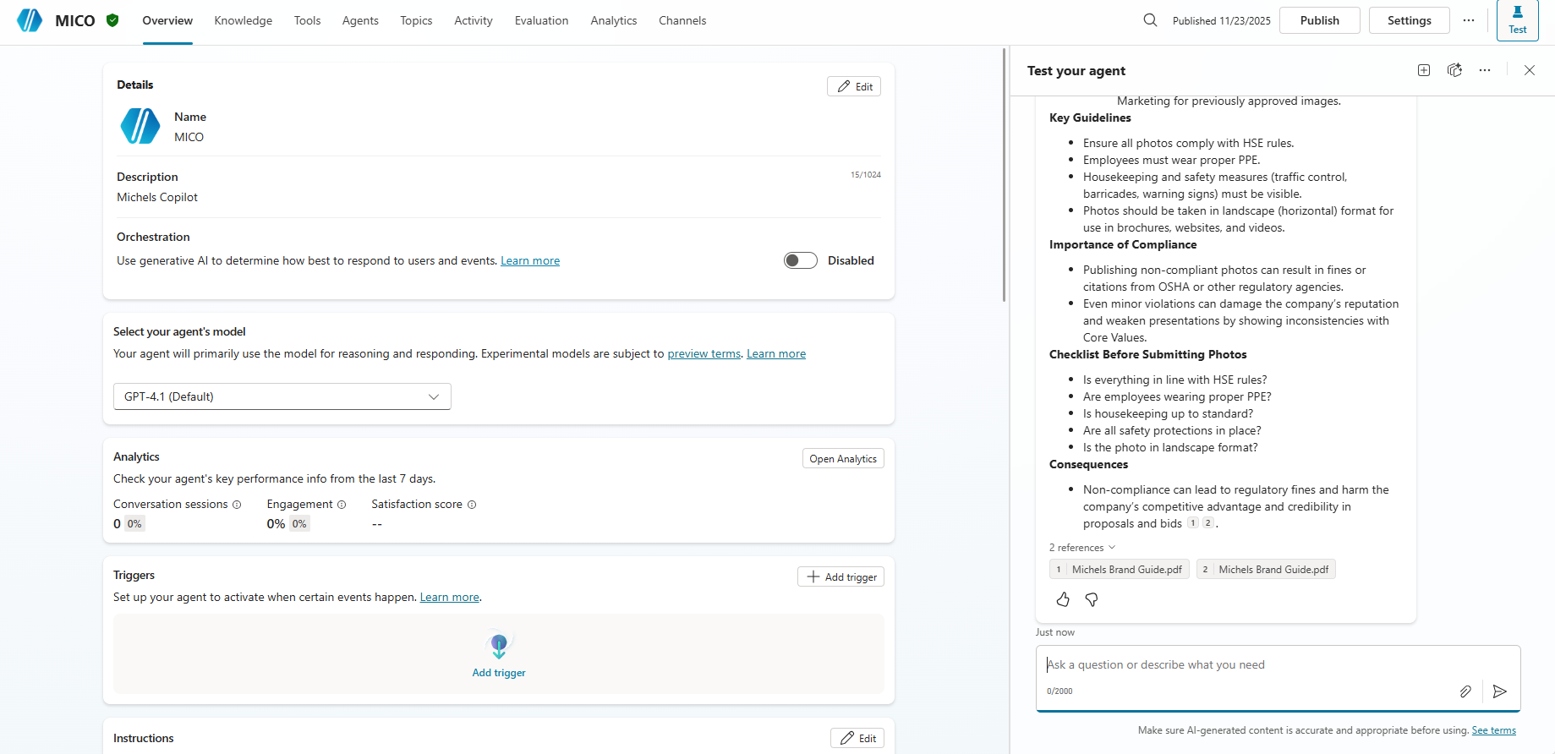
Ai AGENT

Slide 8
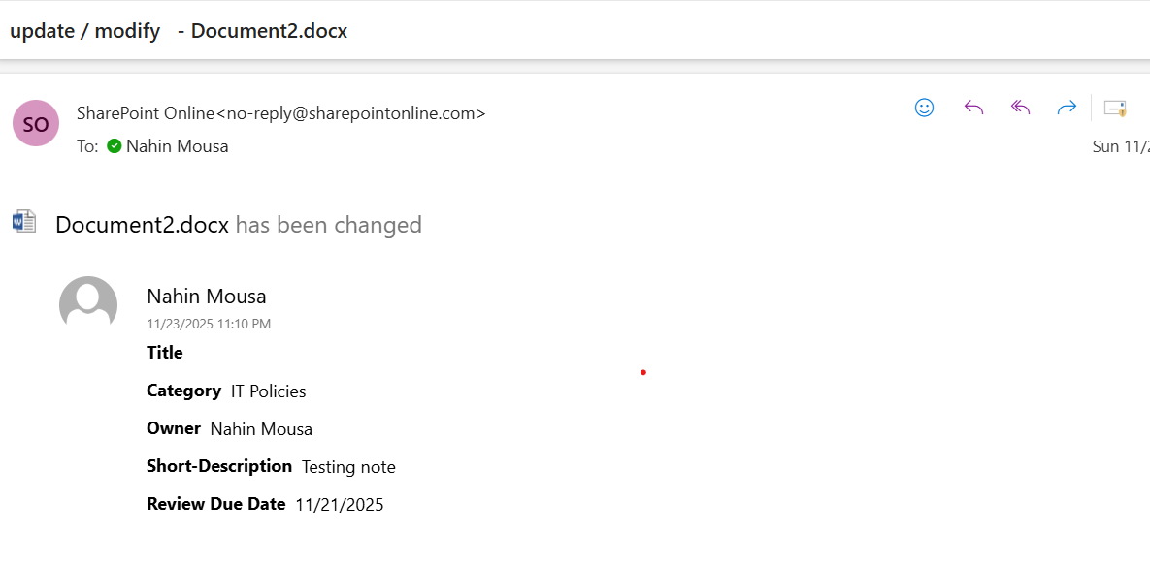
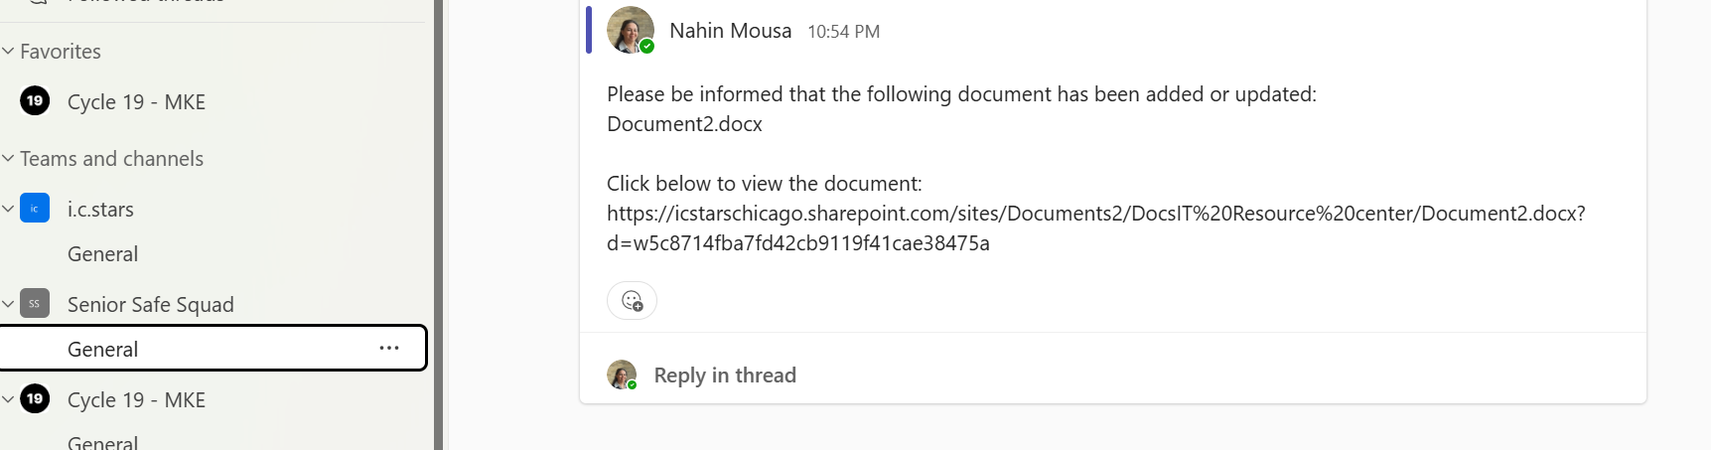
Solution- Document life-cycle
(User email & Notification)
If a document is modified or a new document is added, the user will receive an email and a Microsoft Teams notification.
User Email
User Notification

Slide 9
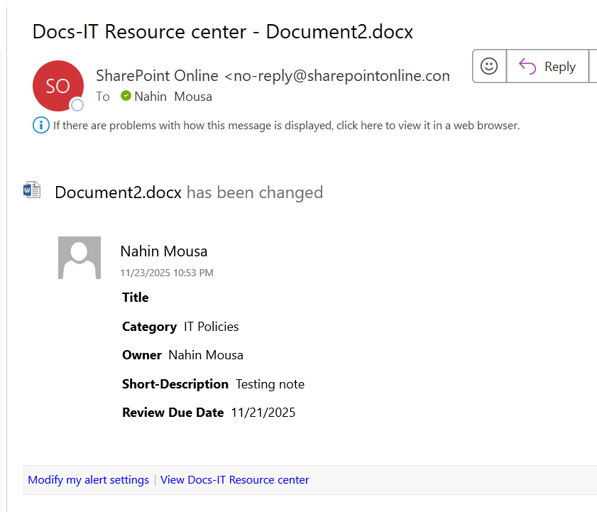
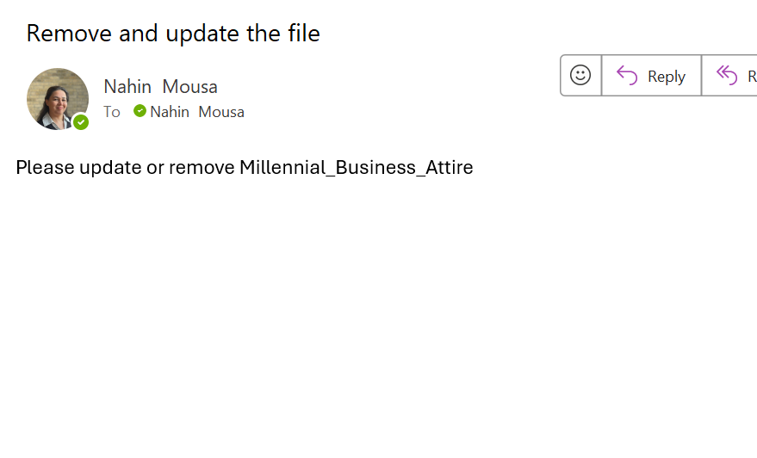
Solution- Document life-cycle (Owner update/Reminder)
If a document is modified or updated, the document owner will receive an email.
Every three months, the document owner will receive a reminder email to review, update, or remove the document.

Slide 10
Key Features
Quick links to IT services.
IT Policies and documentation life cycle.
Problem reporting and service request forms.
Search documents through AI assistant.
Home Navigation has all the website content
Develop a dashboard to measure website interaction metrics

Slide 11
Estimate for Success
Reduce repetitive IT questions by 40%.
Faster information access.
Improved communication.
Higher employee satisfaction.
Update documents

Slide 12
Enhancements
Send SMS: Notify employees instantly through text messages for urgent updates or approvals.
AI Agent: Integrate an AI agent to answer questions, guide users, search documents, and reduce help-desk workload .
Advanced Power BI Analytics: Expand dashboards for deeper insights, trends, and performance tracking.
Engagement Hub: Add quizzes, activities, and dynamic news to improve communication and employee engagement.

Slide 13
Thank you
Q&A

