Slide 1
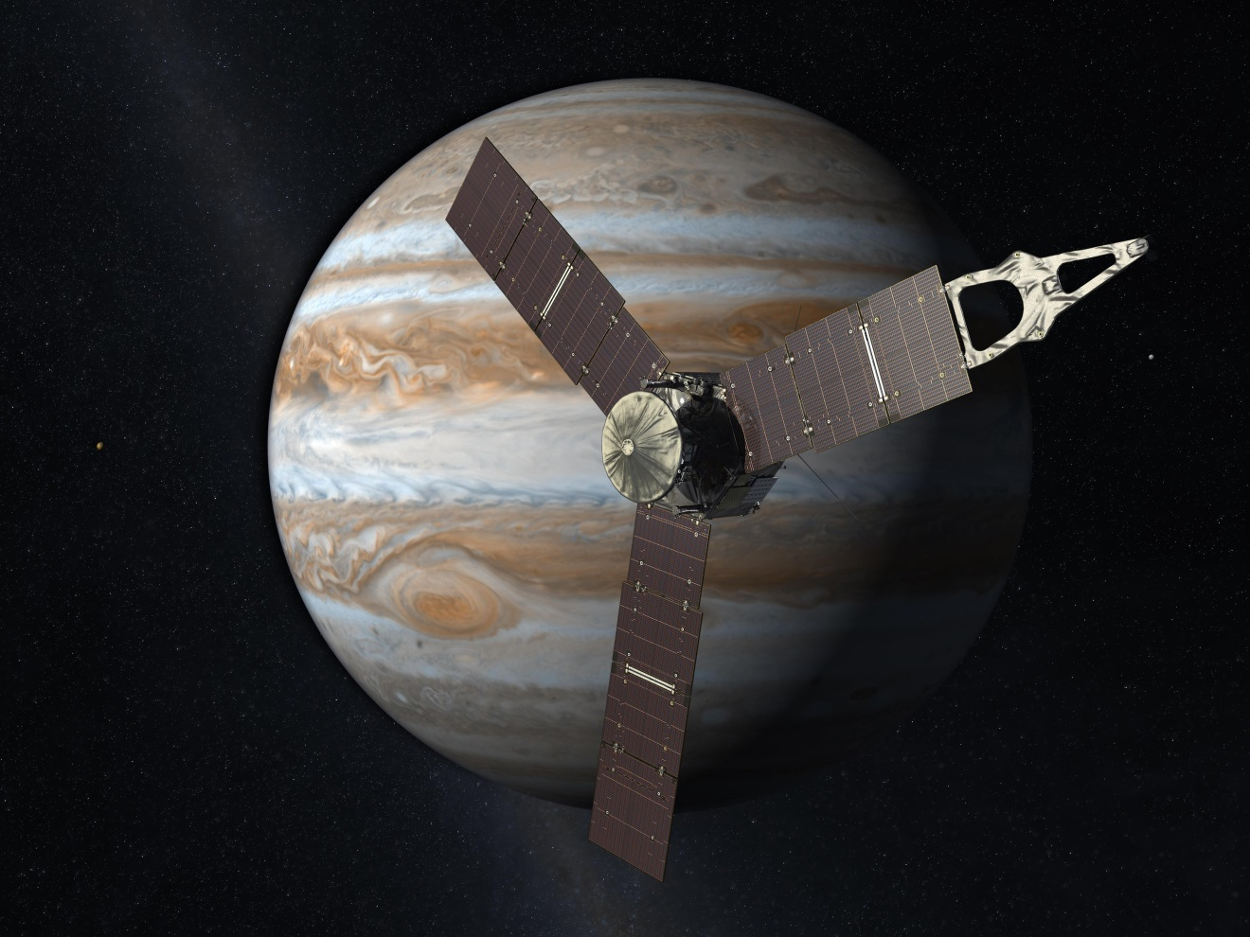
Is there a solid core inside?
https://nasa.gov/juno
The Juno mission to Jupiter, still ongoing, has already delivered a trove of new data about the atmosphere, the magnetosphere, the rings, and, our focus, the gravity field.

Slide 2
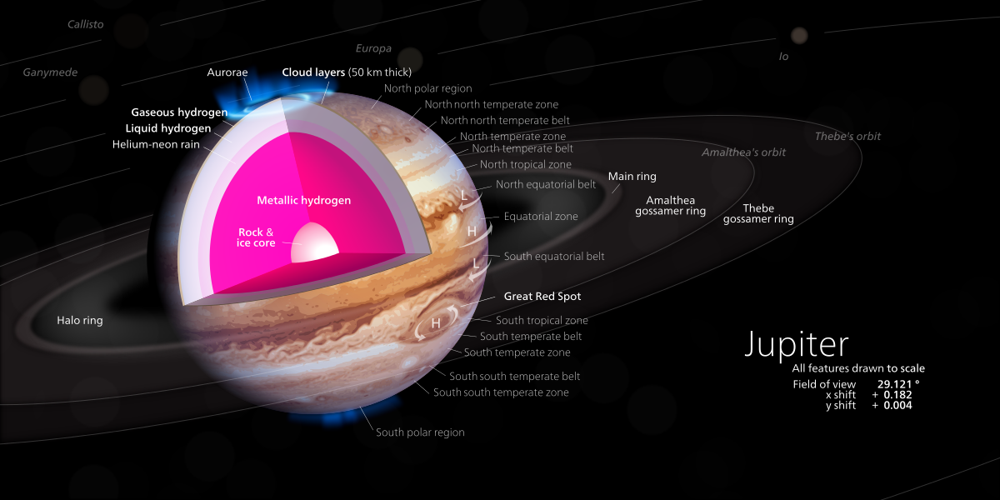
Is there a solid core inside?
https://commons.wikimedia.org/
The gravity field is determined by the spatial distribution of mass. Therefore, the spatial distribution of mass can be deduced from the measured gravity field, with some assumptions

Slide 3
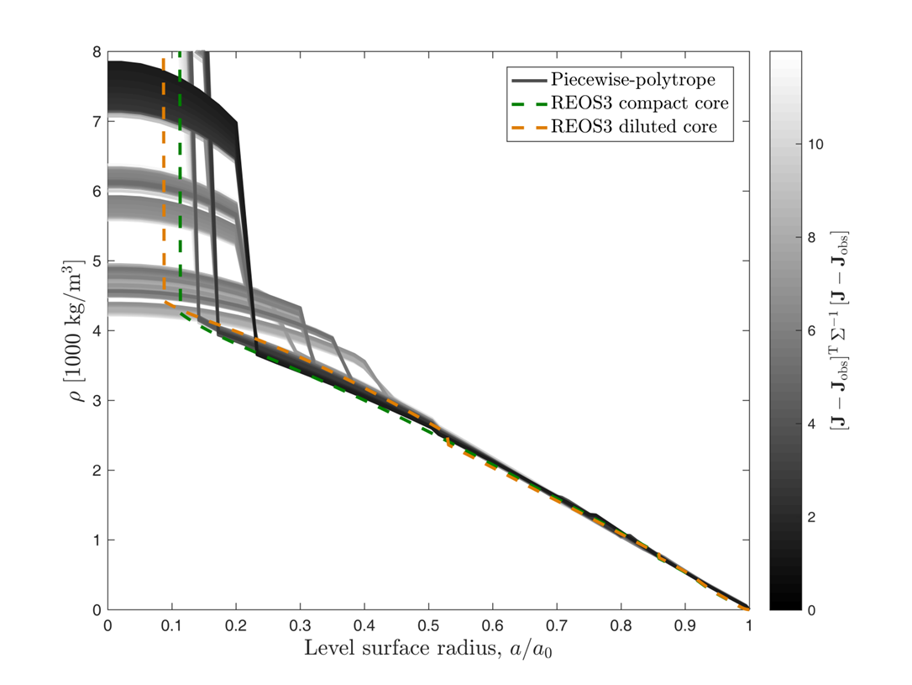
Is there a solid core inside?
A measurement or observation or a physical quantity is never a single value. It always comes with an associated uncertainty. All the models depicted above have gravity fields that match the observed gravity field, to some precision! Some show evidence of a sharp boundary around a solid core. Some show a gradual increase in density throughout. Is it possible, with increased precision, to rule out enough of them to determine what the real Jupiter is like inside?

