Slide 1
EE354L Picoblaze Basics Some Significant Aspects
Date of first creation: 7/11/2016 Date of last revision: 9/15/2018, 3/2/2020
Gandhi Puvvada
Reference: KCPSM6_User_Guide_30Sept14.pdf from Xilinx https://www.xilinx.com/products/intellectual-property/picoblaze.html

Slide 2
Items crossed off
For initial acquaintance of the picoblaze and its operation, a few of its advanced features are not that important. I have crossed them off so that you can focus on the essential aspects first. Significant items that were crossed off: 1. The second register bank and the instructions associated with it 2. Scratch pad memory operations 3. Shift and rotate operations 4. Sleep, rdl and reset pins

Slide 3
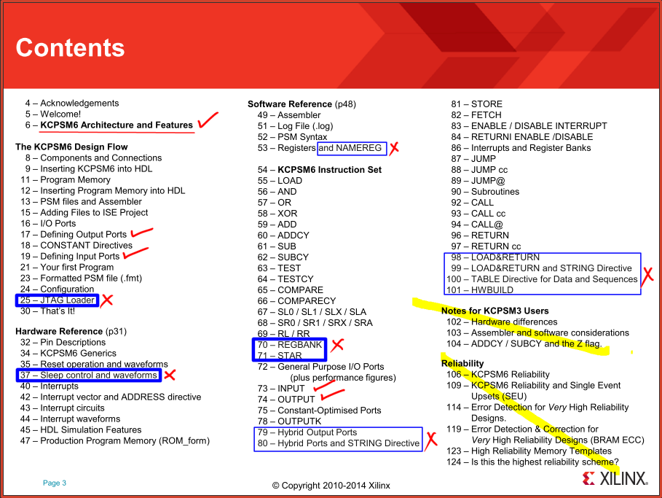

Slide 4
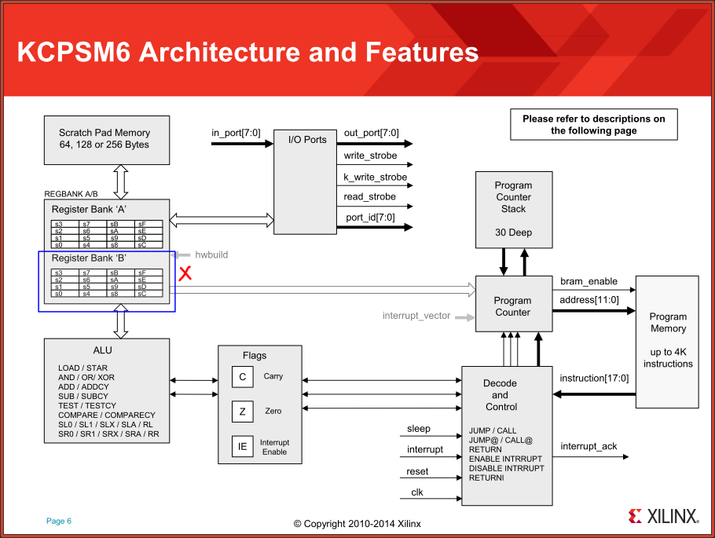

Slide 5
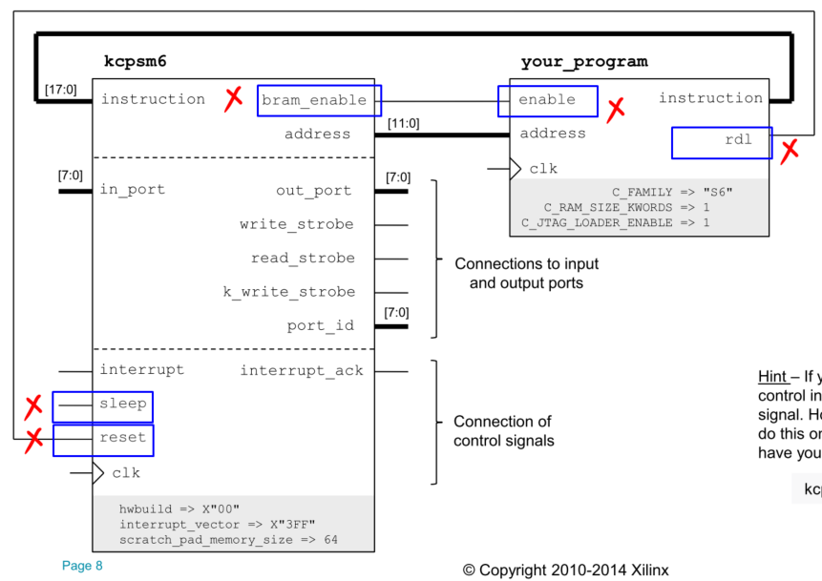

Slide 6
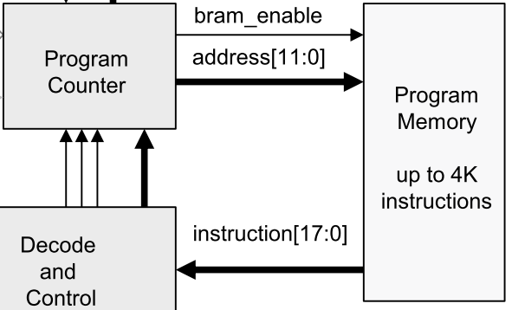
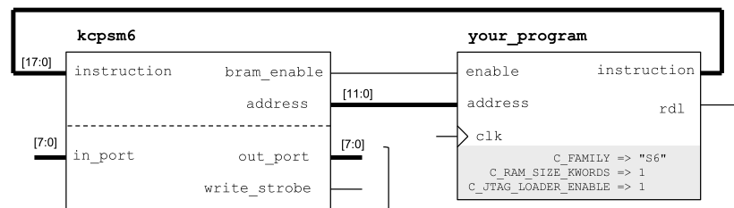
Instruction Memory size
The address of the instruction memory is 12 bits. So you can have up to 4K of instruction memory. 2^12 = 4K. The choices for the size of instruction memory are 1K, 2K, and 4K. The instructions are 18-bit long. Hence the sizes of the instruction memory are 1Kx18, 2Kx18, 4Kx18.

Slide 7
Starting value of PC on reset
It is basic and important that the PC starts with a known desired value after reset in every processor and the very first instruction to be fetched is located there. This starting address may vary for different processors. Notably, for the x86 processors, it is FFFF0 hex. For our Picoblaze and for many processors, it is all zeros (000 hex).

Slide 8
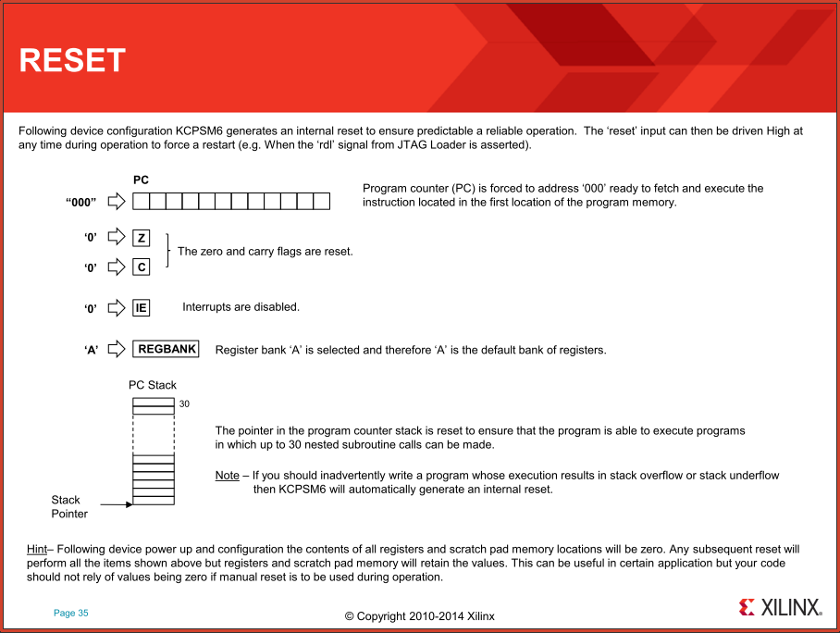

Slide 9
Picoblaze ISA (Instruction Set Architecture) Introduction to the Assembly Language Instructions

Slide 10
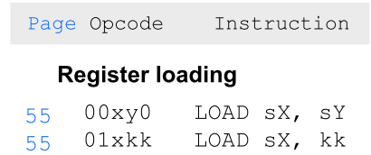
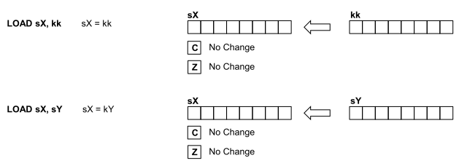
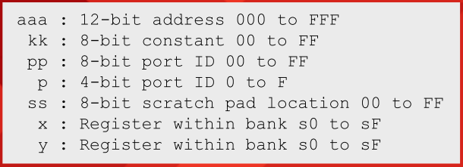
Instruction format
The instructions are 18-bit long and are written in 5-digit hex (see page 54, copy of which is on the next page). Left most hex digit goes from 0 to 3 only, hence it requires only 2 binary bits. The opcode is the left-most 6 bits (left-most 2 hex digits). Example: LOAD sX, kk is translated as 01xkk

Slide 11
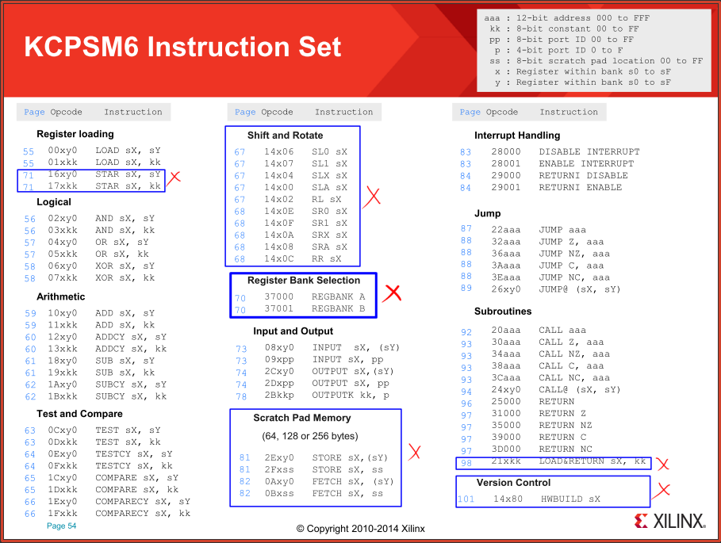

Slide 12
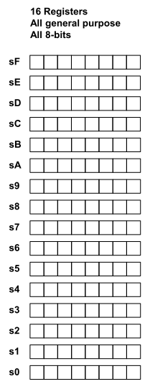
Instruction format continued
Notice that the register file has 16 registers, each of 8 bits. The processor is an 8-bit processor, meaning it will add or subtract or move 8 bits at a time. Since there are 16 registers, the registers are named s0 through sF. The register ID is four bits (one hex digit).
LOAD sX, sY 00xy0
LOAD s2, s5
00250
000000_0010_0101_0000
4 bits wasted! They are zeros always

Slide 13
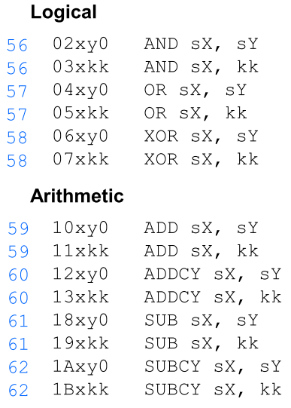
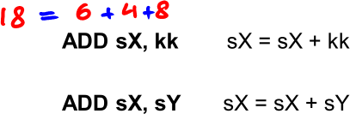
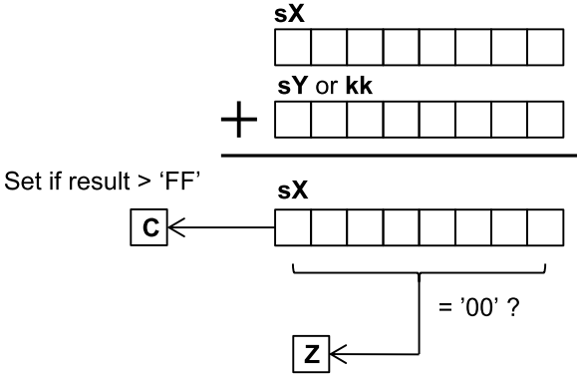
Arithmetic and Logic instructions
3 operands or 2 operands? In many processors these instructions are three operand instructions. Example: add destination, source_1, source_2 However to fit into the 18 bits of the instruction, picoblaze designer has made the source_1 the destination also.

Slide 14
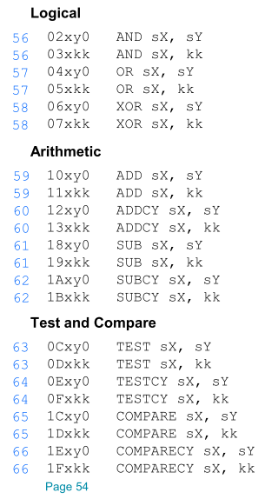
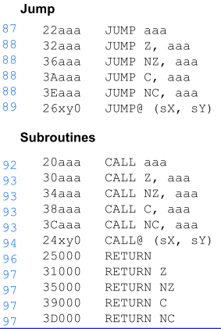
The Carry (C) and the Zero (Z) flags
It is important to understand how the Arithmetic, Logical, Test, and Compare instructions change the Carry (C) and the Zero (Z) flags and further how the conditional jumps, conditional calls, and conditional returns utilize the Carry (C) and the Zero (Z) flags.

Slide 15
Carry, Borrow, and Odd Parity
Even though the name of the flag is “Carry”, its meaning changes depending on the context. Logical operations (AND, OR, and XOR) will reset the carry to zero. The ADD operation will set the carry if the out-going carry C8 is true (otherwise will reset it). The COMPARE operation performs comparison by performing subtraction. The COMPARE and SUBtract operations will set the carry if the subtrahend is bigger (otherwise will reset the carry). So the carry flag can be viewed as representing the out-going borrow in subtraction. In the case of TEST instructions, AND operation is performed to see if the result is zero or if the result has odd number of 1’s as indicated by the carry flag. So the carry flag can be viewed as an Odd Parity of the result 8 bits in the case of the TEST (and an Odd Parity of the result 8 bits plus one incoming carry bit in the case of the TESTCY).

Slide 16
Multi-precision arithmetic/logical operations
Processors are categorized as 8-bit or 16-bit or 32-bit or 64-bit processors based on their internal data bus width. A 32-bit processor for example, has a 32-bit ALU and can add the contents of two 32-bit registers in one stroke. However, even an 8-bit processor can perform 32-bit addition by splitting it into 4 8-bit additions and using ADDCY for the last 3 add operations to include the carry from the previous 3 operations. Shown on the side is a 32-bit incrementation and a 32-bit decrementation code using ADD/ADDCY and SUB/SUBCY instructions. Assume that the four registers, s3, s2, s1, s0 contain the 32-bit value with s3 containing the most significant byte and the s0 containing the least significant byte.
ADD s0, 1'd
ADDCY s1, 0'd
ADDCY s2, 0'd
ADDCY s3, 0'd
SUB s0, 1'd
SUBCY s1, 0'd
SUBCY s2, 0'd
SUBCY s3, 0'd
We may need to create a one-millisecond delay loop routine by counting instructions (thereby clocks). The 32-bit incrementor and the 32-bit decrementer routines come handy.

Slide 17
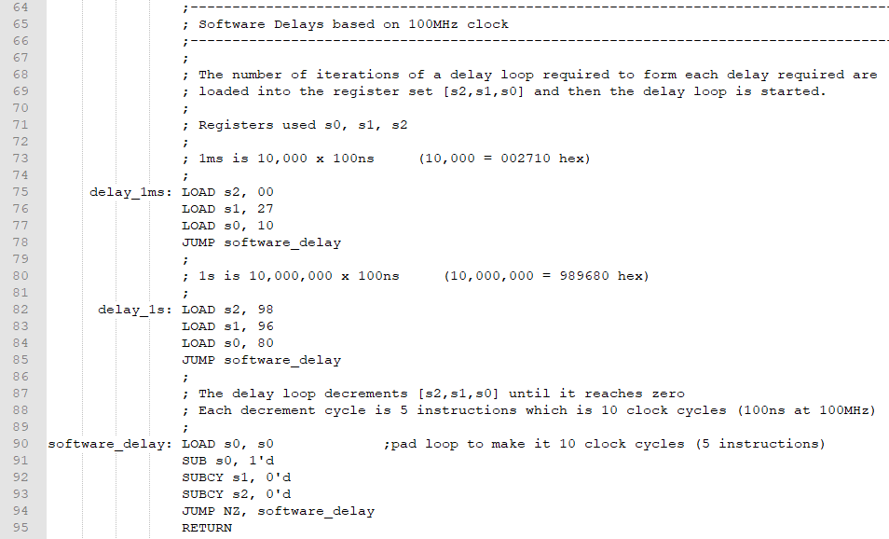
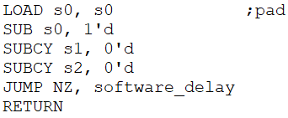
Software Delays based on 100MHz clock

Slide 18
Subroutine calls and returns from subroutines
Picoblaze supports subroutine calls and returns from subroutines. It has a 30-deep PC stack. Nested subroutine calls are supported. 40 CALL aaa 41 LOAD sA, 00’d In the above, the CALL instruction is at 40 and the return address (the address of the instruction in calling program to which we need to return) is 41. Some processors increment 40 to 41 as part of the execution of the CALL instruction and save 41 on the stack. Then the RETURN instruction retrieves the return address from the stack and causes return to the main program. However in the picoblaze, the CALL instruction address 40 is saved on the stack and the RETUN instruction retrieves 40, increments it to 41 and then causes return to 41.

Slide 19
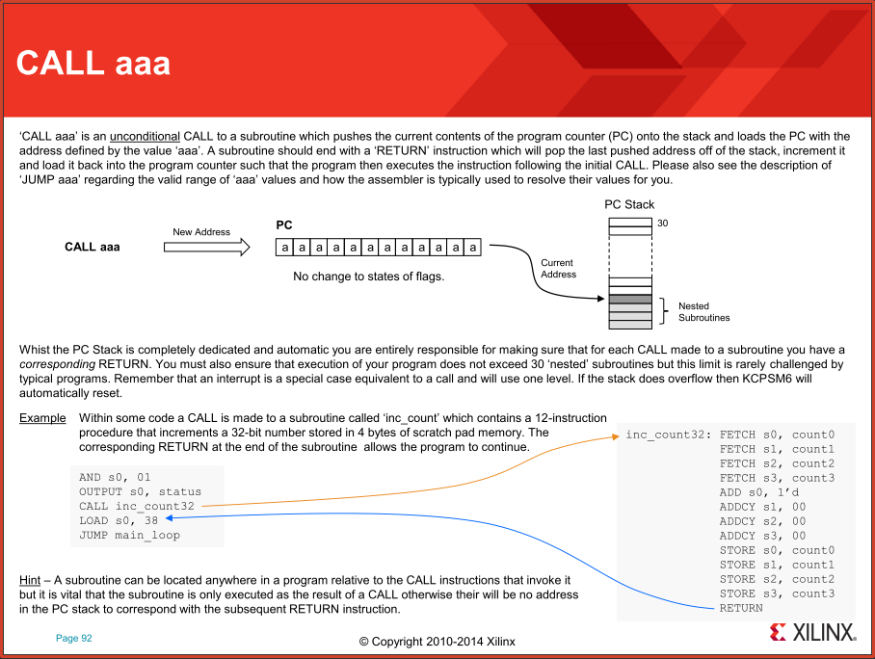

Slide 20
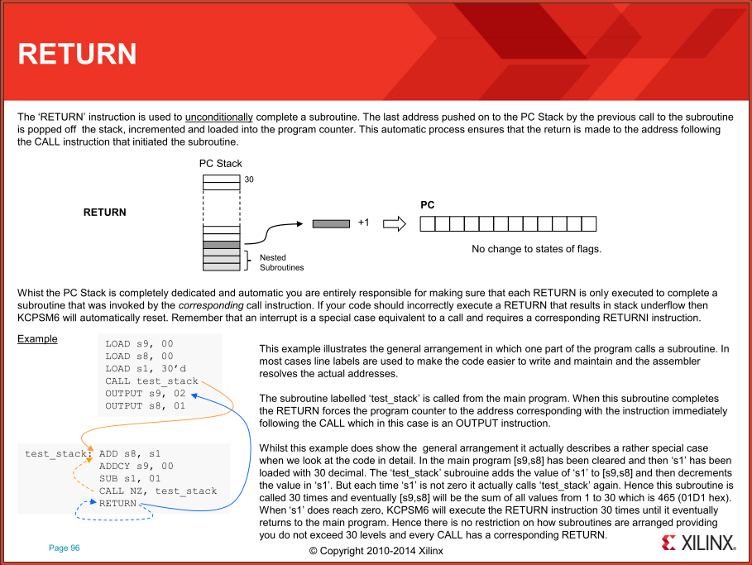

Slide 21
Interface with the Fabric Logic
via
Input ports and
Output ports

Slide 22
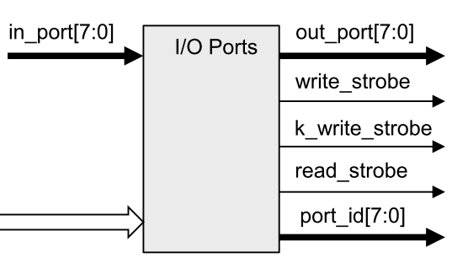
Interface with the Fabric Logic via Input and Output ports
Data from input port For example from 8 Switches
Data to output port For example to 8 LEDs
Address of the port Input port or Output port
Using the 8-bit port_id[7:0], we can generate 256 port addresses and talk to them (exchange data with them). So, all together do we have 256 I/O ports or do we have 256 input ports and 256 output ports?

Slide 23
Interface with the Fabric Logic via Input and Output ports
port_id[3:0]
256 Input ports (Read only) 8-bit port_id qualified by read_strobe produces 256 IDSPs (Input Device Select Pulses)
256 output ports (Write only) 8-bit port_id qualified by write_strobe produces 256 ODSPs (Output Device Select Pulses)
16 output ports (Write only) 4-bit port_id qualified by k_write_strobe produces 16 k_ODSPs (k_Output Device Select Pulses)

Slide 24
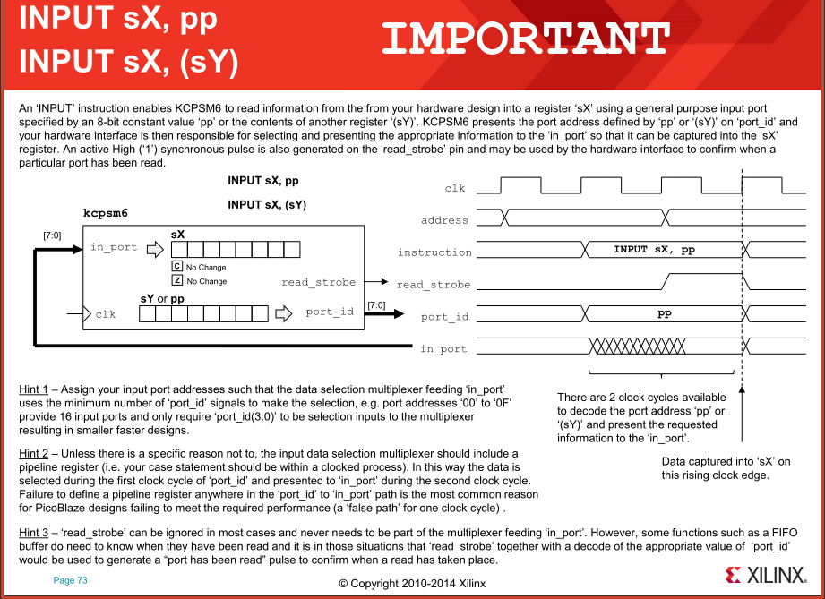

Slide 25
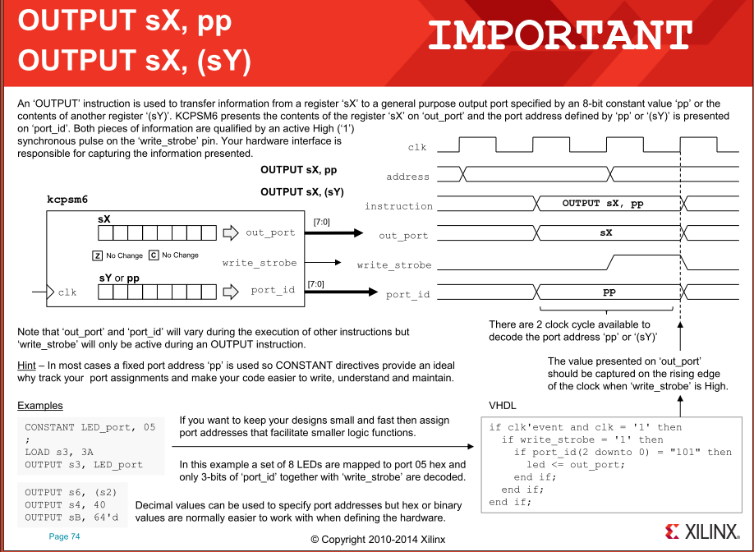

Slide 26
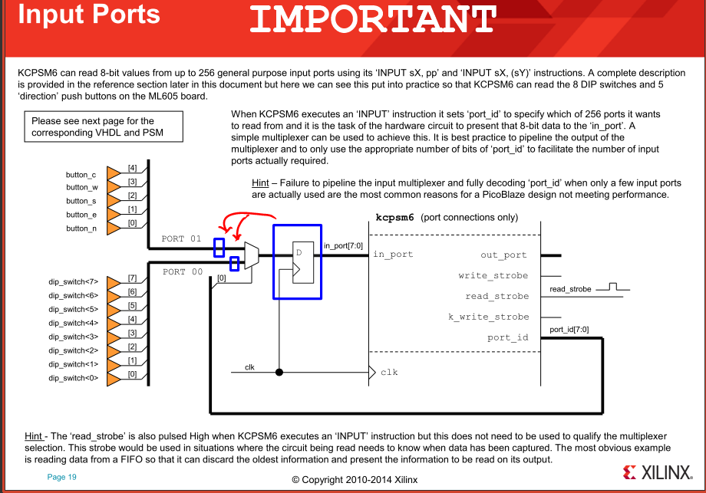
In a non-FPGA based design such as an ASIC or a custom VLSI, it is common practice to use tristate buffers in place of a mux. You want to enable a tri-state buffer only after confirming that the address is stabilized and is not changing. This is to make sure that multiple tristate buffers are not enabled unintentionally for a short length of time during address transitions. Hence, I have moved the pipeline register to the upstream of the mux. In my design, there is a register for every input port, and it captures data on every clock. The data read by the processor is one clock delayed and in most cases that is not harmful (particularly in our application with manual operation of switches and buttons.
not meeting clock period.

Slide 27
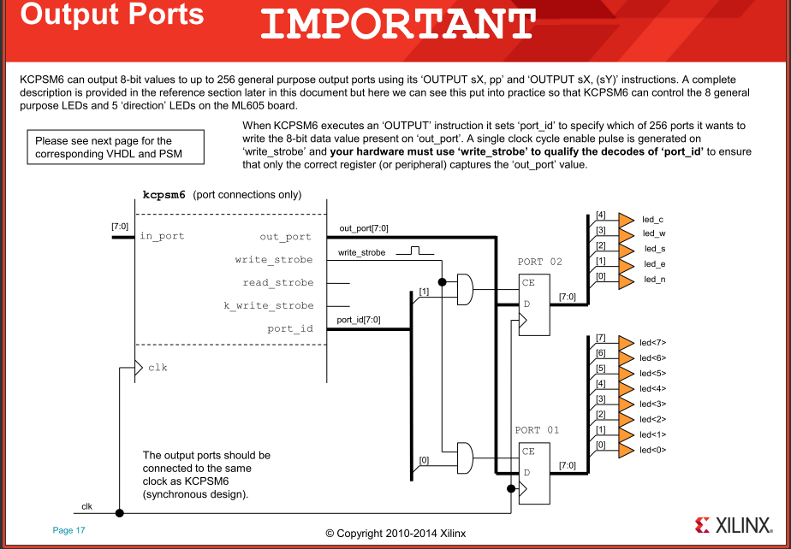

Slide 28
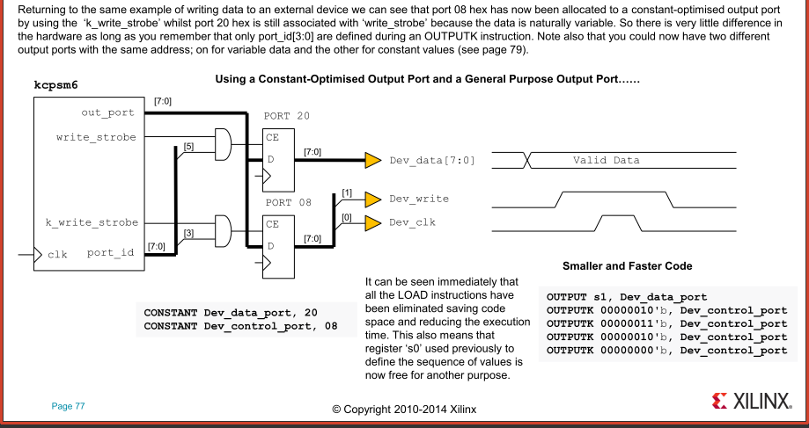

Slide 29
Interrupts, Interrupt Vector, and ISR
Please see the next 5 pages. One observation, we wish to make, is that the RETURNI (pronounced Return-I, I for Interrupt) does not increment the address retrieved from the stack. So Picoblaze, on recognizing that there is an interrupt request, would save the return address on the stack. This is slightly deferent from the CALL instruction execution. So the stack should not be called the CALL address stack or RETUN address stack. Perhaps that is why the Picoblaze user guide calls it a PC Stack! Please go through the discussion about where to locate the ISR and how to specify the interrupt vector parameter while instantiating the picoblaze processor in the top design, and also how to use the assembler directive ADDRESS to specify the location of the ISR routine to the assembler.

Slide 30
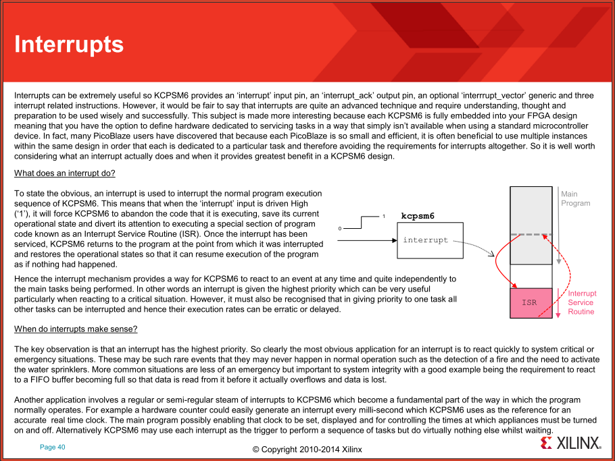

Slide 31
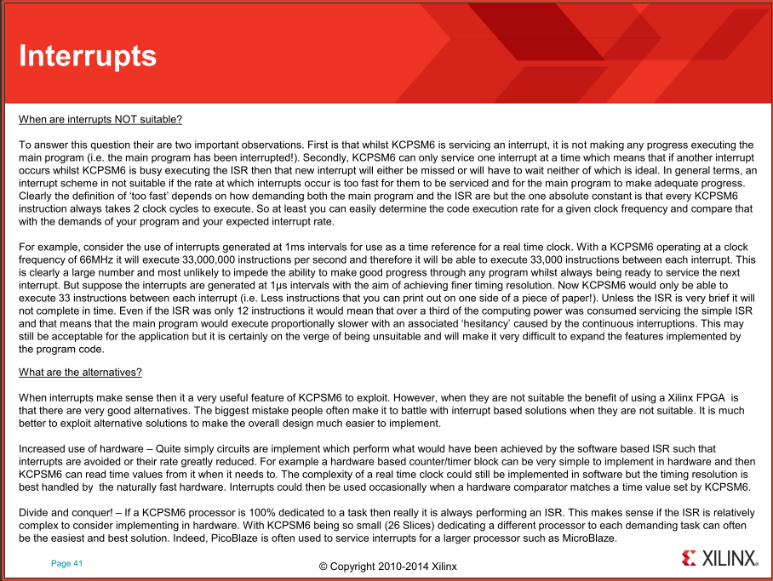
there
implemented

Slide 32
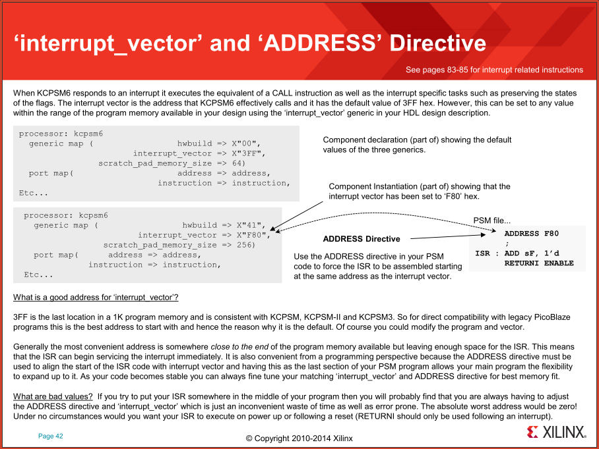
VHDL

Slide 33
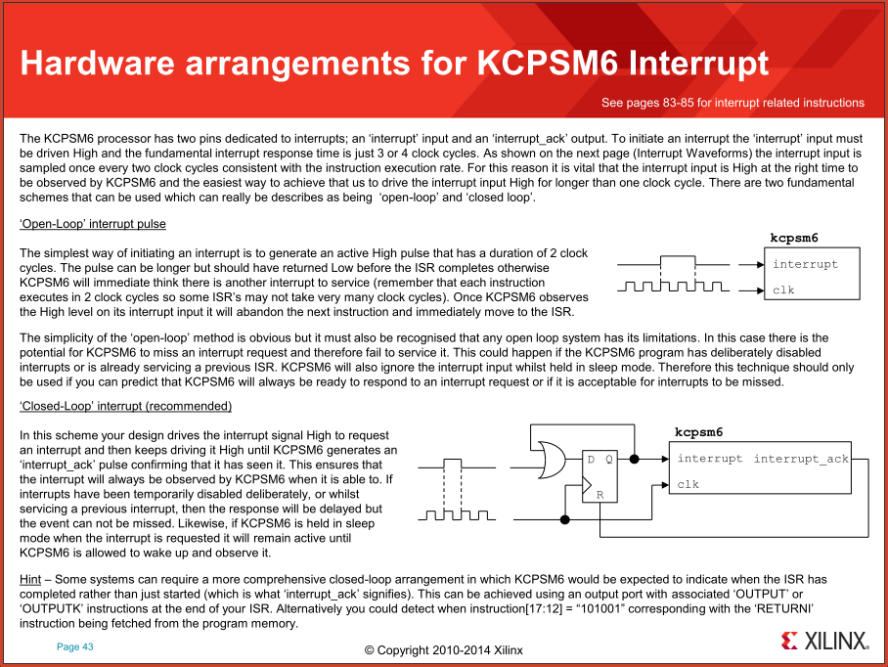
is for us

Slide 34
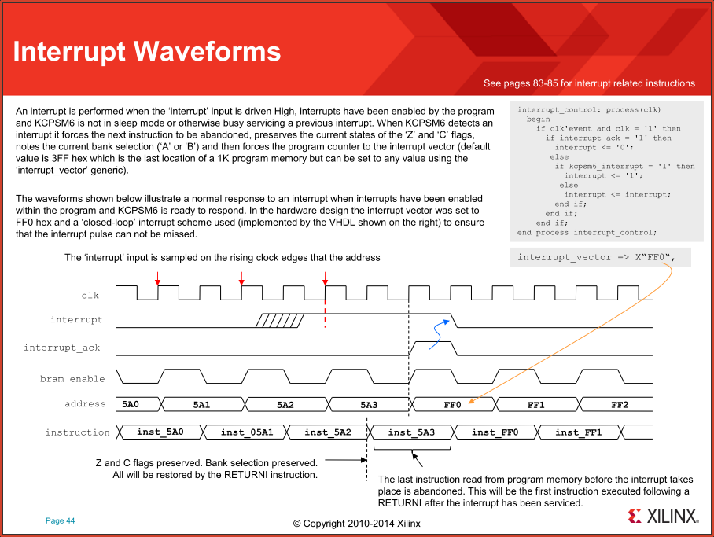
VHDL

