Slide 1
भाव
MSDS 630 · NLP HACKATHON · PROJECT 4
Hindi Sentiment Monitor
Positive, neutral or negative: reading the mood of Hindi text with models you can explain line by line.
Isha Joshi · Manikantha Kothamasu · Sowseelyatha Mutharaju · Muralidhar Reddy Nandi · Rohan Sabbani
Notes:
Presenter: Manikantha Kothamasu, Team Lead (0-1 min). Introduce the team and the goal: a lightweight, explainable Hindi sentiment classifier. भाव (bhaav) means feeling or sentiment.

Slide 2
THE CLIENT PROBLEM
A brand launching in India needs to know how people feel
Devanagari Hindi
Hinglish
Mixed with English
यह फोन बहुत अच्छा है
yeh phone bahut accha hai
battery life is bekaar
The focus of this build, with a labeled dataset.
Hindi in Latin letters, no standard spelling. Not covered yet.
Code-switching inside one post. Not covered yet.
English-only sentiment tools miss most of this conversation · 2
Notes:
Presenter: Manikantha Kothamasu, Team Lead (0-1 min). Frame the client need. Be upfront: this build covers Devanagari Hindi only, with instructor approval; Hinglish and mixed posts are future work.

Slide 3
THE DATA
2,500 labeled Hindi sentences
Label balance
2,498
Positive
955
usable rows after de-duplication
Negative
848
70 / 15 / 15
Neutral
697
train, dev, test; stratified; seed 42
Short sentences of about 7 words, all Devanagari. Duplicates were removed before splitting, so no sentence appears in both train and test.
SentiHin-2500 (Hugging Face MLap/SentiHin-2500) · 3
Notes:
Presenter: Rohan Sabbani, Data Engineer (1-3 min). 2,500 Hindi sentences, three classes, mildly imbalanced. De-duplicated on normalized text before the split to avoid leakage. Mention the data is short and fairly templated; the limitations slide explains the consequence.

Slide 4
THE APPROACH
Simple, explainable, and honestly evaluated
1
2
3
4
Normalize
Features
Models
Evaluate
Unicode NFC, URLs and @mentions removed, the danda as its own token, Latin letters lowercased.
TF-IDF on words (1 to 2-grams) and characters (2 to 5-grams), fit on training data only.
Naive Bayes baseline, logistic regression tuned on dev, a negation-aware variant, then fine-tuned MuRIL.
Macro-F1 with confidence intervals, 5-fold CV, per-class scores, hand-labeled errors.
Classical models run offline on a laptop; MuRIL was fine-tuned on a Colab GPU · 4
Notes:
Presenter: Muralidhar Reddy Nandi, Modeling Lead (1-3 min). Four steps. Vectorizer fit on training only; macro-F1 rather than accuracy. Hyperparameters were chosen on dev, then the test set was used once. A negation-aware variant was tested because negation is the biggest error source; it did not help, which we report honestly. A pretrained Indian-language transformer, MuRIL, was then fine-tuned on a Colab GPU.

Slide 5
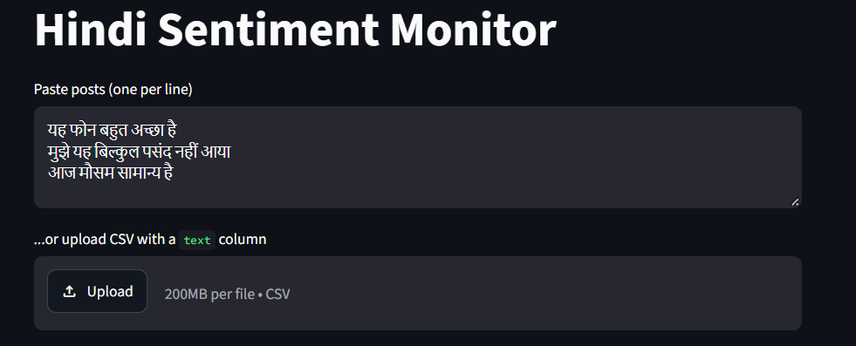
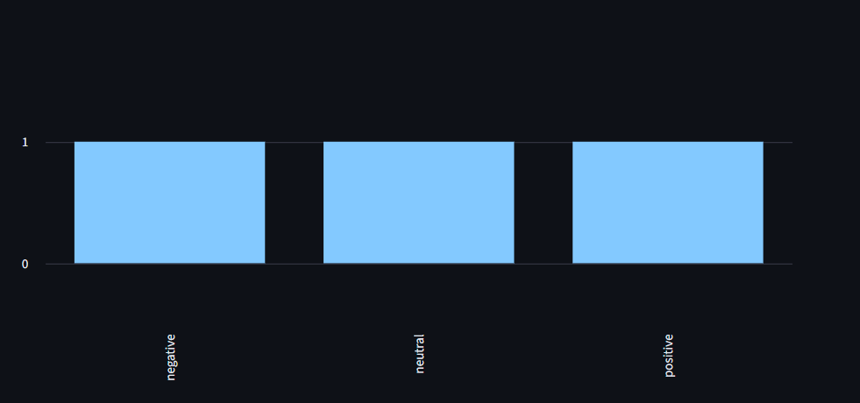
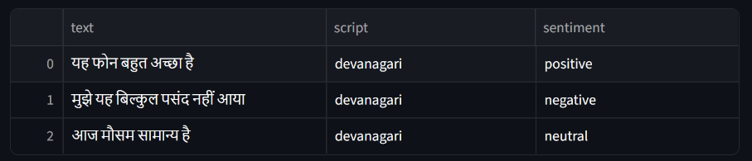
LIVE DEMO
Paste posts, see the sentiment
Paste posts or upload a CSV
Batch breakdown by sentiment and script
Runs offline on a laptop
Screenshots from our live Streamlit app, running the logistic regression model · 5
Notes:
Presenter: Isha Joshi, Demo Lead (3-6 min). These are real screenshots of the app. Switch to the live Streamlit app, paste a few lines including one with negation to show an honest failure. Fallback: python demo_cli.py.

Slide 6
RESULTS ON THE TEST SET
Fine-tuned MuRIL reaches 0.975 macro-F1, up from 0.945
NAIVE BAYES
LOGISTIC REGRESSION
LR + NEGATION
FINE-TUNED MURIL
0.895
0.945
0.944
0.975
macro-F1, 375 test sentences
baseline
macro-F1, 375 test sentences
95% CI 0.921 to 0.966
macro-F1, 375 test sentences
95% CI 0.920 to 0.965
macro-F1, 375 test sentences
single run, Colab GPU
5-fold CV macro-F1: baseline LR 0.958 ± 0.006, with negation 0.963 ± 0.008. The two classical variants are within noise. MuRIL has no confidence interval (one run).
Same train/dev/test split for every model · 6
Notes:
Presenter: Sowseelyatha Mutharaju, Evaluation Lead (6-8 min). Headline: fine-tuned MuRIL 0.975, logistic regression 0.945, Naive Bayes 0.895. The negation-aware variant scored 0.944; confidence intervals overlap completely and cross-validation differences are within one standard deviation, so we conclude negation marking did not help. It fixed 2 of 21 baseline errors but introduced 2 new ones. Fine-tuned MuRIL (google/muril-base-cased) scored 0.975 on the same split, the best result, but it is a single run with no confidence interval, so say 'about 3 points better' and not more. Caveat to say aloud: the data is easy, so treat scores as optimistic.

Slide 7
PER-CLASS F1
Neutral is the strongest class on this data
Logistic regression
Naive Bayes
Negative
0.93
0.87
Neutral
0.96
0.92
Positive
0.95
0.89
Neutral usually trails on social data; here its wording is distinctive, which flatters the score · 7
Notes:
Presenter: Sowseelyatha Mutharaju, Evaluation Lead (6-8 min). Neutral is often the hardest class and we report it separately as the brief asks. Here it scores highest because neutral sentences use very recognizable phrasing. That is a property of this dataset, not proof neutral is easy in the wild.

Slide 8
ERROR ANALYSIS
21 errors in 375 sentences, four causes
7
Negation
7
Rare sentiment words
इस निर्णय से कार्य में कोई सुधार नहीं हुआ
यह प्रोडक्ट मेरी उम्मीदों पर खरा उतरा
true negative, predicted neutral
true positive, predicted negative
3
Mild sentiment, weak cue
4
Ambiguous or factual
ऑनलाइन प्लेटफ़ॉर्म की सुविधा सीमित रही
यह जूता टाइट है।
true negative, predicted positive
true negative, predicted neutral
All 21 test errors were labeled by hand. Negation features fixed 2 and added 2 · 8
Notes:
Presenter: Sowseelyatha Mutharaju, Evaluation Lead (6-8 min), ideally with a Hindi speaker explaining the examples. Seven errors are negation (the model sees a positive word like सुधार and misses नहीं). Seven involve rare words. Three are mild sentiment. Four are arguable labels.

Slide 9
LIMITATIONS AND ETHICS
Where this system should not be trusted
Optimistic scores
One script only
About 43% of test sentences closely match a pattern in training. Real posts are messier.
Devanagari only. Hinglish, code-mixing, emoji and sarcasm are untested.
Negation and rare words
Aggregate use only
Bag-of-words models miss “not good” patterns, even with negation marking, and words seen rarely.
Fine for brand-level trends. Not for judging individuals; social data carries demographic bias.
Report honestly: a modest number with an explanation beats an inflated one · 9
Notes:
Presenter: Manikantha Kothamasu, Team Lead (8-10 min). Lead with the 43% figure: share of test sentences with at least 0.7 word-set overlap with some training sentence. Then script coverage, negation, and aggregate vs individual use.

Slide 10
WITH ANOTHER WEEK
Harder data, a stronger model, human review
1
2
3
Stress-test MuRIL
Real social posts
Human in the loop
Repeat with several seeds for a confidence interval, and test on Hinglish and noisy posts.
Add Hinglish and noisy tweets so scores reflect what the client will see.
Route low-confidence posts to a reviewer instead of trusting every label.
Thank you · Questions? · 10
Notes:
Presenter: Manikantha Kothamasu, Team Lead (8-10 min). Close with three next steps, then Q&A. Every team member must be ready to explain any file in the repository.

