Slide 1
भाव
MSDS 630 · NLP HACKATHON · PROJECT 4
Hindi Sentiment Monitor
Positive, neutral or negative: reading the mood of Hindi text with models you can explain line by line.
Code: https://github.com/nmr999/hindi-sentiment-monitor
Isha Joshi · Manikantha Kothamasu · Sowseelyatha Mutharaju · Muralidhar Reddy Nandi · Rohan Sabbani

Slide 2
THE CLIENT PROBLEM
A brand launching in India needs to know how people feel
Devanagari Hindi
Hinglish
Mixed with English
यह फोन बहुत अच्छा है
yeh phone bahut accha hai
battery life is bekaar
The focus of this build, with a labeled dataset.
Hindi in Latin letters, no standard spelling. Not covered yet.
Code-switching inside one post. Not covered yet.
English-only sentiment tools miss most of this conversation · 2

Slide 3
THE DATA
2,500 labeled Hindi sentences
Label balance
2,498
Positive
955
usable rows after de-duplication
Negative
848
70 / 15 / 15
Neutral
697
train, dev, test; stratified; seed 42
Short sentences of about 7 words, all Devanagari. Duplicates were removed before splitting, so no sentence appears in both train and test.
SentiHin-2500 (Hugging Face MLap/SentiHin-2500) · 3

Slide 4
THE APPROACH
Simple, explainable, and honestly evaluated
1
2
3
4
Normalize
Features
Models
Evaluate
Unicode NFC, URLs and @mentions removed, the danda as its own token, Latin letters lowercased.
TF-IDF on words (1 to 2-grams) and characters (2 to 5-grams), fit on training data only.
Naive Bayes baseline, logistic regression tuned on dev, a negation-aware variant, then fine-tuned MuRIL.
Macro-F1 with confidence intervals, 5-fold CV, per-class scores, hand-labeled errors.
Classical models run offline on a laptop; MuRIL was fine-tuned on a Colab GPU · 4

Slide 5
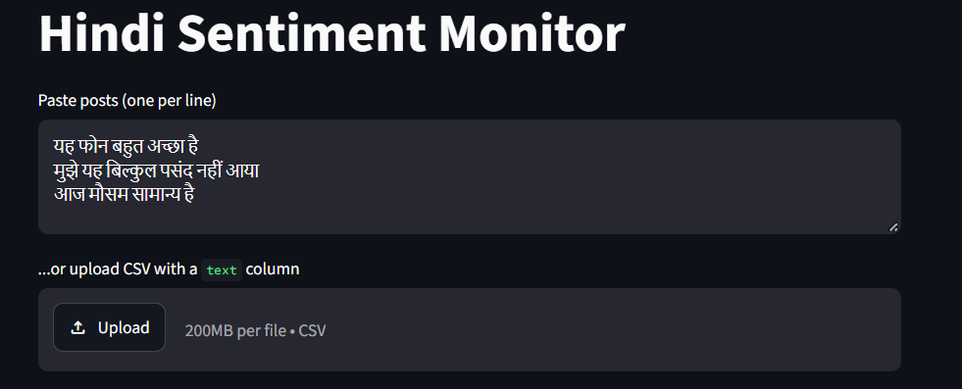
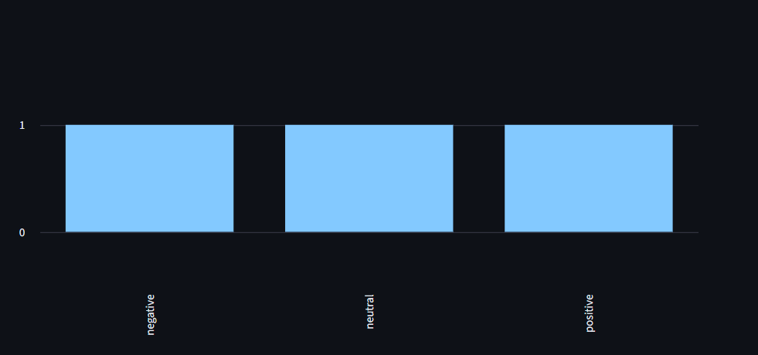
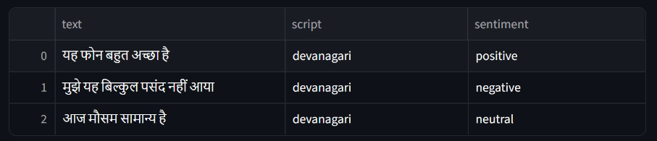
LIVE DEMO
Paste posts, see the sentiment
Paste posts or upload a CSV
Batch breakdown by sentiment and script
Runs offline on a laptop
Screenshots from our live Streamlit app, running the logistic regression model · 5

Slide 6
RESULTS ON THE TEST SET
Fine-tuned MuRIL reaches 0.975 macro-F1, up from 0.945
NAIVE BAYES
LOGISTIC REGRESSION
LR + NEGATION
FINE-TUNED MURIL
0.895
0.945
0.944
0.975
macro-F1, 375 test sentences
baseline
macro-F1, 375 test sentences
95% CI 0.921 to 0.966
macro-F1, 375 test sentences
95% CI 0.920 to 0.965
macro-F1, 375 test sentences
single run, Colab GPU
5-fold CV macro-F1: baseline LR 0.958 ± 0.006, with negation 0.963 ± 0.008. The two classical variants are within noise. MuRIL has no confidence interval (one run).
Same train/dev/test split for every model · 6

Slide 7
ERROR ANALYSIS
21 errors in 375 sentences, four causes
7
Negation
7
Rare sentiment words
इस निर्णय से कार्य में कोई सुधार नहीं हुआ
यह प्रोडक्ट मेरी उम्मीदों पर खरा उतरा
true negative, predicted neutral
true positive, predicted negative
3
Mild sentiment, weak cue
4
Ambiguous or factual
ऑनलाइन प्लेटफ़ॉर्म की सुविधा सीमित रही
यह जूता टाइट है।
true negative, predicted positive
true negative, predicted neutral
All 21 test errors were labeled by hand. Negation features fixed 2 and added 2 · 7

Slide 8
LIMITATIONS AND ETHICS
Where this system should not be trusted
Optimistic scores
One script only
About 43% of test sentences closely match a pattern in training. Real posts are messier.
Devanagari only. Hinglish, code-mixing, emoji and sarcasm are untested.
Negation and rare words
Aggregate use only
Bag-of-words models miss “not good” patterns, even with negation marking, and words seen rarely.
Fine for brand-level trends. Not for judging individuals; social data carries demographic bias.
Report honestly: a modest number with an explanation beats an inflated one · 8

Slide 9
WITH ANOTHER WEEK
Harder data, a stronger model, human review
1
2
3
Stress-test MuRIL
Real social posts
Human in the loop
Repeat with several seeds for a confidence interval, and test on Hinglish and noisy posts.
Add Hinglish and noisy tweets so scores reflect what the client will see.
Route low-confidence posts to a reviewer instead of trusting every label.
Next steps · 9

Slide 10
TECHNICAL SUMMARY
Problem, data, method, results, limits, next steps
PROBLEM
Model | Macro-F1 | Neg F1 | Neu F1 | Pos F1
Naive Bayes | 0.895 | 0.87 | 0.92 | 0.89
Logistic regression | 0.945 | 0.93 | 0.96 | 0.95
LR + negation | 0.944 | 0.93 | 0.95 | 0.95
Fine-tuned MuRIL | 0.975 | - | - | -
Classify Hindi text as positive, neutral or negative so a brand can monitor how customers feel. Scope: Devanagari Hindi only (instructor-approved).
DATA
SentiHin-2500 (Hugging Face MLap/SentiHin-2500): 2,498 sentences after de-duplication; stratified 70/15/15 split, seed 42; 375 test sentences.
METHOD
Test set, same split for every model. LR 95% CI 0.921 to 0.966. Negation features gave no gain. MuRIL is a single run with no confidence interval.
Unicode normalization; TF-IDF words (1-2) and characters (2-5), fit on train only; Naive Bayes; logistic regression tuned on dev; negation features; MuRIL fine-tuned on a Colab GPU. Metric: macro-F1.
LIMITATIONS
NEXT STEPS
Short, templated, Devanagari-only data (about 43% of test sentences closely match a training pattern), so scores are optimistic. Negation and rare words cause most errors. Untested on Hinglish, sarcasm and long posts.
Several MuRIL seeds for a confidence interval; Hinglish and real social posts; route low-confidence posts to a human reviewer.
Code and README: https://github.com/nmr999/hindi-sentiment-monitor
Thank you · Questions? · 10

