Slide 1





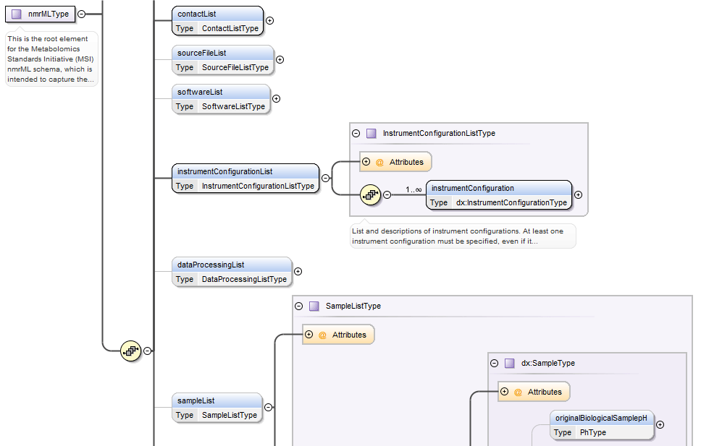
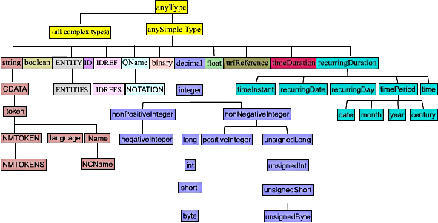

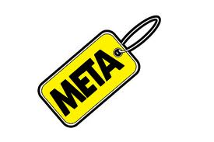
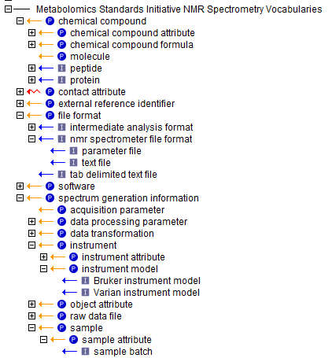


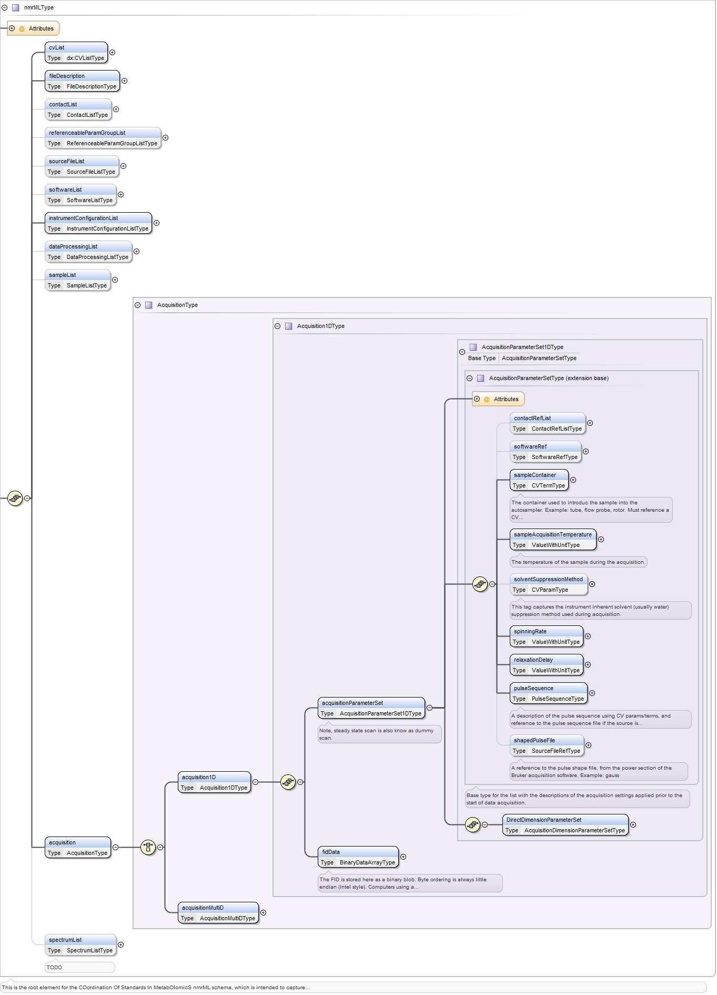
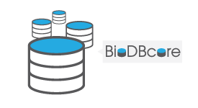
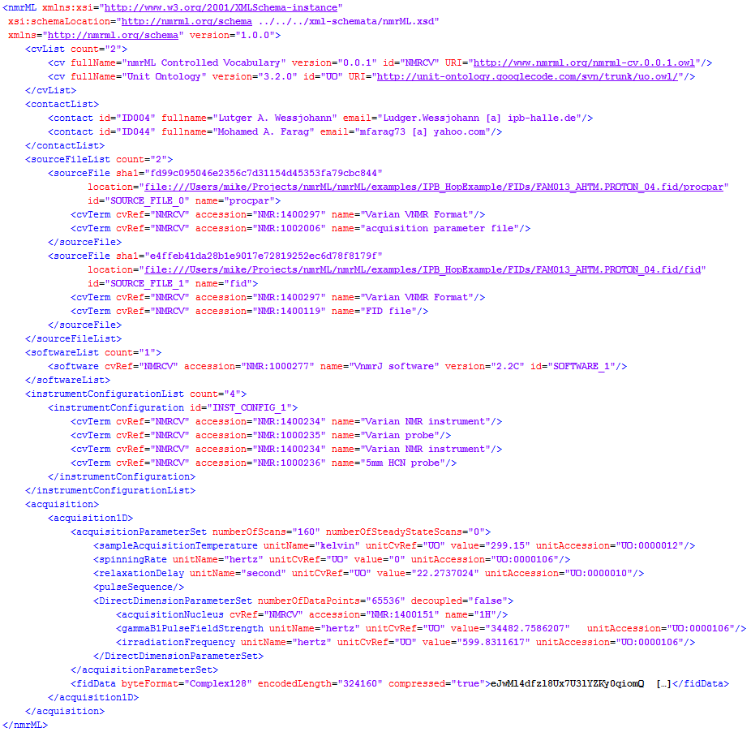
















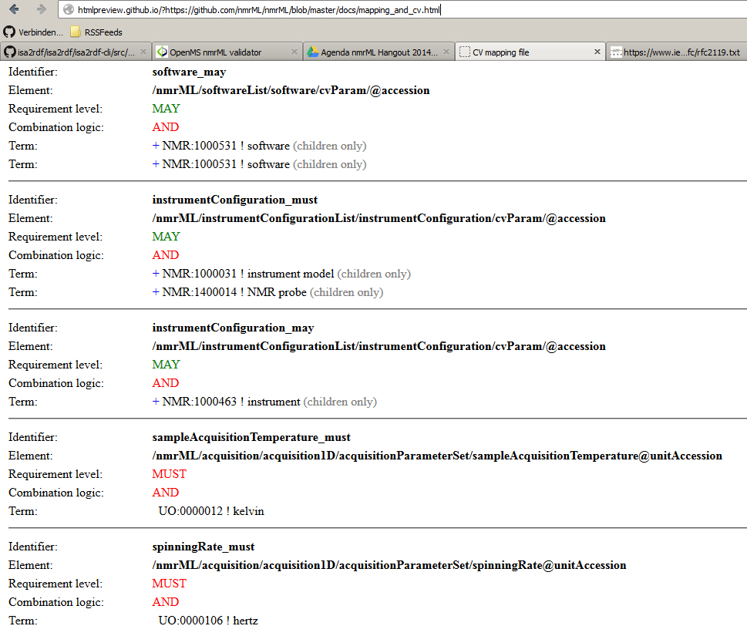

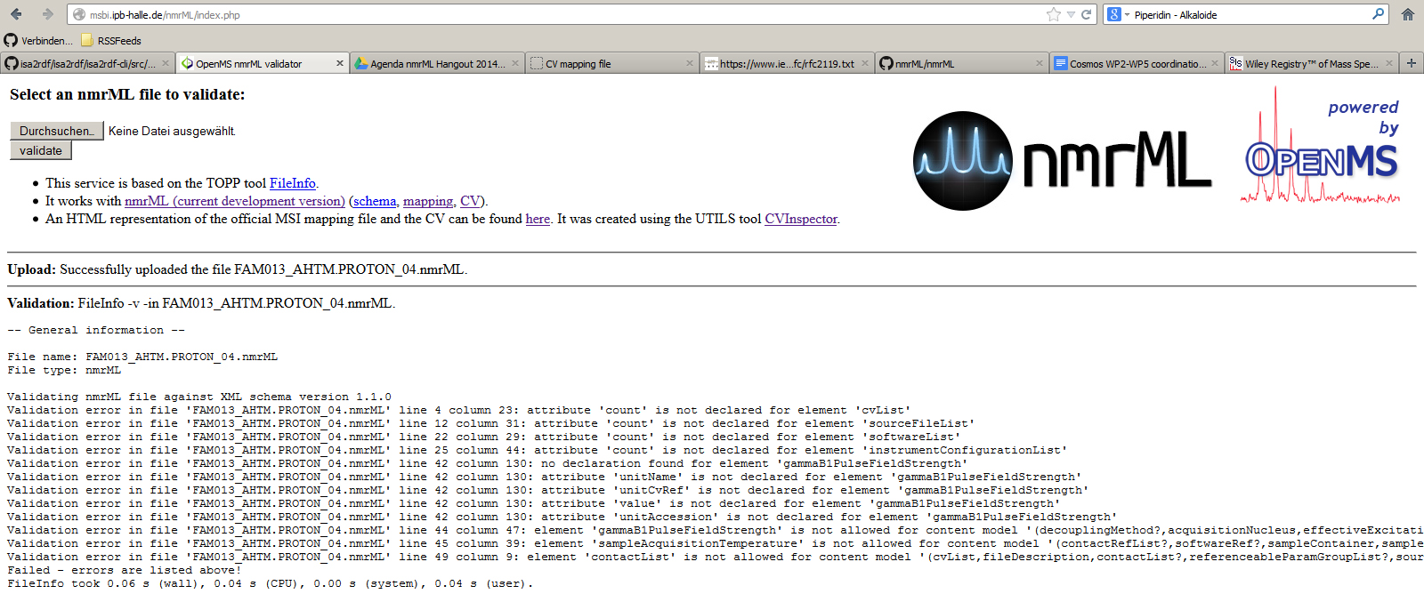



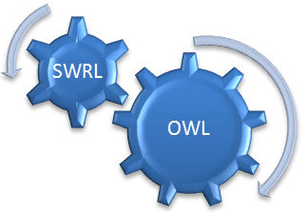









nmrML: an XML-based open standard for
NMR data storage and exchange
Daniel Schober ¹, Michael Wilson², Daniel Jacob³, Annick Moing³, Catherine Deborde³, Luis de Figueiredo⁴, Kenneth Haug⁴,
Philippe Rocca-Serra⁵, John Easton⁶, Christian Ludwig⁷, Antonio Rosato⁸, David Wishart², Christoph Steinbeck⁴, Reza Salek⁴, Steffen Neumann¹
The need for an open NMR standard
NMR data is currently accumulating in local data silos, hindering distribution and secondary data usage. Cross platform NMR data access, integration and comparison is hindered by incompatible vendor formats and the lack of a robust vendor-agnostic NMR data standard. Data in proprietary data formats age fast, posing the danger of irreproducible data from older studies. An open vendor-neutral storage standard is needed as a long-term archival format if emerging metabolomics repositories are to capture data from all vendor formats in a persistent way, that support the dynamics in the field.
The nmrML setup
nmrML setup
The COordination of Standards in MetabOlomicS, COSMOS EU consortium has teamed up with the Metabolomics Standards Initiative (MSI) to create an open exchange and storage format for NMR data. We largely follow design principles already established in the Proteomics Standards Initiative (PSI) for the mzML data standard for mass spectrometry. The standard is composed of an XML schema definition (nmrML.xsd) and an accompanying controlled vocabulary (nmrCV.owl), which ensures update flexibility and schema robustness by allowing to outsource more variant and dynamic descriptors into the vocabulary, which is referenced from within an nmrML data file.
xsd elements
& attributes
xsd datatypes
Stable experimental & raw data
nmrML.xsd
nmrCV terms
Variant terminological & contextual data
nmrCV.owl
nmrML.xsd
nmrML.xml data example
nmrML use cases
Data excerpt from a paper: Farag, M., Porzel, A., Schmidt, J. & Wessjohann, L. Metabolite profiling and fingerprinting of commercial cultivars of Humulus lupulus L. (hop) - a comparision of MS and NMR methods in metabolomics, Metabolomics 8, 492-507, (2012)
Open Format
Persistent
storage
Data Repositories
Intelligent
processing
Global
MetaboLights
HMDB
Increased Re-use
Quality
assurance
Local
[YOUR LOGO]
Format Conversion
Semantic Validators
Data Processing
Parsers
for vendor formats
& other standards, e.g. R
Error detection
Completeness
policy compliance
Decision support
Open NMR Tools
JCampDX
MetaboQuant
R statistics
nmrIO
Parsers
To ease format conversions we deliver parsers for Bruker & Agilent/Varian data formats, which can be incorporated into open NMR processing and analysis software.
Raw data
Proprietary Vendor Formats
Bruker or Agilent
Enriched data
JAVA parser
by D. Jacobs, Bordeaux
Python parser
by M. Wilson, Edmonton
ISA-Tab
Preexisting open formats
JCAMP-DX
Context enrichment
e.g. adding sample source
manual conversion
other parsers
nmrIO R package
by S. Neumann, Halle
Processed data
Visualisations
e.g. nmr spectra viewer
Statistical processing
e.g. R, rNMR, Batman
Metabolomics DBs
e.g. Metabolights, HMDB, …
Semantic data validation
We also deliver a semantic validator webservice, which checks the quality of your NMR data files in a multilayered approach, i.e. ensuring the data is syntactically well formatted, adheres to the nmrML.xsd, and is sufficiently detailed with respect to data content and CV annotations. Semantic validation exploits rules that set constraints on certain XML positions, i.e. which CV terms are allowed at a certain XML location. Such checks can enforce aspects of minimal information requirements, e.g. from the Core Information for Metabolomics Reporting (CIMR) or given journal policies.
Validation rules (html) for semantic checks on CV terms
The Validation Layer Onion
Validation webservice & result of schema compliance check
Syntax check
XML parser validates data on correct XML Syntax
Schema compliance check
Xerxes parser validates structural compliance
of data against XSD
Semantic check
Rule-driven validation verifies if CV terms are plausible at certain positions in data
MI Standard compliance check
Enforces completeness i.e. along Minimum Information checklists
like Core Information for Metabolomics Reporting (CIMR)
Journal Policy compliance check
Combined validation on nmrML AND additional publication metadata can ensure that the metabolomics Journal policies are met in an articles data set
Outlook
Project resources
Our standard is accepted by major open source NMR data processing tools and will serve the MetaboLights repository with a stable storage format. Coverage is already good at raw data capture, yet the XSD and CV will be expanded for better processed data & quantification data handling. We encourage potential users and the open source community to evaluate our resource and invite you for collaboration.
Website: http://www.nmrML.org
Github: https://github.com/nmrML/nmrML
Cosmos: http://www.cosmos-fp7.eu/
Email: info@nmrml.org
Google Group: https://groups.google.com/group/nmrml
¹Leibniz Institute of Plant Biochemistry, Dept. of Stress and Developmental Biology, Weinberg 3, 06120 Halle, Germany
²Department of Computing/Biological Sciences, University of Alberta, Edmonton, Canada
³INRA, Univ. Bordeaux, Metabolome Facility of Bordeaux Functional Genomics Center, 71 av Edouard Bourlaux, F-33140 Villenave d’Ornon, France
⁴European Molecular Biology Laboratory, European Bioinformatics Institute (EMBL-EBI), Wellcome Trust Genome Campus, Hinxton, Cambridge, CB10 1SD, UK
⁵University of Oxford, e-Research Centre, 7 Keble Road, Oxford, OX1 3QG, UK
⁶School of Electronic, Electrical and Computer Engineering, University of Birmingham, Edgbaston, Birmingham, B15 2TT, UK
⁷School of Cancer Sciences, University of Birmingham, Edgbaston, Birmingham, B15 2TT, UK
⁸Magnetic Resonance Center (CERM), University of Florence, 50019 Sesto Fiorentino (FI), Italy
MetaboLights: http://www.ebi.ac.uk/metabolights/
MSI: http://msi-workgroups.sourceforge.net/
CIMR-MI: http://mibbi.sourceforge.net/projects/CIMR.shtml
This project is funded through European Commission COSMOS Grant EC312941
MetaboLights
External Resources

