Slide 1
Tutorial for Sakai- Meetings
aka
Big Blue Button
Prepared by CVR, January 2018.

Slide 2
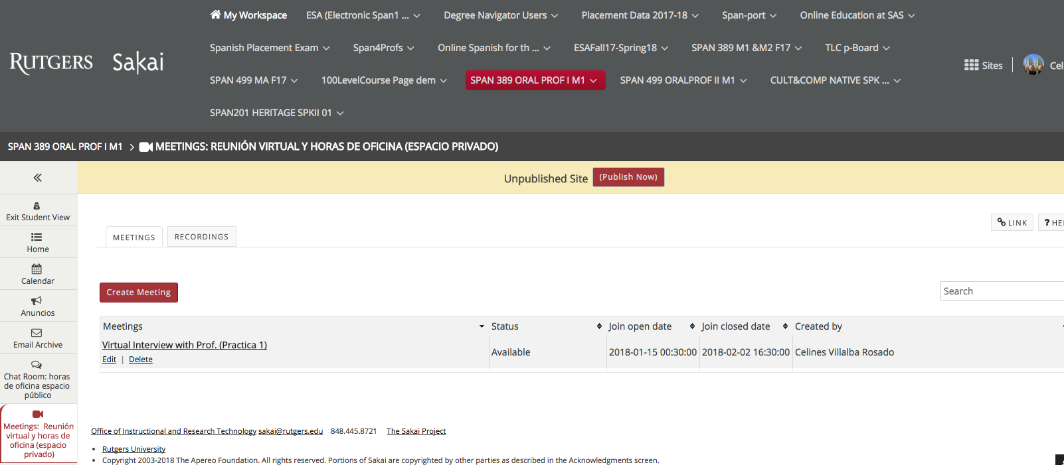
G. Where do I meet one on one with my Professor for office hours o for practice?
12. Sakai-Meetings (Big Blue Button)
You will use Sakai-meetings (BigBlueButton) for some tasks.
Here in Sakai you will meet with your professor for private office hours or for virtual meetings.
1. Click on it to enter. the session.

Slide 3
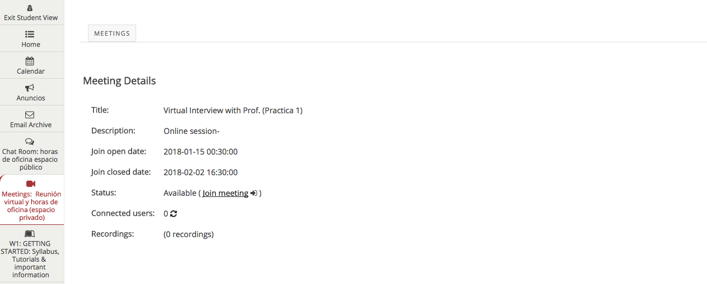
G. Where do I meet one on one with my Professor for office hours o for practice?
12. Sakai-Meetings (Big Blue Button)
2. Click on join meeting.

Slide 4
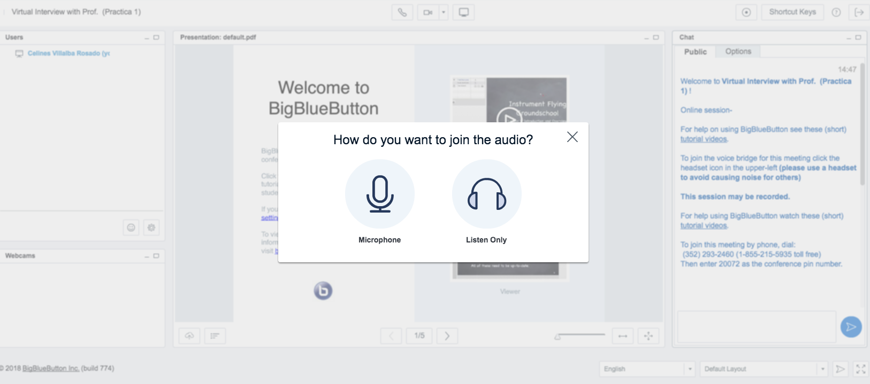
G. Where do I meet one on one with my Professor for office hours o for practice?
12. Sakai-Meetings (Big Blue Button)
3. Click on Microphone.

Slide 5
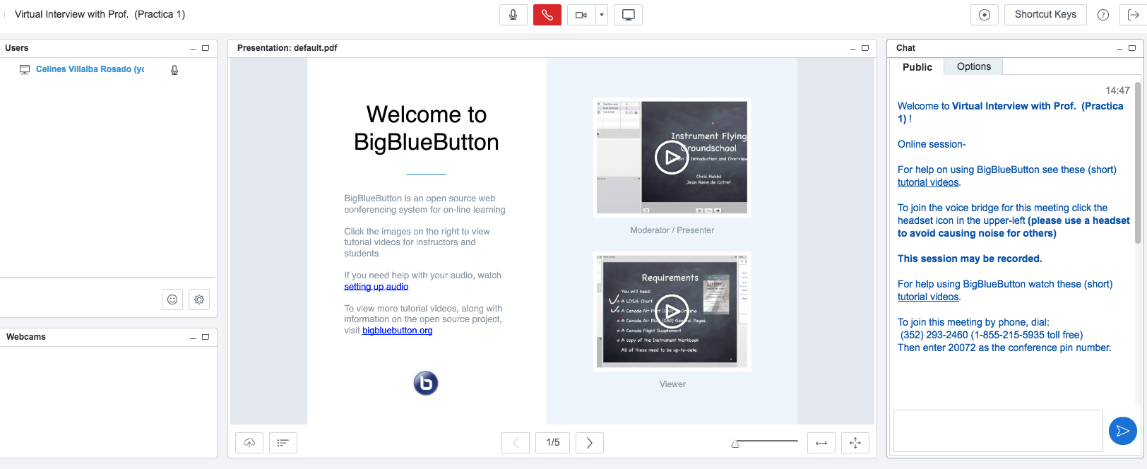
G. Where do I meet one on one with my Professor for office hours o for practice?
12. Sakai-Meetings (Big Blue Button)
4. Take tutorials and learn about:
Activate your video camera
How to set up your audio (speakers)
Your microphone
Locate Chat area

Slide 6
Where do I meet one on one with my Professor for office hours o for practice?
12. Sakai-Meetings

