Slide 1
Integration Solution
&
Enterprise Architecture
By DIXIT PATEL

Slide 2

Introduction
Enterprises are not architected at all.
They are grown.
Entrepreneur start Business.....
… with a business plan for a new venture
.... with too many unknowns
.... with establishment of a framework for growth.
… without architect an organization as an enterprise

Slide 3

Introduction
Enterprises are not architected at all.
They are grown.
Few years down the road......
… He will have a nice, healthy, growing enterprise on your hands
… but It won’t look much like that original plan
… lots of screw up work / plumbing is needed to fix problem/new changes

Slide 4
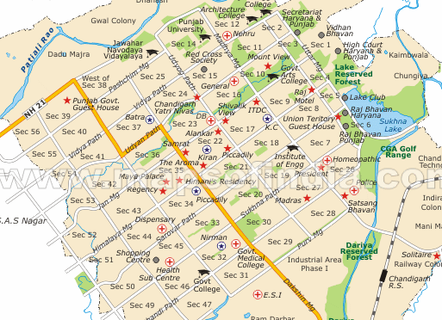
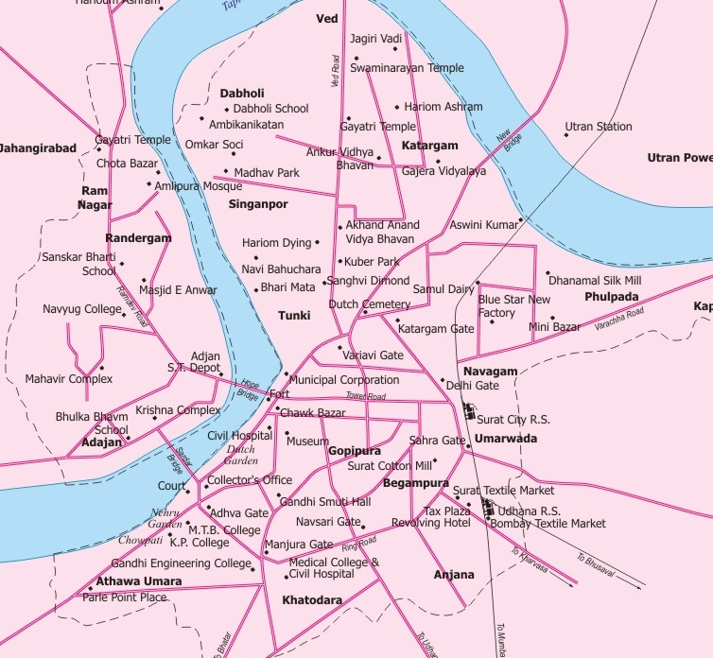
Introduction
Unplanned v/s Planned
What could be done....
… follow best practices for growing
… follow the framework for enterprise architecture

Slide 5
Introduction
Existing enterprises are not Architected well and they need to be screwed up
New business needs Enterprise Architecture & Best Practices at the start up to the stage they grow as an Enterprise

Slide 6
EAI
EAI

Slide 7
EAI - Introduction
What is EAI ( Enterprise Application Integration ) ?
… Integration between various Applications in an Enterprise
… Reuse what already exists while adding new applications and data.
… Software Infrastructure that creates a logical environment - Middleware
… Transportation services of our enterprise
… Modernize traditional system made with old technology

Slide 8
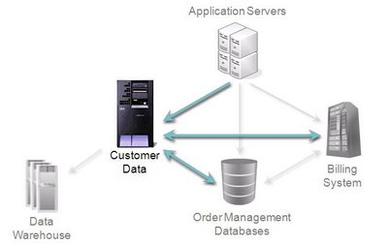
EAI
EAI

Slide 9
EAI - purpose
Purpose of EAI
… Data/Information consistency in multiple systems
… integration and link across applications
… single unified consistent access to various applications.
… Modernizing, consolidating, and coordinating the legacy applications
… linking together various systems from different operating systems, different database and different computer languages

Slide 10
EAI - Advantages
Advantages
… Real time information access among systems
… Streamlines business processes
… Raise efficiency
… Maintains information integrity across multiple systems
… Ease of development and maintenance
… Increase the business value of your IT environment.
… easily adoptaton of "change"

Slide 11
EAI
Why EAI by Independent Team....
… Special attention is needed for Integration
… project team have to provide solution in time to customer
(Target Date) which may be the main focus
… Expertise needed in Different kind of technology for EAI
… Different problem has different solution which need to be checked
with EAI Tools/Technology

Slide 12
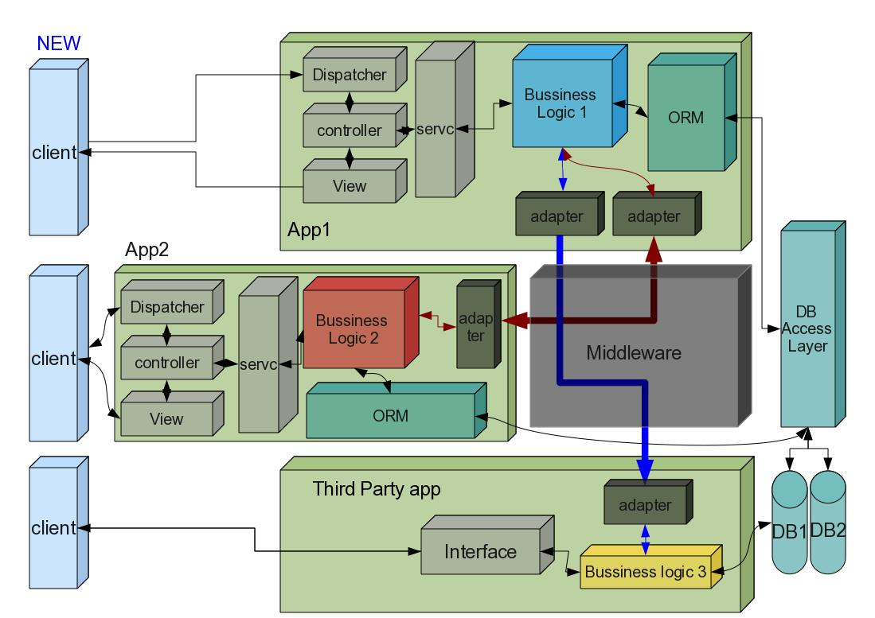

Slide 13
Thanks
Query ?
Doublt ?
Suggestion ?

