Slide 1
Jasper Report
What is Jasper Report?
Third Party Tool I-Report
Jasper File Types
Required Jar Files
Jasper Report Without Spring
Jasper Report With Spring
Extra Features

Slide 2
What is Jasper Report?
Open Source Reporting Engine
Entirely Written in Java
Supported Formats
CSV
Excel
PDF
HTML

Slide 3
Third Party Tool I-Report
Open Source Standalone Graphical Program
Provide Plugin to the Net beans
Provide Report Designer Capability
Able to Run Report

Slide 4
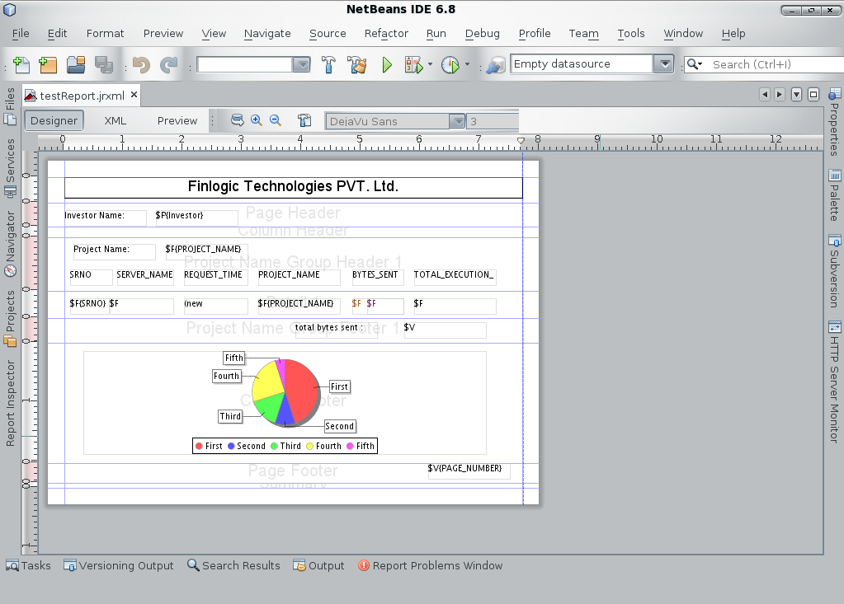
I-Report GUI

Slide 5
Jasper File Types
.jrxml file - This is design file in XML file.
.jasper file - This is compiled version of .jrxml file.

Slide 6
Required Jar Files
jasperreports-4.0.0.jar
itext-2.1.7.jar
bouncycastle.jar
jcommon-1.0.16.jar
commons-beanutils-1.8.0.jar
commons-collections-2.1.1.jar
commons-digester-1.7.jar
commons-logging-1.1.jar
jfreechart-1.0.13.jar
poi-3.6.jar

Slide 7
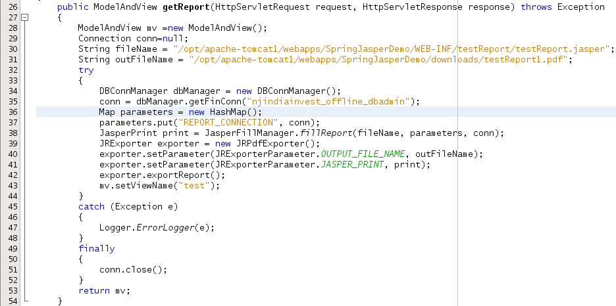
Jasper Report Without Spring
Sample code to generate Jasper Report.

Slide 8

Jasper Report With Spring
Supported File Types
JasperReportsCsvView
JasperReportsHtmlView
JasperReportsPdfView
JasperReportsXlsView
JasperReportsMultiFormatView
Dispatcher-Servlet.xml

Slide 9
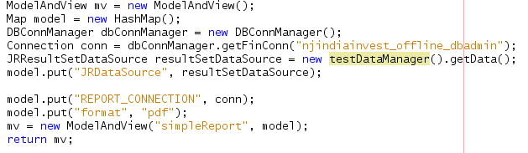
Jasper Report With Spring ...
views.properties file
TestController.java

Slide 10
Jasper Report With SubReport
Use to print associated data for each line item in a report.
2 Steps to add subreport.
Add subreport code to the design file for main report.
Create one or more design files for the subreport.

Slide 11
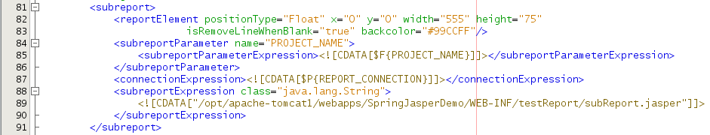
Subreport code for the design file
testReport.jrxml

Slide 12
Extra Features
Chart
Table
List
CrossTab
Image
Frame
Sub Report

Slide 13
THANKS
End of Presentation
Disclaimer:
This information package is prepared by NJ IndiaInvest on a confidential basis for internal consumption only. The contents, information of this package may not be disclosed, reproduced or used in whole or in part for any purpose or furnished to any other persons without the express prior written permission of NJ IndiaInvest. If you are not the authorised recipient of this information, please immediately destroy / delete the same, if any format that you have.
No representation or warranty, expressed or implied, is made nor is any responsibility of any kind accepted with respect to the completeness or accuracy of any information. NJ IndiaInvest and its directors, employees, agents and consultants shall have no liability (including liability to any person by reason of negligence or negligent misstatement) for any statements, opinions, information or matters (expressed or implied) arising out of, contained in or derived from, or for any omissions from the package.

