Slide 1
PART 1
What is Software Architecture ?
What is Architectural Pattern
Where is MVC ?
PART 2
What is MVC ?
How to achieve it using JAVA ?
Advantages
Software Architecture
& MVC
By DIXIT PATEL

Slide 2

Agenda
PART 1
What is Software Architecture ?
What is Architectural Pattern
Where is MVC ?

Slide 3
Development : Architecture -> Design -> Code
Software Architecture
creates
using
Architectural Pattern
MVC
Software Architect
Software Design
creates
using
Design Pattern
Code
creates
Developer

Slide 4
Development : Architecture -> Design -> Code
Software Architecture
Is the structure / structures of the system
Software components,
Externally visible properties of those components
Relationships between them.
Is the realization of non-functional requirements‏
Architectural pattern
Common fundamentals & characteristics on which Different architectures is designed
"strictly described and commonly available".
Even though an architectural pattern conveys an image of a system, it is not an architecture as such.

Slide 5
Development : Architecture -> Design -> Code
Software Design
A plan for a solution
Low-level component and algorithm implementation
Issues as well as the architectural view
Software design is the realization of functional requirements.
Takes care of Abstraction, Modularity, Control Hierarchy, Structural Partitioning, Data Structure, Information Hiding along with Functionality
Software Design pattern
Reusable solution to a commonly occurring problem
A design pattern is not a finished design that can be transformed directly into code.
Is a description or template for how to solve a problem that can be used in many different situations.

Slide 6
Development : Architecture -> Design -> Code
Code
Actual implementation of Architecture and Design.

Slide 7
Development : Architecture -> Design -> Code
Some architectural patterns
1) Model-View-Controller
( Presentation-abstraction-control, Model View Presenter, Model View View Model )‏
2) Service-oriented architecture
3) Multi tier architecture (often three-tier)
4) Client-Server
5) Layers
6) Component-Based Architectur
7) Pipe and filter architecture

Slide 8
Agenda
PART 2
What is MVC ?
How to achieve it using JAVA ?
Advantages
Suggestion & Queries

Slide 9
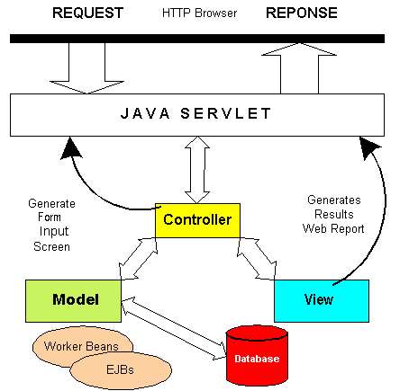
What is MVC
What is
Model-View-Controller
MVC is
an architectural pattern
The pattern isolates
"domain logic" from input and presentation (UI).

Slide 10
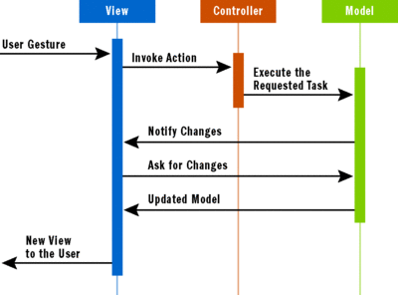
Control flow of MVC:

Slide 11
What is MVC
M (model)‏
Enterprise data and the Business rules
Access to and Updates of this data.
Domain-specific representation of the data
Data access layer is part of model.
How to implement MVC in JAVA – few example from many available options
Java classes
Entity beans
POJO in Spring framework.

Slide 12
What is MVC
V (view)‏
The view renders the contents of model
User interface element
Multiple views can exist for a single model for different purposes.
Specifies how that data should be presented.
push model : where the view registers itself with the model for change notifications
pull model : where the view is responsible for calling the model when it needs to retrieve the most current data.
How to implement MVC in JAVA – few example from many available options
Java Server Faces (JSF)‏
Java Server Page
Adobe Flex
Struts
servlet.

Slide 13
What is MVC
C (controller)
Receives input and initiates a response by making calls on model objects.
Instructs the model perform actions based on that input.
select an appropriate view Based on the user interactions and the outcome of the model actions.
How to implement MVC in JAVA – few example from many available options
Controller
JavaServer Faces (JSF)‏
Servlet
Struts
Spring

Slide 14
Why MVC
without Model-View-Controller
High Maintenance cost
Tightly coupled - interdependent
Can't Re-Use
Duplicate work
Complex
Data access , Business logic, and Presentation code are mixed and interdependent.
Difficult to maintain and change
High coupling makes classes difficult or impossible to reuse
New development requires rework and/or duplicate business logic/ Data access code
which then requires maintenance in multiple places

Slide 15
Why MVC
with MVC
The Model-View-Controller design pattern solves these problems by decoupling data access, business logic, and data presentation and user interaction.
change in design (HTML) without altering code (Java)
Modular separation of function
Easier to maintain
switching a database engine should not require any changes to Controllers or Views
permits independent development, testing and maintenance of each
Web design staff can modify UI without understanding code
Multiple views to share the same enterprise data model, which makes supporting multiple clients easier to implement, test, and maintain. (command line, web, mobile apps, swing)‏

Slide 16
Feedback
Question | suggestion | Feedback ??

Slide 17
Thank you
Thank You .........

