Slide 1



atmosphere-eubrazil.eu
@AtmosphereEUBR
TMA Framework Usage Demo

Slide 2
Outline
Kubernetes Cluster Initialization
TMA_Monitor Deployment
Client Usage
Probe Development
Containers Metrics Reported

Slide 3
Kubernetes Cluster Initialization

Slide 4
Kubernetes Cluster Initialization
Master Initialization
Master Configuration
Network Plugin Installation (Flannel)
Add static route for Kubernetes DNS

Slide 5
Kubernetes Cluster Initialization
Join a worker node to Kubernetes Cluster
All previous commands are explained in more detail in this README:
https://github.com/eubr-atmosphere/tma-framework-m/tree/master/development/server#prerequisites

Slide 6
TMA_Monitor Deployment

Slide 7
TMA_Monitor Deployment
Worker Node
Build base Docker image of Monitor
Build Docker image of Monitor on worker node
Build Docker image of Apache Kafka
Build Docker image of Apache Zookeeper

Slide 8
TMA_Monitor Deployment
Master Node
Deployment of Apache Kafka, and Apache Zookeeper using setup-testing-mode.sh script
Deploys Apache Kafka and Apache Zookeeper persistent volumes;
Deploys Apache Kafka and Apache Zookeeper images;
Creates Apache Kafka topic topic-monitor.

Slide 9
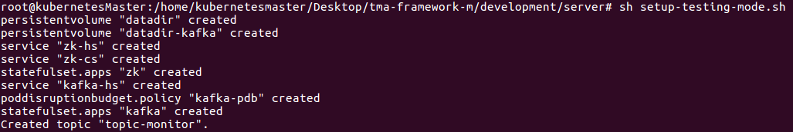
TMA_Monitor Deployment

Slide 10
TMA_Monitor Deployment
Master Node
Deployment of Monitor
With Monitor deployed, it can be accessed by two endpoints:
Inside Kubernetes Cluster
Outside Kubernetes Cluster

Slide 11
TMA_Monitor Deployment
Master Node
Inside Kubernetes Cluster
https://monitor-server-0.monitor-server.default.svc.cluster.local:5000/monitor
Outside Kubernetes Cluster
For instance, to check the Monitor pod IP:
To access Monitor, the endpoint is:
https://10.100.166.233:5000/monitor

Slide 12
Client Usage

Slide 13
Client Usage
Probes must be deployed to generate valid data and send them to Monitor endpoint.
Worker Node
Build Probe Docker base image
Build Probe Docker image

Slide 14
Client Usage
Worker Node
Deployment of Probe
Testing
Start an Apache Kafka consumer that receives all monitor data inside Apache Kafka pod.

Slide 15
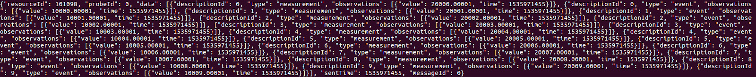
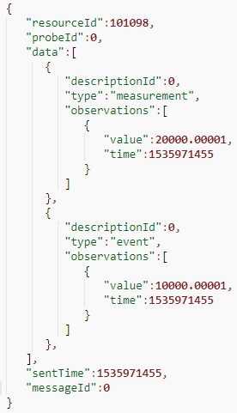
Client Usage

Slide 16
Probe Development

Slide 17
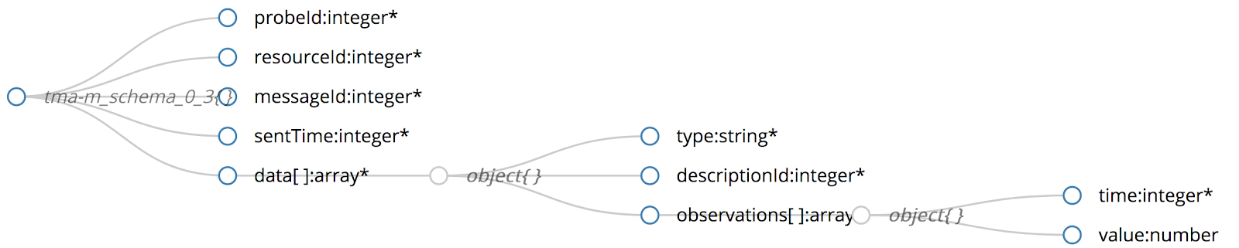
Probe Development
TMA_Monitor supports any probe that sends the collected data according the following schema:
Any programming language is supported.

Slide 18
Probe Development
There are base Docker images that support probes written both in Java and Python that can be used;
All base images already have the Monitor needed certificate to establish a session with it;
All base images are in dependency folder of the tma-framework-m repository;
All Docker images of probes to be developed must be built from the respective Docker base image.

Slide 19
Probe Development
Example: Probe Python Demo
It generates random valid data;
All files are presented in this directory:
This probe is composed by:
probe-python-demo.py;
communication.py;
data.py;
message.py;
observation.py.

Slide 20
Probe Development
Example: Probe Python Demo
probe-python-demo.py
Main file of the probe;
Generates random values for:
descriptionId;
value;
Time field gets the value of timestamp.
communication.py
Class that sends message to Monitor endpoint.

Slide 21
Probe Development
Example: Probe Python Demo
data.py
Class that builds data arrays with values of:
type;
descriptionId;
observations arrays.

Slide 22
Probe Development
Example: Probe Python Demo
message.py
Class that builds the message to send to Monitor with values of:
probeId;
resourceId;
messageId;
sentTime;
data object defined in data.py file.

Slide 23
Probe Development
Example: Probe Python Demo
observation.py
Class that builds observation arrays with values of:
time;
value.

Slide 24
Probe Development
Example: Probe Python Demo
After writing all code files, it is needed to build probe Docker image in Worker node. In this case:
Finally, deploy the probe in Kubernetes:

Slide 25
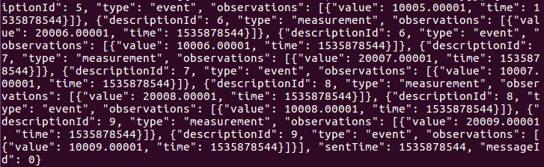
Probe Development
Example: Probe Python Demo
For testing purposes, execute an Apache Kafka consumer in Apache Kafka pod:
The data is received:

Slide 26

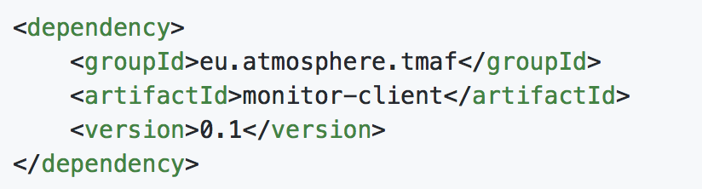
Probe Development
Example: Probe Java Demo
The development of Java probes can be done by using a library which is available through Maven:
Reference: https://github.com/eubr-atmosphere/tma-framework-m/tree/master/development/libraries
To use the library, add the following reference to the probe:

Slide 27
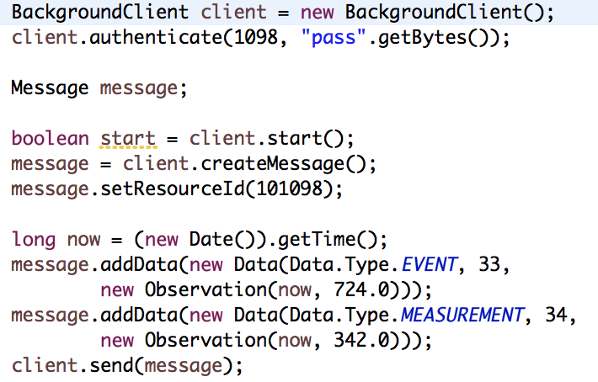
Probe Development
Example: Probe Java Demo
The following java code starts a client, and send the measurements to the monitor

Slide 28
Container Metrics Reported

Slide 29
Container Metrics Reported
Probe that collects some metrics of a Kubernetes pod;
K8s probe is in this directory:
K8s probe is composed by four python files:
dockerAPI.py;
message.py;
data.py;
observation.py.

Slide 30
Container Metrics Reported
dockerAPI.py
Metrics such as cpu values, memory usage and disk accesses are collected;
It sends these metrics in a format of json to TMA-Monitor;
The format of the messages respects the schema of this project.
message.py
Builds the message to send to Monitor API.

Slide 31
Container Metrics Reported
data.py
Class that represents data object of schema, specifies its type, descriptionId and observations.
observation.py
Constructs observation object with values of time (timestamp) and value.

Slide 32
Container Metrics Reported
This probe receives as input the name of the docker container to monitor, and the url of the TMA-Monitor;
Worker Node
Build Probe Docker image on Worker node;
Docker container is executed that will be the managed system;

Slide 33
Container Metrics Reported
Master Node
Probe deployment;
Testing
Start an Apache Kafka consumer that receives all monitor data inside Apache Kafka pod.

Slide 34
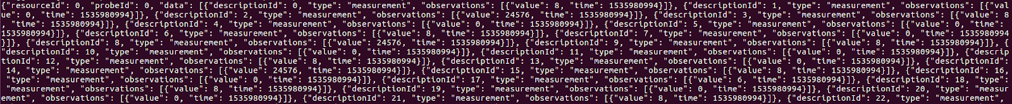
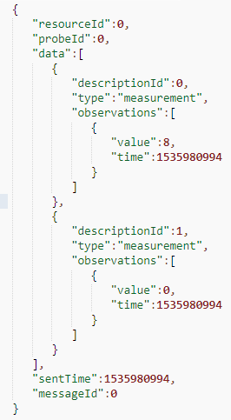
Container Metrics Reported

Slide 35


Thank you very much
for your attention!
mvieira@dei.uc.pt
nmsa@dei.uc.pt
josep@dei.uc.pt
Questions?
atmosphere-eubrazil.eu

