Slide 1

Architecture
Arnon Rotem-Gal-Oz
Product Line Architect
arnon@rgoarchitects.com
http://www.rgoarchitects.com

Slide 2


Agenda
Why Software Architecture?
What’s Software Architecture?
Architecture types ? Levels ???
Introduction to Architecture Documentation

Slide 3
Discussion
What’s Software Architecture

Slide 4

Architecting a dog house
Can be built by one person
Requires
Minimal modeling
Simple process
Simple tools
Kruchten
Notes:
.

Slide 5
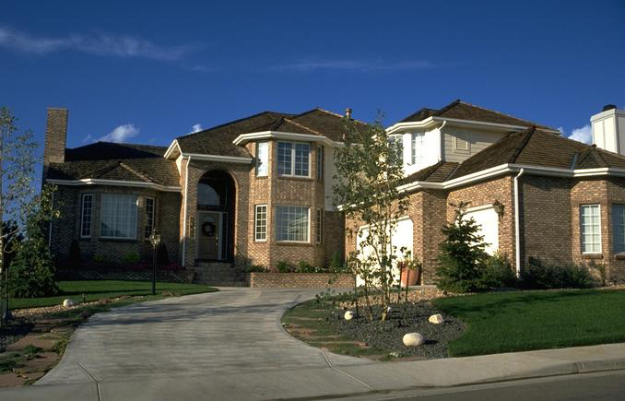
Architecting a house
Built most efficiently and timely by a team
Requires
Modeling
Well-defined process
Power tools
Kruchten
Notes:
.

Slide 6
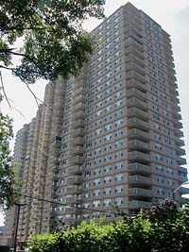
Architecting a high rise
Kruchten
Notes:
.

Slide 7
Differences
Scale
Process
Cost
Schedule
Skills and development teams
Materials and technologies
Stakeholders
Risks

Slide 8
Agenda
Why Software Architecture?
What’s Software Architecture?
Architecture types ? Levels ???
Introduction to Architecture Documentation

Slide 9
Architecture defined
Software architecture is what software architects do
Beck
Notes:
.

Slide 10


Architecture defined
Formal Definition
IEEE 1471-2000
  Software architecture is the fundamental organization of a system, embodied in its components, their relationships to each other and the environment, and the principles governing its design and evolution
IEEE 1471-2000
Notes:
.
Emphasize that the rationale for the architectural decisions is very important.

Slide 11


Architecture defined
Another Go
Software architecture encompasses the set of significant decisions about the organization of a software system
  Selection of the structural elements and their interfaces by which a system is composed
  Behavior as specified in collaborations among those elements
  Composition of these structural and behavioral elements into larger subsystems
  Architectural style that guides this organization
Booch, Kruchten, Reitman, Bittner, and Shaw
Notes:
.
Emphasize that the rationale for the architectural decisions is very important.

Slide 12
Architecture defined
Few More
Perry and Wolf, 1992
  A set of architectural (or design) elements that have a particular form
Boehm et al., 1995
  A software system architecture comprises
    A collection of software and system components, connections, and constraints
    A collection of system stakeholders' need statements
    A rationale which demonstrates that the components, connections, and constraints define a system that, if implemented, would satisfy the collection of system stakeholders' need statements
Clements et al., 1997
  The software architecture of a program or computing system is the structure or structures of the system, which comprise software components, the externally visible properties of those components, and the relationships among them
http://www.sei.edu/architecture/definitions.html
Notes:
.
Key words in the definitions are underlined.

Slide 13
Common elements 1/2
Architecture defines major components
Architecture defines component relationships (structures) and interactions
Architecture omits content information about components that does not pertain to their interactions
Behavior of components is a part of architecture insofar as it can be discerned from the point of view of another component
Notes:
.
Every system has an architecture, even if it is not formally “spec’ed out”.

Slide 14
Common elements 2/2
Every system has an architecture (even a system composed of one component)
Architecture defines the rationale behind the components and the structure
Architecture definitions do not define what a component is
Architecture is not a single structure -- no single structure is the architecture
Notes:
.
Every system has an architecture, even if it is not formally “spec’ed out”.

Slide 15
Architecture is Early
Architecture represents the set of earliest design decisions
  Hardest to change
  Most critical to get right
Architecture is the first design artifact where a system’s quality attributes are addressed

Slide 16
Architecture Drives
Architecture serves as the blueprint for the system but also the project:
  Team structure
  Documentation organization
  Work breakdown structure
  Scheduling, planning, budgeting
  Unit testing, integration
Architecture establishes the communication and coordination mechanisms among components

Slide 17
Architecture vs. Design
Architecture: where non-functional decisions are cast, and functional requirements are partitioned
Design: where functional requirements are accomplished
architecture
non-functional requirements
(“ilities”)
design
functional requirements
(domains)
Important : this is a general guideline – sometimes the borders are blurred
Notes:
.

Slide 18

System Quality Attribute
Performance
Availability
Usability
Security
Time To Market
Cost and Benefits
Projected life time
Targeted Market
Integration with Legacy System
Roll back Schedule
End User’s view
Business
Community
view
Maintainability
Portability
Reusability
Testability
Developer’s view
A list of quality attributes exists in
ISO/IEC 9126-2001 Information Technology – Software Product Quality
Notes:
We will return to this when we’ll speak about Evaluating Architectures (ATAM, LAAAM)

Slide 19
Agenda
Why Software Architecture?
What’s Software Architecture?
Software Architecture types ? Levels ???
Introduction to Architecture Documentation

Slide 20
Business Architecture
Concerned with the business model as it relates to an automated solution.
  E-business is a good candidate
  Structural part of requirements analysis.
  Domain Specific

Slide 21
Technical Architecture
Specific to technology and the use of this technology to structure the technical points (Technology Mapping) of an architecture
  .NET
  J2EE
  Hardware architects

Slide 22
Solutions Architecture
Specific to a particular business area (or project) but still reliant on being a technical focal point for communications between the domain architect, business interests and development.

Slide 23
Enterprise Architecture
The organizing logic for a firm’s core business processes and IT capabilities captured in a set of principles, policies and technical choices to achieve the business standardization and integration requirements of the firm’s operating model.
Concerned with cross project/solution architecture and communication between different practices in architecture.

Slide 24
Product Line Architecture
Common Architecture for a set of products or systems developed by an organization

Slide 25
Product Line - Initiation
Evolutionary
  Product line architecture and components evolve with the requirements posed by new product line members.
Revolutionary
    Product line architecture and components developed to match requirements of all expected product-line members

Slide 26
Agenda
Why Software Architecture?
What’s Software Architecture?
Architecture types ? Levels ???
Introduction to Architecture Documentation

Slide 27
IEEE 1471 - Recap
Recommended Practice for Architectural Description of Architectural Description of Software-Intensive Systems
  Define the Relations between
    Stakeholders
    Concerns
    Views
    Viewpoint
    Models
    Architectural Description

Slide 28
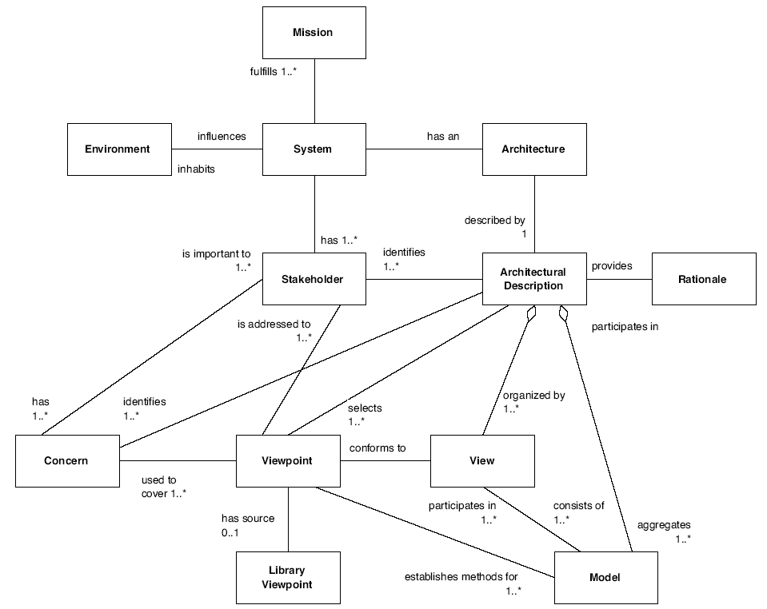
Documentation Conceptual Model
IEEE 1471-2000

Slide 29
Stakeholders & their concerns
Maintainer
Functionality
Price
End User
Dev Costs
Customer
On Time Delivery
Sales
Performance
Stability & Maintainability
Dev Manager
Ease of Use
Developer
Ease of Debugging
Modifiability
Sys Admin
Testability & Traceability
Structure & dependency between component
Ease of Installation
Ease of Integration

Slide 30
Documentation Conceptual Model
IEEE 1471-2000

Slide 31
Discussion
What views do you know / use

Slide 32
Views, Views and more Views
RUP – 4 + 1
RM-ODP – 5
DODAF – 3 (top level)
Zachman – 36(!)
MS – Well…

Slide 33
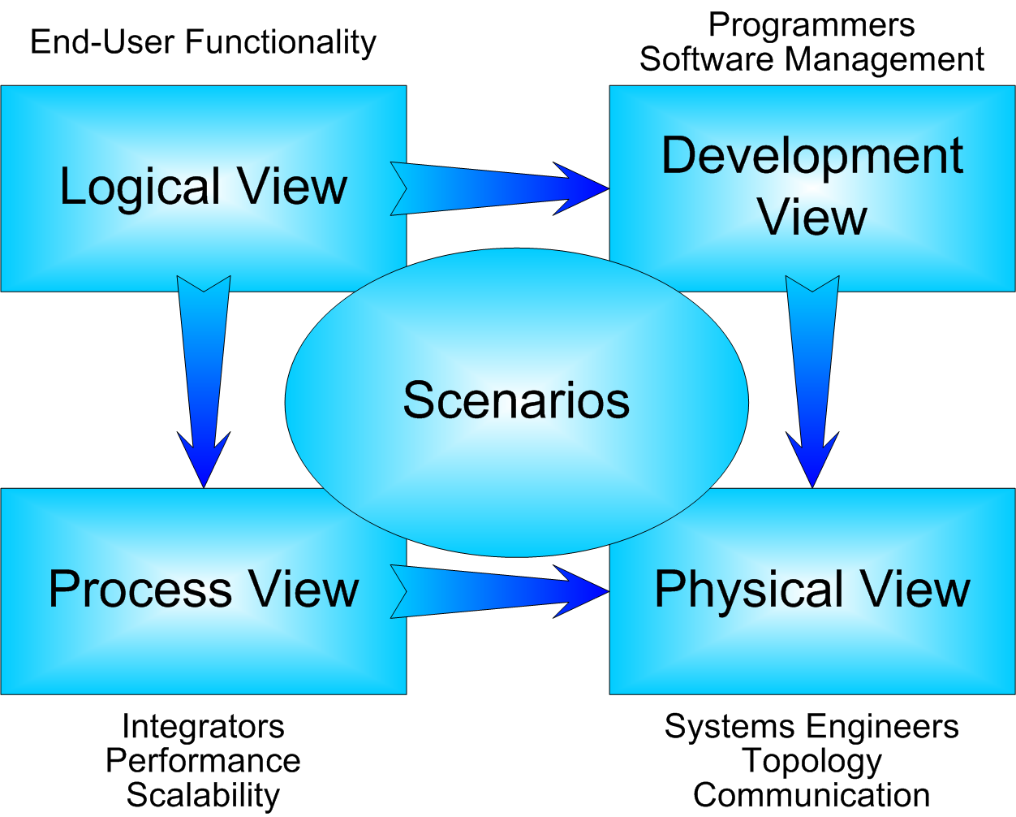
RUP – 4+1

Slide 34
RM-ODP Viewpoints (2001)
Manager
Enterprise
Business model
Database Modeler
Designers
Logical, data modeling
Logical view of services
Information
Computational
Operating Sys. Engineer
Developer
Servers, Comm,
Physical view of
data and services
(IDL, WSDL)
Engineering
Technology

Slide 35
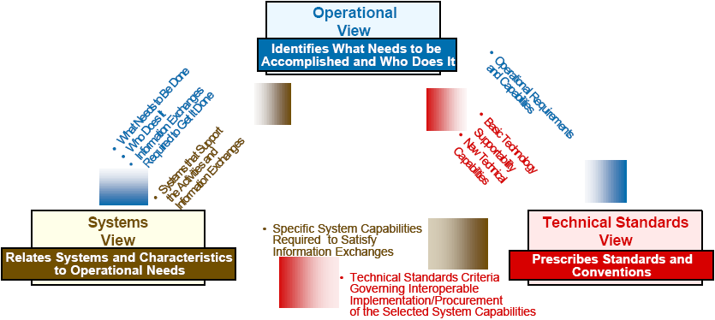
DODAF (3 Main Views)

Slide 36
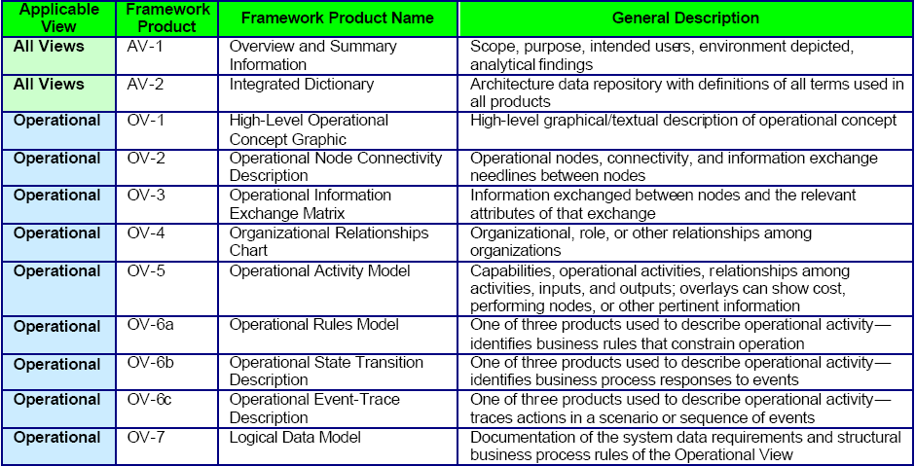
DoDAF Products 1/2

Slide 37
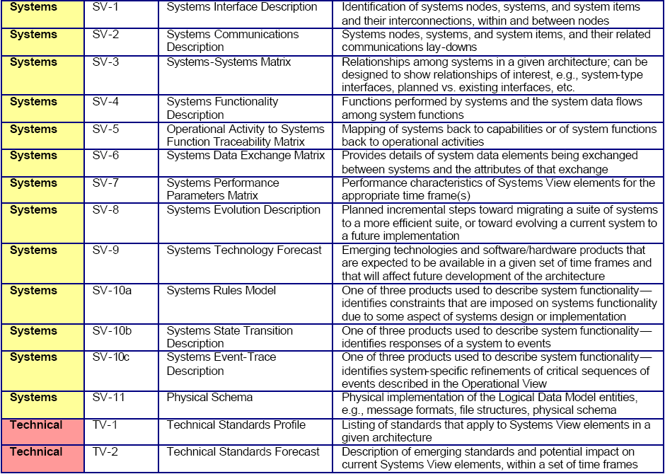
DoDAF Products 2/2

Slide 38
Zachman Framework
Data
(What)
Function
(How)
Network
(Where)
People
(Who)
Time
(When)
Motivation
(Why)
Scope (Ballpark) view
Owners View (Enterprise Model)
Designers View (System Model)
Builder’s View (Technology Model)
Out of Context View (Detailed Model)
Operational View (Functioning)

Slide 39
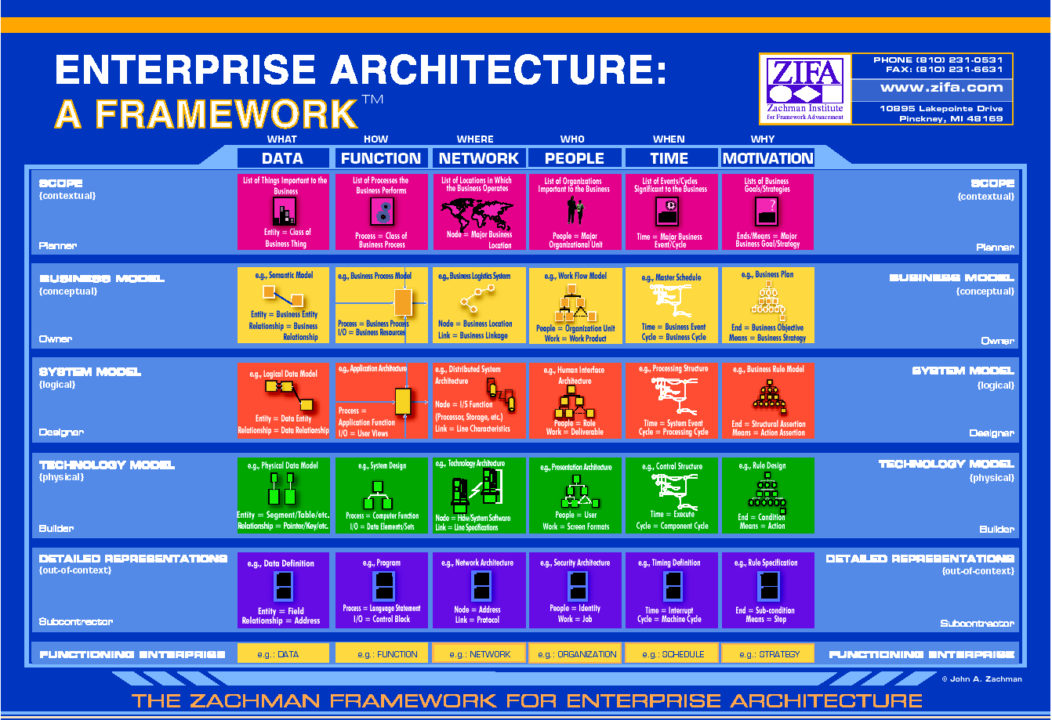

Slide 40
Old Model
MSF 3.0 + Views
Aimed at business executives
Aimed at business process owners
Aimed at architects and designers
Aimed at designers and developers
Contextual
Conceptual
Logical
Physical

Slide 41
Old Model
MSF 3.0 + Views
Business strategies & processes
Applications to facilitate business process
Information needed to manage business
Technology to support business & application needs
Contextual
Conceptual
Applications View
Information View
Technology View
Business View
Logical
Physical

Slide 42
New Model set of views and artifacts -
Business
Capabilities
Technology
Architecture
Manual
Procedures
Reconciliation
Business Processes
and Entities
Constraints
Reconciliation
Services, Messages,
Applications, Endpoints
Logical
Data Center
Constraints
Abstraction/
Refinement
Abstraction/
Refinement
XML, Projects,
DBs, Classes, Code
Physical servers & segments
Deployment
Units
packaged into
deployed on

Slide 43
Can be mapped…
Business
Applications
Information
Technology
Business
Capabilities
Technology
Architecture
Contextual
Manual
Procedures
Reconciliation
Conceptual
Business Processes
and Entities
Constraints
Reconciliation
Logical
Services, Messages,
Applications, Endpoints
Logical
Data Center
Constraints
Physical
Abstraction/
Refinement
Abstraction/
Refinement
XML, Projects,
DBs, Classes, Code
Physical servers & segments
Deployment
Units
packaged into
deployed on

Slide 44
Documentation Conceptual Model
IEEE 1471-2000

Slide 45
Models
Non-standard Models
ADL
UML
DSL

Slide 46
“Non Standard” - Block Diagrams
Signing
Authentication
Authorization
Rich UI
Controls
Monitoring
Log & Trace
Exception Management
Configuration
Web UI
Service Interface
Activity
Business Rules
Human Workflow
Workflow
Service Agents
DAL
E-Publish
EAI
ECM
DW
OLTP

Slide 47
An ADL Example (in ACME)
System simple_cs = {
  Component client = {Port send-request}
  Component server = {Port receive-request}
  Connector rpc = {Roles {caller, callee}}
  Attachments : {client.send-request to rpc.caller;
  server.receive-request to rpc.callee}
}
client
send-request
rpc
server
receive-request
caller
callee
Notes:
.

Slide 48
ADL - Pros
ADLs represent a formal way of representing architecture
ADLs are intended to be both human and machine readable
ADLs support describing a system at a higher level than previously possible
ADLs permit analysis of architectures – completeness, consistency, ambiguity, and performance
ADLs can support automatic generation of simulations / software systems
Notes:
.

Slide 49
ADL - Cons
There is not universal agreement on what ADLs should represent, particularly as regards the behavior of the architecture
Representations currently in use are relatively difficult to parse and are not supported by commercial tools
Most ADLs tend to be very vertically optimized toward a particular kind of analysis
Most ADL work today has been undertaken with academic rather than commercial goals in mind
Notes:
.

Slide 50
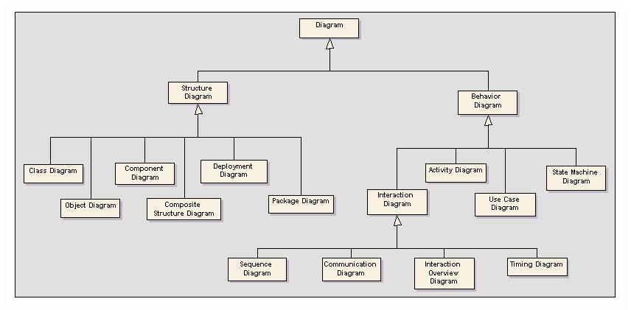
UML 2.0
13 diagram types

Slide 51
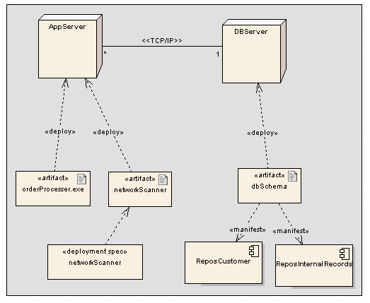
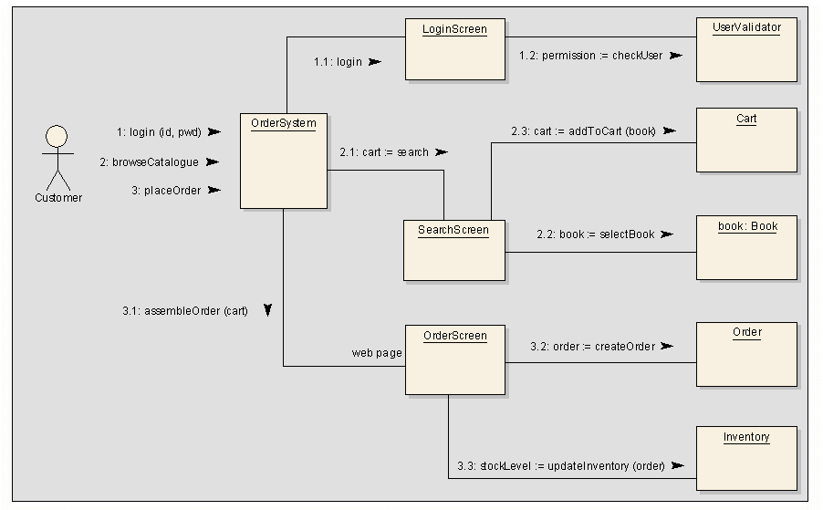
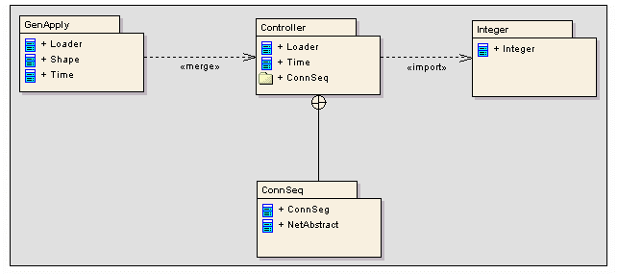
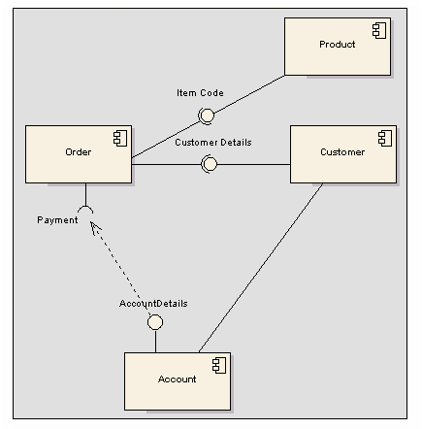
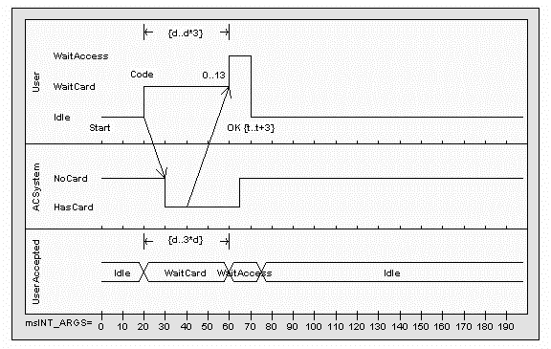
UML

Slide 52
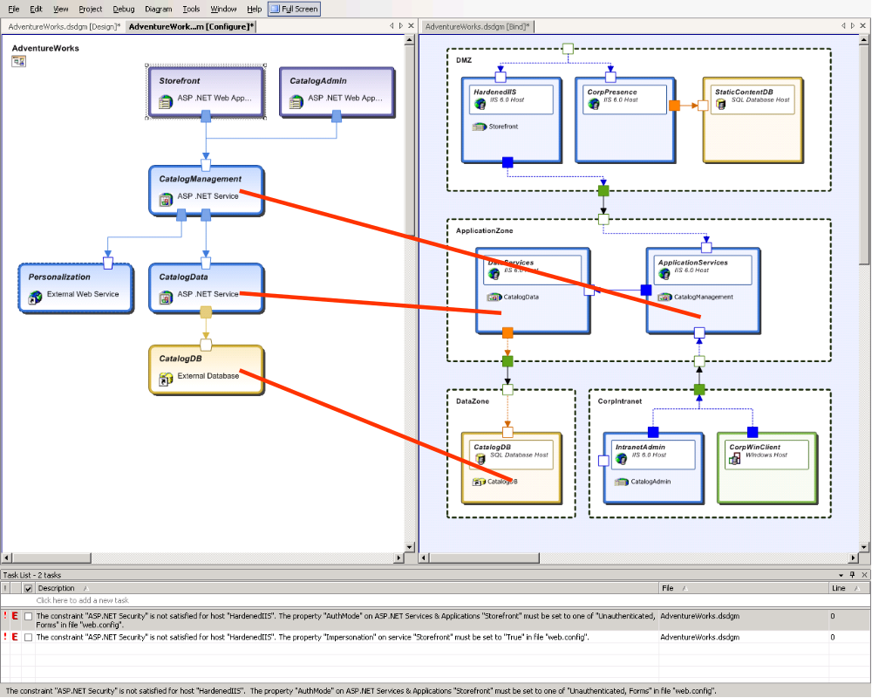
DSL
Business
Capabilities
Technology
Architecture
Manual
Procedures
Reconciliation
Business Processes
and Entities
Constraints
Reconciliation
Services, Messages,
Applications, Endpoints
Logical
Data Center
Constraints
Abstraction/
Refinement
Abstraction/
Refinement
XML, Projects,
DBs, Classes, Code
Physical servers & segments
Deployment
Units
packaged into
deployed on

Slide 53
ADL - revisited
ADLs are essentially a DSL for architecture
The Architecture DSLs in VSTS – can be considered as an ADL
  The difference – VSTS has a set of languages instead of one trying to encompass all views

Slide 54
Discussion
What’s the “best” modeling techniques

Slide 55
Documentation Conceptual Model
IEEE 1471-2000

Slide 56
Discussion
How much documentation

Slide 57
Famous Last Words…
“It is a very humbling experience to make a multimillion-dollar mistake, but it is also very memorable….” (Fred Brooks - “Mythical Man-Month” p.47)

Slide 58
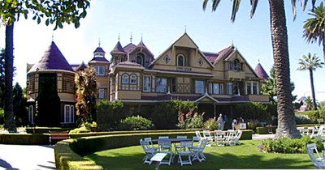
The Need of Architecture
The Winchester “Mystery” House
38 years of construction – 147 builders 0 architects
160 rooms – 40 bedrooms, 6 kitchens, 2 basements, 950 doors
65 doors to blank walls, 13 staircases abandoned, 24 skylights in floors
No architectural blueprint exists

