Slide 1

Java Server Faces

Slide 2
JSF defines
What is JSF?
A component architecture
A standard set of UI widgets
Application infrastructure
Powerful architecture for displaying component in different ways.
Automatically keeps UI components in synch with Java Objects (Backing beans).
Make web development faster and easier.

Slide 3
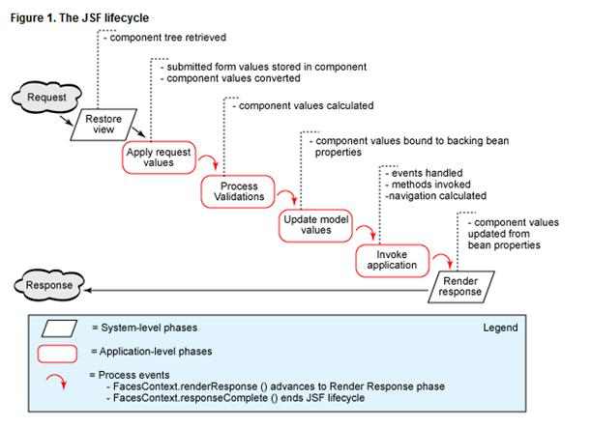
JSF Request Processing Life cycle
How JSF works?

Slide 4
1. Restore View
How JSF works?

