Slide 1
Classes and objects
Classes
Defining class
Instance variables
Constructors
Methods
Access modifiers
public – field accessible from all classes
Private – field accessible only within its own class
public class Bicycle {
// the Bicycle class has one fields
public int cadence;
// the Bicycle class has one constructor
public Bicycle(int startCadence, int startSpeed, int startGear) {
gear = startGear;
cadence = startCadence;
speed = startSpeed;
}
// the Bicycle class has one method
public void setCadence(int newValue) {
cadence = newValue;
}
}
Lab 8.1: Demonstration of using Access modifiers

Slide 2
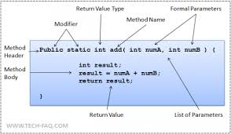
Classes and objects
Classes
Defining Methods
Method naming convention
Should be a verb in lowercase or a multi-word name that begins with a verb in lowercase, followed by adjectives, nouns, etc. In multi-word names, the first letter of each of the second and following words should be capitalized. Here are some examples:
Ex:
run
runFast
getBackground
getFinalData
compareTo
setX
isEmpty

Slide 3
Classes and objects
Classes: Overloading Methods
Methods within a class can have the same name if they have different parameter lists
Overloaded methods may have different return type.
public class MethodOverloadingDemo {
public void getEmpName(int empId) {
......
}
public void getEmpName(String empName) {
......
}
public void getEmpName(int empId, String empName) {
......
}
public void getEmpName(Date dob, String empName) {
......
}
}

Slide 4
Classes and objects
Classes: Constructors
Similar to method declarations—except that they use the name of the class and have no return type
There can be any number of constructors provided there are different number and types of arguments.
You can use any data type for a parameter of a method or a constructor
public Bicycle(int startCadence, int startSpeed, int startGear) {
gear = startGear;
cadence = startCadence;
speed = startSpeed;
}
Bicycle myBike = new Bicycle(30, 0, 8);

Slide 5
Classes and objects
Classes : Passing Primitive Data Type Arguments
Primitive arguments, such as an int or a double, are passed into methods by value.
Any changes to the values of the parameters exist only within the scope of the method
Classes: Passing Reference Data Type Arguments
Reference data type parameters, such as objects, are also passed into methods by value
This means that when the method returns, the passed-in reference still references the same object as before.
The values of the object's fields can be changed in the method, if they have the proper access level.
Lab9.1:
Passing primitive data type and reference data type arguments to contstuctors and methods.

Slide 6
Classes and objects
Objects:
Declaration
Instantiation
Initialization
Referencing object fields
Calling object’s methods
Lab9.2: Creating and using Objects.
Point originOne = new Point(23, 94);
Rectangle rectOne = new Rectangle(originOne, 100, 200);
Rectangle rectTwo = new Rectangle(50, 100);

Slide 7
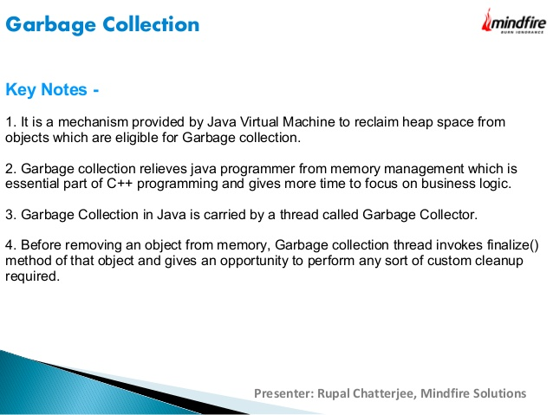
Classes and objects

Slide 8
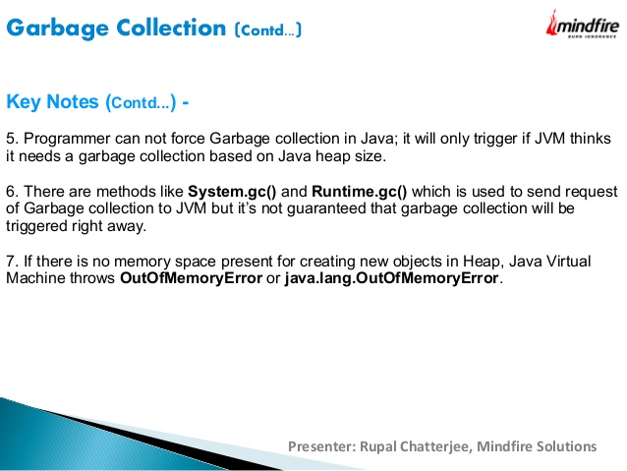
Classes and objects

Slide 9
Classes and objects
Returning Value from Method:
Any method declared void doesn't return a value.
Within the body of the method, you use the return statement to return the value.
A return statement can be used to branch out of a control flow block and exit the method
public Bicycle seeWhosFastest(Bicycle myBike, Bicycle yourBike, Environment env) {
Bicycle fastest;
// code to calculate which bike is
// faster, given each bike's gear
// and cadence and given the
// environment (terrain and wind)
return fastest;
}

Slide 10
Classes and objects - Packages
A package is a grouping of related types providing access protection and name space management.
Use packages for,
Easier to find and use classes
Avoid naming conflicts
Control access
Grouping related classes
Lab10.1: Demonstration of using the packages
//in the Circle.java file
package graphics;
public class Circle extends Graphic
implements Draggable {
. . .
}

Slide 11
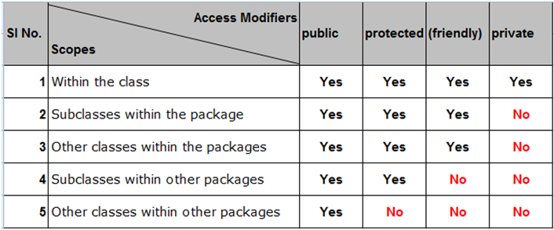
Classes and objects – Access modifiers
Determine whether other classes can use a particular field or invoke a particular method.
At the top level—public, or package-private (no explicit modifier).
At the member level—public, private, protected, or package-private (no explicit modifier).

Slide 12
Classes and objects - Packages
Naming convention:
Package names are written in all lower case
Companies use their reversed Internet domain name to begin their package names—for example, com.example.mypackage for a package named mypackage created by a programmer at example.com
//in the Circle.java file
package graphics;
public class Circle extends Graphic
implements Draggable {
. . .
}

Slide 13
Classes and objects - Packages
Static Imports:
Used to access to static final fields (constants) and static methods from one or two classes
public static final double PI
= 3.141592653589793;
public static double cos(double a){
...
}
Normally
double r = Math.cos(Math.PI * theta);
Using static import
import static java.lang.Math.PI;
import static java.lang.Math.cos;
double r = cos(PI * theta);
Referring to a Package Member by Its Qualified Name:
Ex:
graphics.Rectangle
graphics.Rectangle myRect = new graphics.Rectangle();
Importing a package member:
Ex: import graphics.Rectangle;
Rectangle myRectangle = new Rectangle();
Import entire package
import graphics.*;

Slide 14
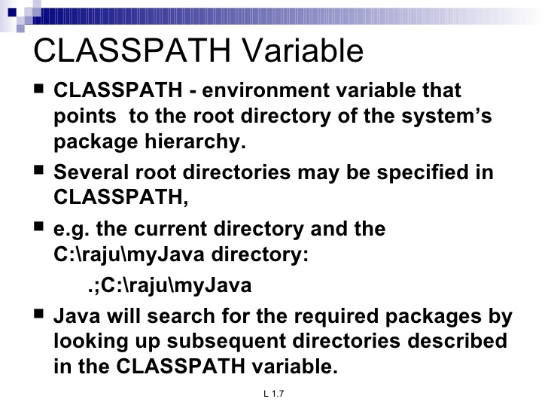
Classes and objects - Packages

Slide 15
Classes and objects
Class Members
Class Variables
Fields that have the static modifier in their declaration are called static fields or class variables
They are associated with class rather than with object.
Every instance of the class shares a class variable, which is in one fixed location in memory.
Any object can change the value of a class variable, but class variables can also be manipulated without creating an instance of the class.
Ex:
static double PI = 3.141592653589793;

Slide 16
Classes and objects
Class Members
Class Methods:
The methods with static modifier are called class method.
They can be invoked without creating the instance of the Class.
A common use for static methods is to access static fields
Instance methods can access instance variables and instance methods directly.
Instance methods can access class variables and class methods directly.
Class methods can access class variables and class methods directly.
Class methods cannot access instance variables or instance methods directly—they must use an object reference. Also, class methods cannot use the this keyword as there is no instance for this to refer to.
public static int getNumberOfBicycles() {
return numberOfBicycles;
}
Bicycle.getNumberOfBicycles();

Slide 17
Classes and objects
Constants:
The static modifier, in combination with the final modifier, is also used to define constants.
The final modifier indicates that the value of this field cannot change.
static final double PI = 3.141592653589793;
Lab10.2: Demonstration of using the packages, access modifier, class variable, class methods.

Slide 18
Classes and objects
Constants:
The static modifier, in combination with the final modifier, is also used to define constants.
The final modifier indicates that the value of this field cannot change.
static final double PI = 3.141592653589793;
Lab10.2: Demonstration of using the packages, access modifier, class variable, class methods.

Slide 19
Classes and objects
Initializing Fields:
public class BedAndBreakfast {
// initialize to 10
public static int capacity = 10;
// initialize to false
private boolean full = false;
}
Using static blocks:
static {
// whatever code is needed for initialization goes here
}

Slide 20
Classes and objects [Todo]
Sample programmes to display the correct output

Slide 21
Nested classes
Class within a class
Why Nested class?
For logically grouping classes that are only used in one place.
It increases encapsulation
More readable and maintainable code
inner classes have to be used where things belong together
Static and Non-static (inner class) nested classes
class OuterClass {
...
class NestedClass {
...
}
}
class OuterClass {
...
static class StaticNestedClass {
...
}
class InnerClass {
...
}
}

Slide 22
Nested classes
Non-static Nested class (Inner class):
class ScreenCapture {
class CaptureButtonListener implements ClickListener {
public void onClick( ClickEvent click ) {
//..capture
pressCount++;
}
}
Button button = new Button("capture");
int pressCount = 0;
void addListeners() {
button.addClickListener( new CaptureButtonListener() );
}
}
Inner classes can be instantiated as following:
OuterClass.InnerClass innerObject = outerObject.new InnerClass();

Slide 23
Nested classes
Static Nested class:
Button button = new Button("capture");
int pressCount = 0;
public void captureRequested() {
//do capture...
pressCount++;
}
void addListeners() {
button.addClickListener( new CaptureButtonListener(this) );
}
}
public class ScreenCapture {
public static class CaptureButtonListener implements ClickListener {
protected ScreenCapture controller;
public CaptureButtonListener( ScreenCapture controller ) {
this.controller = controller;
}
public void onClick( ClickEvent click ) {
//..capture
controller.pressCount++;
}
}
Static nested classes are accessed using the enclosing class name:
OuterClass.StaticNestedClass
For example, to create an object for the static nested class, use this syntax:
OuterClass.StaticNestedClass nestedObject = new OuterClass.StaticNestedClass();

Slide 24
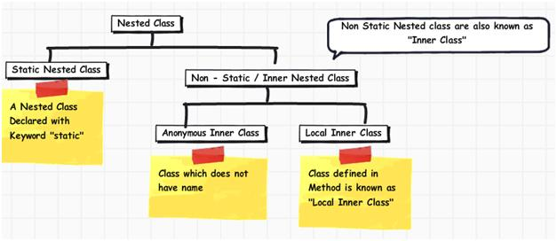
Nested classes
Lab11.1: Demonstration of using inner classes: ShadowTest
Lab11.2: Demonstration of using inner classes: DataStructure
:

Slide 25
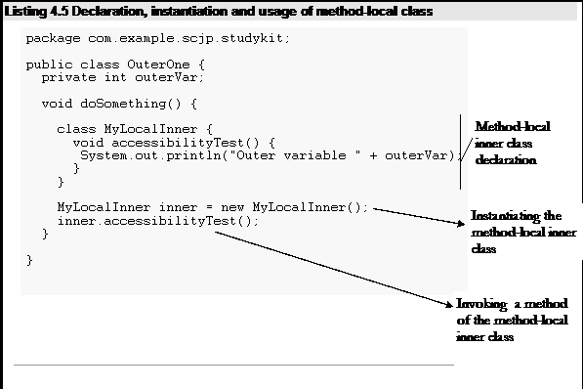
Nested classes
Local class:
Local classes are classes that are defined in a block

Slide 26
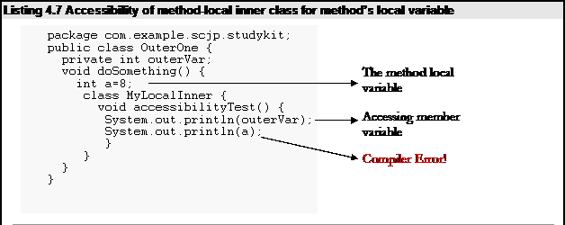
Nested classes
Local class:

Slide 27
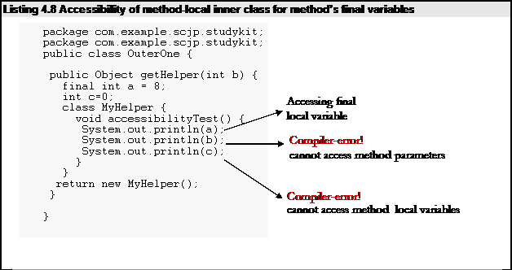
Nested classes
Local class:

Slide 28
Nested classes
Local class:
Local class can access only final local variables.
Local class can have access to method parameters.
Local class cannot have static initializers or member interfaces.
Local class can have only static final variables.
Lab11.3: Demonstration of using Local classes

Slide 29
Nested classes
Anonymous classes:
They are like local classes except that they do not have a name.
They enable you to declare and instantiate a class at the same time
Access to local variables same as for local class.
An anonymous class has access to the members of its enclosing class
Cannot access local variables in its enclosing scope that are not declared as final or effectively final.
cannot declare static initializers or member interfaces in an anonymous class
can have static members provided that they are constant variables.

Slide 30
class and object: enum type
enum types are used to represent a fixed set of constants.
Since they are constants, the names of an enum type's fields are in uppercase letters
Ex:
public enum Day {
SUNDAY, MONDAY, TUESDAY, WEDNESDAY,
THURSDAY, FRIDAY, SATURDAY
}
Lab11.5: Demonstration of using Enum types.
Lab11.6: Demonstration of using Enum types with calculations:

