Slide 1
exceptions
Java development with Eclipse IDE

Slide 2
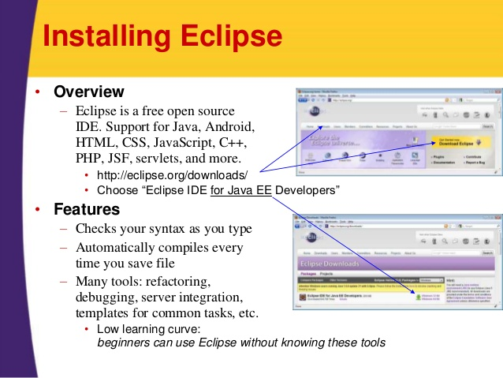
exceptions
Installing Eclipse
Lab20.1:
Installing Eclipse IDE

Slide 3
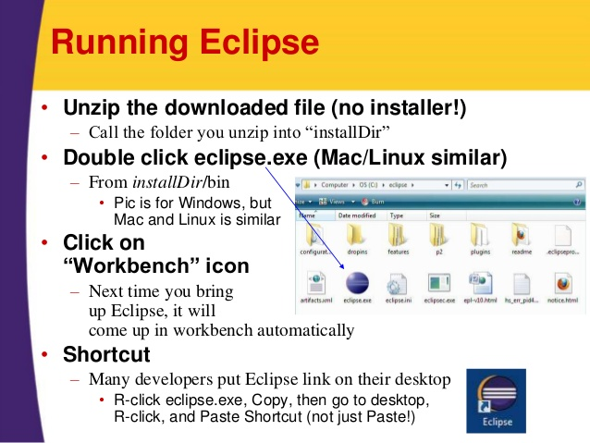
exceptions
Running Eclipse
Lab20.2:
Hello world java program in eclipse.
Lab20.3: Importing existing projects into workspace

Slide 4
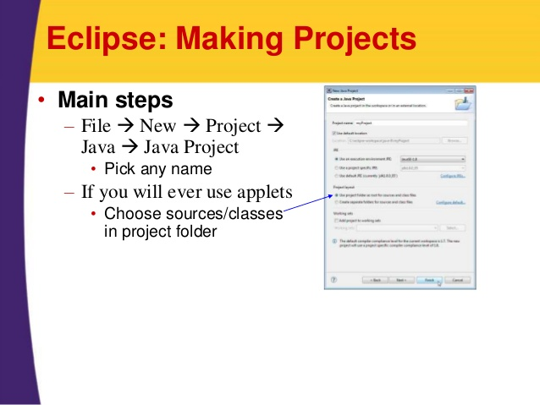
exceptions
Running Eclipse

Slide 5
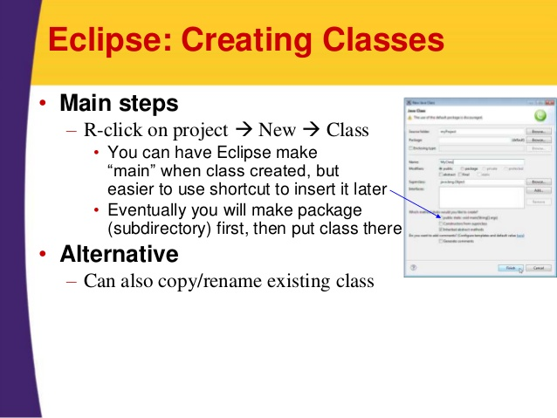
exceptions
Running Eclipse

Slide 6
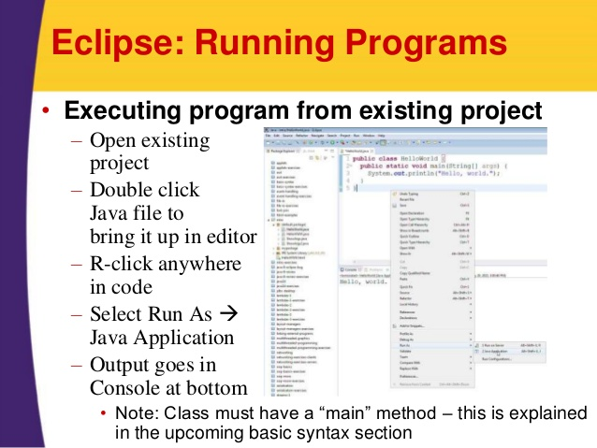
exceptions
Running Eclipse

Slide 7
exceptions
References:
http://www.slideshare.net/martyhall/java-8-programming-tutorial-java-with-eclipse-setup-and-getting-started

Slide 8
exceptions
Running Eclipse

Slide 9
exceptions

Slide 10
Java - miscellaneous
Type Comparison Operator instanceof
The instanceof operator compares an object to a specified type.
You can use it to test if an object is an instance of a class, an instance of a subclass, or an instance of a class that implements a particular interface
Classes implementing interfaces
class MyClass extends MySuperClass implements YourInterface {
// field, constructor, and
// method declarations
}

Slide 11
Java - miscellaneous
Varargs – Specifying Arbitrary number of arguments
public Polygon polygonFrom(Point... corners) {
int numberOfSides = corners.length;
double squareOfSide1, lengthOfSide1;
squareOfSide1 = (corners[1].x - corners[0].x)
* (corners[1].x - corners[0].x)
+ (corners[1].y - corners[0].y)
* (corners[1].y - corners[0].y);
lengthOfSide1 = Math.sqrt(squareOfSide1);
// more method body code follows that creates and returns a
// polygon connecting the Points
}
You will most commonly see varargs with the printing methods; for example, this printf method:
public PrintStream printf(String format, Object... args)
allows you to print an arbitrary number of objects. It can be called like this:
System.out.printf("%s: %d, %s%n", name, idnum, address);

Slide 12
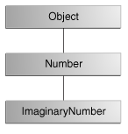
Java - miscellaneous
Returning a Class or Interface
When a method uses a class name as its return type the class of the type of the returned object must be either a subclass of, or the exact class of, the return type.
public Number returnANumber() {
...
}
The returnANumber method can return an ImaginaryNumber but not an Object. ImaginaryNumber is a Number because it's a subclass of Number. However, an Object is not necessarily a Number — it could be a String or another type

Slide 13
Advanced java
Garbage collection
JDBC
Lambda expressions
Annotations
Aggregate operations on collection using Lambarda expression.
Java streaming
Blocking queue
Aggregate operations
Autoboxing and unboxing

Slide 14
https://docs.oracle.com/javase/tutorial/reallybigindex.html
http://www.slideshare.net/EdurekaIN/java-class-3
http://www.slideshare.net/abdurrehmanabdurrehman391/variables-and-data-types-by-sir-khalid
http://www.slideshare.net/abdurrehmanabdurrehman391/java-advancedoop
http://www.slideshare.net/MindfireSolutions/java-garbage-collection-how-it-works?next_slideshow=1
http://www.slideshare.net/arnold7490/unit-4-java
http://www.slideshare.net/arnold7490/unit-3-java?next_slideshow=1
http://www.slideshare.net/tushardesarda/java-tutorial-3
http://www.slideshare.net/muralidhar9e/java-exception-handling-ppt
http://www.slideshare.net/emprovise/2-javabasics
http://www.slideshare.net/AllanHuang/java-new-evolution
http://www.slideshare.net/antonkeks/4-collections
http://www.slideshare.net/andreaiacono/java8-39841939 - Java8 features
http://www.slideshare.net/AbhishekKhune/07-java-collection
http://www.slideshare.net/shahjahan786/generics-27960064 - Generics
http://www.slideshare.net/caroljmcdonald/java-generics-2485138?next_slideshow=1

Slide 15
http://www.slideshare.net/KavitaGanesan/is-66154415-kavitaganesanv2 - Strings
http://www.slideshare.net/antonkeks/10-threads - Threads
http://www.slideshare.net/BenjDelMundo/java-thread-synchronization - Synchronization
http://www.slideshare.net/javaonkar/thread-concurrancy - Synchronization
http://www.slideshare.net/lineking/io-package - Basic IO
http://new.51cto.com – Buffered streams.
http://www.slideshare.net/EmertxeSlides/010-core-javaiofundamentals - IO
http://www.slideshare.net/martyhall/file-io-in-java-8-applying-the-power-of-streams - File IO
http://www.slideshare.net/boulderjug/55-things-in-java-7 - File IO

