Slide 1
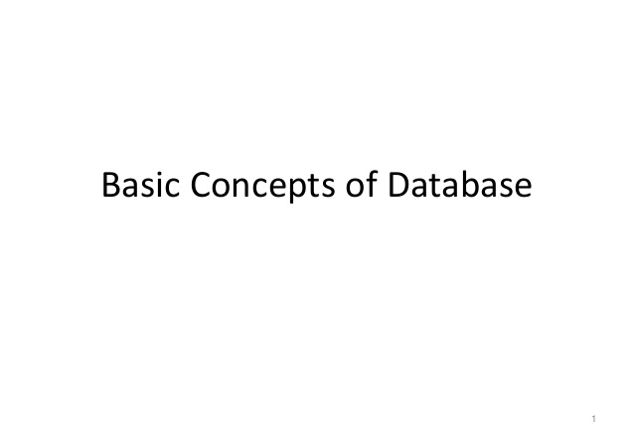
exceptions

Slide 2
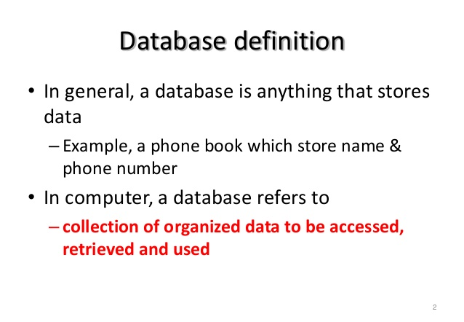

exceptions

Slide 3
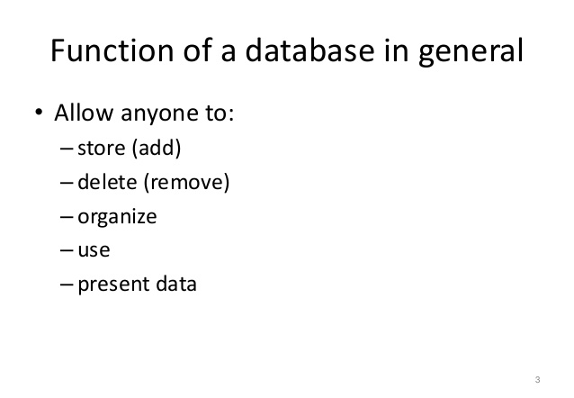
exceptions

Slide 4
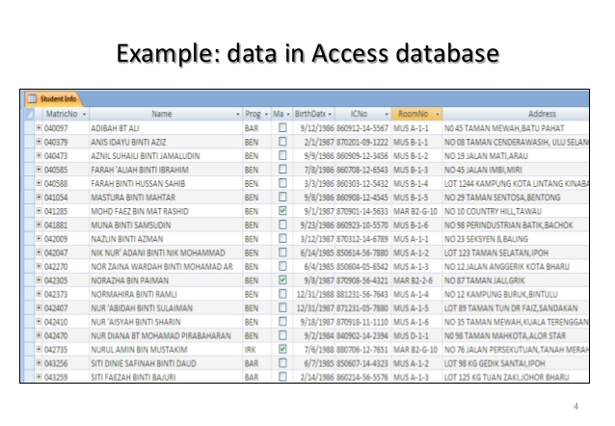
exceptions

Slide 5
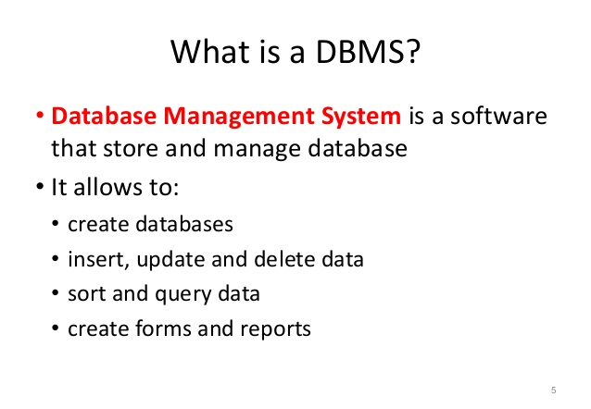
exceptions

Slide 6
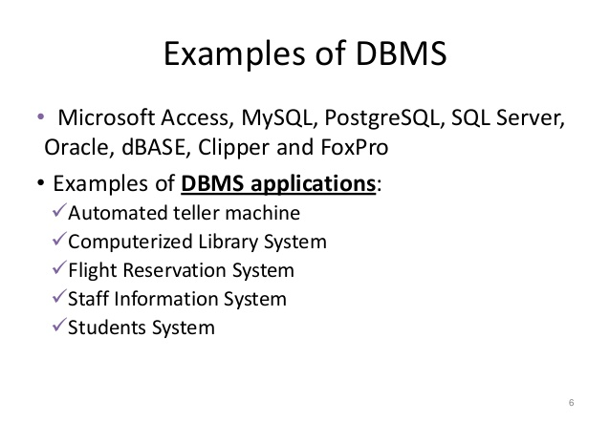
exceptions

Slide 7
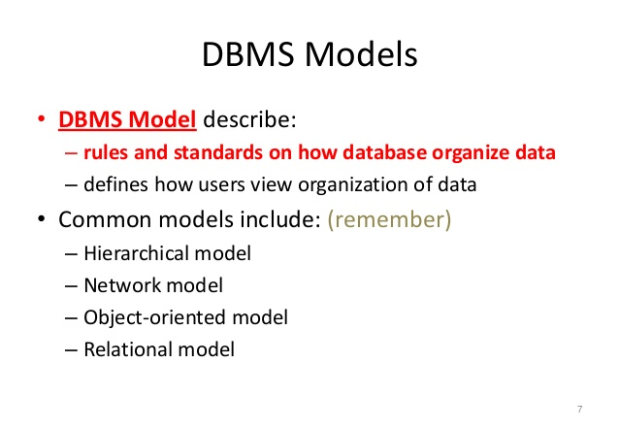
exceptions

Slide 8
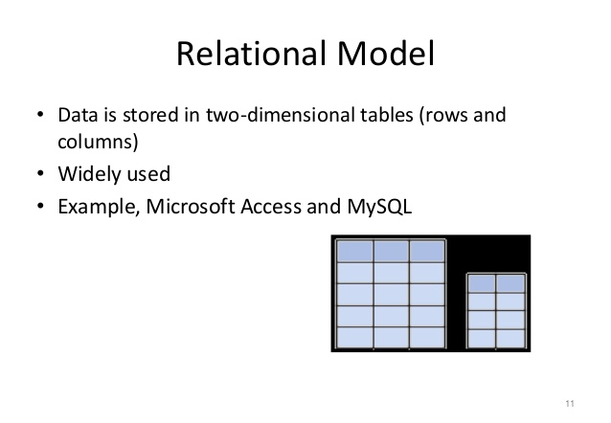
exceptions

Slide 9
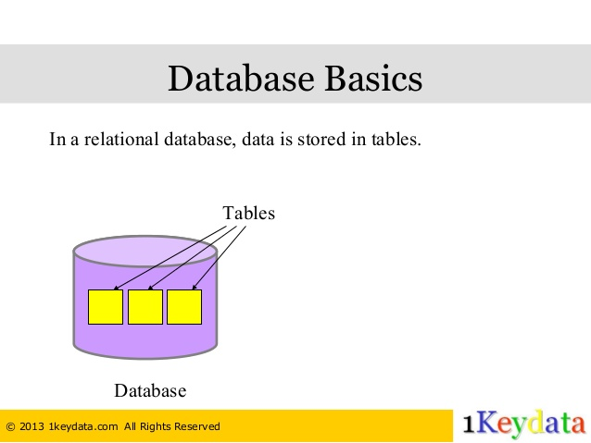
exceptions

Slide 10
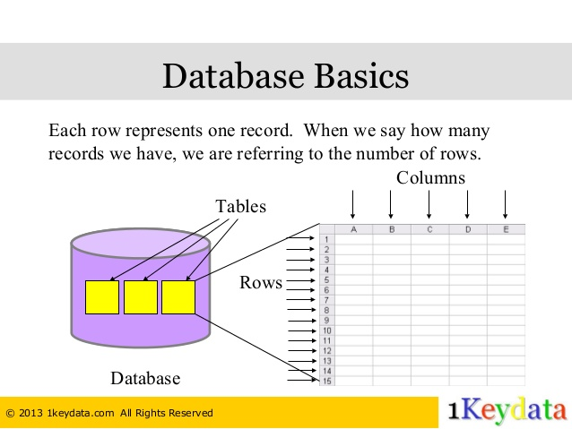
exceptions

Slide 11
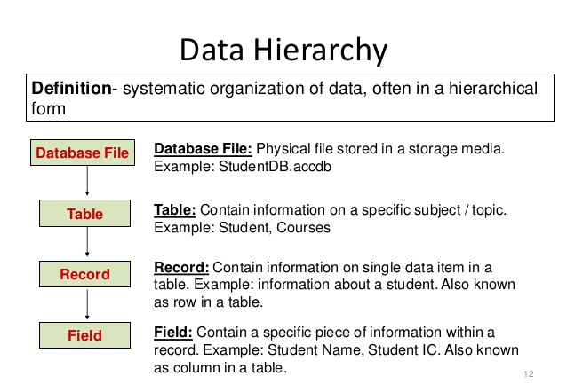
exceptions

Slide 12
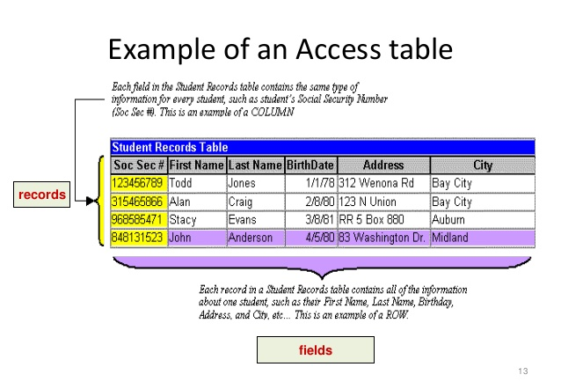
exceptions

Slide 13
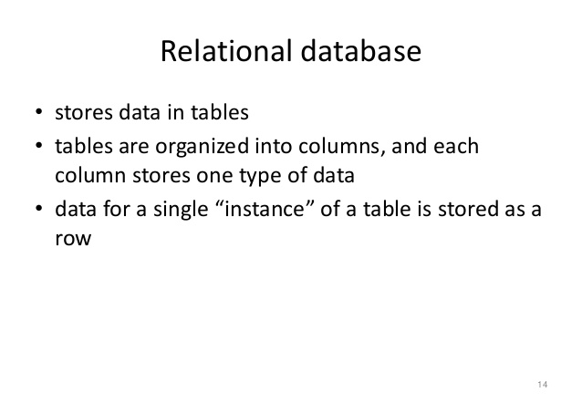
exceptions

Slide 14
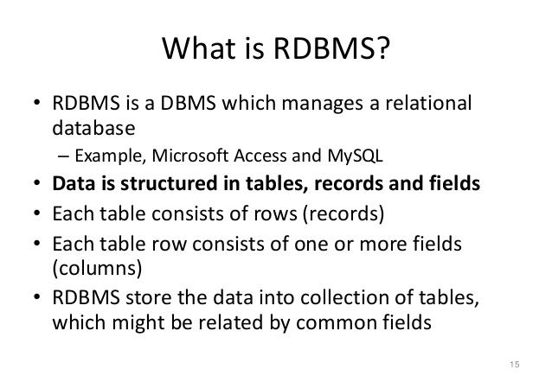
exceptions

Slide 15
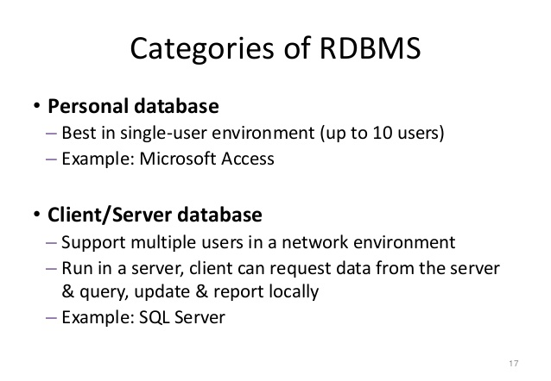
exceptions

Slide 16
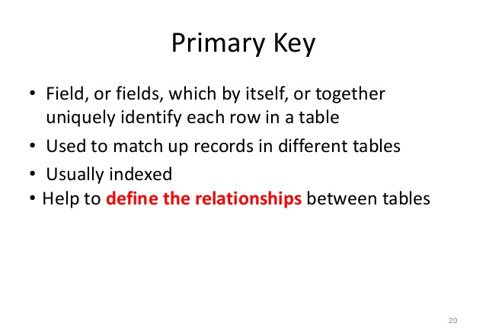
exceptions

Slide 17
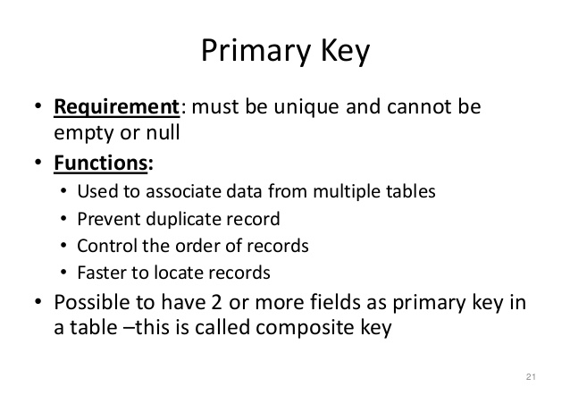
exceptions

Slide 18
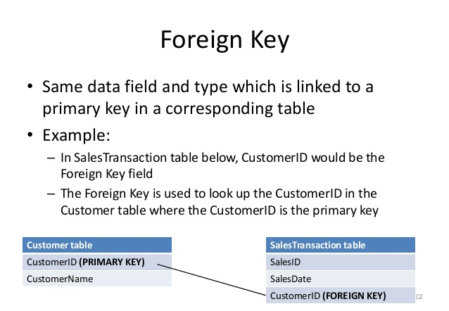
exceptions

Slide 19
exceptions
SQL
(Structured Query Language)

Slide 20
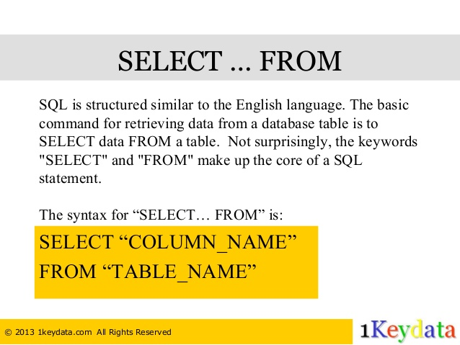
exceptions

Slide 21
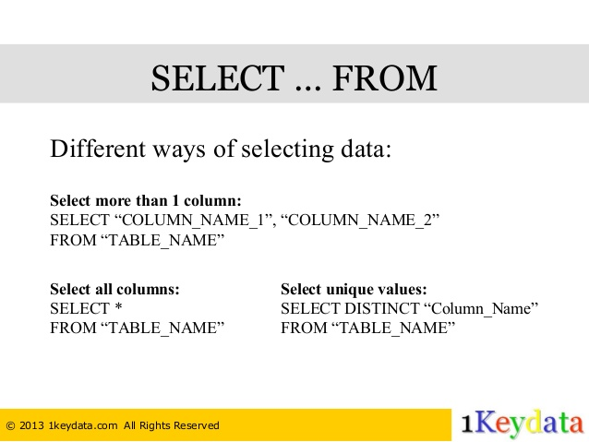
exceptions

Slide 22
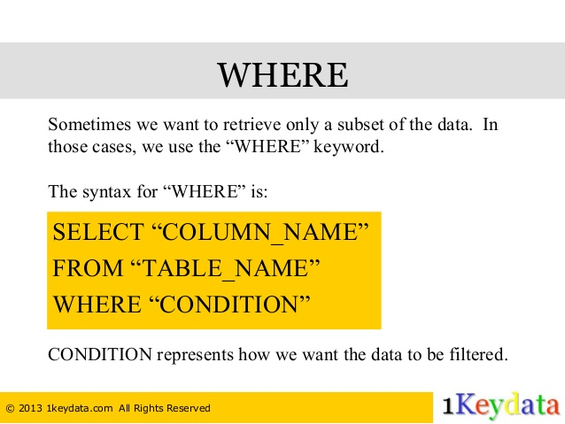
exceptions

Slide 23
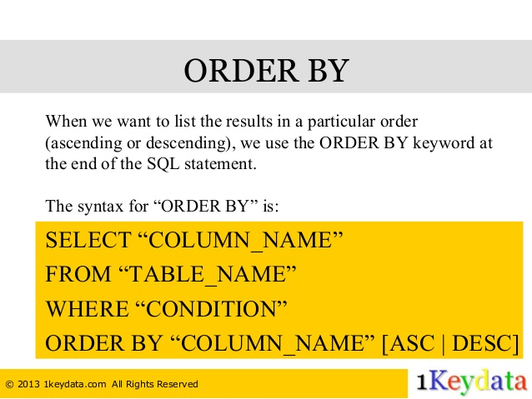
exceptions

Slide 24
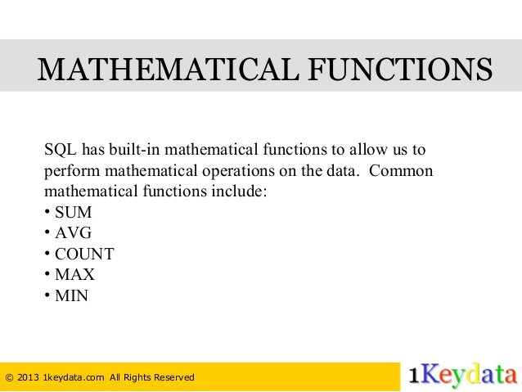
exceptions

Slide 25
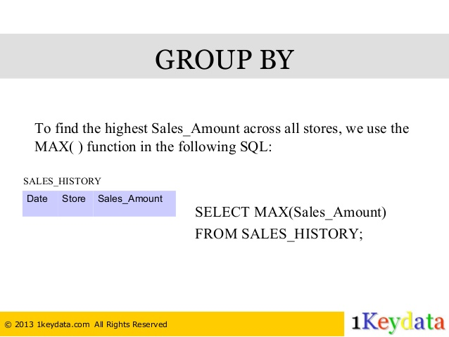
exceptions

Slide 26
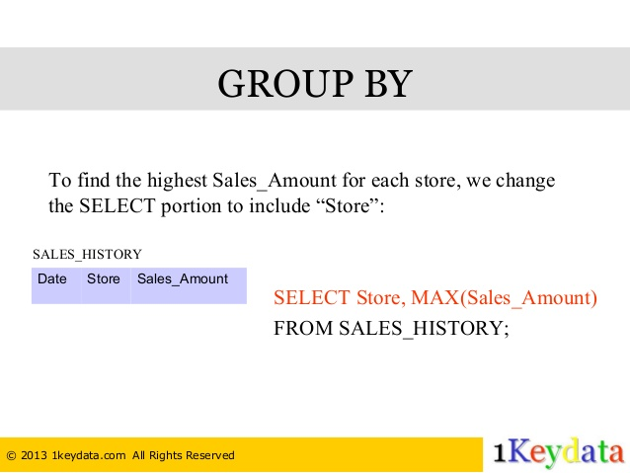
exceptions

Slide 27
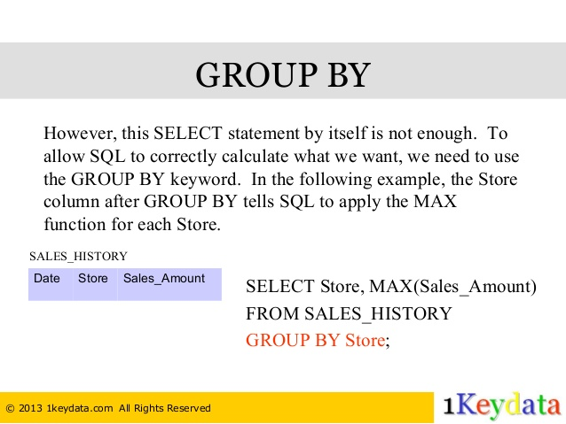
exceptions

Slide 28
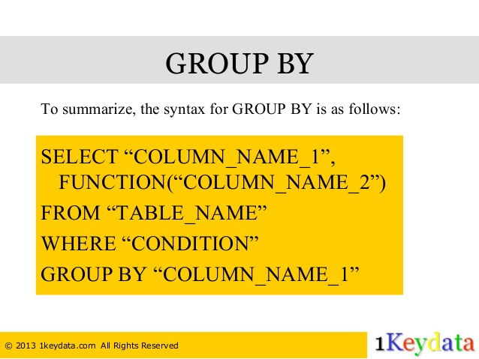
exceptions

Slide 29
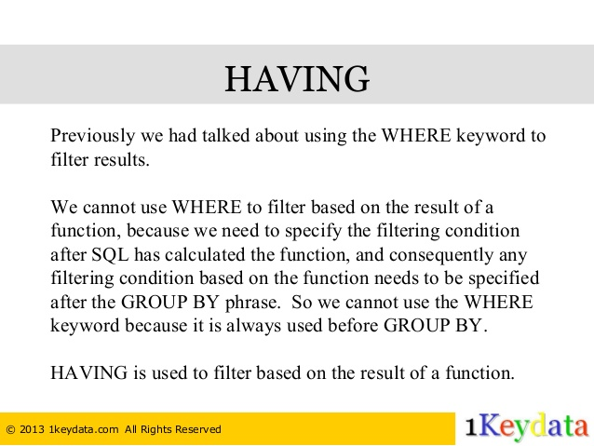
exceptions

Slide 30
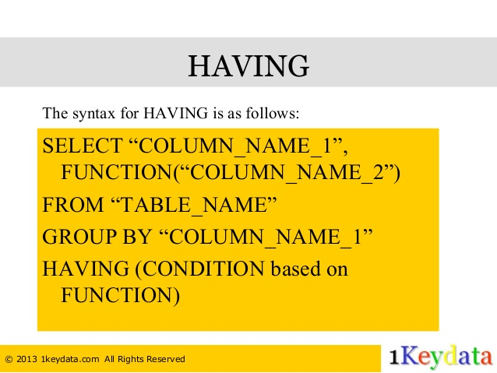
exceptions

Slide 31
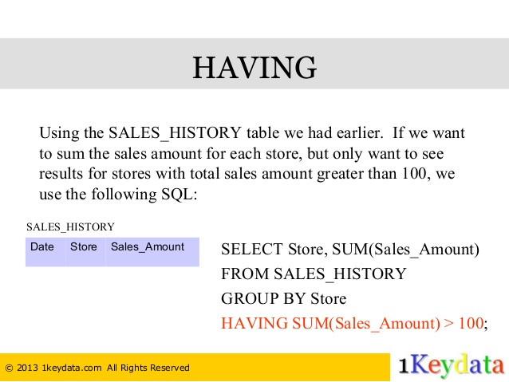
exceptions

Slide 32
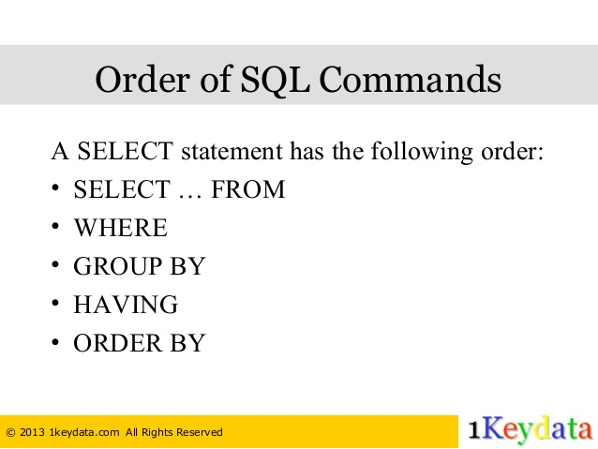
exceptions

Slide 33
exceptions

Slide 34
exceptions
Running Eclipse

Slide 35
exceptions
References:
http://www.slideshare.net/sakuvenderzira/c1-basic-concepts-of-database
http://www.slideshare.net/1keydata/sql-tutorial-basic-commands

Slide 36
http://www.slideshare.net/KavitaGanesan/is-66154415-kavitaganesanv2 - Strings
http://www.slideshare.net/antonkeks/10-threads - Threads
http://www.slideshare.net/BenjDelMundo/java-thread-synchronization - Synchronization
http://www.slideshare.net/javaonkar/thread-concurrancy - Synchronization
http://www.slideshare.net/lineking/io-package - Basic IO
http://new.51cto.com – Buffered streams.
http://www.slideshare.net/EmertxeSlides/010-core-javaiofundamentals - IO
http://www.slideshare.net/martyhall/file-io-in-java-8-applying-the-power-of-streams - File IO
http://www.slideshare.net/boulderjug/55-things-in-java-7 - File IO

