Slide 1
exceptions
JDBC Database Access

Slide 2
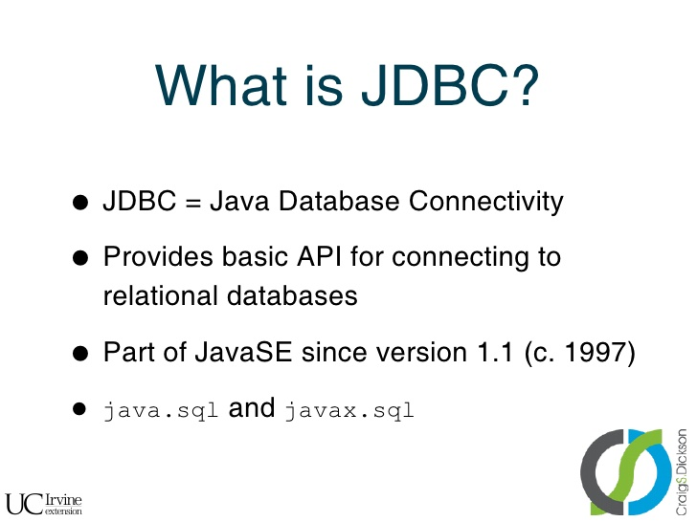

exceptions

Slide 3
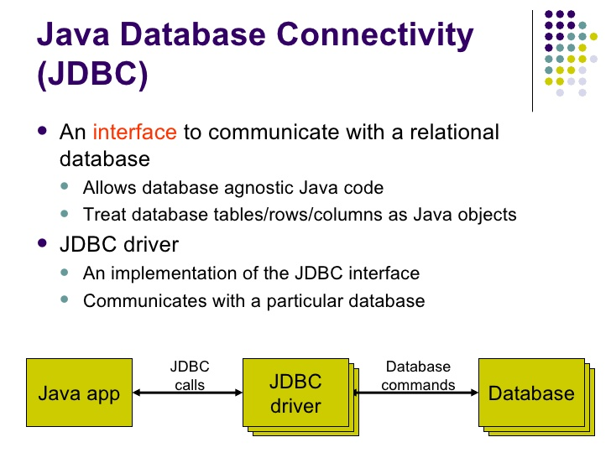
exceptions

Slide 4
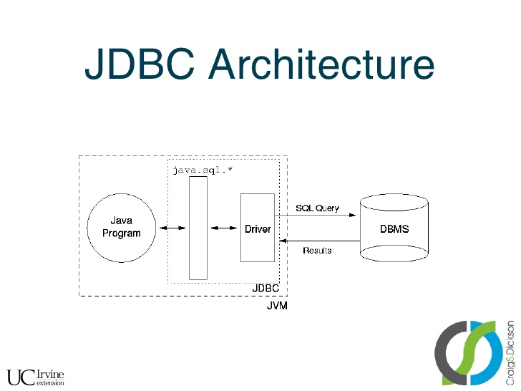
exceptions

Slide 5
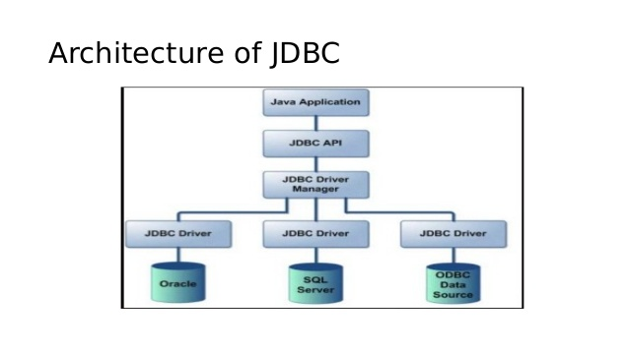
exceptions

Slide 6
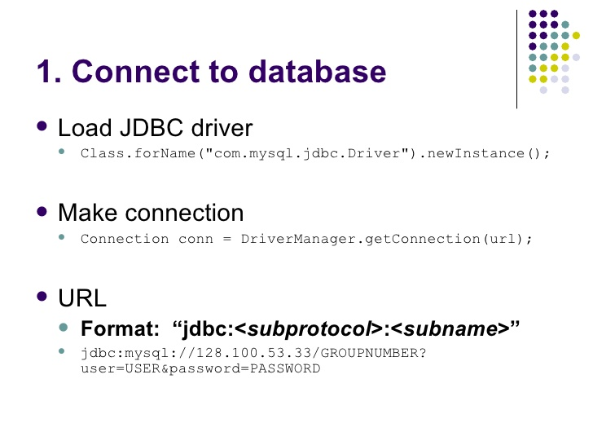
exceptions

Slide 7
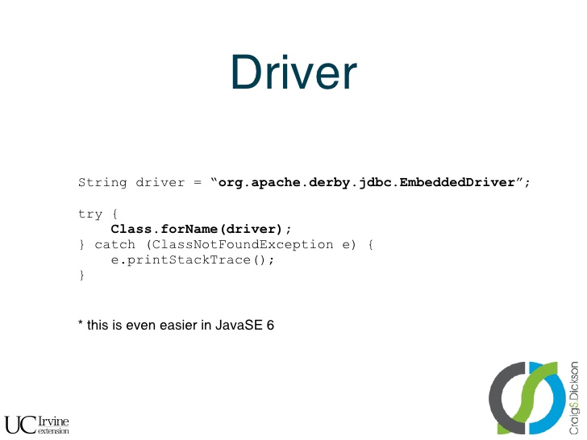
exceptions

Slide 8
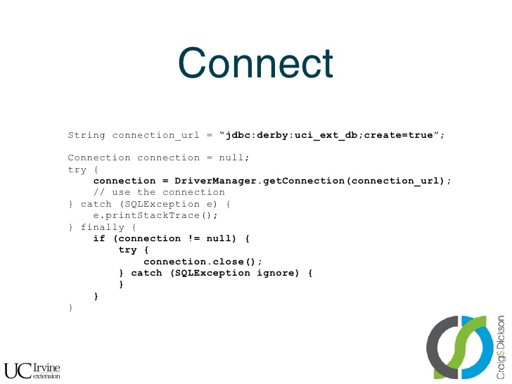
exceptions

Slide 9
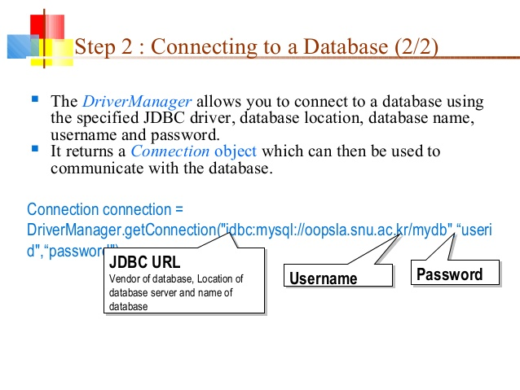
exceptions

Slide 10
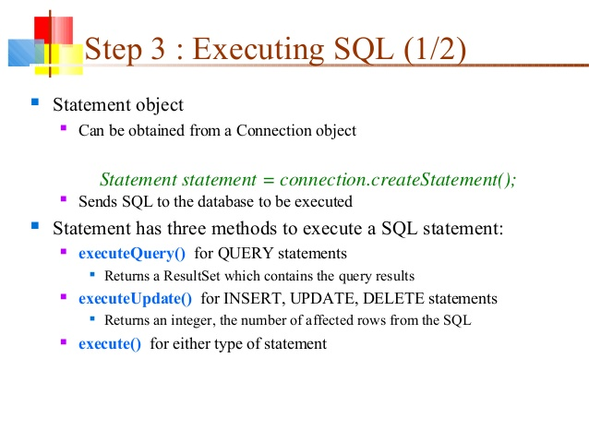
exceptions

Slide 11
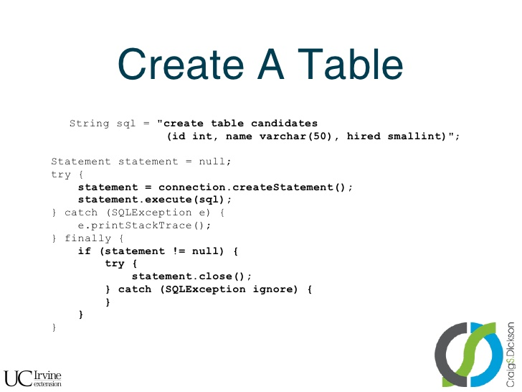
exceptions

Slide 12
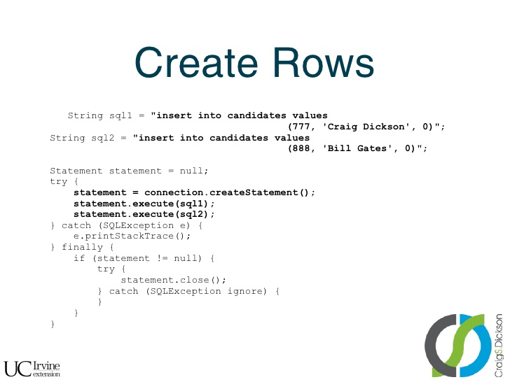
exceptions

Slide 13
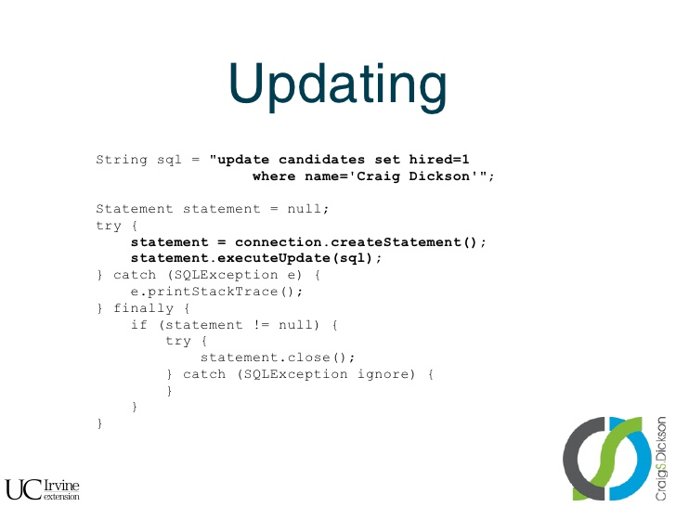
exceptions

Slide 14
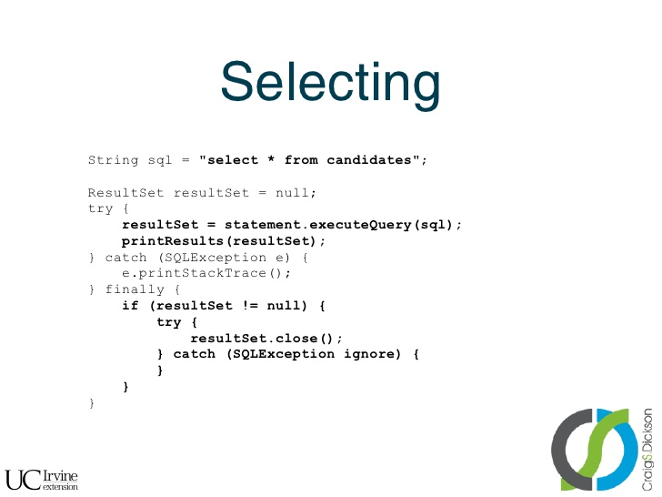
exceptions

Slide 15
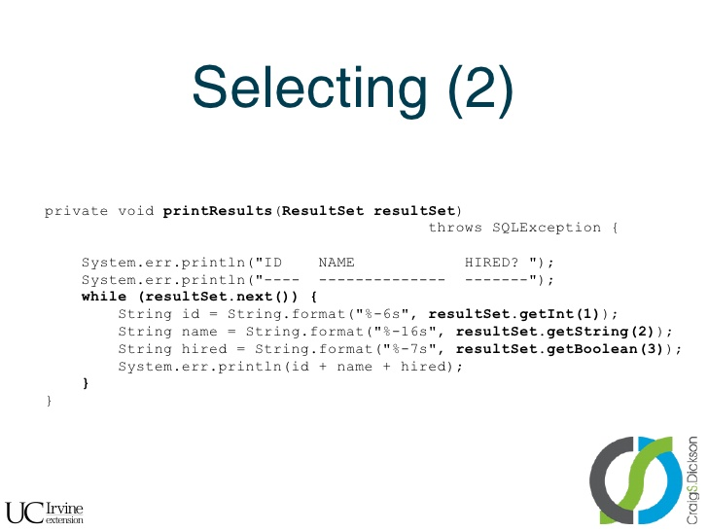
exceptions

Slide 16
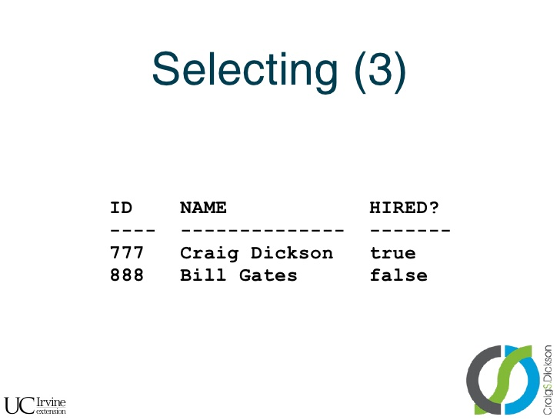
exceptions

Slide 17
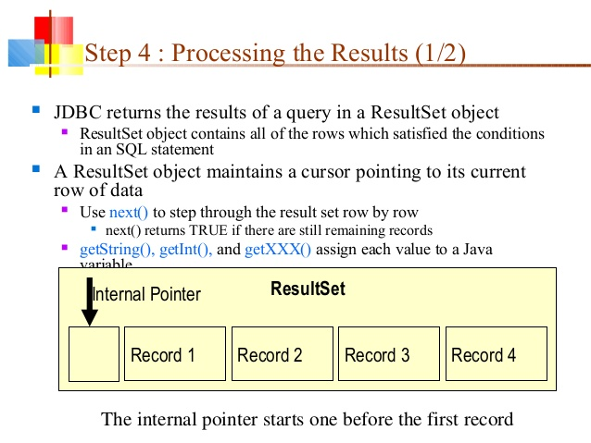
exceptions

Slide 18
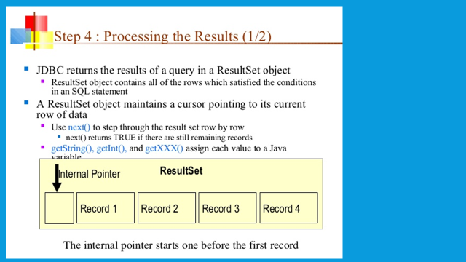
exceptions

Slide 19
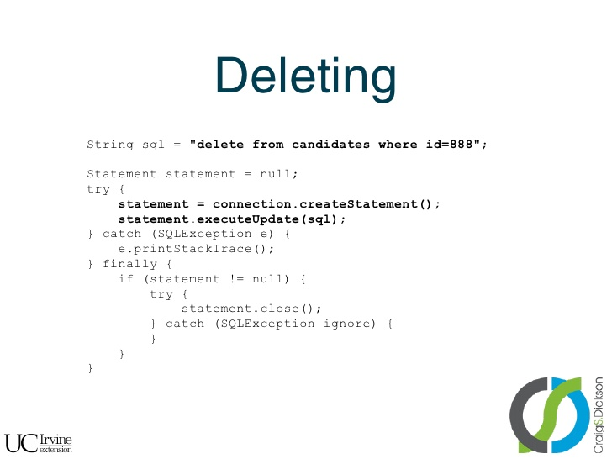
exceptions

Slide 20
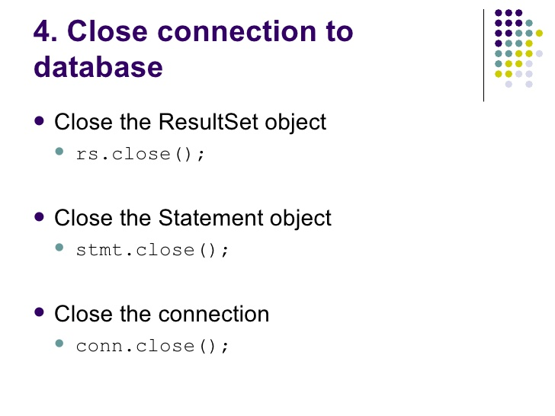
exceptions

Slide 21
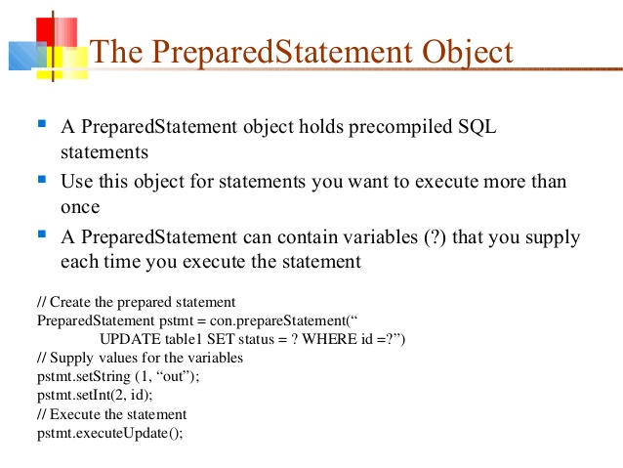
exceptions

Slide 22
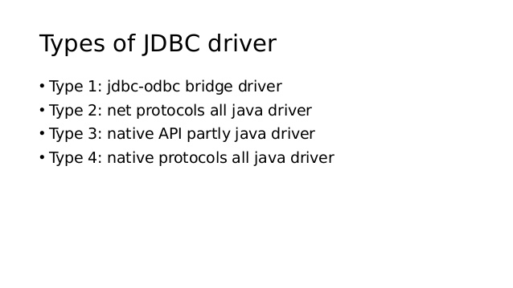
exceptions

Slide 23
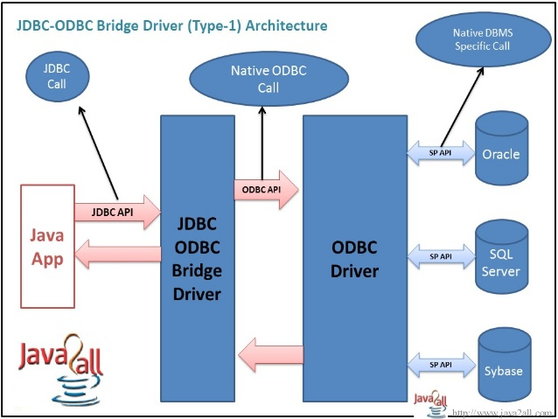
exceptions

Slide 24
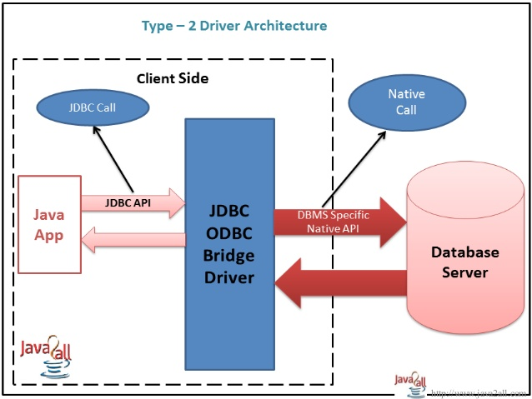
exceptions

Slide 25
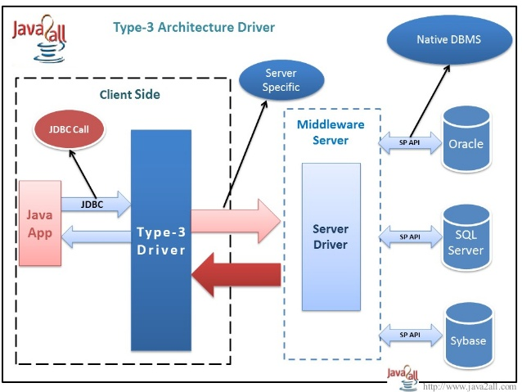
exceptions

Slide 26
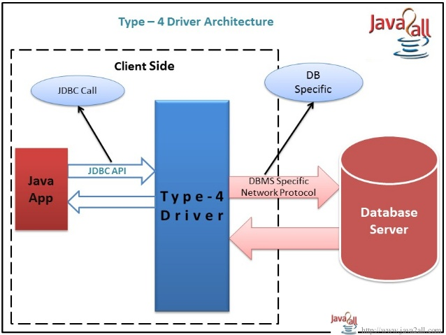
exceptions

Slide 27
exceptions

Slide 28
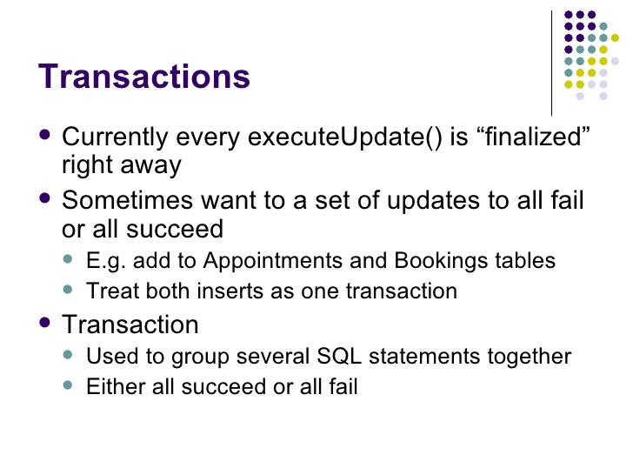
exceptions

Slide 29
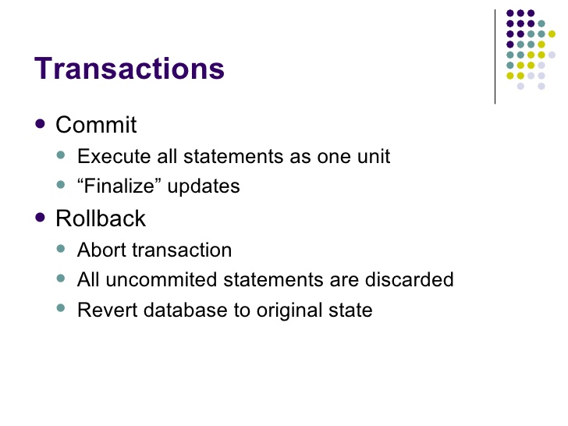
exceptions

Slide 30
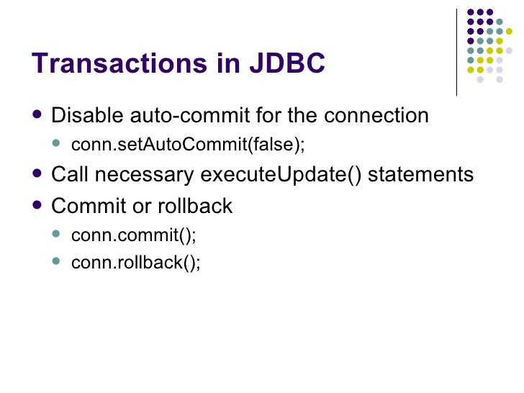
exceptions

Slide 31
exceptions

Slide 32
exceptions

Slide 33
exceptions

Slide 34
exceptions

Slide 35
exceptions
Running Eclipse

Slide 36
exceptions
References:
http://www.slideshare.net/itsec/jdbc-tutorial

Slide 37
Java - miscellaneous
Type Comparison Operator instanceof
The instanceof operator compares an object to a specified type.
You can use it to test if an object is an instance of a class, an instance of a subclass, or an instance of a class that implements a particular interface
Classes implementing interfaces
class MyClass extends MySuperClass implements YourInterface {
// field, constructor, and
// method declarations
}

Slide 38
Java - miscellaneous
Varargs – Specifying Arbitrary number of arguments
public Polygon polygonFrom(Point... corners) {
int numberOfSides = corners.length;
double squareOfSide1, lengthOfSide1;
squareOfSide1 = (corners[1].x - corners[0].x)
* (corners[1].x - corners[0].x)
+ (corners[1].y - corners[0].y)
* (corners[1].y - corners[0].y);
lengthOfSide1 = Math.sqrt(squareOfSide1);
// more method body code follows that creates and returns a
// polygon connecting the Points
}
You will most commonly see varargs with the printing methods; for example, this printf method:
public PrintStream printf(String format, Object... args)
allows you to print an arbitrary number of objects. It can be called like this:
System.out.printf("%s: %d, %s%n", name, idnum, address);

Slide 39
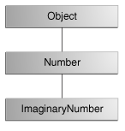
Java - miscellaneous
Returning a Class or Interface
When a method uses a class name as its return type the class of the type of the returned object must be either a subclass of, or the exact class of, the return type.
public Number returnANumber() {
...
}
The returnANumber method can return an ImaginaryNumber but not an Object. ImaginaryNumber is a Number because it's a subclass of Number. However, an Object is not necessarily a Number — it could be a String or another type

Slide 40
Advanced java
Garbage collection
JDBC
Lambda expressions
Annotations
Aggregate operations on collection using Lambarda expression.
Java streaming
Blocking queue
Aggregate operations
Autoboxing and unboxing

Slide 41
https://docs.oracle.com/javase/tutorial/reallybigindex.html
http://www.slideshare.net/EdurekaIN/java-class-3
http://www.slideshare.net/abdurrehmanabdurrehman391/variables-and-data-types-by-sir-khalid
http://www.slideshare.net/abdurrehmanabdurrehman391/java-advancedoop
http://www.slideshare.net/MindfireSolutions/java-garbage-collection-how-it-works?next_slideshow=1
http://www.slideshare.net/arnold7490/unit-4-java
http://www.slideshare.net/arnold7490/unit-3-java?next_slideshow=1
http://www.slideshare.net/tushardesarda/java-tutorial-3
http://www.slideshare.net/muralidhar9e/java-exception-handling-ppt
http://www.slideshare.net/emprovise/2-javabasics
http://www.slideshare.net/AllanHuang/java-new-evolution
http://www.slideshare.net/antonkeks/4-collections
http://www.slideshare.net/andreaiacono/java8-39841939 - Java8 features
http://www.slideshare.net/AbhishekKhune/07-java-collection
http://www.slideshare.net/shahjahan786/generics-27960064 - Generics
http://www.slideshare.net/caroljmcdonald/java-generics-2485138?next_slideshow=1

Slide 42
http://www.slideshare.net/KavitaGanesan/is-66154415-kavitaganesanv2 - Strings
http://www.slideshare.net/antonkeks/10-threads - Threads
http://www.slideshare.net/BenjDelMundo/java-thread-synchronization - Synchronization
http://www.slideshare.net/javaonkar/thread-concurrancy - Synchronization
http://www.slideshare.net/lineking/io-package - Basic IO
http://new.51cto.com – Buffered streams.
http://www.slideshare.net/EmertxeSlides/010-core-javaiofundamentals - IO
http://www.slideshare.net/martyhall/file-io-in-java-8-applying-the-power-of-streams - File IO
http://www.slideshare.net/boulderjug/55-things-in-java-7 - File IO

