Slide 1
Java programming fundamentals

Slide 2
Course content
Introduction to Java
Java platform
Object oriented programming basics
Java Language basics
Classes and Objects
Nested Classes
Interfaces and Inheritance
Exception Handling
Collections
Generics
Numbers and Strings
Concurrency
Basic IO
Java Development with Eclipse IDE

Slide 3
Why java?
Simple Object oriented
Distributed Multithreaded
• Dynamic • Architecture neutral
• Portable
• High performance
• Robust
• Secure

Slide 4
Lab Exercise: Executing java programme
Lab 1 : Installing the Java Software and setting up the environment
Lab 2: Setting up the Java environment.
Lab 3: Writing and executing java Hello World Programme

Slide 5
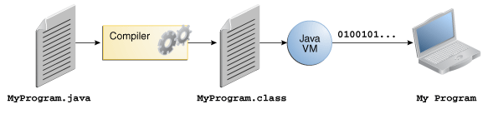
Java platform
A platform is the hardware or software environment in which a program runs.
The Java platform differs from most other platforms in that it's a software-only platform that runs on top of other hardware-based platforms

Slide 6
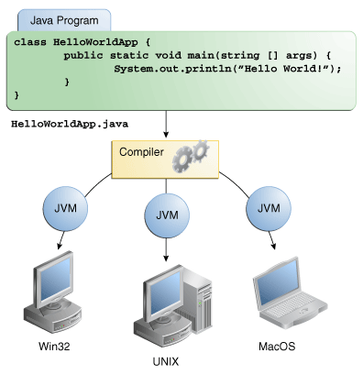
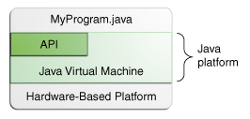
Java platform ……

Slide 7
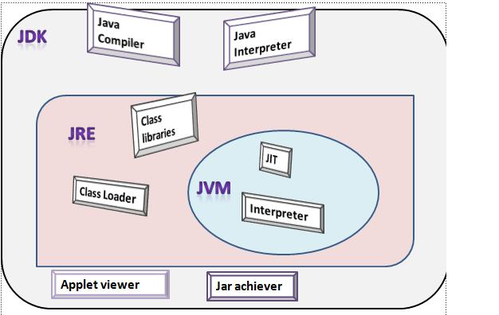
Java platform………..

Slide 8
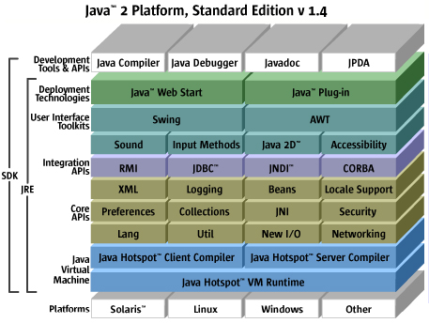
Java platform………..

Slide 9
Java platform………..

Slide 10
OOPs concepts
int cadence = 0;int speed = 0;int gear = 1;
Class
Object
Inheritance
Encapsulation
Polymorphism
Abstraction
Interface

Slide 11
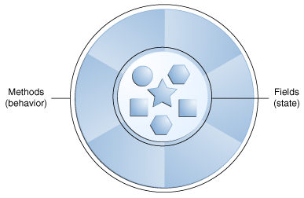
OOPs concepts ………
Object
They all have state and behavior
Class
A class is the blueprint from which individual objects are created

Slide 12
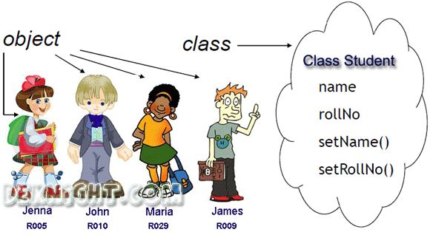
OOPs concepts ………

Slide 13
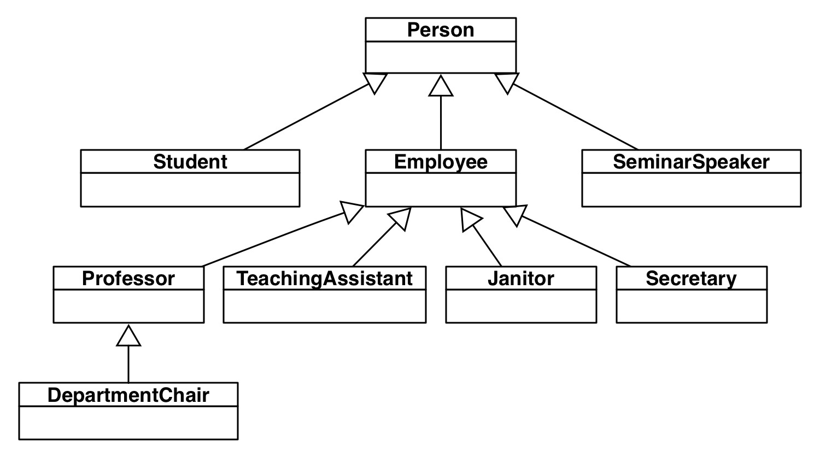
OOPs concepts ………
Inheritance
Process whereby an object of a class acquires characteristics from the object of the other class

Slide 14
OOPs concepts ………
Encapsulation
Encapsulation means that the internal representation of an Object is generally hidden from view outside of the object's definition.
The features of encapsulation are supported using classes.
A supposed benefit of encapsulation is that it can reduce system complexity, and thus increase robustness.

Slide 15
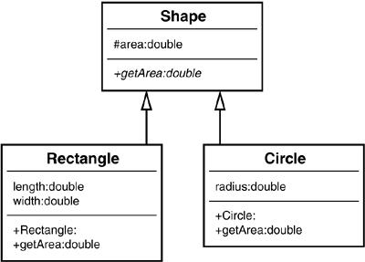
OOPs concepts ………
Abstraction
Technique for managing complexity of computer systems.
Polymorphism
The ability to appear in many forms.

Slide 16
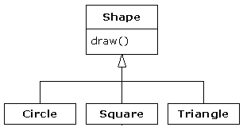
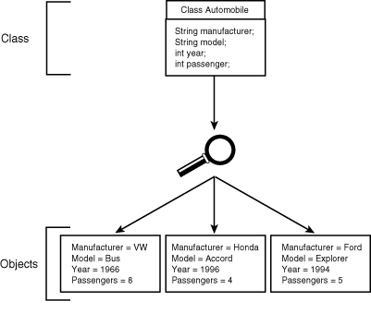
OOPs concepts ………
Interface
Objects define their interaction with the outside world through the methods that they expose.

