Slide 1

exceptions

Slide 2
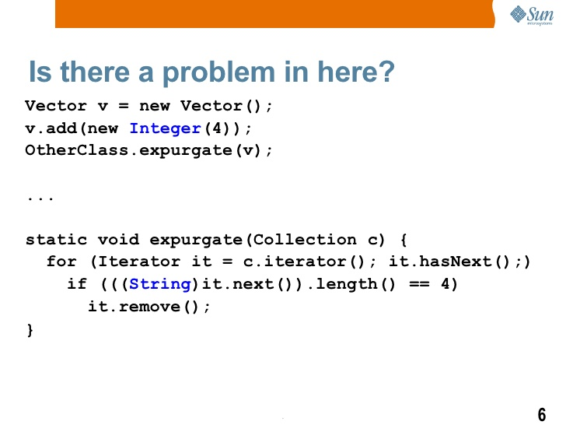
exceptions

Slide 3
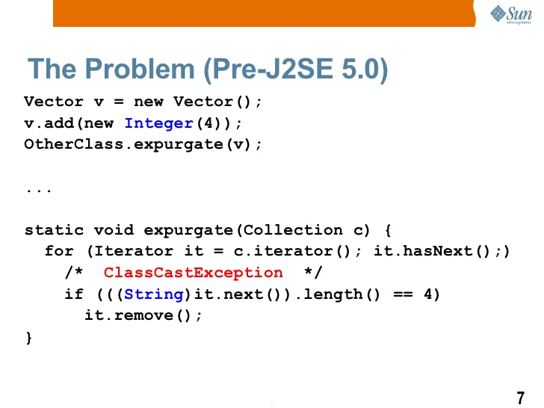
exceptions

Slide 4
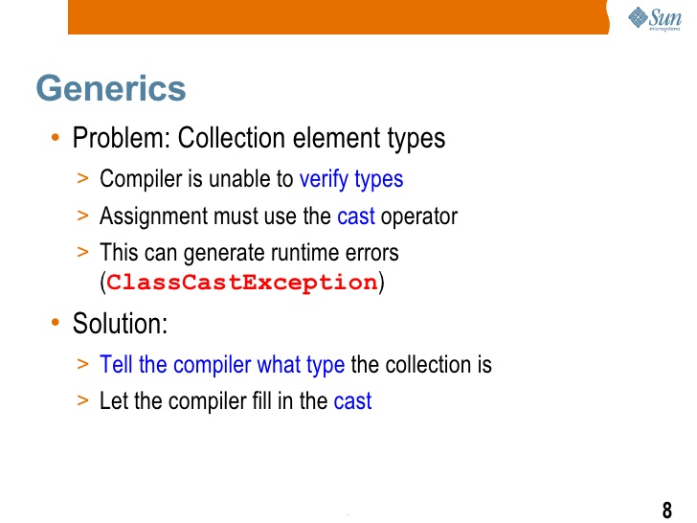
exceptions

Slide 5
exceptions
Compile-time bugs are easier to detect early and fix.
Runtime bugs, however, can be much more problematic; they don't always surface immediately, and when they do, it may be at a point in the program that is far removed from the actual cause of the problem.
Generics add stability to your code by making more of your bugs detectable at compile time.
Generics enable types (classes and interfaces) to be parameters when defining classes.

Slide 6
exceptions
Benefits:
Provides stronger type checks at compile time:
Elimination of casts.
The following code snippet without generics requires casting:
List list = new ArrayList();
list.add("hello");
String s = (String) list.get(0);
When re-written to use generics, the code does not require casting:
List<String> list = new ArrayList<String>();
list.add("hello");
String s = list.get(0); // no cast

Slide 7
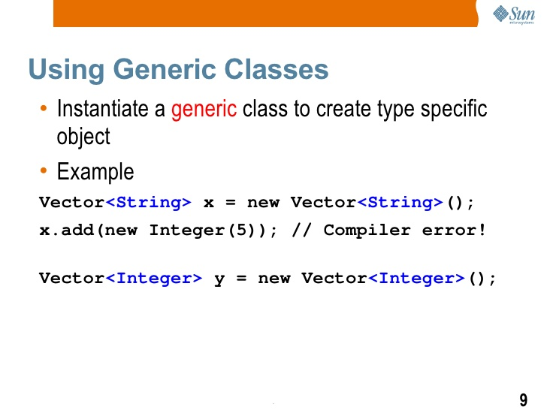
exceptions

Slide 8
exceptions
A generic type is a generic class or interface that is parameterized over types.
Example:
public class Box {
private Object object;
public void set(Object object) { this.object = object;
public Object get() { return object; }
}
Generic Type
public class Box<T> {
// T stands for "Type“
private T t;
public void set(T t) { this.t = t; }
public T get() { return t; }
}
A type variable can be any non-primitive type you specify: any class type, any interface type, any array type, or even another type variable

Slide 9
exceptions
Type Parameter Naming Conventions
E - Element (used extensively by the Java Collections Framework)
K - Key
N - Number
T - Type
V - Value
S,U,V etc. - 2nd, 3rd, 4th types
Instantiating generic type
Box<Integer> integerBox;
Box<Integer> integerBox = new Box<Integer>();

Slide 10
exceptions
Multiple Type Parameters
public interface Pair<K, V> {
public K getKey();
public V getValue();
}
public class OrderedPair<K, V> implements Pair<K, V> {
private K key;
private V value;
public OrderedPair(K key, V value) {
this.key = key;
this.value = value;
}
public K getKey() { return key; }
public V getValue() { return value; }
}
Pair<String, String> p2 = new OrderedPair<String, String>("hello", "world");
OrderedPair<String, Box<Integer>> p = new OrderedPair<>("primes", new Box<Integer>(...));

Slide 11
exceptions
Raw Types/Parameterized Type
public class Box<T> {
public void set(T t) { /* ... */ }
// ...
}
Box<Integer> intBox = new Box<>(); - Parameterized type
Box rawBox = new Box(); - Raw type
Box<String> stringBox = new Box<>();
Box rawBox = stringBox; // OK
Box rawBox = new Box(); // rawBox is a raw type of Box<T>
Box<Integer> intBox = rawBox; // warning: unchecked conversion

Slide 12

exceptions
Generic Methods
Generic methods are methods that introduce their own type parameters
Type parameter's scope is limited to the method where it is declared
public class Util {
public static <K, V> boolean compare(Pair<K, V> p1, Pair<K, V> p2) {
return p1.getKey().equals(p2.getKey()) &&
p1.getValue().equals(p2.getValue());
}
}

Slide 13
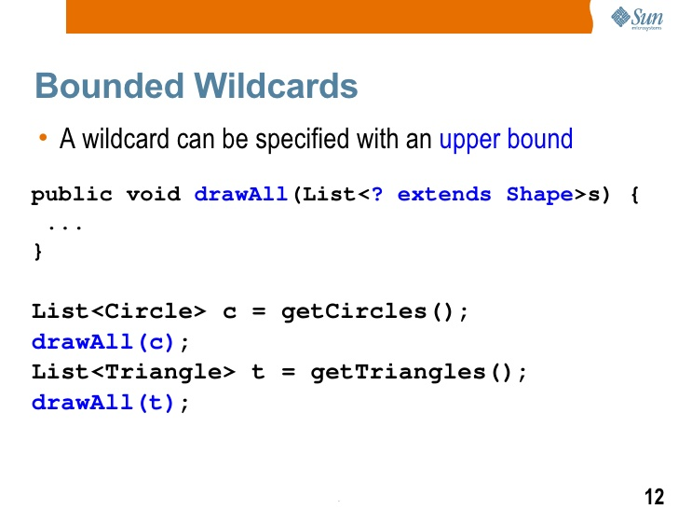
exceptions

Slide 14
exceptions
Bounded Type Parameters:
Used to restrict the types that can be used as type arguments in a parameterized type:
Ex:
public class NaturalNumber<T extends Integer> {
private T n;
public NaturalNumber(T n) { this.n = n; }
public boolean isEven() {
return n.intValue() % 2 == 0;
}
// ...
}
Lab16.2: Demonstration of Bounded type Generics

Slide 15
exceptions
Multiple Bounds
A type variable with multiple bounds is a subtype of all the types listed in the bound.
If one of the bounds is a class, it must be specified first
Class A { /* ... */ }
interface B { /* ... */ }
interface C { /* ... */ }
class D <T extends A & B & C> { /* ... */ }

Slide 16
exceptions
Generic Methods and Bounded Type Parameters
public static <T> int countGreaterThan(T[] anArray, T elem) {
int count = 0;
for (T e : anArray)
if (e > elem) // compiler error
++count;
return count;
}
public static <T extends Comparable<T>> int countGreaterThan(T[] anArray, T elem) {
int count = 0;
for (T e : anArray)
if (e.compareTo(elem) > 0)
++count;
return count;
}

Slide 17
exceptions
public static <T> int countGreaterThan(T[] anArray, T elem) {
int count = 0;
for (T e : anArray)
if (e > elem) // compiler error
++count;
return count;
}
public static <T extends Comparable<T>> int countGreaterThan(T[] anArray, T elem) {
int count = 0;
for (T e : anArray)
if (e.compareTo(elem) > 0)
++count;
return count;
}

Slide 18
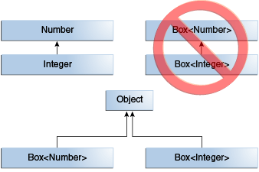
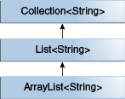
exceptions
Generics, Inheritance, and Subtypes
public void boxTest(Box<Number> n) { /* ... */
}
What type of argument does it accept?
Box<Integer> and Box<Double> are not subtypes of Box<Number>

Slide 19
exceptions
Type Inference
Type inference is a Java compiler's ability to look at each method invocation and corresponding declaration to determine the type argument (or arguments) that make the invocation applicable.
Ex:
Map<String, List<String>> myMap = new HashMap(); // unchecked conversion warning
List<string> names = new ArrayList<string>();
List<string> names = new ArrayList<>();

Slide 20
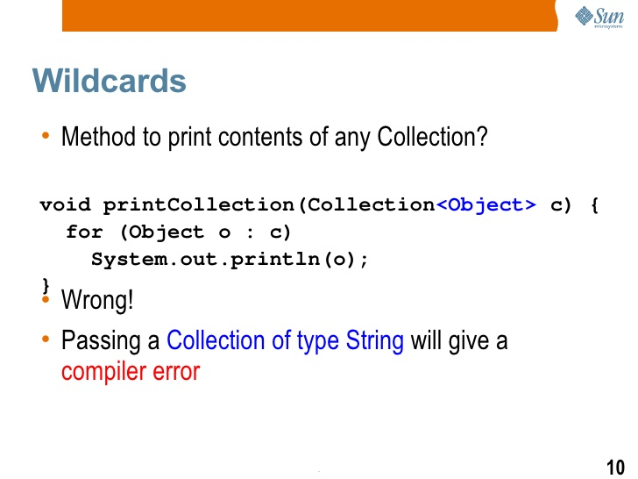
exceptions

Slide 21
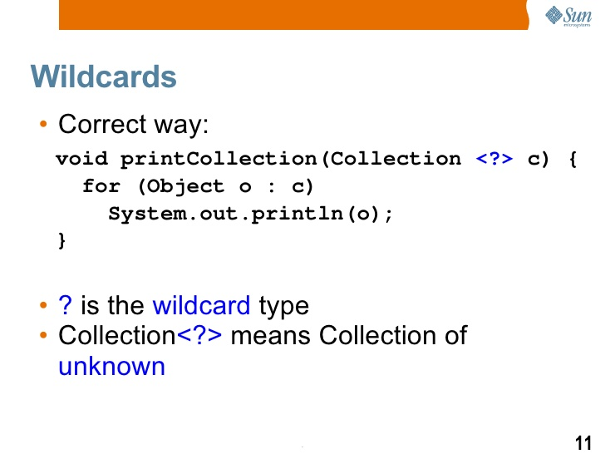
exceptions

Slide 22
exceptions
Wild Cards
The question mark (?), called the wildcard, represents an unknown type.
Used as the type of a parameter, field, or local variable; sometimes as a return type.
The wildcard is never used as a type argument for a generic method invocation, a generic class instance creation, or a super type.

Slide 23
exceptions
Upper Bounded Wild Cards
To write the method that works on lists of Number and the subtypes of Number, such as Integer, Double, and Float, you would specify List<? extends Number>.
The term List<Number> is more restrictive than List<? extends Number> because the former matches a list of type Number only, whereas the latter matches a list of type Number or any of its subclasses.
Unbounded Wildcards
The unbounded wildcard type is specified using the wildcard character (?), for example, List<?>.
Useful If you are writing a method that can be implemented using functionality provided in the Object class.
Ex:
public static void printList(List<?> list) {
for (Object elem: list)
System.out.print(elem + " ");
System.out.println();
}

Slide 24
exceptions
Lower Bounded Wildcards
A lower bounded wildcard restricts the unknown type to be a specific type or a super type of that type.
You can specify an upper bound for a wildcard, or you can specify a lower bound, but you cannot specify both.
Ex:
To write the method that works on lists of Integer and the super types of Integer, such as Integer, Number, and Object, you would specify List<? super Integer>.
Ex:
public static void addNumbers(List<? super Integer> list) {
for (int i = 1; i <= 10; i++) {
list.add(i);
}
}

Slide 25
exceptions
Wildcards and Subtyping
class A { /* ... */ }
class B extends A { /* ... */ }
B b = new B();
A a = b;
List<B> lb = new ArrayList<>();
List<A> la = lb; // compile-time error
List<? extends Integer> intList = new ArrayList<>();
List<? extends Number> numList = intList; // OK. List<? extends Integer> is a subtype of List<? extends Number>

Slide 26
exceptions
Restrictions on Generics
Cannot Instantiate Generic Types with Primitive Types
Pair<int, char> p = new Pair<>(8, 'a'); // compile-time error
Pair<Integer, Character> p = new Pair<>(8, 'a');
Cannot Create Instances of Type Parameters
public static <E> void append(List<E> list) {
E elem = new E(); // compile-time error
list.add(elem);
}
Cannot Declare Static Fields Whose Types are Type Parameters
public class MobileDevice<T> {
private static T os;
// ...
}
MobileDevice<Smartphone> phone = new MobileDevice<>();
MobileDevice<Pager> pager = new MobileDevice<>();
MobileDevice<TabletPC> pc = new MobileDevice<>();
Because the static field os is shared by phone, pager, and pc, what is the actual type of os? It cannot be Smartphone, Pager, and TabletPC at the same time. You cannot, therefore, create static fields of type parameters.

Slide 27
exceptions
Restrictions on Generics…….
Cannot Use Casts or instanceof with Parameterized Types
public static <E> void rtti(List<E> list) {
if (list instanceof ArrayList<Integer>) { // compile-time error
// ...
}
}
Cannot Create Arrays of Parameterized Types
List<Integer>[] arrayOfLists = new List<Integer>[2]; // compile-time error
Cannot Create, Catch, or Throw Objects of Parameterized Types

Slide 28
exceptions

Slide 29
Java - miscellaneous
Type Comparison Operator instanceof
The instanceof operator compares an object to a specified type.
You can use it to test if an object is an instance of a class, an instance of a subclass, or an instance of a class that implements a particular interface
Classes implementing interfaces
class MyClass extends MySuperClass implements YourInterface {
// field, constructor, and
// method declarations
}

Slide 30
Java - miscellaneous
Varargs – Specifying Arbitrary number of arguments
public Polygon polygonFrom(Point... corners) {
int numberOfSides = corners.length;
double squareOfSide1, lengthOfSide1;
squareOfSide1 = (corners[1].x - corners[0].x)
* (corners[1].x - corners[0].x)
+ (corners[1].y - corners[0].y)
* (corners[1].y - corners[0].y);
lengthOfSide1 = Math.sqrt(squareOfSide1);
// more method body code follows that creates and returns a
// polygon connecting the Points
}
You will most commonly see varargs with the printing methods; for example, this printf method:
public PrintStream printf(String format, Object... args)
allows you to print an arbitrary number of objects. It can be called like this:
System.out.printf("%s: %d, %s%n", name, idnum, address);

Slide 31
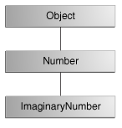
Java - miscellaneous
Returning a Class or Interface
When a method uses a class name as its return type the class of the type of the returned object must be either a subclass of, or the exact class of, the return type.
public Number returnANumber() {
...
}
The returnANumber method can return an ImaginaryNumber but not an Object. ImaginaryNumber is a Number because it's a subclass of Number. However, an Object is not necessarily a Number — it could be a String or another type

Slide 32
Advanced java
Garbage collection
JDBC
Lambda expressions
Annotations
Aggregate operations on collection using Lambarda expression.
Java streaming
Blocking queue
Aggregate operations
Autoboxing

Slide 33
https://docs.oracle.com/javase/tutorial/reallybigindex.html
http://www.slideshare.net/EdurekaIN/java-class-3
http://www.slideshare.net/abdurrehmanabdurrehman391/variables-and-data-types-by-sir-khalid
http://www.slideshare.net/abdurrehmanabdurrehman391/java-advancedoop
http://www.slideshare.net/MindfireSolutions/java-garbage-collection-how-it-works?next_slideshow=1
http://www.slideshare.net/arnold7490/unit-4-java
http://www.slideshare.net/arnold7490/unit-3-java?next_slideshow=1
http://www.slideshare.net/tushardesarda/java-tutorial-3
http://www.slideshare.net/muralidhar9e/java-exception-handling-ppt
http://www.slideshare.net/emprovise/2-javabasics
http://www.slideshare.net/AllanHuang/java-new-evolution
http://www.slideshare.net/antonkeks/4-collections
http://www.slideshare.net/andreaiacono/java8-39841939 - Java8 features
http://www.slideshare.net/AbhishekKhune/07-java-collection
http://www.slideshare.net/shahjahan786/generics-27960064 - Generics
http://www.slideshare.net/caroljmcdonald/java-generics-2485138?next_slideshow=1

