Slide 1
Java programming fundamentals

Slide 2
Course content
Introduction to Java
Java platform
Object oriented programming basics
Java Language basics
Classes and Objects
Nested Classes
Interfaces and Inheritance

Slide 3
Why java?
Simple Object oriented
Distributed Multithreaded
• Dynamic • Architecture neutral
• Portable
• High performance
• Robust
• Secure

Slide 4
Lab Exercise: Executing java programme
Lab 1 : Installing the Java Software and setting up the environment
Lab 2: Setting up the Java environment.
Lab 3: Writing and executing java Hello World Programme

Slide 5
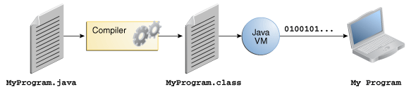
Java platform
A platform is the hardware or software environment in which a program runs.
The Java platform differs from most other platforms in that it's a software-only platform that runs on top of other hardware-based platforms

Slide 6
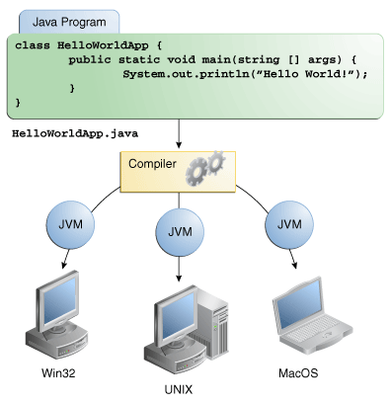
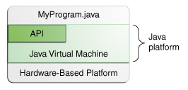
Java platform ……

Slide 7
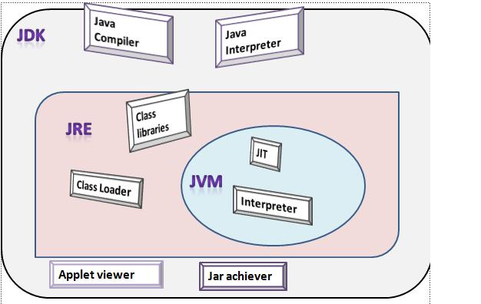
Java platform………..

Slide 8
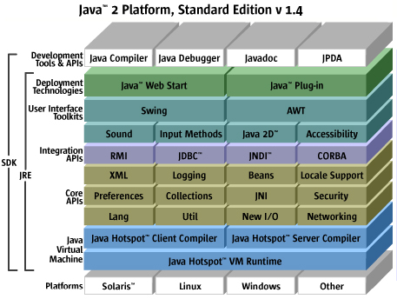
Java platform………..

Slide 9
OOPs concepts
int cadence = 0;int speed = 0;int gear = 1;
Class
Object
Inheritance
Encapsulation
Polymorphism
Abstraction
Interface

Slide 10
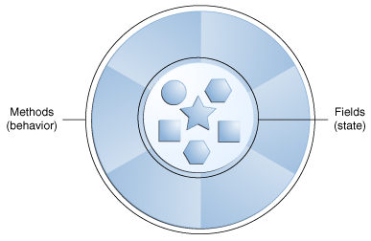
OOPs concepts ………
Object
They all have state and behavior
Class
A class is the blueprint from which individual objects are created

Slide 11
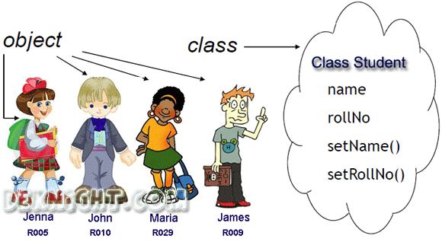
OOPs concepts ………

Slide 12
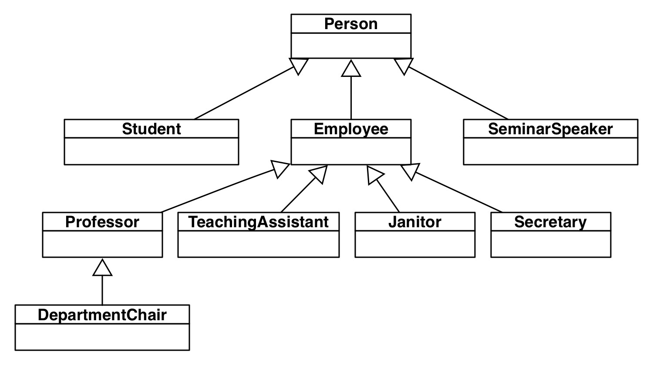
OOPs concepts ………
Inheritance
Process whereby an object of a class acquires characteristics from the object of the other class

Slide 13
OOPs concepts ………
Encapsulation
Encapsulation means that the internal representation of an Object is generally hidden from view outside of the object's definition.
The features of encapsulation are supported using classes.
A supposed benefit of encapsulation is that it can reduce system complexity, and thus increase robustness.

Slide 14
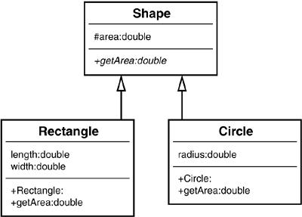
OOPs concepts ………
Abstraction
Technique for managing complexity of computer systems.
Polymorphism
The ability to appear in many forms.

Slide 15
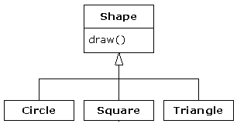
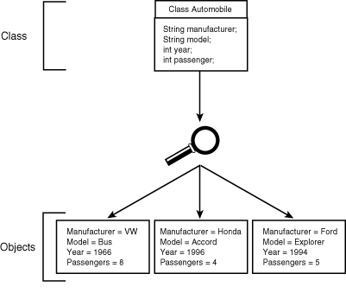
OOPs concepts ………
Interface
Objects define their interaction with the outside world through the methods that they expose.

Slide 16
Language basics
Variables
Operators
Expressions, Statements and Blocks
Control Flow Statements

Slide 17
LAB – Variables, datatype, literal, arrays
LAB4: Execute the programme Car.java for variables demonstration
LAB5: Execute the “ArrayDemo”.java for array demonstration

Slide 18
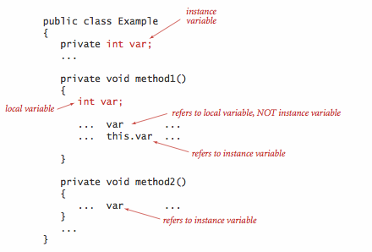
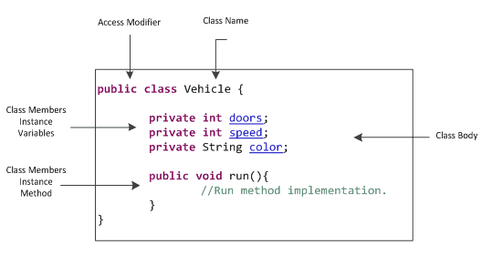
Language basics - Variables

Slide 19
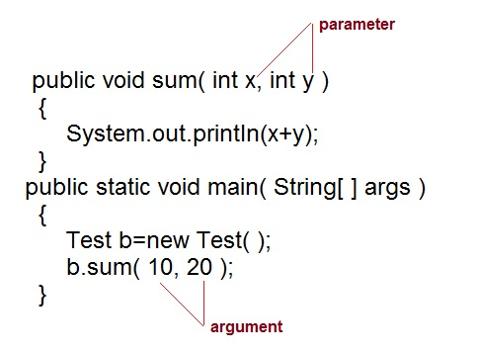
Language basics - Variables

Slide 20
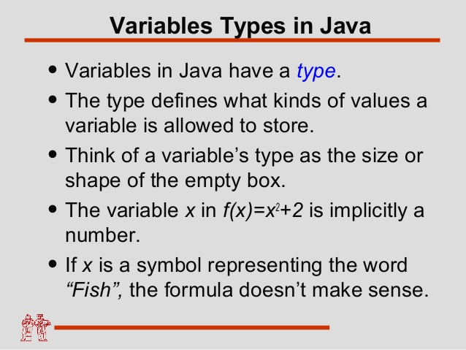
Language basics - Variables

Slide 21
Language basics - Variables
Variable Naming Convention
Variable names are case-sensitive
If the name you choose consists of only one word, spell that word in all lowercase letters. If it consists of more than one word, capitalize the first letter of each subsequent word.
Ex: gearRatio, currentGear
If your variable stores a constant value, such as static capitalizing every letter and separating subsequent words with the underscore character.
Ex: final int NUM_GEARS = 6

Slide 22
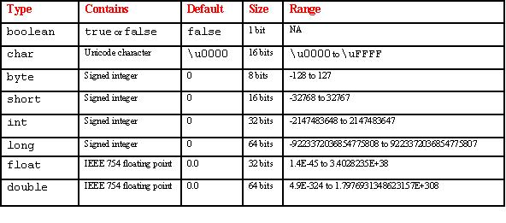
Language basics – data types
Primitive Data Types
A primitive type is predefined by the language and is named by a reserved keyword.
Primitive values do not share state with other primitive values
L
f

Slide 23
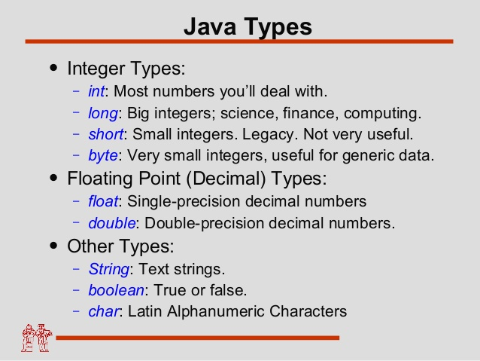
Language basics – data types

Slide 24
Language basics - literals
Literals
A literal is the source code representation of a fixed value;
literals are represented directly in your code without requiring computation
Ex:
boolean result = true;
char capitalC = 'C';
byte b = 100;
short s = 10000;
int i = 100000;

Slide 25
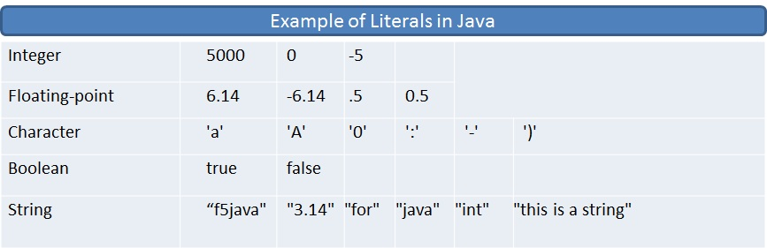
Language basics - literals

Slide 26
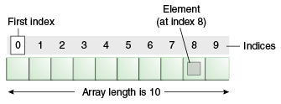
Language basics - Arrays
Arrays
An array is a container object that holds a fixed number of values of a single type.
After creation, its length is fixed.

Slide 27
Language basics - Arrays
Defining arrays:
byte[] anArrayOfBytes = new byte[10];
short[] anArrayOfShorts = new short[10];
long[] anArrayOfLongs = new long[10];
float[] anArrayOfFloats = new float[10];
double[] anArrayOfDoubles = new double[10];
boolean[] anArrayOfBooleans = new boolean[10];
char[] anArrayOfChars = new char[10];
String[] anArrayOfStrings = new String[10];
Creating and initializing array:
int[] anArray = {100, 200, 300, 400, 500, 600,700, 800, 900, 1000};

Slide 28
quiz time - Variables
The term "instance variable" is another name for ___.
The term "class variable" is another name for ___.
A local variable stores temporary state; it is declared inside a ___.
A variable declared within the opening and closing parenthesis of a method signature is called a ____.
What are the eight primitive data types supported by the Java programming language?
Character strings are represented by the class ___.
An ___ is a container object that holds a fixed number of values of a single type.

Slide 29
Language basics- operator
Arithmetic Operator
Lab 6.1 : Arithmetic operator demo

Slide 30
Language basics- operator
Unary Operator
Lab6.2 : Unary operator demo

Slide 31
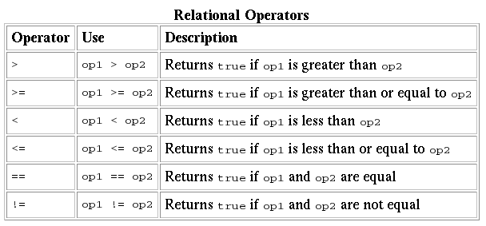
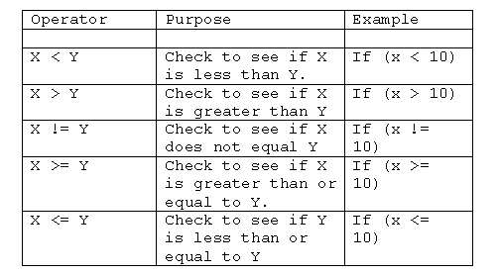
Language basics- operator
Lab6.3 : Relational operator demo

Slide 32
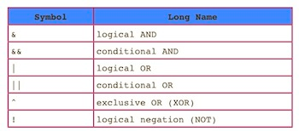
Language basics- operator
Conditional Operator
& evaluates both sides of the operation.
&& evaluates the left side of the operation, if it's true, it continues and evaluates the right side
Lab6.4 : Conditional operator demo

Slide 33
Quiz time- operator
The instanceof operator compares an object to a specified type. You can use it to test if an object is an instance of a class, an instance of a subclass, or an instance of a class that implements a particular interface
Consider the following code snippet.
arrayOfInts[j] > arrayOfInts[j+1]
Which operators does the code contain?
Consider the following code snippet.
int i = 10;
int n = i++%5;
What are the values of i and n after the code is executed?
What are the final values of i and n if instead of using the postfix increment operator (i++),
you use the prefix version (++i))?
To invert the value of a boolean, which operator would you use?
Which operator is used to compare two values, = or == ?
Explain the following code sample: result = someCondition ? value1 : value2;

Slide 34
Language basics- expressions, statements, blocks
Expression:
An expression is a construct made up of variables, operators, and method invocations, which are constructed according to the syntax of the language, that evaluates to a single value.
Ex:
cadence = 0
anArray[0] = 100;
value1 == value2
"Element 1 at index 0: " + anArray[0]
Statements:
Statements are roughly equivalent to sentences in natural languages.
A statement forms a complete unit of execution.
Ex:
System.out.println("Hello World!");
Bicycle myBike = new Bicycle();

Slide 35
Language basics- expressions, statements, blocks
Blocks:
A block is a group of zero or more statements between balanced braces and can be used anywhere a single statement is allowed.
Ex:
class BlockDemo {
public static void main(String[] args) {
boolean condition = true;
if (condition) { // begin block 1
System.out.println("Condition is true.");
} // end block one
else { // begin block 2
System.out.println("Condition is false.");
} // end block 2
}
}

Slide 36
Quiz time- expressions, statements, blocks
Operators may be used in building ___, which compute values.
Expressions are the core components of ___.
Statements may be grouped into ___.
The following code snippet is an example of a ___ expression.
1 * 2 * 3
Statements are roughly equivalent to sentences in natural languages, but instead of ending with a period, a statement ends with a ___.
A block is a group of zero or more statements between balanced ___ and can be used anywhere a single statement is allowed.

Slide 37
Language basics- control flow statements
Control flow statements, break up the flow of execution by employing decision making, looping, and branching, enabling your program to conditionally execute particular blocks of code.
If-then
void applyBrakes() {
// the "if" clause: bicycle must be moving
if (isMoving){
// the "then" clause: decrease current speed
currentSpeed--;
}
}

Slide 38
Language basics- control flow statements
If-then-else
void applyBrakes() {
if (isMoving) {
currentSpeed--;
} else {
System.err.println("The bicycle has already stopped!");
}
}
Lab7.1 : Demonstration of If Else control flow statements

Slide 39
Language basics- control flow statements
Switch Statement:
Switch statement can have a number of possible execution paths.
Works with the byte, short, char, and int primitive data types. It also works with enumerated types, the String class, and a few special classes that wrap certain primitive types: Character, Byte, Short, and Integer .
All statements after the matching case label are executed in sequence, regardless of the expression of subsequent case labels, until a break statement is encountered
Ex: switch (month) {
case 1: monthString = "January";
break;
case 2: monthString = "February";
break;
............
default: monthString = "Invalid month";
break;
}

Slide 40
Language basics- control flow statements
Switch Statement:
Lab7.2 : Demonstration of switch control flow statements
Lab7.3: Demonstration of Switch control flow statements without break statement

Slide 41
Language basics- control flow statements
while and do-while Statements:
while (expression) {
statement(s)
}
do {
statement(s)
} while (expression);
Lab7.5: Demonstration of using while loop
Lab7.6: Demonstration of using do-while loop

Slide 42
Language basics- control flow statements
for Statements:
Provides a compact way to iterate over a range of values
for (initialization; termination; increment) {
statement(s)
}
Ex:
class ForDemo {
public static void main(String[] args){
for(int i=1; i<11; i++){
System.out.println("Count is: " + i);
}
}
}
// infinite loop
for ( ; ; ) {
// your code goes here
}
int[] numbers = {1,2,3,4,5,6,7,8,9,10};
//Enhanced for loop
for (int item : numbers) {
System.out.println("Count is: " + item);
}

Slide 43
Language basics- control flow statements
Branching Statements:
break statement
Un-labelled break
Ex:
for (i = 0; i < arrayOfInts.length; i++) {
if (arrayOfInts[i] == searchfor) {
foundIt = true;
break;
}
}
Labelled break
search:
for (i = 0; i < arrayOfInts.length; i++) {
for (j = 0; j < arrayOfInts[i].length;
j++) {
if (arrayOfInts[i][j] == searchfor) {
foundIt = true;
break search;
}
}
}

Slide 44
Language basics- control flow statements
continue Statements:
Un-labelled continue
Ex:
for (int i = 0; i < max; i++) {
// interested only in p's
if (searchMe.charAt(i) != 'p')
continue;
// process p's
numPs++;
}
Labelled continue
test:
for (int i = 0; i <= max; i++) {
int n = substring.length();
int j = i;
int k = 0;
while (n-- != 0) {
if (searchMe.charAt(j++) != substring.charAt(k++)) {
continue test;
}
}
foundIt = true;
break test;
}

Slide 45
Language basics- control flow statements
Lab7.7: Demonstration of using for loop
Lab7.8: Demonstration of using enhanced for loop
Lab7.9: Demonstration of using labelled break statement
Lab7.10: Demonstration of using un-labelled continue statement
Lab7.11: Demonstration of using labelled continue statement

Slide 46
Quiz time-control flow statements
The most basic control flow statement supported by the Java programming language is the ___ statement.
The ___ statement allows for any number of possible execution paths.
The ___ statement is similar to the while statement, but evaluates its expression at the ___ of the loop.
How do you write an infinite loop using the for statement?
How do you write an infinite loop using the while statement?

Slide 47
Classes and objects
Classes
Defining class
Instance variables
Constructors
Methods
Access modifiers
public – field accessible from all classes
Private – field accessible only within its own class
public class Bicycle {
// the Bicycle class has one fields
public int cadence;
// the Bicycle class has one constructor
public Bicycle(int startCadence, int startSpeed, int startGear) {
gear = startGear;
cadence = startCadence;
speed = startSpeed;
}
// the Bicycle class has one method
public void setCadence(int newValue) {
cadence = newValue;
}
}
Lab 8.1: Demonstration of using Access modifiers

Slide 48
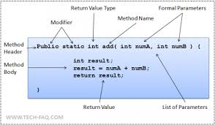
Classes and objects
Classes
Defining Methods
Method naming convention
Should be a verb in lowercase or a multi-word name that begins with a verb in lowercase, followed by adjectives, nouns, etc. In multi-word names, the first letter of each of the second and following words should be capitalized. Here are some examples:
Ex:
run
runFast
getBackground
getFinalData
compareTo
setX
isEmpty

Slide 49
Classes and objects
Classes: Overloading Methods
Methods within a class can have the same name if they have different parameter lists
Overloaded methods may have different return type.
public class MethodOverloadingDemo {
public void getEmpName(int empId) {
......
}
public void getEmpName(String empName) {
......
}
public void getEmpName(int empId, String empName) {
......
}
public void getEmpName(Date dob, String empName) {
......
}
}

Slide 50
Classes and objects
Classes: Constructors
Similar to method declarations—except that they use the name of the class and have no return type
There can be any number of constructors provided there are different number and types of arguments.
You can use any data type for a parameter of a method or a constructor
public Bicycle(int startCadence, int startSpeed, int startGear) {
gear = startGear;
cadence = startCadence;
speed = startSpeed;
}
Bicycle myBike = new Bicycle(30, 0, 8);

Slide 51
Classes and objects
Classes : Passing Primitive Data Type Arguments
Primitive arguments, such as an int or a double, are passed into methods by value.
Any changes to the values of the parameters exist only within the scope of the method
Classes: Passing Reference Data Type Arguments
Reference data type parameters, such as objects, are also passed into methods by value
This means that when the method returns, the passed-in reference still references the same object as before.
The values of the object's fields can be changed in the method, if they have the proper access level.
Lab9.1:
Passing primitive data type and reference data type arguments to contstuctors and methods.

Slide 52
Classes and objects
Objects:
Declaration
Instantiation
Initialization
Referencing object fields
Calling object’s methods
Lab9.2: Creating and using Objects.
Point originOne = new Point(23, 94);
Rectangle rectOne = new Rectangle(originOne, 100, 200);
Rectangle rectTwo = new Rectangle(50, 100);

Slide 53
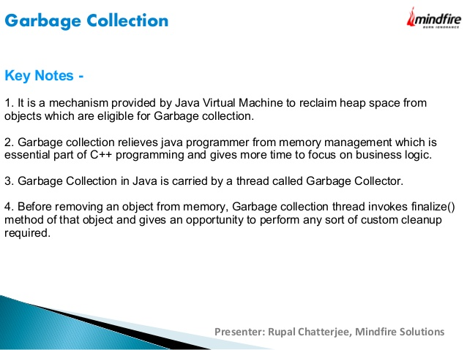
Classes and objects

Slide 54
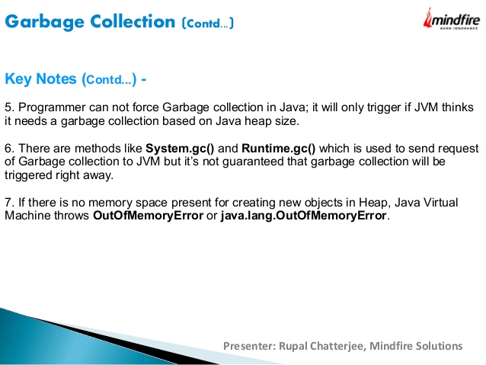
Classes and objects

Slide 55
Classes and objects
Returning Value from Method:
Any method declared void doesn't return a value.
Within the body of the method, you use the return statement to return the value.
A return statement can be used to branch out of a control flow block and exit the method
public Bicycle seeWhosFastest(Bicycle myBike, Bicycle yourBike, Environment env) {
Bicycle fastest;
// code to calculate which bike is
// faster, given each bike's gear
// and cadence and given the
// environment (terrain and wind)
return fastest;
}

Slide 56
Classes and objects - Packages
A package is a grouping of related types providing access protection and name space management.
Use packages for,
Easier to find and use classes
Avoid naming conflicts
Control access
Grouping related classes
Lab10.1: Demonstration of using the packages
//in the Circle.java file
package graphics;
public class Circle extends Graphic
implements Draggable {
. . .
}

Slide 57
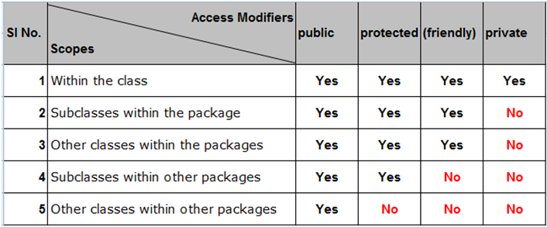
Classes and objects – Access modifiers
Determine whether other classes can use a particular field or invoke a particular method.
At the top level—public, or package-private (no explicit modifier).
At the member level—public, private, protected, or package-private (no explicit modifier).

Slide 58
Classes and objects - Packages
Naming convention:
Package names are written in all lower case
Companies use their reversed Internet domain name to begin their package names—for example, com.example.mypackage for a package named mypackage created by a programmer at example.com
//in the Circle.java file
package graphics;
public class Circle extends Graphic
implements Draggable {
. . .
}

Slide 59
Classes and objects - Packages
Static Imports:
Used to access to static final fields (constants) and static methods from one or two classes
public static final double PI
= 3.141592653589793;
public static double cos(double a){
...
}
Normally
double r = Math.cos(Math.PI * theta);
Using static import
import static java.lang.Math.PI;
import static java.lang.Math.cos;
double r = cos(PI * theta);
Referring to a Package Member by Its Qualified Name:
Ex:
graphics.Rectangle
graphics.Rectangle myRect = new graphics.Rectangle();
Importing a package member:
Ex: import graphics.Rectangle;
Rectangle myRectangle = new Rectangle();
Import entire package
import graphics.*;

Slide 60
Classes and objects
Class Members
Class Variables
Fields that have the static modifier in their declaration are called static fields or class variables
They are associated with class rather than with object.
Every instance of the class shares a class variable, which is in one fixed location in memory.
Any object can change the value of a class variable, but class variables can also be manipulated without creating an instance of the class.
Ex:
static double PI = 3.141592653589793;

Slide 61
Classes and objects
Class Members
Class Methods:
The methods with static modifier are called class method.
They can be invoked without creating the instance of the Class.
A common use for static methods is to access static fields
Instance methods can access instance variables and instance methods directly.
Instance methods can access class variables and class methods directly.
Class methods can access class variables and class methods directly.
Class methods cannot access instance variables or instance methods directly—they must use an object reference. Also, class methods cannot use the this keyword as there is no instance for this to refer to.
public static int getNumberOfBicycles() {
return numberOfBicycles;
}
Bicycle.getNumberOfBicycles();

Slide 62
Classes and objects
Constants:
The static modifier, in combination with the final modifier, is also used to define constants.
The final modifier indicates that the value of this field cannot change.
static final double PI = 3.141592653589793;
Lab10.2: Demonstration of using the packages, access modifier, class variable, class methods.

Slide 63
Classes and objects
Constants:
The static modifier, in combination with the final modifier, is also used to define constants.
The final modifier indicates that the value of this field cannot change.
static final double PI = 3.141592653589793;
Lab10.2: Demonstration of using the packages, access modifier, class variable, class methods.

Slide 64
Classes and objects
Initializing Fields:
public class BedAndBreakfast {
// initialize to 10
public static int capacity = 10;
// initialize to false
private boolean full = false;
}
Using static blocks:
static {
// whatever code is needed for initialization goes here
}

Slide 65
Classes and objects [Todo]
Sample programmes to display the correct output

Slide 66
Nested classes
Class within a class
Why Nested class?
For logically grouping classes that are only used in one place.
It increases encapsulation
More readable and maintainable code
inner classes have to be used where things belong together
Static and Non-static (inner class) nested classes
class OuterClass {
...
class NestedClass {
...
}
}
class OuterClass {
...
static class StaticNestedClass {
...
}
class InnerClass {
...
}
}

Slide 67
Nested classes
Non-static Nested class (Inner class):
class ScreenCapture {
class CaptureButtonListener implements ClickListener {
public void onClick( ClickEvent click ) {
//..capture
pressCount++;
}
}
Button button = new Button("capture");
int pressCount = 0;
void addListeners() {
button.addClickListener( new CaptureButtonListener() );
}
}
Inner classes can be instantiated as following:
OuterClass.InnerClass innerObject = outerObject.new InnerClass();

Slide 68
Nested classes
Static Nested class:
Button button = new Button("capture");
int pressCount = 0;
public void captureRequested() {
//do capture...
pressCount++;
}
void addListeners() {
button.addClickListener( new CaptureButtonListener(this) );
}
}
public class ScreenCapture {
public static class CaptureButtonListener implements ClickListener {
protected ScreenCapture controller;
public CaptureButtonListener( ScreenCapture controller ) {
this.controller = controller;
}
public void onClick( ClickEvent click ) {
//..capture
controller.pressCount++;
}
}
Static nested classes are accessed using the enclosing class name:
OuterClass.StaticNestedClass
For example, to create an object for the static nested class, use this syntax:
OuterClass.StaticNestedClass nestedObject = new OuterClass.StaticNestedClass();

Slide 69
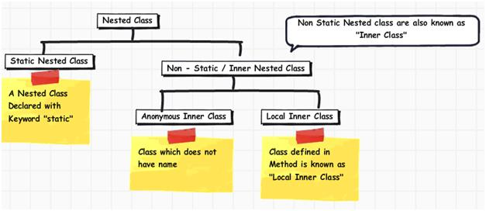
Nested classes
Lab11.1: Demonstration of using inner classes: ShadowTest
Lab11.2: Demonstration of using inner classes: DataStructure
:

Slide 70
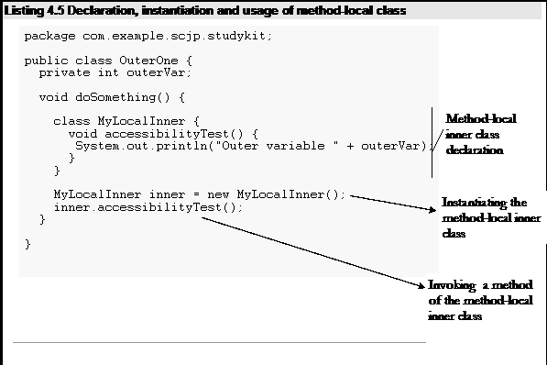
Nested classes
Local class:
Local classes are classes that are defined in a block

Slide 71
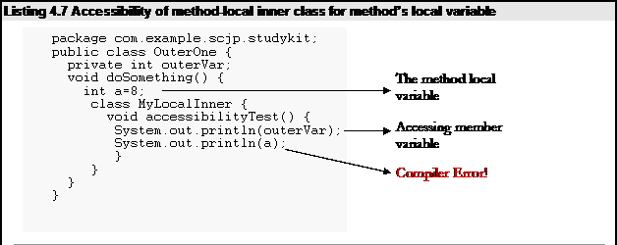
Nested classes
Local class:

Slide 72
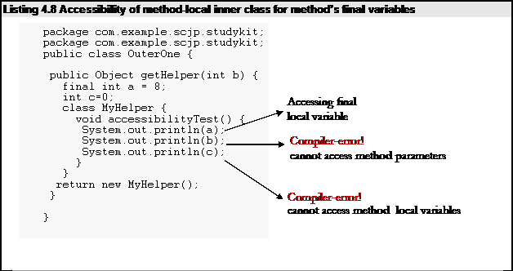
Nested classes
Local class:

Slide 73
Nested classes
Local class:
Local class can access only final local variables.
Local class can have access to method parameters.
Local class cannot have static initializers or member interfaces.
Local class can have only static final variables.
Lab11.3: Demonstration of using Local classes

Slide 74
Nested classes
Anonymous classes:
They are like local classes except that they do not have a name.
They enable you to declare and instantiate a class at the same time
Access to local variables same as for local class.
An anonymous class has access to the members of its enclosing class
Cannot access local variables in its enclosing scope that are not declared as final or effectively final.
cannot declare static initializers or member interfaces in an anonymous class
can have static members provided that they are constant variables.

Slide 75
class and object: enum type
enum types are used to represent a fixed set of constants.
Since they are constants, the names of an enum type's fields are in uppercase letters
Ex:
public enum Day {
SUNDAY, MONDAY, TUESDAY, WEDNESDAY,
THURSDAY, FRIDAY, SATURDAY
}
Lab11.5: Demonstration of using Enum types.
Lab11.6: Demonstration of using Enum types with calculations:

Slide 76
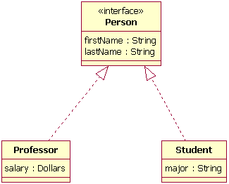
Interfaces and inheritance
Interfaces are contracts that defines how the software will interact with outside world.
reference type, similar to a class, that can contain only constants, method signatures, default methods, static methods, and nested types.
Method bodies exist only for default methods and static methods.
Interfaces cannot be instantiated.
Variables should be public, static and final.
Ex:
Automobile manufacturers write software (Java, of course) that operates the automobile—stop, start, accelerate, turn left, and so forth.
Electronic guidance instrument manufacturers, make computer systems that receive GPS (Global Positioning System) position data and wireless transmission of traffic conditions and use that information to drive the car

Slide 77
Interfaces and inheritance
Defining Interface:
public interface <NameOfInterface>
{
//Any number of final, static fields
//Any number of abstract method declarations
//Any number of default methods.
}

Slide 78
Interfaces and inheritance

Slide 79
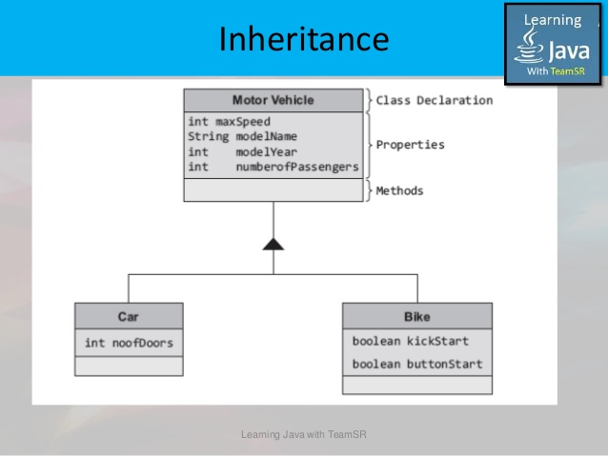
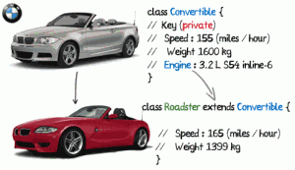
Interfaces and inheritance

Slide 80
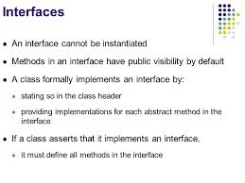
Interfaces and inheritance

Slide 81
Interfaces and inheritance

Slide 82
Java - miscellaneous
Type Comparison Operator instanceof
The instanceof operator compares an object to a specified type.
You can use it to test if an object is an instance of a class, an instance of a subclass, or an instance of a class that implements a particular interface
Classes implementing interfaces
class MyClass extends MySuperClass implements YourInterface {
// field, constructor, and
// method declarations
}

Slide 83
Java - miscellaneous
Varargs – Specifying Arbitrary number of arguments
public Polygon polygonFrom(Point... corners) {
int numberOfSides = corners.length;
double squareOfSide1, lengthOfSide1;
squareOfSide1 = (corners[1].x - corners[0].x)
* (corners[1].x - corners[0].x)
+ (corners[1].y - corners[0].y)
* (corners[1].y - corners[0].y);
lengthOfSide1 = Math.sqrt(squareOfSide1);
// more method body code follows that creates and returns a
// polygon connecting the Points
}
You will most commonly see varargs with the printing methods; for example, this printf method:
public PrintStream printf(String format, Object... args)
allows you to print an arbitrary number of objects. It can be called like this:
System.out.printf("%s: %d, %s%n", name, idnum, address);

Slide 84
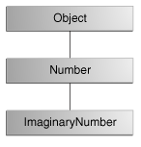
Java - miscellaneous
Returning a Class or Interface
When a method uses a class name as its return type the class of the type of the returned object must be either a subclass of, or the exact class of, the return type.
public Number returnANumber() {
...
}
The returnANumber method can return an ImaginaryNumber but not an Object. ImaginaryNumber is a Number because it's a subclass of Number. However, an Object is not necessarily a Number — it could be a String or another type

Slide 85
Advanced java
Garbage collection
JDBC
Lambda expressions
Annotations

Slide 86
references
https://docs.oracle.com/javase/tutorial/reallybigindex.html
http://www.slideshare.net/EdurekaIN/java-class-3
http://www.slideshare.net/abdurrehmanabdurrehman391/variables-and-data-types-by-sir-khalid
http://www.slideshare.net/abdurrehmanabdurrehman391/java-advancedoop
http://www.slideshare.net/MindfireSolutions/java-garbage-collection-how-it-works?next_slideshow=1

