Slide 1

Introduction to JavaServerFaces & MyFaces
Anudeep Jassal

Slide 2

Topics of Discussion
What is JSF?
JSF Architecture.
How does JSF work.
What is MyFaces?

Slide 3
What is Java Server Faces?
JSF is a new and upcoming web application framework that accomplishes the MVC paradigm It is similar to Struts but has features and concepts that are beyond those of Struts - especially the component orientation.
Provides set of reusable custom components.
Provides set of JSP tags to access those components.

Slide 4
JSF Architecture
JSF follows MVC framework
Model: objects and properties of application
View: Renderers take care of view.
Controller: FacesServlet/ JSF infrastructure defines the flow of the application.

Slide 5
How JSF works
A form is displayed
  Form uses <f:view> and <h:form>
The form is submitted to itself.
The bean is instantiated. Listed in the managed-bean section of faces-config.xml
The action controller method is invoked.
The action method returns a condition.
The result page is displayed.

Slide 6
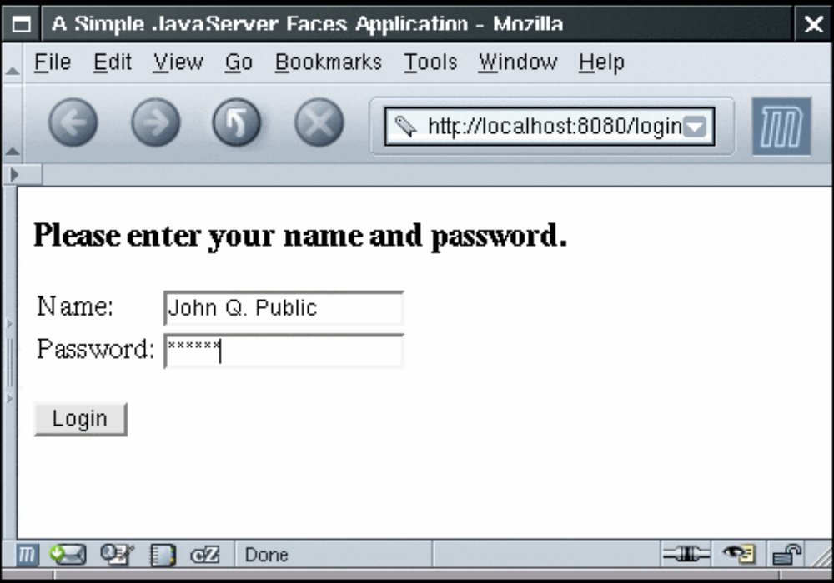
Login page

Slide 7
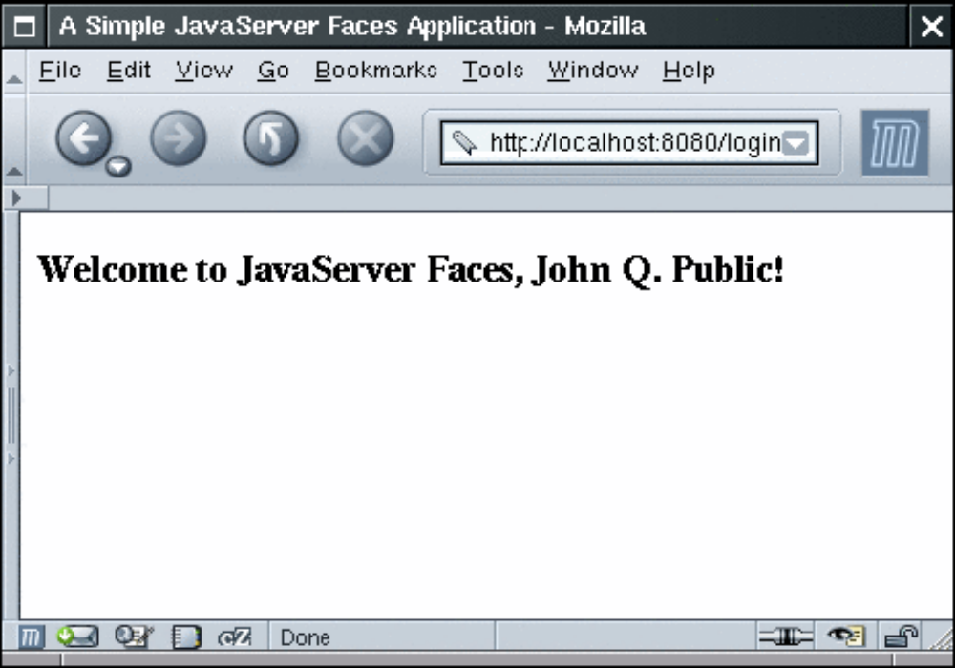
Welcome page

Slide 8
Example files
index.jsp,welcome.jsp – define the login and welcome screens.
UserBean.java – manages user data
faces-config.xml – configuration file for the application.
web.xml – deployment descriptor.

Slide 9
JSF Example(index.jsp)
<%@ taglib uri="http://java.sun.com/jsf/core" prefix="f" %>
<%@ taglib uri="http://java.sun.com/jsf/html" prefix="h" %>
<f:loadBundle basename=“com.corejsf.bundle.Messages" var="Message"/>
<f:view>
…
<h:form>
<h3><h:outputText value="#{Message.inputname_header}"/></h3>
<table>
<tr>
<td>Name:</td>
<h:inputText value="#{user.name}“ required=“true”/>
<f:validateLength minimum="2" maximum="20"/>
…
<td>Password:</td>
<h:inputSecret value="#{user.password}"/>
…
<h:commandButton value="Login" action="login"/>
</h:form>
</f:view>

Slide 10
index.jsp
Tag Libraries: core and html.
<%@ taglib uri="http://java.sun.com/jsf/html" prefix="h" %>
<%@ taglib uri="http://java.sun.com/jsf/core" prefix="f" %>
Core tags are used to perform core actions and display nothing to the user. Html tags are used to render html elements(text, form elements etc) to the user.
<f:loadBundle> is a core tag. Loads properties file and makes it value available to variable message.
<f:loadBundle basename=“com.corejsf..bundle.Messages" var="Message"/>
All JSF components must be nested inside <f:view> core tag.
<f:view>
<h:form>
<h3><h:outputText value="#{Message.inputname_header}"/></h3>
<h:inputText value="#{user.name}“ required=“true”/>
<f:validateLength minimum="2" maximum="20"/>
<h:inputSecret value="#{user.password}"/>
<h:commandButton value="Login" action="login"/>
</h:form>
</f:view>

Slide 11
Example (Cntd.)
Any attribute value that starts with # and is wrapped in {} is dynamically substituted in
#{Message.inputname_header}
<h:form> represents form element
Form action is defined in the <h:commandButton> element.
<h:commandButton value="Login" action="login"/>
<h:inputText> for name field renders a textbox. Required attribute tells the value must be provided by the user. Thus validating the field.
<h:inputText value="#{user.userName}" required="true">
Nested core tag provides range validation.
<f:validateLength minimum="2" maximum="20"/>

Slide 12
UserBean.java
public class UserBean {
public String getName() { . . . }
public void setName(String newValue) {. . . }
public String getPassword() { . . . }
public void setPassword(String newValue) { . . . }
. . .
}

Slide 13
Configuration file (faces-config.xml)
<?xml version="1.0"?>
<!DOCTYPE faces-config PUBLIC
"-//Sun Microsystems, Inc.//DTD JavaServer Faces Config 1.0//EN"
"http://java.sun.com/dtd/web-facesconfig_1_0.dtd">
<faces-config>
<navigation-rule>
<from-view-id>/index.jsp</from-view-id>
<navigation-case>
<from-outcome>login</from-outcome>
<to-view-id>/welcome.jsp</to-view-id>
</ navigation-case>
</navigation-rule>
<managed-bean>
<managed-bean-name>user</managed-bean-name>
<managed-bean-class>com.corejsf.UserBean</managed-bean-class>
<managed-bean-scope>session</managed-bean-scope>
</managed-bean>
</faces-config>

Slide 14
Configuration File(Cntd.)
faces-config.xml defines how one page will navigate to next. Also specifies managed beans.
<navigation-rule>
<from-view-id>/index.jsp</from-view-id>
<navigation-case>
<from-outcome>login</from-outcome>
<to-view-id>/welcome.jsp</to-view-id>
</navigation-case>
</navigation-rule
<from-view-id> page you are currently on.
<to-view-id> next page to display.
<from-outcome> value matches the action attribute of the command button of index.jsp
<h:commandButton value="Login" action="login"/>

Slide 15
Configuration file (Cntd.)
Managed bean is the model of the framework.
<managed-bean-name> is the name the views use to reference the bean.<managed-bean-name>user</managed-bean-name>
<h:inputText value="#{user.name}“ required=“true”/>
<managed-bean-class> is the fully classified name for the bean.
<managed-bean-class> com.corejsf.UserBean </managed-bean-class>
<managed-bean-scope>session</managed-bean-scope>

Slide 16
Web.xml (Deployment Descriptor)
<context-param>
<param-name>
javax.faces.CONFIG_FILES</param-name>
<param-value>
/WEB-INF/faces-config.xml
</param-value>
<description>
</description>
</context-param>
<servlet>
<servlet-name>Faces Servlet</servlet-name>
<servlet-class>
javax.faces.webapp.FacesServlet
</servlet-class>
<load-on-startup>1</load-on-startup>
</servlet>
<servlet-mapping>
<servlet-name>Faces Servlet</servlet-name>
<url-pattern *.faces </url-pattern>
</servlet-mapping>

Slide 17
Web.xml (Cntd.)
Javax.faces.CONFIG_FILES parameter tells where the JSF configuration file exists.
<param-name>
javax.faces.CONFIG_FILES
</param-name>
<param-value>
/WEB-INF/examples-config.xml
</param-value>
Javax.faces.STATE_SAVING_METHOD specifies where the state must be saved: client or server.
<param-name>
javax.faces.STATE_SAVING_METHOD
</param-name>
<param-value>server</param-value>
The servlet-mapping and servlet blocks specify that any URL that ends in a .jsf extension should be redirected through a servlet called javax.faces.webapp.FacesServlet.

Slide 18
What is Apache MyFaces?
First free open source implementation of JSF.
Provides rich set of prefabricated components.

Slide 19
MyFaces Component Libraries
Tomahawk
  Original MyFaces component library.
Tobago
  Apache Library now under MyFaces umbrella.
Trinidad
  Originally Oracle ADF components.

Slide 20
Using MyFaces Tomahawk Components
Add jar files to WEB-INF/lib
  Tomahawk.jar
  Commons-fileupload.jar
  Commons-validator.jar
  Oro-xxx-jar
Import the extended tag library
<%@ taglib uri=http://myfaces.apache.org/tomahawk prefix="t"%>
Enable extensions filter
  Add a filter and two filter mappings in web.xml
    Delivers JavaScript code and style sheets. Components which use JavaScript will fail without these entries in web.xml

Slide 21
Date Component
Input Text control for dates.
Attributes
  Value – the Date value.
  Type – Defines the content type. Date,time or both
  popupCalendar - If true, button added that pops up JavaScript calendar for input. Default is false

Slide 22
t:inputDate example
Main JSP page
<h:form>
Date: <t:inputDate value=“#{sample.date}” popupCalendar="true"/><BR>
<h:commandButton action="show-date"/>
</h:form>
Bean
package coreservlets
import java.util.*;
public class SampleBean {
private Date date;
public Date getDate() { return(date); }
public void setDate(Date date) {
this.date = date;
}

Slide 23
Example (Cntd.)
faces-config.xml
<managed-bean>
<managed-bean-name>sample</managed-bean-name>
<managed-bean-class>
coreservlets.SampleBean
</managed-bean-class>
<managed-bean-scope>request</managed-bean-scope>
</managed-bean>
<navigation-rule>
<from-view-id>/date.jsp</from-view-id>
<navigation-case>
<from-outcome>show-date</from-outcome>
<to-view-id>/WEB-INF/results/show-date.jsp</to-view-id>
</navigation-case>
</navigation-rule>
Result Page
<H2>You selected the following date:<BR>
<h:outputText value="#{sample.date}"/></H2>

Slide 24
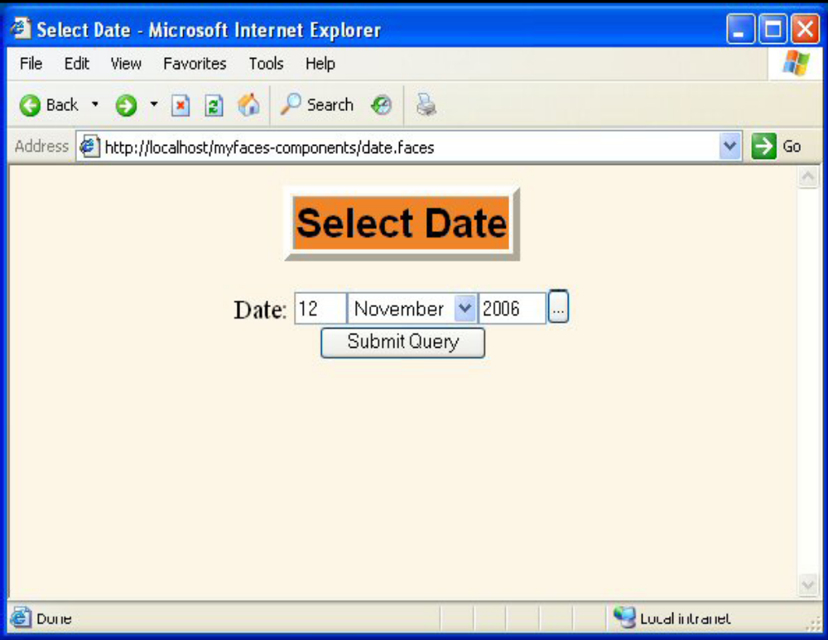
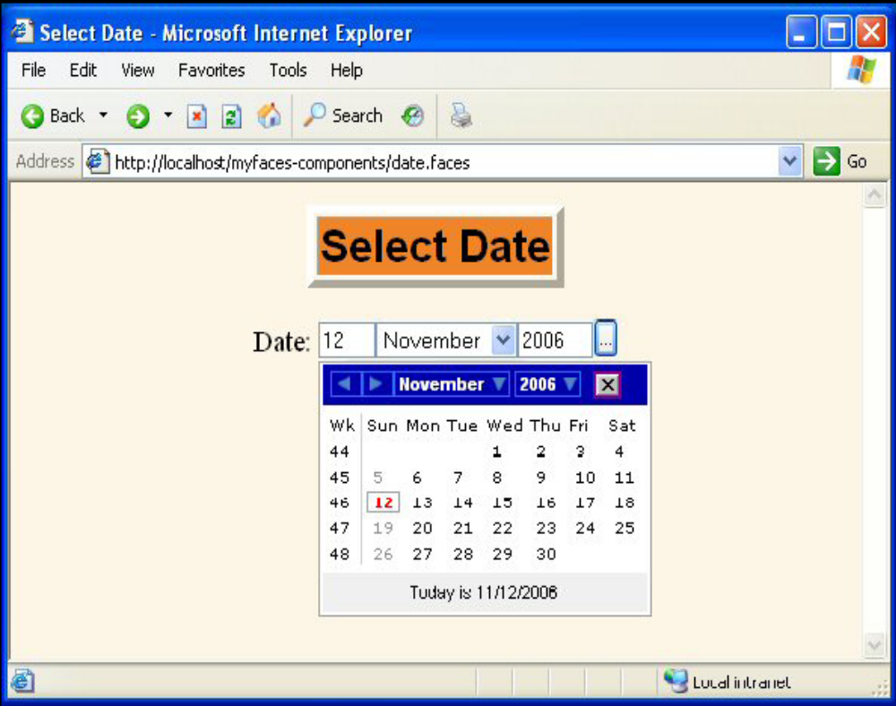
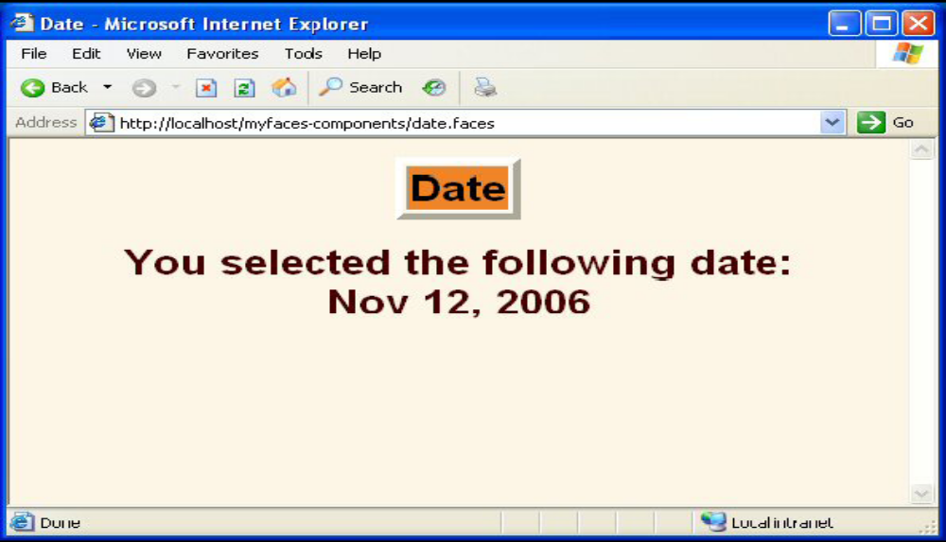

Slide 25
Tabbed Pane
Description- for switching panels.
Attributes
  bgColor – the background color of the active tab
  activeTabStyleClass,inactiveTabStyleClass
t:panelTab contains per tab content. HTML goes within <f:verbatim>
Shared content is outside t:panelTab but within t:panelTabbedPane
Everything must be inside h:form
Non tab content goes outside t:panelTabbedPane

Slide 26
Example t:panelTabbedPane
<h:form>
<t:panelTabbedPane bgcolor="#FFFFCC">
<t:panelTab label="Tab 1">
<f:verbatim><H1>Tab 1</H1></f:verbatim>
</t:panelTab>
<t:panelTab label="Tab 2">
<f:verbatim><H1>Tab 2</H1></f:verbatim>
</t:panelTab>
<t:panelTab label="Tab 3">
<f:verbatim><H1>Tab 3</H1></f:verbatim>
</t:panelTab>
<h:commandButton value="Common Button" action="..."/>
</t:panelTabbedPane>
</h:form>

Slide 27
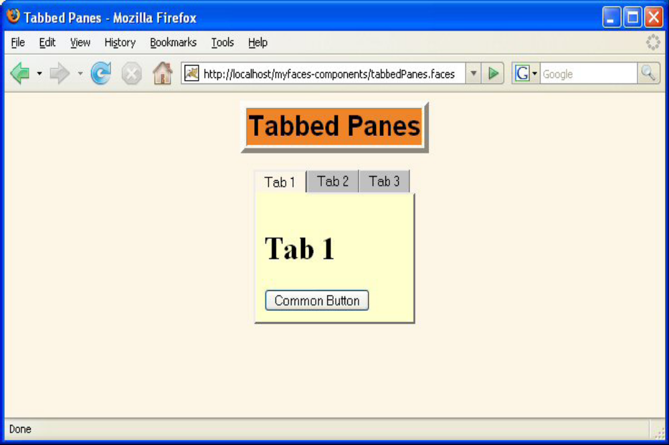

Slide 28
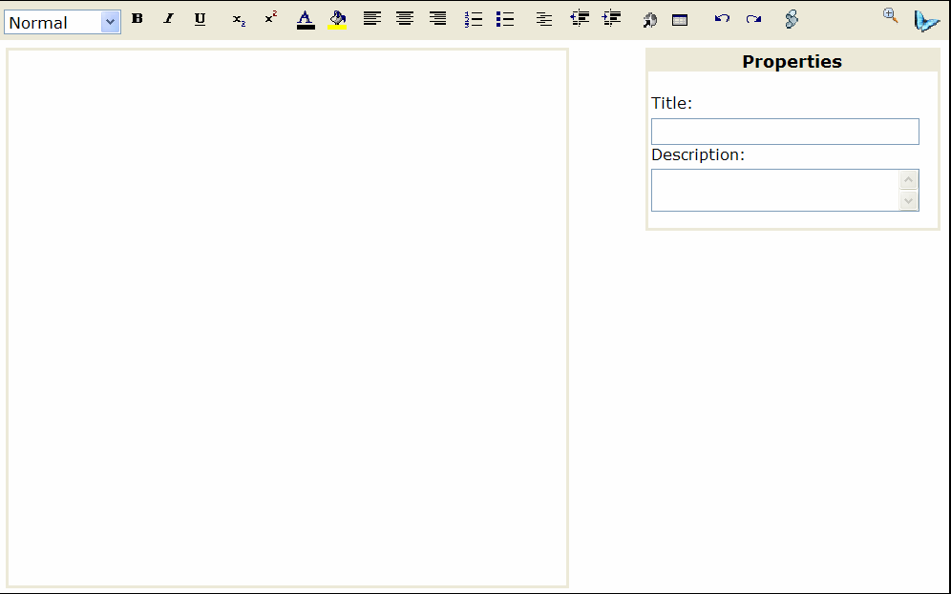
t:inputHTML
Inline HTML based word processor

Slide 29
Usage
<t:inputHtml value="String" style="CSSClass" fallback="{true|false}" type="Constant" allowExternalLinks="{true|false}" addKupuLogo="{true|false}" showAllToolBoxes="{true|false}" allowEditSource="{true|false}" showPropertiesToolBox="{true|false}" showLinksToolBox="{true|false}" showImagesToolBox="{true|false}" showTablesToolBox="{true|false}" showDebugToolBox="{true|false}" showCleanupExpressionsToolBox="{true|false}"/>

Slide 30
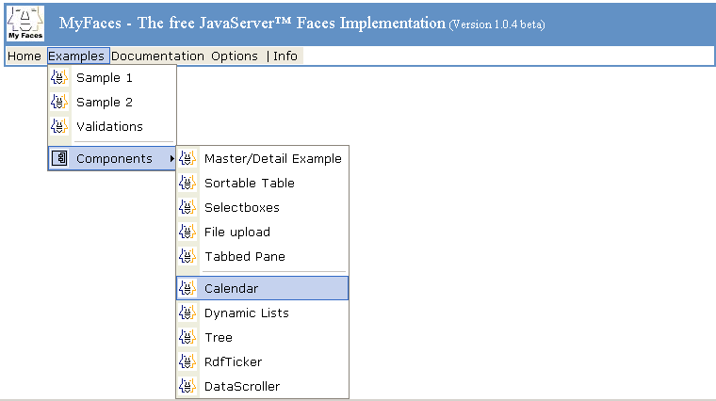
JSCookMenu
Renders a nested navigation menu.

Slide 31
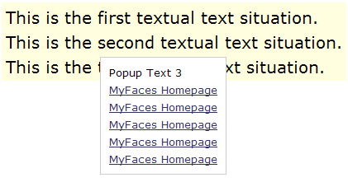
Popup Component
Renders a popup which displays on a mouse event.

Slide 32
Tomahawk Validators
Widely used validators
  validateRegExpr
  validateEmail
  validateCreditCard
  validateEquals

Slide 33

validateRegExpr
Attributes:
  pattern – required
  message - optional
Example
<TABLE BGCOLOR="WHITE">
<h:form>
<TR><TD>
<B>ZIP Code:</B>
<t:inputText value="#{order.zipCode}“ required="true" id="ZIP">
<t:validateRegExpr pattern="\d{5}"
message="ZIP Code must be 5 digits"/>
</t:inputText>
<TD><h:message for="ZIP" styleClass="red"/></TD>
</TD></TR>
</h:form>
</TABLE>

Slide 34
validateEmail
Attributes: no attributes are required
Example
<TR><TD>
<B>Email:</B>
<t:inputText value="#{order.email}“ required="true" id="email">
<t:validateEmail
message="Invalid email address"/>
</t:inputText>
<TD><h:message for="email" styleClass="red"/></TD>
</TD></TR>

Slide 35
validateCreditCard
Attributes: no attributes are required.
  You can specify that only Visa, MasterCard etc are acceptable.
Example:
  <TR><TD>
  <B>Credit Card:</B>
  <t:inputSecret value="#{order.creditCard}“ required="true" id="card1">
  <t:validateCreditCard
  message="Invalid credit card number"/>
  </t:inputSecret>
  <TD><h:message for="card1" styleClass="red"/></TD>
  </TD></TR>

Slide 36
validateEquals(custom validator for equal inputs)
Attributes:
  for: Required
  message: Optional
Example
<t:inputSecret value="#{order.creditCard}“ required="true" id="card1">
<t:validateCreditCard message="Invalid credit card number"/>
</t:inputSecret>
<TD><h:message for="card1" styleClass="red"/></TD>
</TD></TR>
<TR><TD>
<B>Confirm Credit Card:</B>
<t:inputSecret required="true" id="card2">
<t:validateEqual for="card1"
message="The two credit card entries do not match"/>
</t:inputSecret>
<TD><h:message for="card2" styleClass="red"/></TD>

Slide 37
Advantages of JSF
The big advantage of using JSF is that it provides reusable components.
It has drag and drop IDE support.
Provides built-in form validation.
Provides set of APIs and associated custom tags to create HTML forms that have complex interface.

Slide 38
Disadvantages of JSF
Bad Documentation
  Compared to the standard servlet and JSP APIs, JSF has fewer online resources, and many first-time users find the online JSF documentation confusing and poorly organized.
Undeveloped tool support
  There are many IDEs with strong support for standard
  servlet and JSP technology. Support for JSF is only
  beginning to emerge, and final level is yet to be
  determined.

Slide 39
References
http://www.devx.com/Java/Article/28420
http://myfaces.apache.org/tomahawk/
http://java.sun.com/developer/EJTechTips/2004/tt0324.html#2
http://asia.apachecon.com/wp-content/presentations/ApacheConAsia2006_MyFaces_Tutorial.pdf
http://www.oracle.com/technology/obe/obe1013jdev/10131/jsfintro/jsfintro.htm
http://learningjsf.wordpress.com/
http://www.eclipse.org/webtools/jsf/dev_resource/JSFTutorial-RC3/JSFTools_tutorial.html
http://courses.coreservlets.com/Course-Materials/jsf.html
http://developers.sun.com/prodtech/javatools/jscreator/reference/techart/2/writing_custom_components.html
http://www.javaworld.com/javaworld/jw-07-2006/jw-0731-myfaces.html

Slide 40
Questions?

