Slide 1
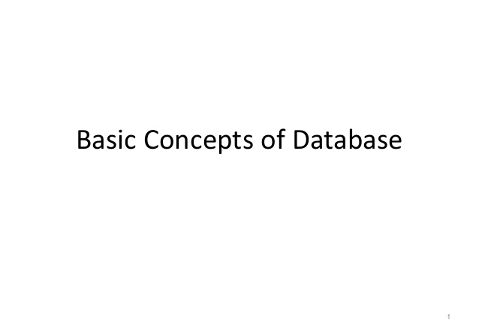
exceptions

Slide 2
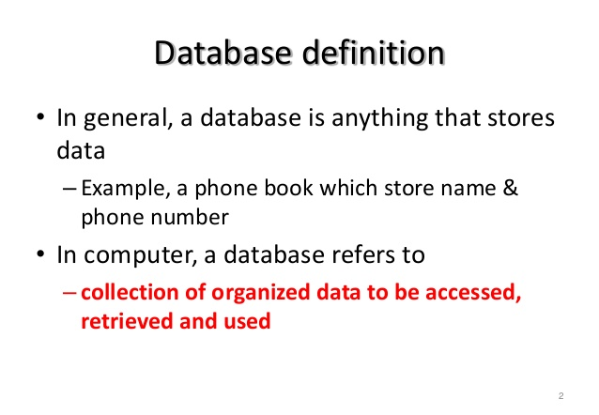

exceptions

Slide 3
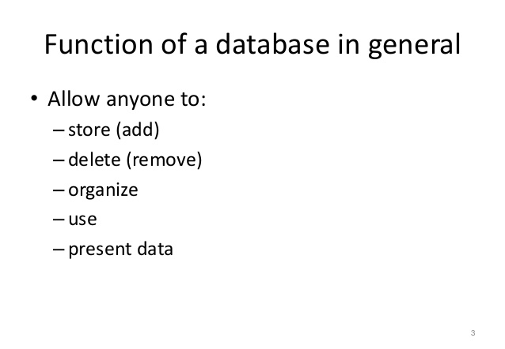
exceptions

Slide 4
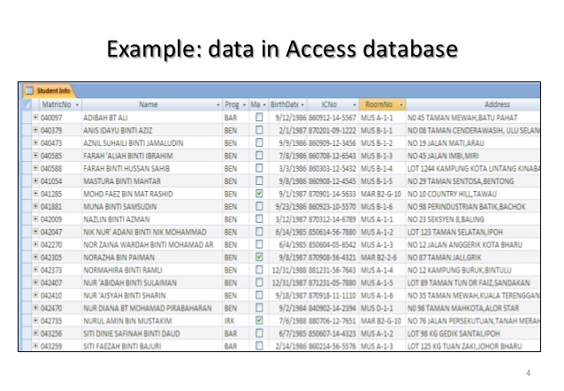
exceptions

Slide 5
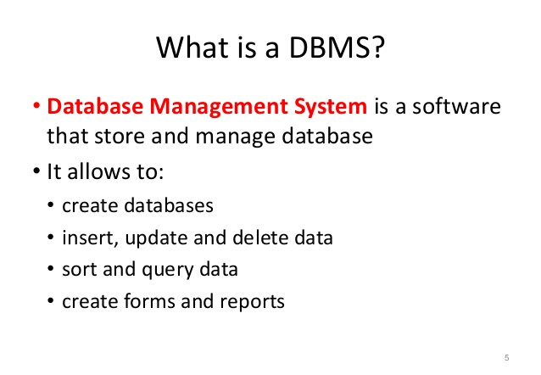
exceptions

Slide 6
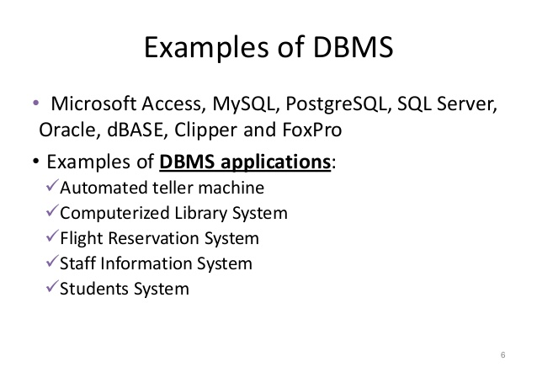
exceptions

Slide 7
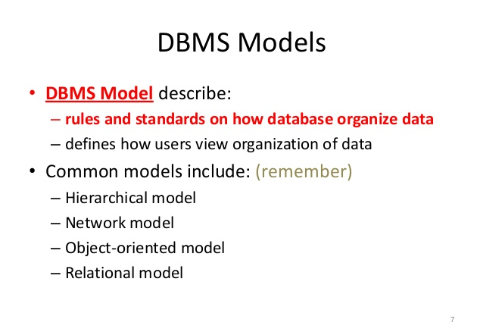
exceptions

Slide 8
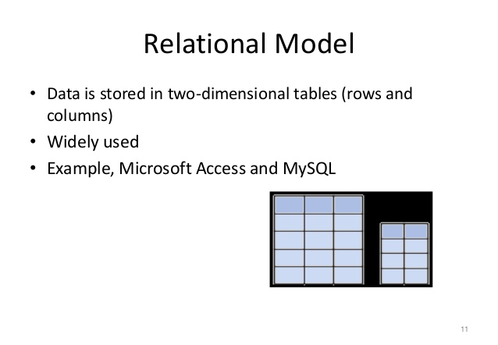
exceptions

Slide 9
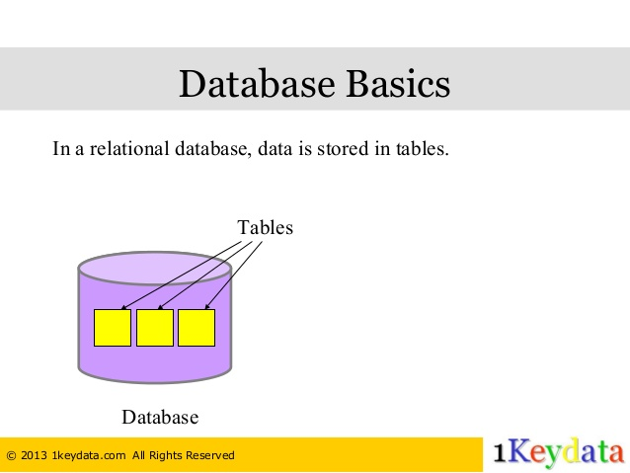
exceptions

Slide 10
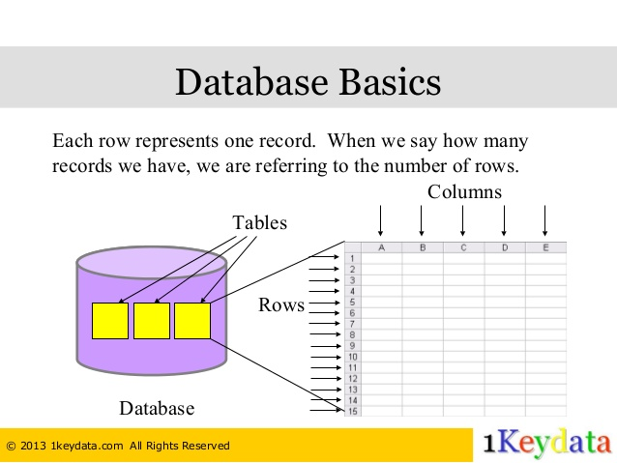
exceptions

Slide 11
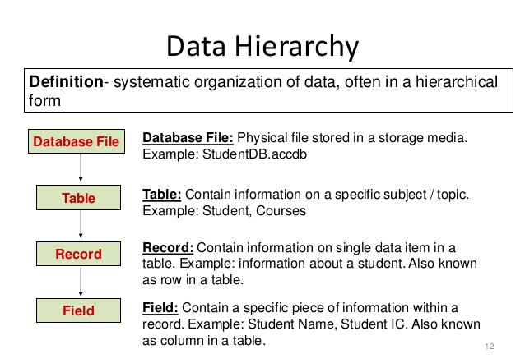
exceptions

Slide 12
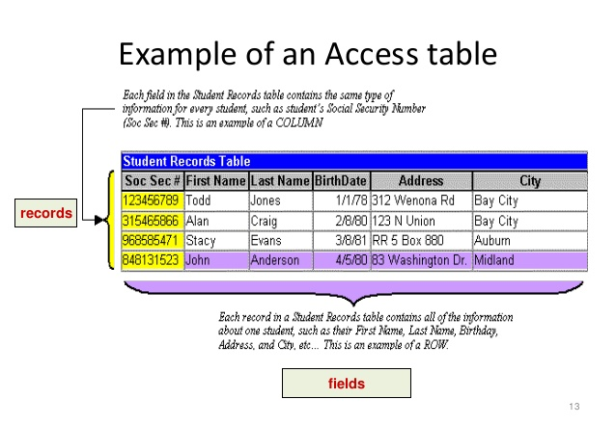
exceptions

Slide 13
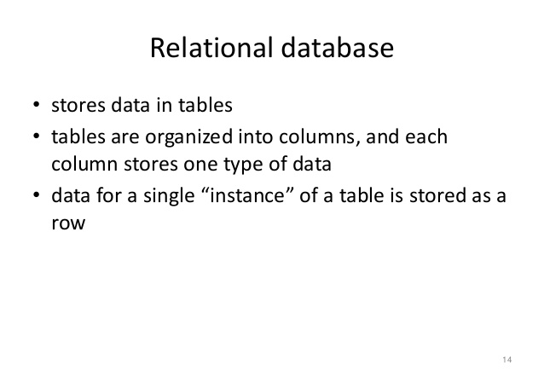
exceptions

Slide 14
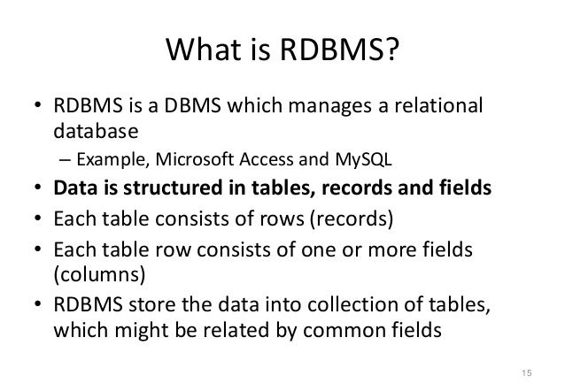
exceptions

Slide 15
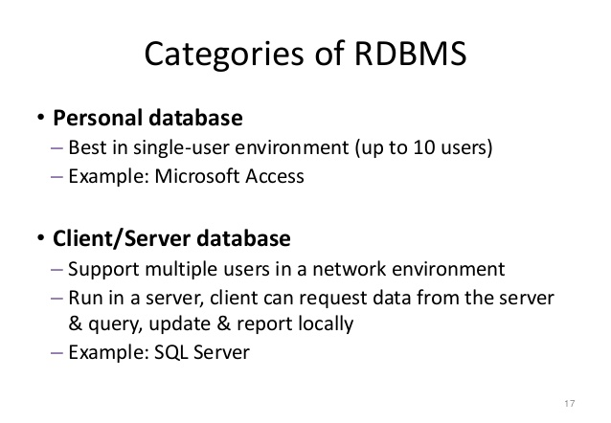
exceptions

Slide 16
exceptions
Lab
Lab21.1: Installing and configuring the mysql database.

Slide 17
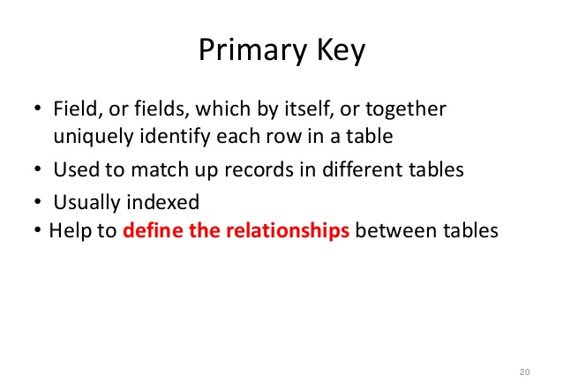
exceptions

Slide 18
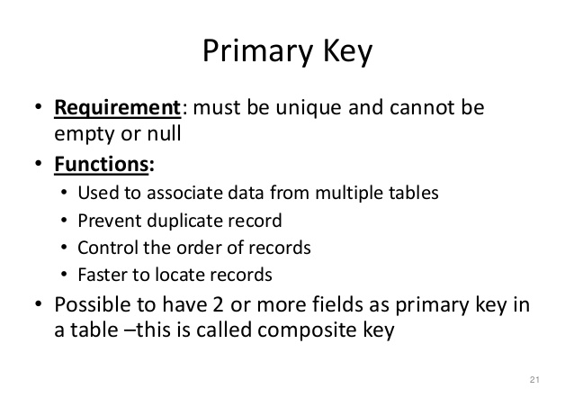
exceptions

Slide 19
exceptions
Primary Key
CREATE TABLE Persons
(
P_Id int NOT NULL,
LastName varchar(255) NOT NULL,
FirstName varchar(255),
Address varchar(255),
City varchar(255),
PRIMARY KEY (P_Id)
)

Slide 20
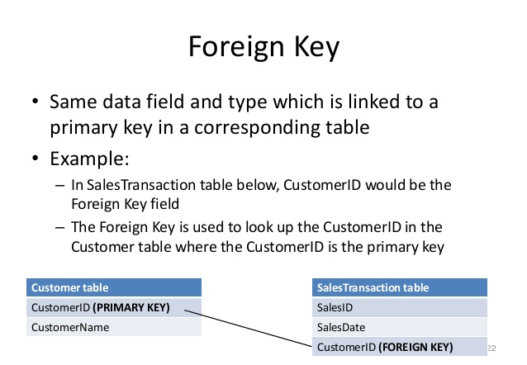
exceptions

Slide 21
exceptions
SQL
(Structured Query Language)

Slide 22
exceptions
SQL
SQL stands for Structured Query Language
SQL lets you access and manipulate databases
SQL is an ANSI (American National Standards Institute) standard

Slide 23
exceptions
SQL Commands
SELECT - extracts data from a database
UPDATE - updates data in a database
DELETE - deletes data from a database
INSERT INTO - inserts new data into a database
CREATE DATABASE - creates a new database
ALTER DATABASE - modifies a database
CREATE TABLE - creates a new table
ALTER TABLE - modifies a table
DROP TABLE - deletes a table
CREATE INDEX - creates an index (search key)
DROP INDEX - deletes an index

Slide 24
exceptions
SQL – CREATE DATABASE
Used to create a database
SQL CREATE DATABASE Syntax:
CREATE DATABASE dbname;
Ex:
CREATE DATABASE my_db;

Slide 25
exceptions
SQL – CREATE TABLE
Used to create a table in a database
SQL CREATE TABLE Syntax:
CREATE TABLE table_name
(
column_name1 data_type(size),
column_name2 data_type(size),
column_name3 data_type(size),
....
);
Ex:
CREATE TABLE Persons
(
PersonID int,
LastName varchar(255),
FirstName varchar(255),
Address varchar(255),
City varchar(255)
);

Slide 26
exceptions
SQL – CREATE TABLE + CONSTRAINT syntax
Constraints are used to specify rules for the data in a table.
If there is any violation between the constraint and the data action, the action is aborted by the constraint
Constraints can be specified when the table is created (inside the CREATE TABLE statement) or after the table is created (inside the ALTER TABLE statement).
SQL CREATE TABLE + CONSTRAINT Syntax
CREATE TABLE table_name
(
column_name1 data_type(size) constraint_name,
column_name2 data_type(size) constraint_name,
column_name3 data_type(size) constraint_name,
....
);

Slide 27
exceptions
SQL – Constraints
NOT NULL - Indicates that a column cannot store NULL value
UNIQUE - Ensures that each row for a column must have a unique value
PRIMARY KEY - A combination of a NOT NULL and UNIQUE. Ensures that a column (or combination of two or more columns) have a unique identity which helps to find a particular record in a table more easily and quickly
FOREIGN KEY - Ensure the referential integrity of the data in one table to match values in another table
CHECK - Ensures that the value in a column meets a specific condition
DEFAULT - Specifies a default value for a column.

Slide 28
exceptions
SQL Commands – INSERT INTO statement
Used to insert new records in a table.
SQL INSERT INTO Syntax
INSERT INTO table_name VALUES (value1,value2,value3,...);
And
INSERT INTO table_name (column1,column2,column3,...) VALUES (value1,value2,value3,...);
Ex:
INSERT INTO Customers (CustomerName, ContactName, Address, City, PostalCode, Country)
VALUES ('Cardinal','Tom B. Erichsen','Skagen 21','Stavanger','4006','Norway');

Slide 29
exceptions
SQL Commands - SELECT
SQL SELECT Syntax:
SELECT column_name,column_name
FROM table_name;
And
SELECT * FROM table_name;
Ex:
SELECT CustomerName,City FROM Customers;
SELECT * FROM Customers;

Slide 30
exceptions
SQL Commands – WHERE Clause
SQL WHERE Syntax:
SELECT column_name,column_name
FROM table_name
WHERE column_name operator value;
Ex:
SELECT * FROM Customers WHERE Country='Mexico';
SELECT * FROM Customers WHERE CustomerID=1

Slide 31
exceptions
SQL Commands – WHERE Clause …
Operators in The WHERE Clause:

Slide 32
exceptions
SQL Commands – AND and OR Operators
The AND & OR operators are used to filter records based on more than one condition.
The AND operator displays a record if both the first condition AND the second condition are true.
The OR operator displays a record if either the first condition OR the second condition is true.
Ex:
SELECT * FROM Customers WHERE Country='Germany‘ AND City='Berlin';
SELECT * FROM Customers WHERE City='Berlin‘ OR City='München';
SELECT * FROM Customers WHERE Country='Germany‘ AND (City='Berlin' OR City='München');

Slide 33
exceptions
SQL Commands – ORDER BY key word
The ORDER BY keyword is used to sort the result-set by one or more columns.
The ORDER BY keyword sorts the records in ascending order by default.
To sort the records in a descending order, you can use the DESC keyword.
SQL ORDER BY Syntax
SELECT column_name, column_name
FROM table_name ORDER BY column_name ASC|DESC, column_name ASC|DESC;
Ex:
SELECT * FROM Customers ORDER BY Country;
SELECT * FROM Customers ORDER BY Country DESC;
SELECT * FROM Customers ORDER BY Country, CustomerName;
SELECT * FROM Customers ORDER BY Country ASC, CustomerName DESC;

Slide 34
exceptions
SQL Commands – UPDATE statement
Used to update existing records in a table..
SQL UPDATE Syntax
UPDATE table_name SET column1=value1,column2=value2,...
WHERE some_column=some_value;
Ex:
UPDATE Customers SET ContactName='Alfred Schmidt', City='Hamburg‘ WHERE CustomerName='Alfreds Futterkiste';

Slide 35
exceptions
SQL Commands – DELETE statement
Used to delete records in a table.
SQL DELETE Syntax
DELETE FROM table_name WHERE some_column=some_value;
To delete all data from table
DELETE FROM table_name;
or
DELETE * FROM table_name;
Ex:
DELETE FROM Customers
WHERE CustomerName='Alfreds Futterkiste' AND ContactName='Maria Anders';
Also we can use TRUNCATE command to delete all the data from the table.
TRUNCATE TABLE table_name

Slide 36
exceptions
SQL Commands – LIKE operator
Used in a WHERE clause to search for a specified pattern in a column.
SQL DELETE Syntax
SELECT column_name(s)
FROM table_name
WHERE column_name LIKE pattern;
Ex:
SELECT * FROM Customers WHERE City LIKE 's%';
SELECT * FROM Customers WHERE Country LIKE '%land%';
SELECT * FROM Customers WHERE Country NOT LIKE '%land%';

Slide 37
exceptions
SQL Commands – IN operator
Allows you to specify multiple values in a WHERE clause.
SQL IN Syntax
SELECT column_name(s)
FROM table_name
WHERE column_name IN (value1,value2,...);
Ex:
SELECT * FROM Customers WHERE City IN ('Paris','London');

Slide 38
exceptions
SQL Commands – BETWEEN operator
Used to select values within a range.
SQL IN Syntax
SELECT column_name(s)
FROM table_name
WHERE column_name BETWEEN value1 AND value2;
Ex:
SELECT * FROM Products WHERE Price BETWEEN 10 AND 20;
SELECT * FROM Products WHERE Price NOT BETWEEN 10 AND 20;
SELECT * FROM Products WHERE (Price BETWEEN 10 AND 20) AND NOT CategoryID IN (1,2,3);
SELECT * FROM Products WHERE ProductName BETWEEN 'C' AND 'M';

Slide 39
exceptions
SQL Commands – Aliases
Used to temporarily rename a table or a column heading.
SQL Alias Syntax for Columns
SELECT column_name AS alias_name FROM table_name;
SQL Alias Syntax for Tables
SELECT column_name(s) FROM table_name AS alias_name;
Ex:
SELECT CustomerName AS Customer, ContactName AS [Contact Person] FROM Customers;
SELECT CustomerName, Address+', '+City+', '+PostalCode+', '+Country AS Address
FROM Customers;
SELECT CustomerName, CONCAT(Address,', ',City,', ',PostalCode,', ',Country) AS Address
FROM Customers;
SELECT o.OrderID, o.OrderDate, c.CustomerName FROM Customers AS c, Orders AS o
WHERE c.CustomerName="Around the Horn" AND c.CustomerID=o.CustomerID;

Slide 40
exceptions
SQL Joins
Used to combine rows from two or more tables, based on a common field between them.
Different SQL JOINs
INNER JOIN: Return all rows from multiple tables where the join condition is met
LEFT JOIN: Return all rows from the left table, and the matched rows from the right table
RIGHT JOIN: Return all rows from the right table, and the matched rows from the left table
FULL JOIN: Return all rows when there is a match in ONE of the tables.

Slide 41
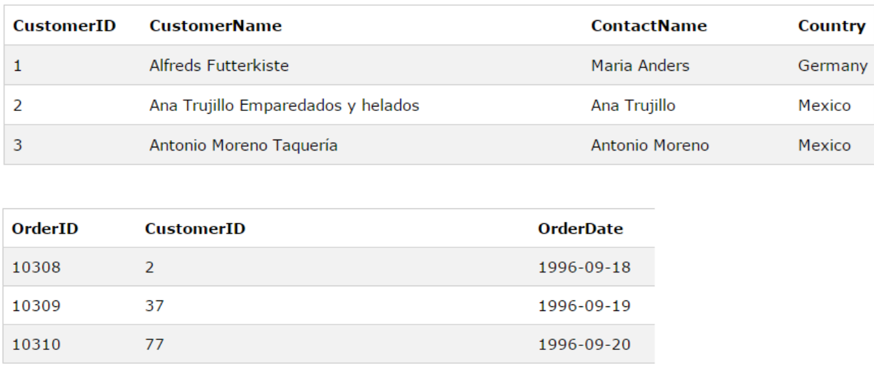
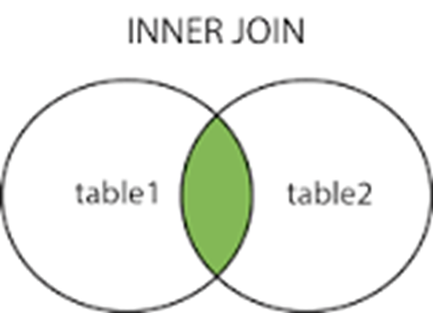
exceptions
SQL Joins – INNER JOIN
Ex:
SELECT Orders.OrderID, Customers.CustomerName, Orders.OrderDate
FROM Orders
INNER JOIN Customers
ON Orders.CustomerID=Customers.CustomerID;

Slide 42
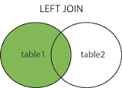
exceptions
SQL Joins – LEFT JOIN
LEFT JOIN keyword returns all rows from the left table (table1), with the matching rows in the right table (table2).
The result is NULL in the right side when there is no match
SQL LEFT JOIN Syntax:
SELECT column_name(s)
FROM table1
LEFT JOIN table2
ON table1.column_name=table2.column_name;
or
SELECT column_name(s)
FROM table1
LEFT OUTER JOIN table2
ON table1.column_name=table2.column_name;

Slide 43
exceptions
SQL Joins – LEFT JOIN …
Ex:
SELECT Customers.CustomerName, Orders.OrderID
FROM Customers
LEFT JOIN Orders
ON Customers.CustomerID=Orders.CustomerID
ORDER BY Customers.CustomerName;

Slide 44
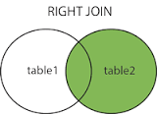
exceptions
SQL Joins – RIGHT JOIN
RIGHT JOIN keyword returns all rows from the right table (table2), with the matching rows in the left table (table1).
The result is NULL in the left side when there is no match.
SQL RIGHT JOIN Syntax:
SELECT column_name(s)
FROM table1
RIGHT JOIN table2
ON table1.column_name=table2.column_name;

Slide 45
exceptions
SQL Joins – RIGHT JOIN …
Ex:
SELECT Orders.OrderID, Employees.FirstName
FROM Orders
RIGHT JOIN Employees
ON Orders.EmployeeID=Employees.EmployeeID
ORDER BY Orders.OrderID;

Slide 46
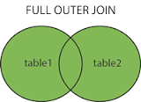
exceptions
SQL Joins – FULL OUTER JOIN
Returns all rows from the left table (table1) and from the right table (table2).
Combines the result of both LEFT and RIGHT joins.
SQL FULL OUTER JOIN Syntax:
SELECT column_name(s)
FROM table1
FULL OUTER JOIN table2
ON table1.column_name=table2.column_name;

Slide 47
exceptions
SQL Joins – FULL OUTER JOIN …
Ex:
SELECT Customers.CustomerName, Orders.OrderID
FROM Customers
FULL OUTER JOIN Orders
ON Customers.CustomerID=Orders.CustomerID
ORDER BY Customers.CustomerName;

Slide 48
exceptions
SQL – DROP TABLE/DATABASE
Used to delete a table/database.
Syntax:
DROP TABLE table_name
DROP DATABASE database_name.

Slide 49
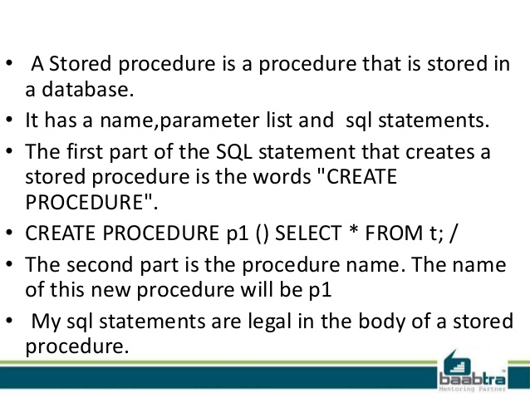
exceptions

Slide 50
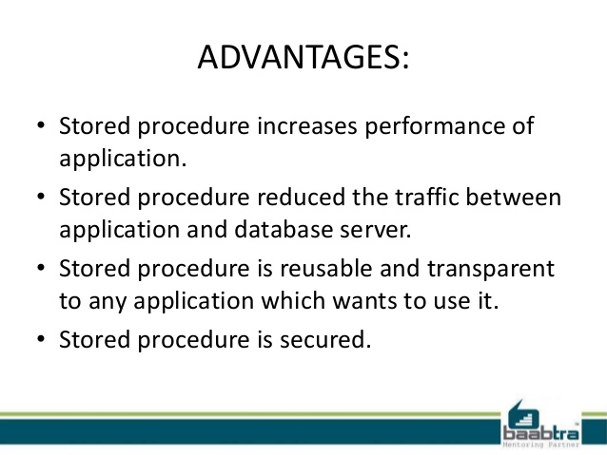
exceptions

Slide 51
exceptions
SQL - QUIZ
http://www.w3schools.com/quiztest/quiztest.asp?qtest=SQL

Slide 52
exceptions
References:
http://www.slideshare.net/sakuvenderzira/c1-basic-concepts-of-database
http://www.slideshare.net/1keydata/sql-tutorial-basic-commands
http://www.w3schools.com/sql
http://www.slideshare.net/BaabtraMentoringPartner/stored-procedure-25160892
Further Reading:
http://www.w3schools.com/sql
http://downloads.mysql.com/docs/refman-5.5-en.a4.pdf

