Slide 1
exceptions
Numbers
and
Strings

Slide 2
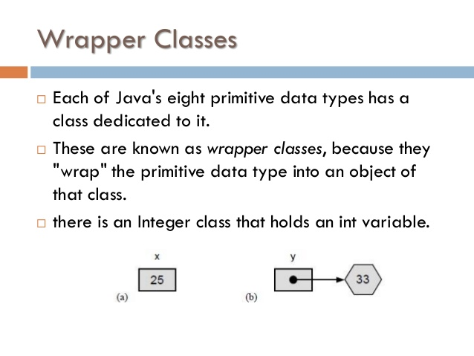
exceptions

Slide 3
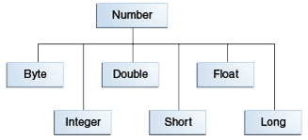
exceptions
Primitives and Wrapper Classes.
Advantages of using Wrapper classes over primitives.
As an argument of a method that expects an object
To use constants defined by the class, such as MIN_VALUE and MAX_VALUE.
To use class methods for converting values to and from other primitive types,

Slide 4
exceptions
Methods implemented by all subclasses of Number

Slide 5
exceptions
Methods implemented by all subclasses of Number……
https://docs.oracle.com/javase/tutorial/java/data/numberclasses.html

Slide 6
exceptions
Formatting Numeric Print Output
System.out that you have been using happens to be a PrintStream object.
[java.io.PrintStream] public PrintStream format(String format, Object... args)
Ex:
System.out.format("The value of " + "the float variable is " +
"%f, while the value of the " + "integer variable is %d, " +
"and the string is %s", floatVar, intVar, stringVar);
To print numbers in the French system (where a comma is used in place of the decimal place in the English representation of floating point numbers), for example, you would use:
System.out.format(Locale.FRANCE,
"The value of the float " + "variable is %f, while the " +
"value of the integer variable " + "is %d, and the string is %s%n",
floatVar, intVar, stringVar);
Lab17.1: Demonstration of using Number formatter:

Slide 7
exceptions
Formatting Numeric Print Output………
Use java.text.DecimalFormat class
To control the display of leading and trailing zeros.
prefixes and suffixes.
Grouping (thousands) separators, and the decimal separator.
customFormat("###,###.###", 123456.789);
static public void customFormat(String pattern, double value ) {
DecimalFormat myFormatter = new DecimalFormat(pattern);
String output = myFormatter.format(value);
System.out.println(value + " " + pattern + " " + output);
}
Lab17.2: Demonstration of using Decimal formatter

Slide 8
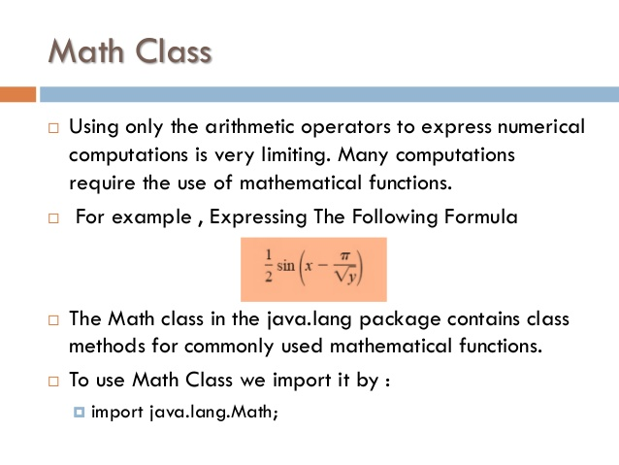
exceptions

Slide 9
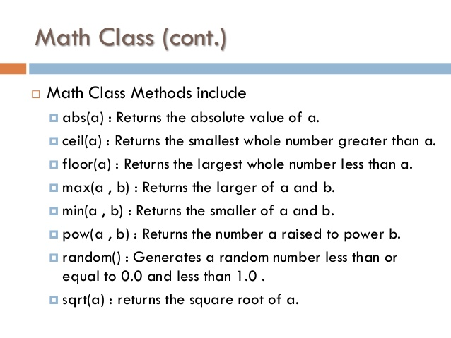
exceptions

Slide 10
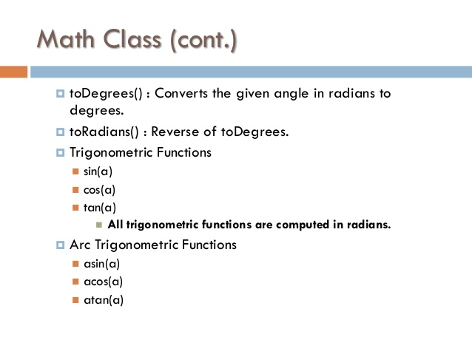
exceptions

Slide 11
exceptions

Slide 12
exceptions

Slide 13
exceptions

Slide 14
exceptions

Slide 15
Java - miscellaneous
Type Comparison Operator instanceof
The instanceof operator compares an object to a specified type.
You can use it to test if an object is an instance of a class, an instance of a subclass, or an instance of a class that implements a particular interface
Classes implementing interfaces
class MyClass extends MySuperClass implements YourInterface {
// field, constructor, and
// method declarations
}

Slide 16
Java - miscellaneous
Varargs – Specifying Arbitrary number of arguments
public Polygon polygonFrom(Point... corners) {
int numberOfSides = corners.length;
double squareOfSide1, lengthOfSide1;
squareOfSide1 = (corners[1].x - corners[0].x)
* (corners[1].x - corners[0].x)
+ (corners[1].y - corners[0].y)
* (corners[1].y - corners[0].y);
lengthOfSide1 = Math.sqrt(squareOfSide1);
// more method body code follows that creates and returns a
// polygon connecting the Points
}
You will most commonly see varargs with the printing methods; for example, this printf method:
public PrintStream printf(String format, Object... args)
allows you to print an arbitrary number of objects. It can be called like this:
System.out.printf("%s: %d, %s%n", name, idnum, address);

Slide 17
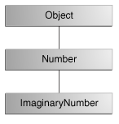
Java - miscellaneous
Returning a Class or Interface
When a method uses a class name as its return type the class of the type of the returned object must be either a subclass of, or the exact class of, the return type.
public Number returnANumber() {
...
}
The returnANumber method can return an ImaginaryNumber but not an Object. ImaginaryNumber is a Number because it's a subclass of Number. However, an Object is not necessarily a Number — it could be a String or another type

Slide 18
Advanced java
Garbage collection
JDBC
Lambda expressions
Annotations
Aggregate operations on collection using Lambarda expression.
Java streaming
Blocking queue
Aggregate operations
Autoboxing

Slide 19
https://docs.oracle.com/javase/tutorial/reallybigindex.html
http://www.slideshare.net/EdurekaIN/java-class-3
http://www.slideshare.net/abdurrehmanabdurrehman391/variables-and-data-types-by-sir-khalid
http://www.slideshare.net/abdurrehmanabdurrehman391/java-advancedoop
http://www.slideshare.net/MindfireSolutions/java-garbage-collection-how-it-works?next_slideshow=1
http://www.slideshare.net/arnold7490/unit-4-java
http://www.slideshare.net/arnold7490/unit-3-java?next_slideshow=1
http://www.slideshare.net/tushardesarda/java-tutorial-3
http://www.slideshare.net/muralidhar9e/java-exception-handling-ppt
http://www.slideshare.net/emprovise/2-javabasics
http://www.slideshare.net/AllanHuang/java-new-evolution
http://www.slideshare.net/antonkeks/4-collections
http://www.slideshare.net/andreaiacono/java8-39841939 - Java8 features
http://www.slideshare.net/AbhishekKhune/07-java-collection
http://www.slideshare.net/shahjahan786/generics-27960064 - Generics
http://www.slideshare.net/caroljmcdonald/java-generics-2485138?next_slideshow=1

