Slide 1

exceptions

Slide 2
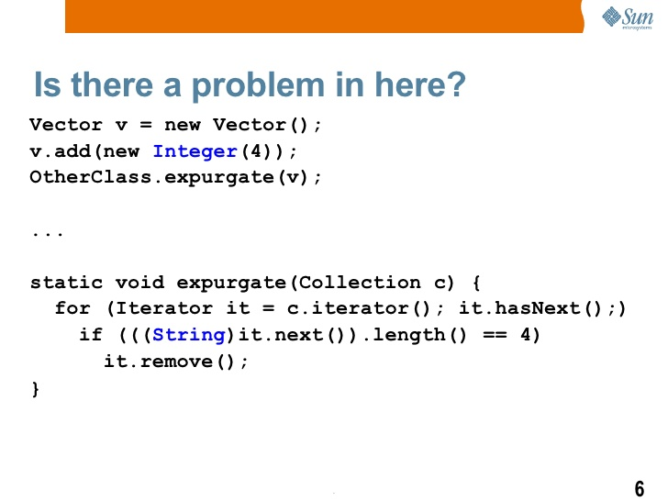
exceptions

Slide 3
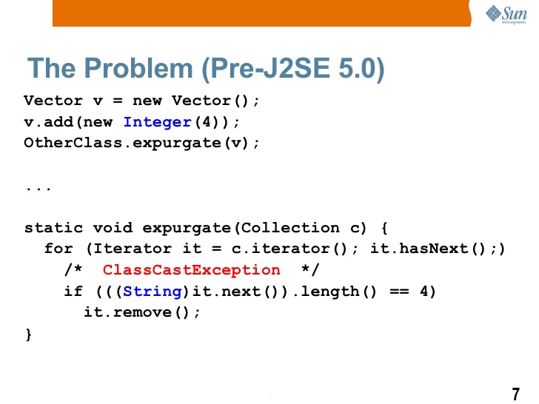
exceptions

Slide 4
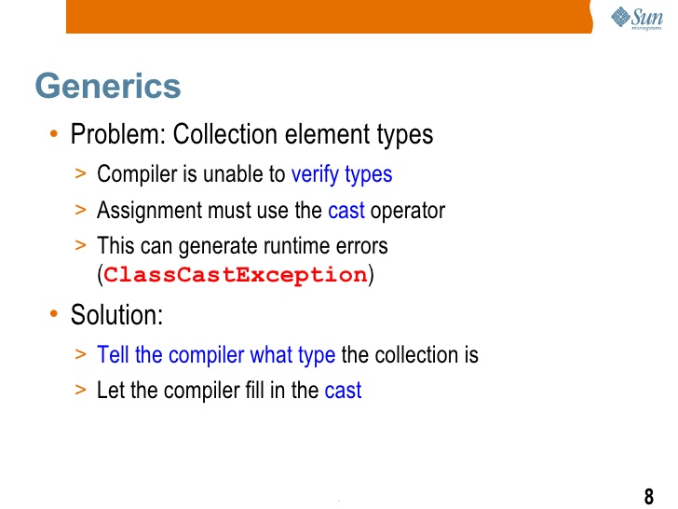
exceptions

Slide 5
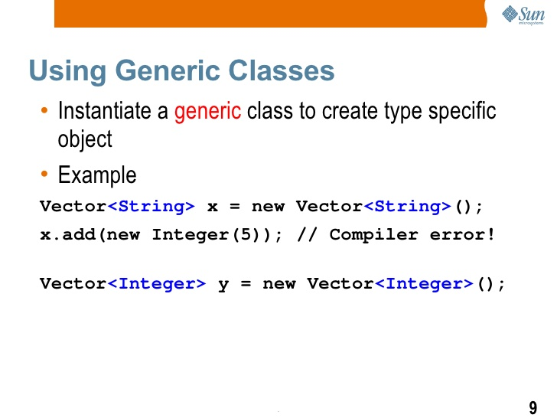
exceptions

Slide 6
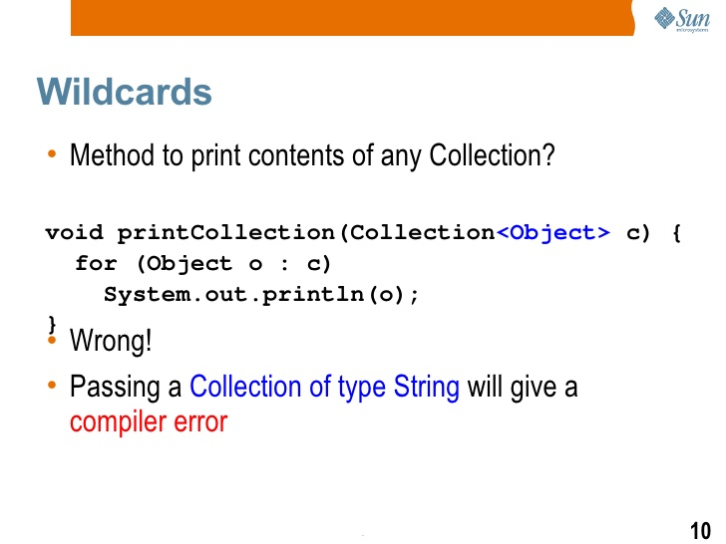
exceptions

Slide 7
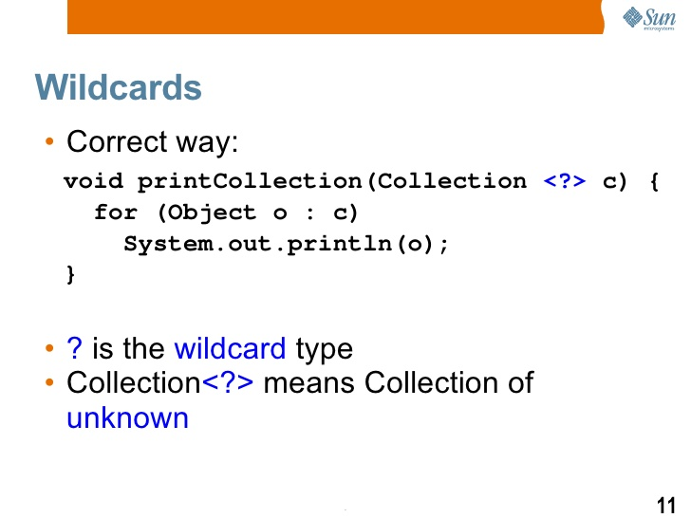
exceptions

Slide 8
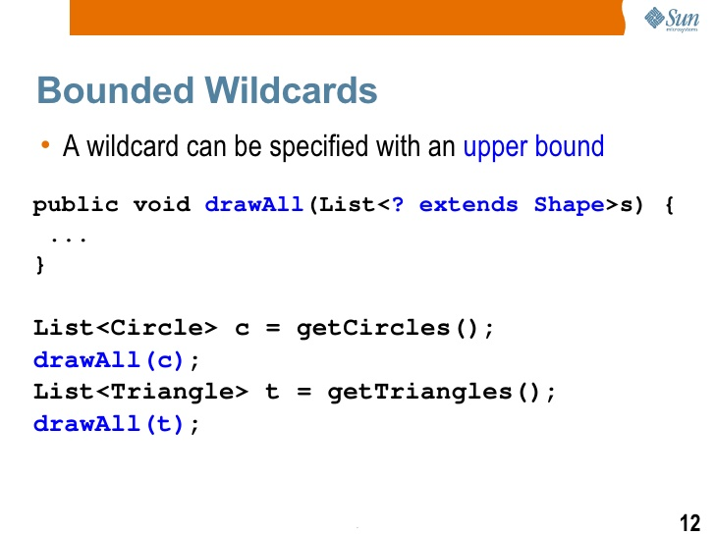
exceptions

Slide 9
exceptions

Slide 10
inheritance

Slide 11
inheritance

Slide 12
inheritance

Slide 13
inheritance

Slide 14
inheritance

Slide 15
inheritance

Slide 16
Interfaces and inheritance

Slide 17
Java - miscellaneous
Type Comparison Operator instanceof
The instanceof operator compares an object to a specified type.
You can use it to test if an object is an instance of a class, an instance of a subclass, or an instance of a class that implements a particular interface
Classes implementing interfaces
class MyClass extends MySuperClass implements YourInterface {
// field, constructor, and
// method declarations
}

Slide 18
Java - miscellaneous
Varargs – Specifying Arbitrary number of arguments
public Polygon polygonFrom(Point... corners) {
int numberOfSides = corners.length;
double squareOfSide1, lengthOfSide1;
squareOfSide1 = (corners[1].x - corners[0].x)
* (corners[1].x - corners[0].x)
+ (corners[1].y - corners[0].y)
* (corners[1].y - corners[0].y);
lengthOfSide1 = Math.sqrt(squareOfSide1);
// more method body code follows that creates and returns a
// polygon connecting the Points
}
You will most commonly see varargs with the printing methods; for example, this printf method:
public PrintStream printf(String format, Object... args)
allows you to print an arbitrary number of objects. It can be called like this:
System.out.printf("%s: %d, %s%n", name, idnum, address);

Slide 19
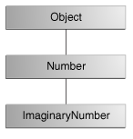
Java - miscellaneous
Returning a Class or Interface
When a method uses a class name as its return type the class of the type of the returned object must be either a subclass of, or the exact class of, the return type.
public Number returnANumber() {
...
}
The returnANumber method can return an ImaginaryNumber but not an Object. ImaginaryNumber is a Number because it's a subclass of Number. However, an Object is not necessarily a Number — it could be a String or another type

Slide 20
Advanced java
Garbage collection
JDBC
Lambda expressions
Annotations
Aggregate operations on collection using Lambarda expression.
Java streaming
Blocking queue
Aggregate operations

Slide 21
https://docs.oracle.com/javase/tutorial/reallybigindex.html
http://www.slideshare.net/EdurekaIN/java-class-3
http://www.slideshare.net/abdurrehmanabdurrehman391/variables-and-data-types-by-sir-khalid
http://www.slideshare.net/abdurrehmanabdurrehman391/java-advancedoop
http://www.slideshare.net/MindfireSolutions/java-garbage-collection-how-it-works?next_slideshow=1
http://www.slideshare.net/arnold7490/unit-4-java
http://www.slideshare.net/arnold7490/unit-3-java?next_slideshow=1
http://www.slideshare.net/tushardesarda/java-tutorial-3
http://www.slideshare.net/muralidhar9e/java-exception-handling-ppt
http://www.slideshare.net/emprovise/2-javabasics
http://www.slideshare.net/AllanHuang/java-new-evolution
http://www.slideshare.net/antonkeks/4-collections
http://www.slideshare.net/andreaiacono/java8-39841939 - Java8 features
http://www.slideshare.net/AbhishekKhune/07-java-collection
http://www.slideshare.net/shahjahan786/generics-27960064 - Generics
http://www.slideshare.net/caroljmcdonald/java-generics-2485138?next_slideshow=1

