Slide 1
Java programming fundamentals

Slide 2
Why java?
Simple Object oriented
Distributed Multithreaded
• Dynamic • Architecture neutral
• Portable
• High performance
• Robust
• Secure

Slide 3
Lab Exercise: Executing java programme
Lab 1 : Installing the Java Software and setting up the environment
Lab 2: Setting up the Java environment.
Lab 3: Writing and executing java Hello World Programme

Slide 4
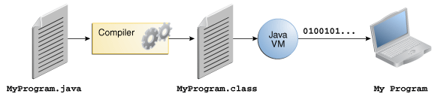
Java platform
A platform is the hardware or software environment in which a program runs.
The Java platform differs from most other platforms in that it's a software-only platform that runs on top of other hardware-based platforms

Slide 5
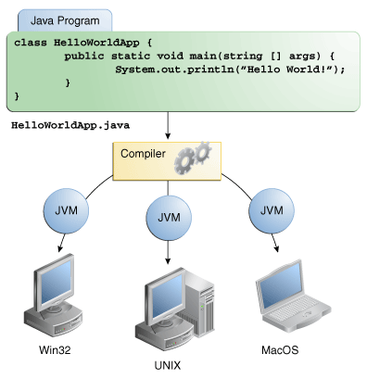
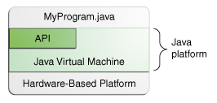
Java platform ……

Slide 6
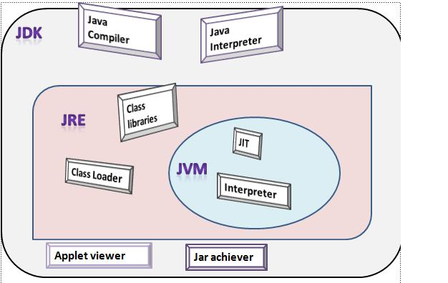
Java platform………..

Slide 7
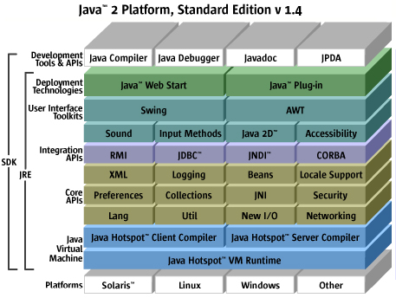
Java platform………..

Slide 8
OOPs concepts
int cadence = 0;int speed = 0;int gear = 1;
Class
Object
Inheritance
Encapsulation
Polymorphism
Abstraction
Interface

Slide 9
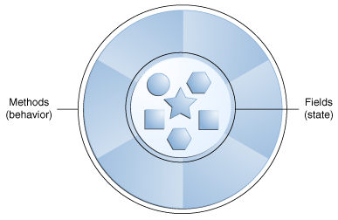
OOPs concepts ………
Object
They all have state and behavior
Class
A class is the blueprint from which individual objects are created

Slide 10
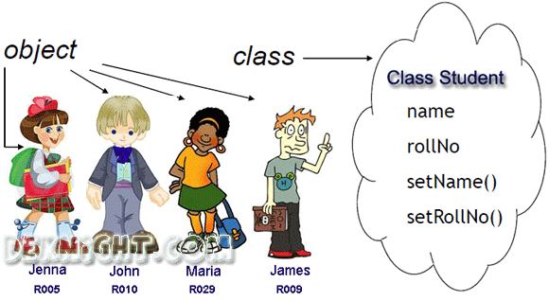
OOPs concepts ………

Slide 11
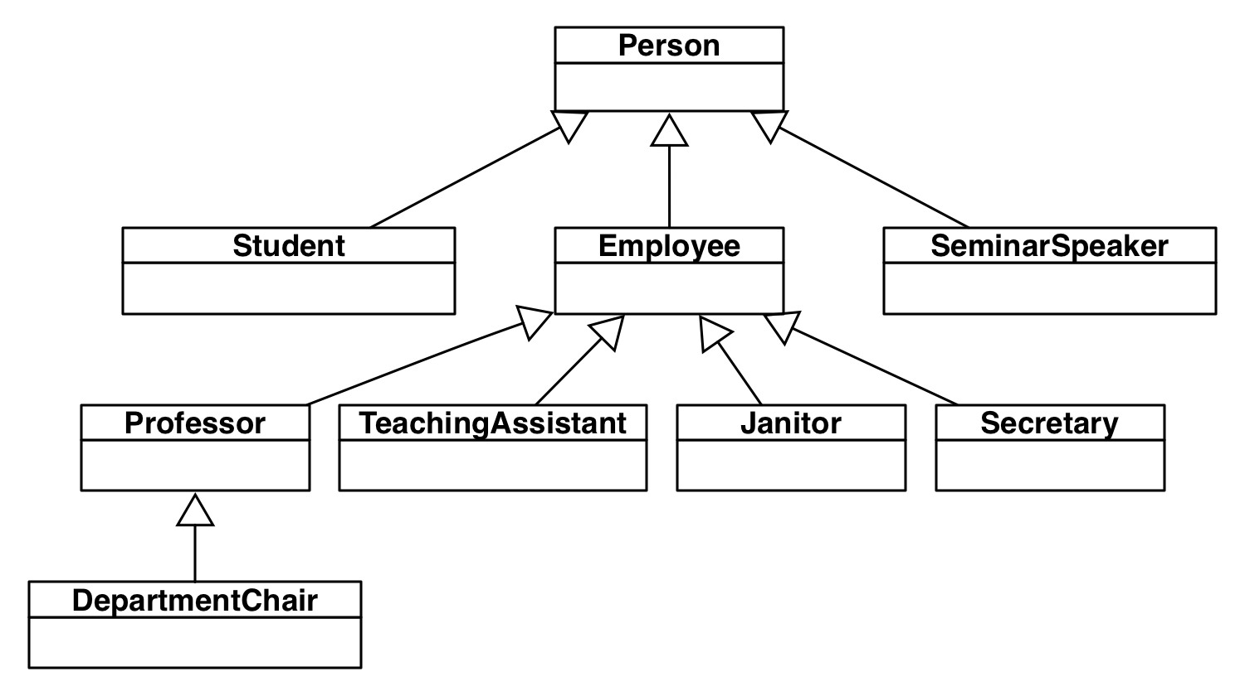
OOPs concepts ………
Inheritance
Process whereby an object of a class acquires characteristics from the object of the other class

Slide 12
OOPs concepts ………
Encapsulation
Encapsulation means that the internal representation of an Object is generally hidden from view outside of the object's definition.
The features of encapsulation are supported using classes.
A supposed benefit of encapsulation is that it can reduce system complexity, and thus increase robustness.

Slide 13
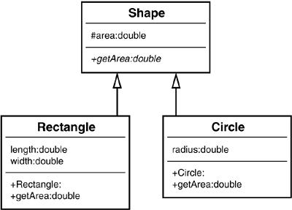
OOPs concepts ………
Abstraction
Technique for managing complexity of computer systems.
Polymorphism
The ability to appear in many forms.

Slide 14
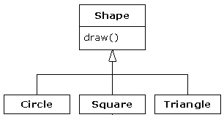
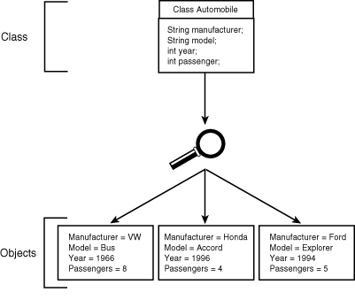
OOPs concepts ………
Interface
Objects define their interaction with the outside world through the methods that they expose.

Slide 15
Language basics
Variables
Operators
Expressions, Statements and Blocks
Control Flow Statements

Slide 16
LAB – Variables, datatype, literal, arrays
LAB4: Execute the programme Car.java for variables demonstration
LAB5: Execute the “ArrayDemo”.java for array demonstration

Slide 17
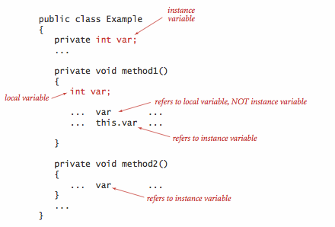
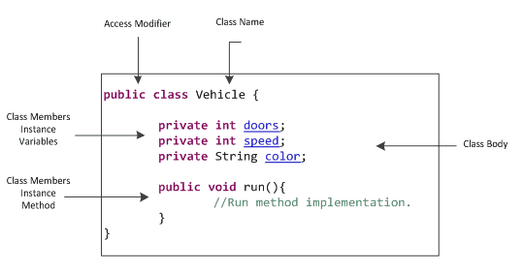
Language basics - Variables

Slide 18
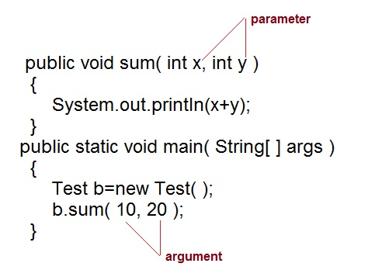
Language basics - Variables

Slide 19
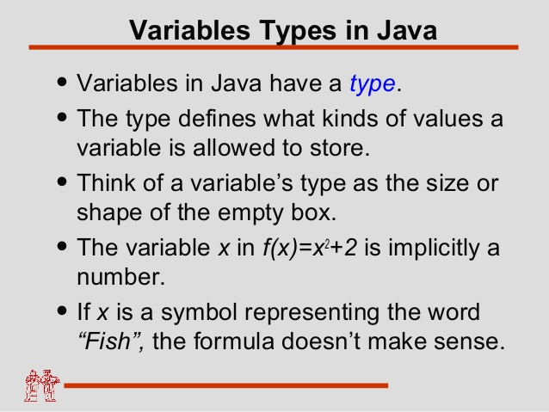
Language basics - Variables

Slide 20
Language basics - Variables
Variable Naming Convention
Variable names are case-sensitive
If the name you choose consists of only one word, spell that word in all lowercase letters. If it consists of more than one word, capitalize the first letter of each subsequent word.
Ex: gearRatio, currentGear
If your variable stores a constant value, such as static capitalizing every letter and separating subsequent words with the underscore character.
Ex: final int NUM_GEARS = 6

Slide 21
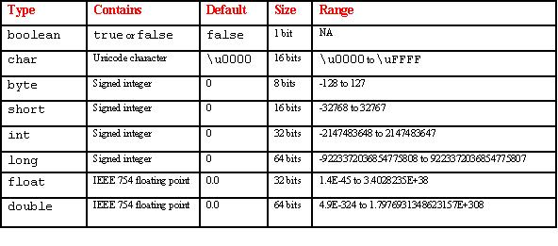
Language basics – data types
Primitive Data Types
A primitive type is predefined by the language and is named by a reserved keyword.
Primitive values do not share state with other primitive values
L
f

Slide 22
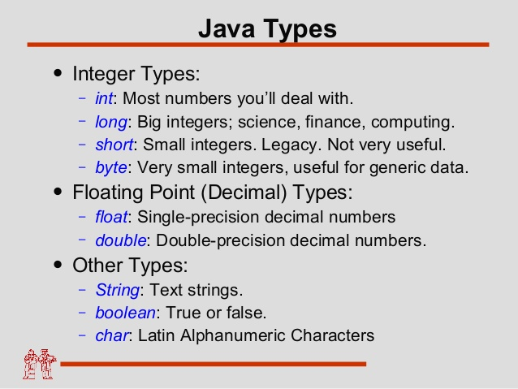
Language basics – data types

Slide 23
Language basics - literals
Literals
A literal is the source code representation of a fixed value;
literals are represented directly in your code without requiring computation
Ex:
boolean result = true;
char capitalC = 'C';
byte b = 100;
short s = 10000;
int i = 100000;

Slide 24
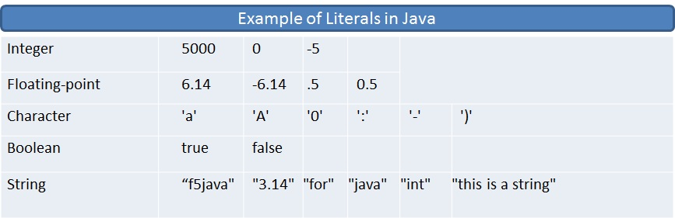
Language basics - literals

Slide 25
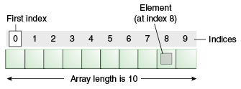
Language basics - Arrays
Arrays
An array is a container object that holds a fixed number of values of a single type.
After creation, its length is fixed.

Slide 26
Language basics - Arrays
Defining arrays:
byte[] anArrayOfBytes = new byte[10];
short[] anArrayOfShorts = new short[10];
long[] anArrayOfLongs = new long[10];
float[] anArrayOfFloats = new float[10];
double[] anArrayOfDoubles = new double[10];
boolean[] anArrayOfBooleans = new boolean[10];
char[] anArrayOfChars = new char[10];
String[] anArrayOfStrings = new String[10];
Creating and initializing array:
int[] anArray = {100, 200, 300, 400, 500, 600,700, 800, 900, 1000};

Slide 27
quiz time - Variables
The term "instance variable" is another name for ___.
The term "class variable" is another name for ___.
A local variable stores temporary state; it is declared inside a ___.
A variable declared within the opening and closing parenthesis of a method signature is called a ____.
What are the eight primitive data types supported by the Java programming language?
Character strings are represented by the class ___.
An ___ is a container object that holds a fixed number of values of a single type.

Slide 28
Language basics- operator
Arithmetic Operator
Lab 6.1 : Arithmetic operator demo

Slide 29
Language basics- operator
Unary Operator
Lab6.2 : Unary operator demo

Slide 30
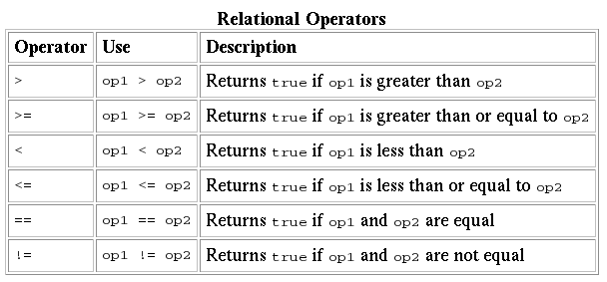
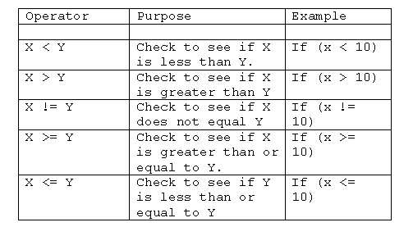
Language basics- operator
Lab6.3 : Relational operator demo

Slide 31
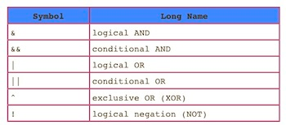
Language basics- operator
Conditional Operator
& evaluates both sides of the operation.
&& evaluates the left side of the operation, if it's true, it continues and evaluates the right side
Lab6.4 : Conditional operator demo

Slide 32
Quiz time- operator
The instanceof operator compares an object to a specified type. You can use it to test if an object is an instance of a class, an instance of a subclass, or an instance of a class that implements a particular interface
Consider the following code snippet.
arrayOfInts[j] > arrayOfInts[j+1]
Which operators does the code contain?
Consider the following code snippet.
int i = 10;
int n = i++%5;
What are the values of i and n after the code is executed?
What are the final values of i and n if instead of using the postfix increment operator (i++),
you use the prefix version (++i))?
To invert the value of a boolean, which operator would you use?
Which operator is used to compare two values, = or == ?
Explain the following code sample: result = someCondition ? value1 : value2;

Slide 33
Language basics- expressions, statements, blocks
Expression:
An expression is a construct made up of variables, operators, and method invocations, which are constructed according to the syntax of the language, that evaluates to a single value.
Ex:
cadence = 0
anArray[0] = 100;
value1 == value2
"Element 1 at index 0: " + anArray[0]
Statements:
Statements are roughly equivalent to sentences in natural languages.
A statement forms a complete unit of execution.
Ex:
System.out.println("Hello World!");
Bicycle myBike = new Bicycle();

Slide 34
Language basics- expressions, statements, blocks
Blocks:
A block is a group of zero or more statements between balanced braces and can be used anywhere a single statement is allowed.
Ex:
class BlockDemo {
public static void main(String[] args) {
boolean condition = true;
if (condition) { // begin block 1
System.out.println("Condition is true.");
} // end block one
else { // begin block 2
System.out.println("Condition is false.");
} // end block 2
}
}

Slide 35
Quiz time- expressions, statements, blocks
Operators may be used in building ___, which compute values.
Expressions are the core components of ___.
Statements may be grouped into ___.
The following code snippet is an example of a ___ expression.
1 * 2 * 3
Statements are roughly equivalent to sentences in natural languages, but instead of ending with a period, a statement ends with a ___.
A block is a group of zero or more statements between balanced ___ and can be used anywhere a single statement is allowed.

Slide 36
Language basics- control flow statements
Control flow statements, break up the flow of execution by employing decision making, looping, and branching, enabling your program to conditionally execute particular blocks of code.
If-then
void applyBrakes() {
// the "if" clause: bicycle must be moving
if (isMoving){
// the "then" clause: decrease current speed
currentSpeed--;
}
}

Slide 37
Language basics- control flow statements
If-then-else
void applyBrakes() {
if (isMoving) {
currentSpeed--;
} else {
System.err.println("The bicycle has already stopped!");
}
}
Lab7.1 : Demonstration of If Else control flow statements

Slide 38
Language basics- control flow statements
Switch Statement:
Switch statement can have a number of possible execution paths.
Works with the byte, short, char, and int primitive data types. It also works with enumerated types, the String class, and a few special classes that wrap certain primitive types: Character, Byte, Short, and Integer .
All statements after the matching case label are executed in sequence, regardless of the expression of subsequent case labels, until a break statement is encountered
Ex: switch (month) {
case 1: monthString = "January";
break;
case 2: monthString = "February";
break;
............
default: monthString = "Invalid month";
break;
}

Slide 39
Language basics- control flow statements
Switch Statement:
Lab7.2 : Demonstration of switch control flow statements
Lab7.3: Demonstration of Switch control flow statements without break statement

Slide 40
Language basics- control flow statements
while and do-while Statements:
while (expression) {
statement(s)
}
do {
statement(s)
} while (expression);

Slide 41
Language basics- operator
The instanceof operator compares an object to a specified type. You can use it to test if an object is an instance of a class, an instance of a subclass, or an instance of a class that implements a particular interface
Type Comparison Operator instanceof
The instanceof operator compares an object to a specified type.
You can use it to test if an object is an instance of a class, an instance of a subclass, or an instance of a class that implements a particular interface

Slide 42
references
https://docs.oracle.com/javase/tutorial/reallybigindex.html
http://www.slideshare.net/EdurekaIN/java-class-3
http://www.slideshare.net/abdurrehmanabdurrehman391/variables-and-data-types-by-sir-khalid

