Slide 1
FLYAIR An Airline Reservation System
Team Leader : Nareshkumar M. Sisodiya
Team Members: Arjun Lokhande
Binu Basil John
Anant Mathur
Khushboo Handa

Slide 2
Outline
Introduction
Domain Analysis
Project Implementation
Tools Used
Lesson Learnt

Slide 3
Introduction
Who we are ?
Fly Air - Airline Reservation System
What we do ?
Prompt and Hassle Free Booking System
User Friendly

Slide 4
Domain Analysis
Why we chose this domain ?
Personal experience.
Ease to comprehend.
Study of the domain
Online website references.
Comparison of features to be provided.
Analysis of the domain.
Technical implementation requirements.
We defined the various actors and their corresponding use cases.

Slide 5
Team Goals
Informal and friendly communication
Time Management
Respecting each other’s point of view
Appreciation and encouragement
Meeting Schedule
Wednesdays: 18:00 - 21:00
Fridays: 12:30 - 16:30

Slide 6
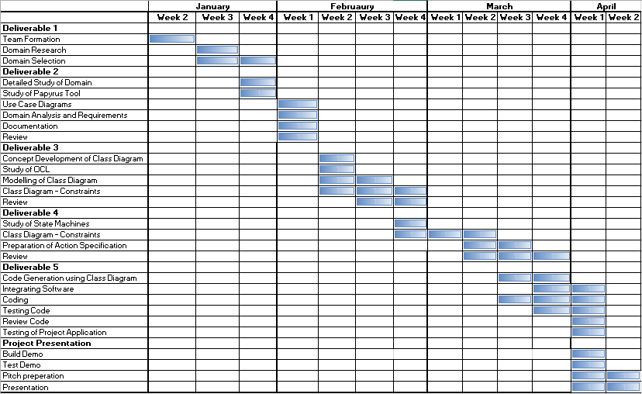
Timeline

Slide 7
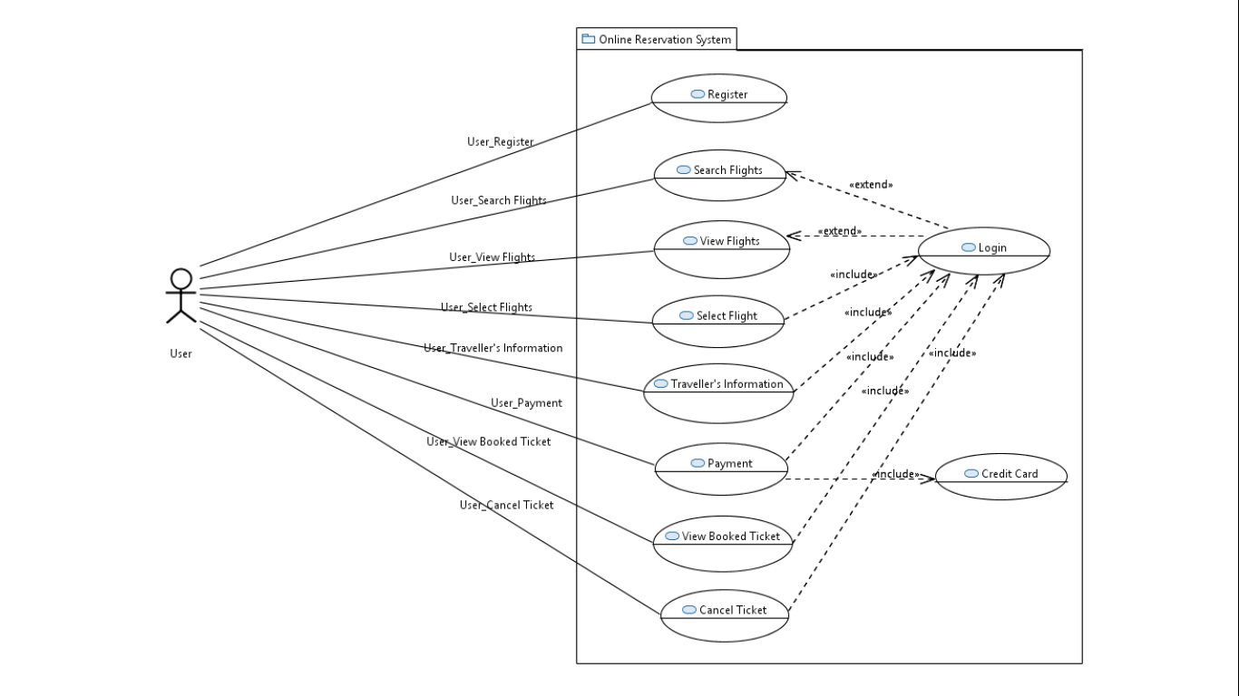
Use Case Diagram

Slide 8
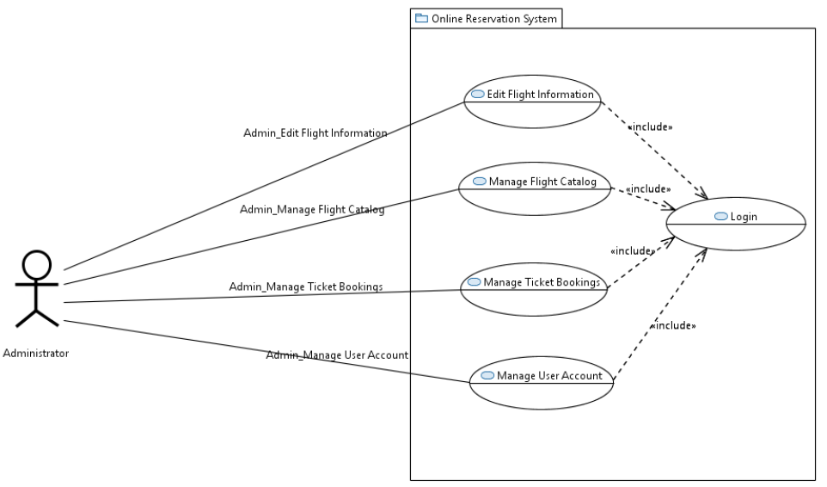

Slide 9
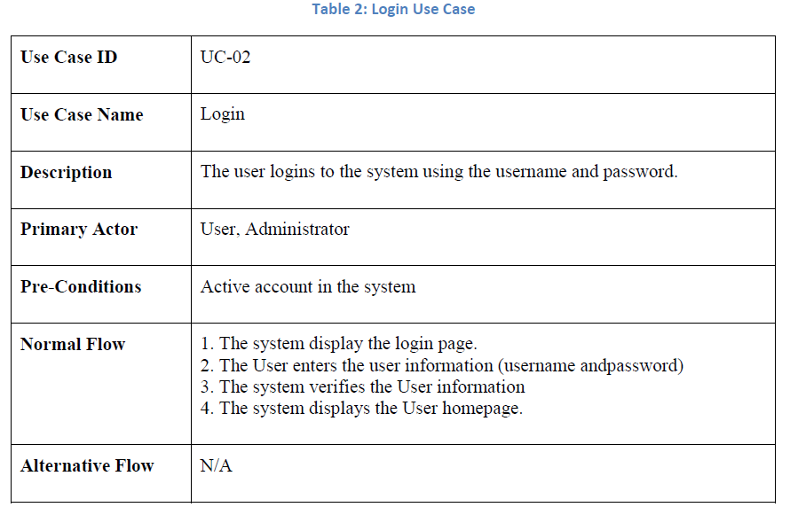

Slide 10
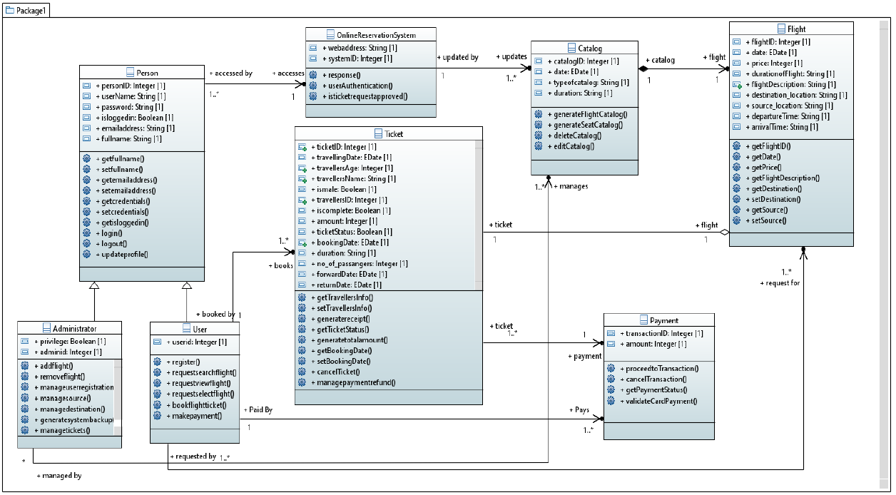
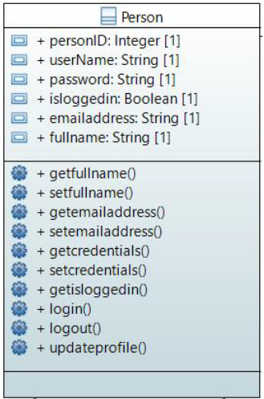
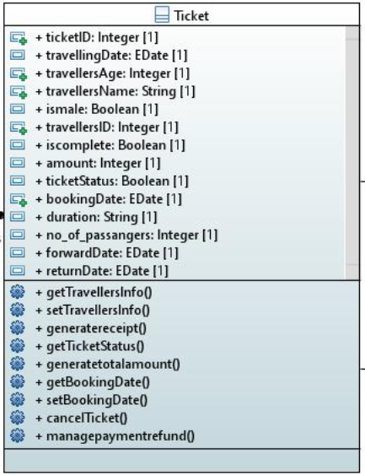
Class Diagram

Slide 11
OCL
Each person who logs in to the system to book a ticket must have an unique ID :
Context : Person
inv: self.allinstances()->forall(P1,P2:Person | P1 <> P2 implies P1.userID <> P2.userID);
Each Ticket booked by the user for scheduled travel should have an unique ID :
Context : Ticket
inv: self.allinstances()->forall(T1,T2:Tickets | T1<>T2 implies T1.ticketID <> T2.ticketID);

Slide 12
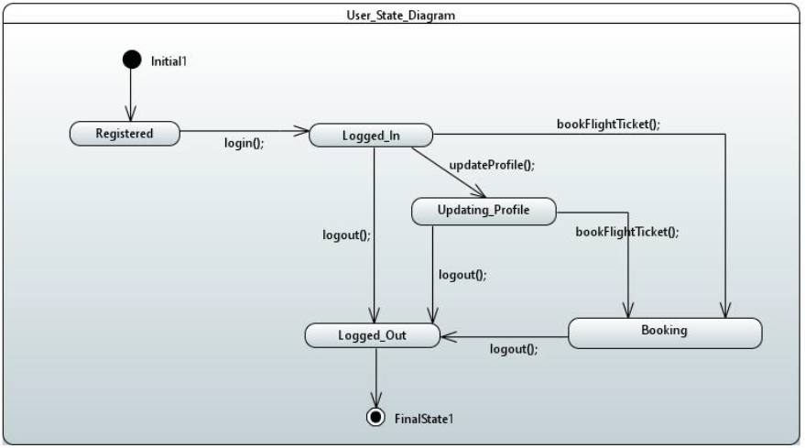
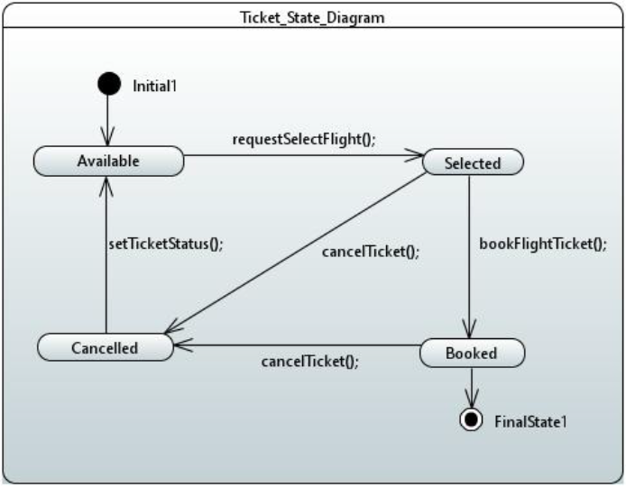
State Diagram

Slide 13
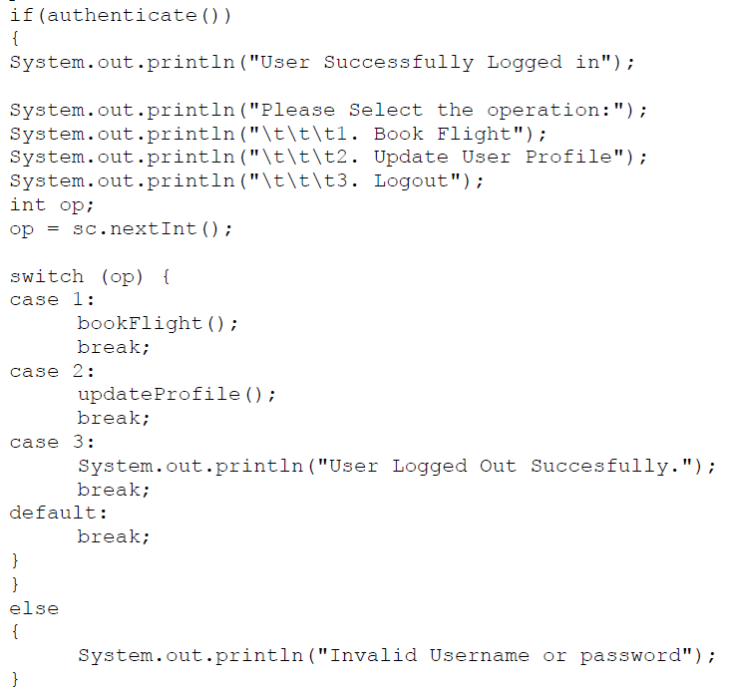
Action Specification Language

Slide 14
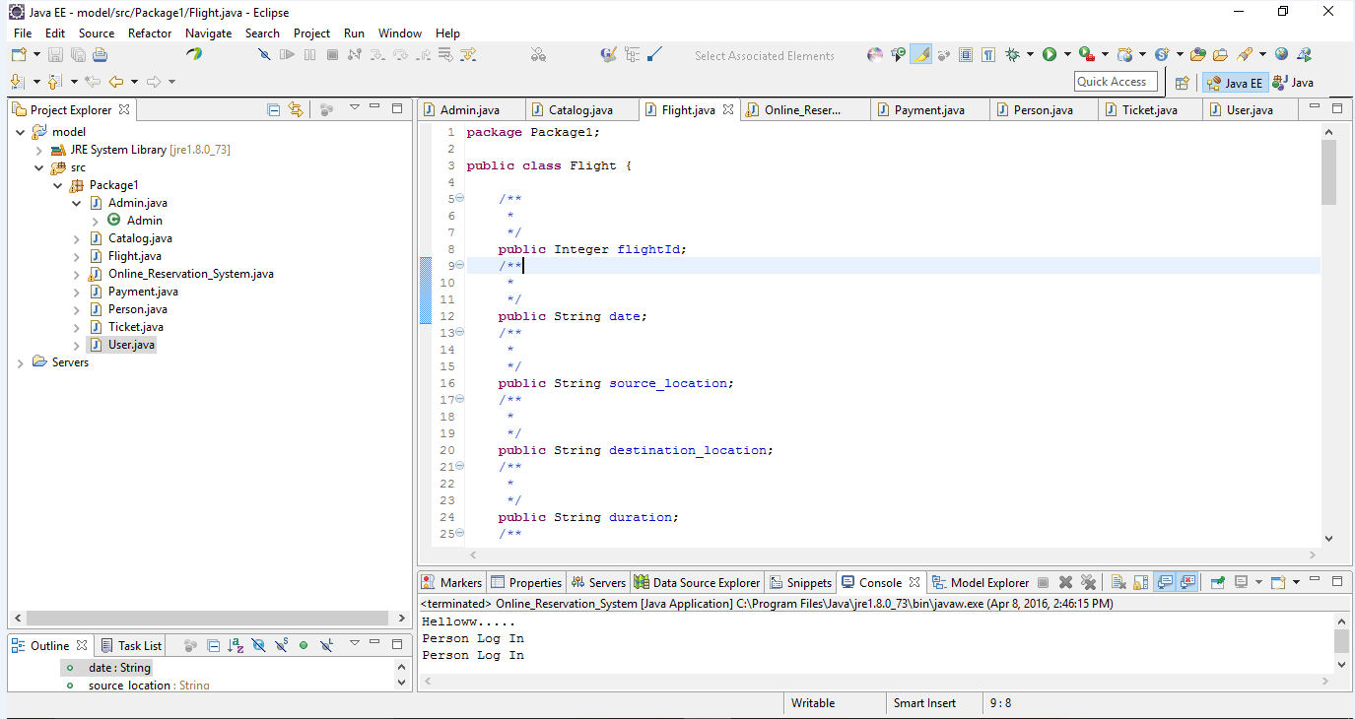
Code Generated from Class Diagram

Slide 15
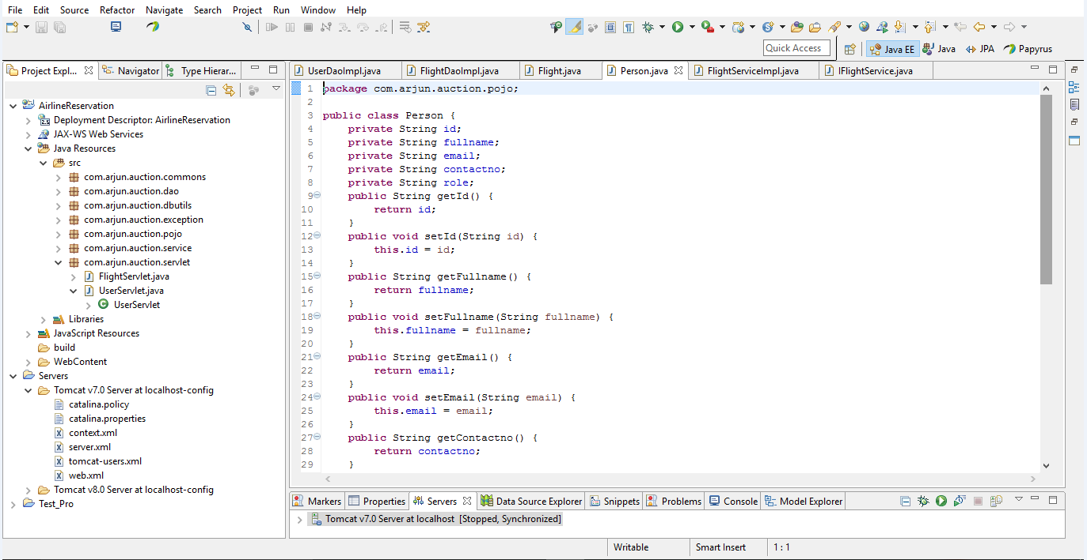
Modified Code

Slide 16
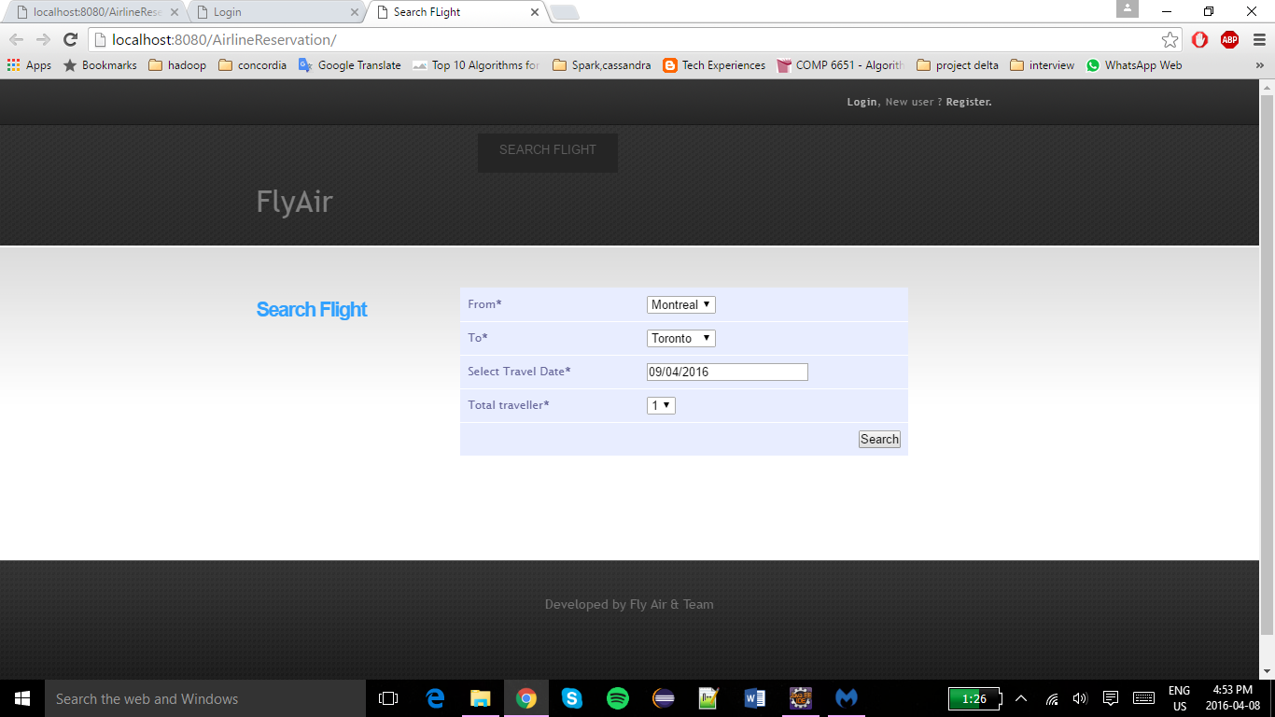
Search Flight:

Slide 17
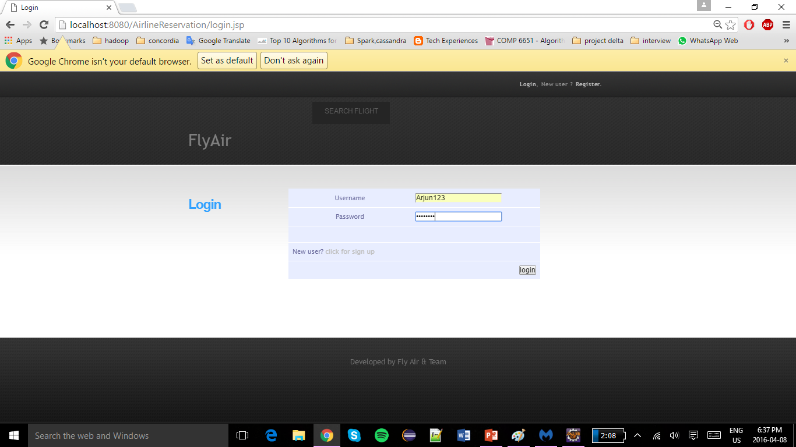
Login:

Slide 18
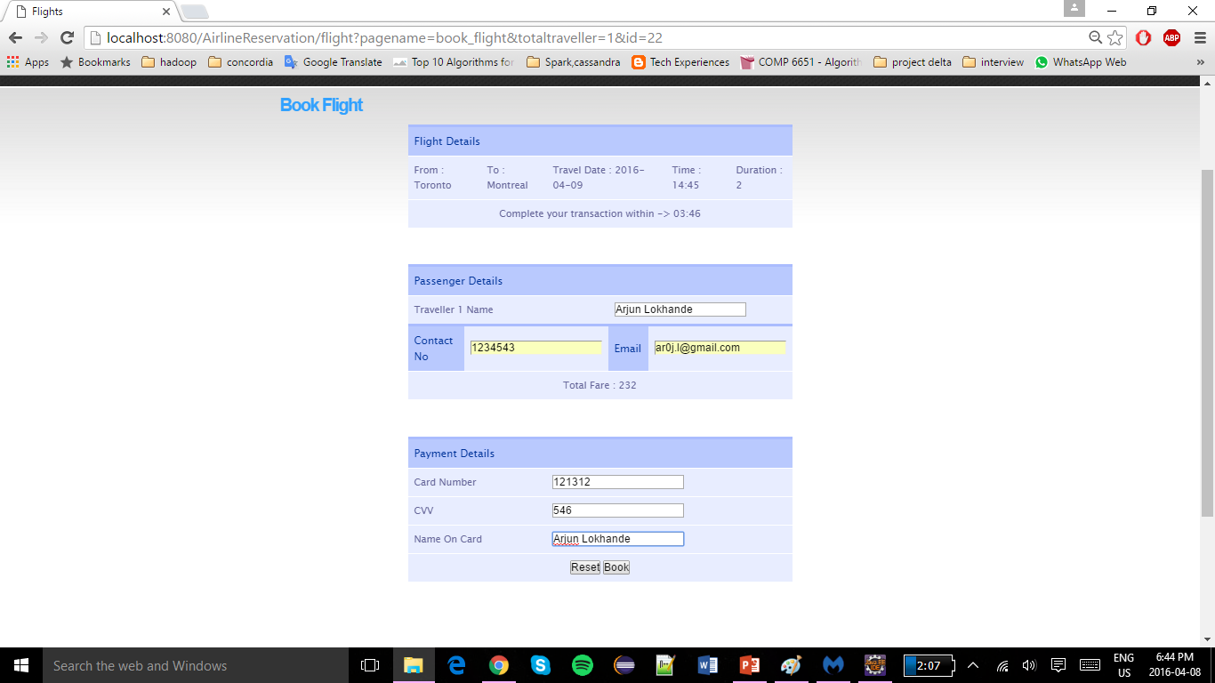
Ticket Booking:

Slide 19
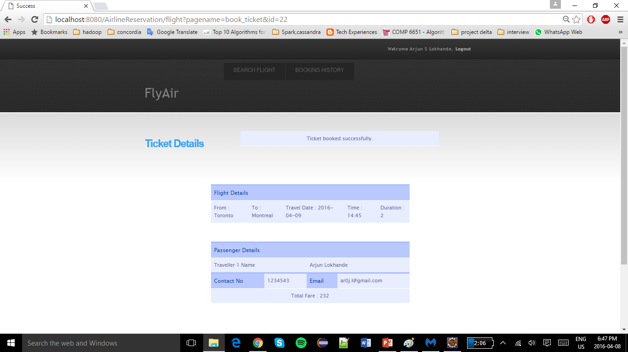
Ticket Confirmation:

Slide 20
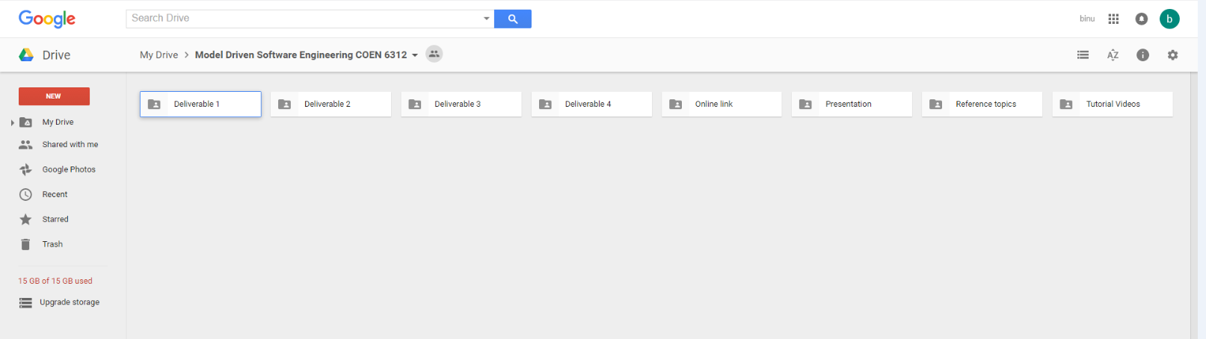
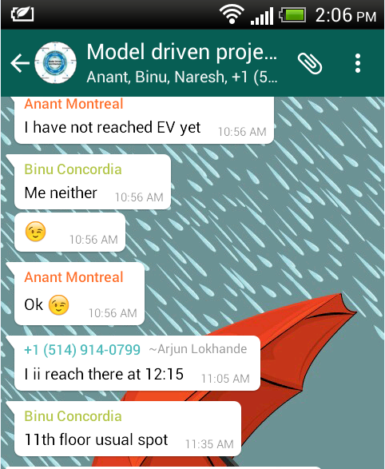
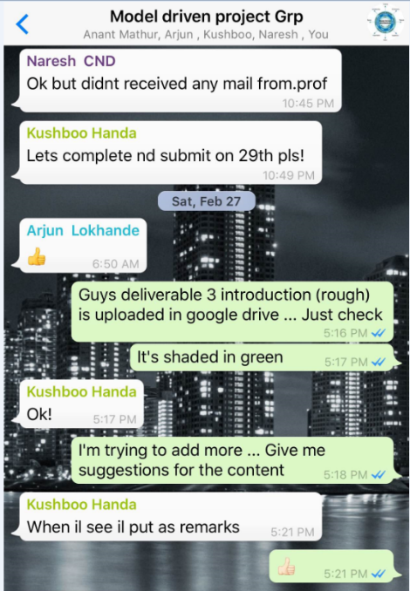
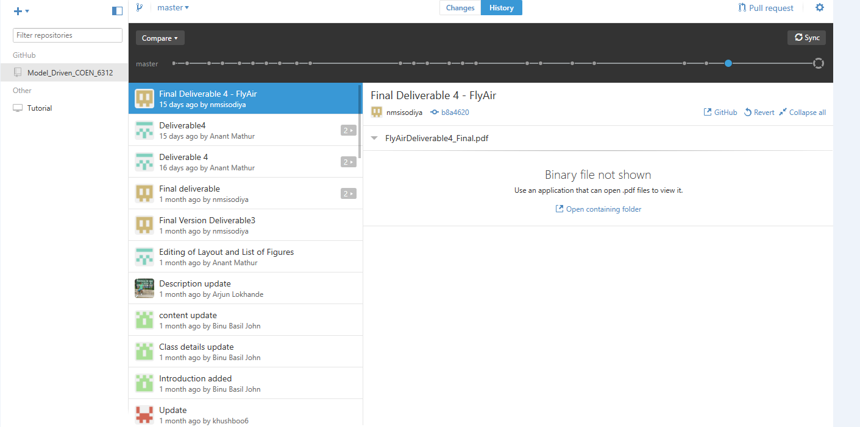
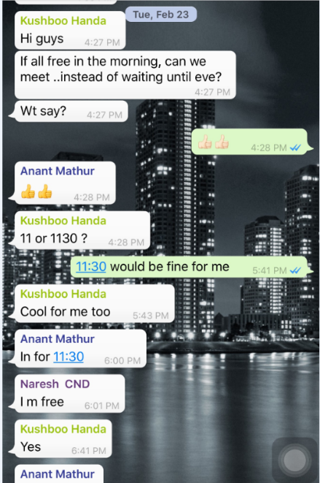
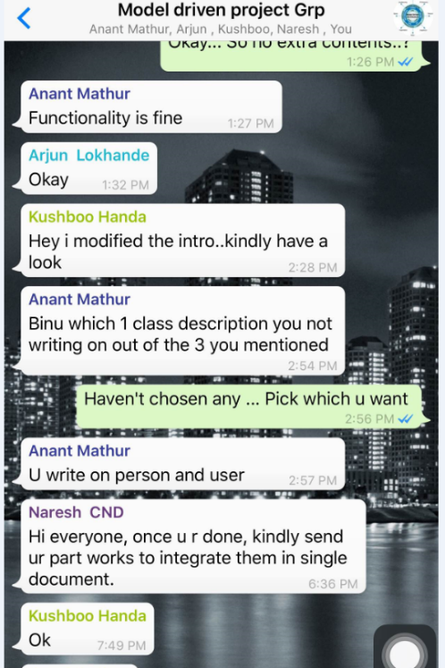
Collaboration Tools
GITHUB
Whatsapp Application
Google Drive

Slide 21
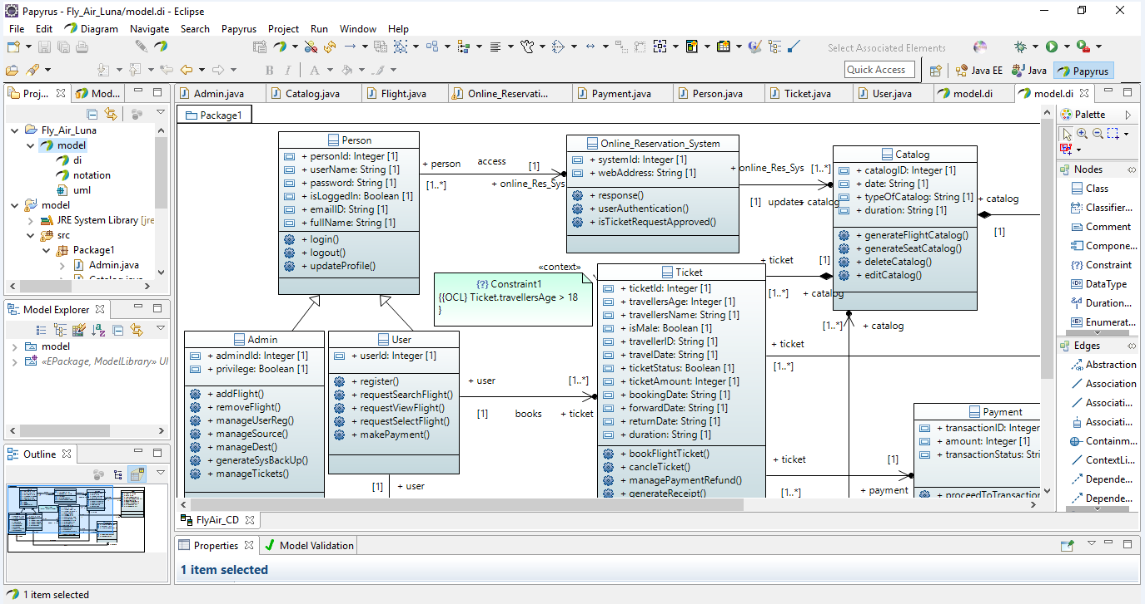
Tools Used
Development Environment: Eclipse, Papyrus
Version control system: Github

Slide 22
Lessons Learnt
Model Driven Software Engineering Approach
Model Diagrams in Papyrus
Code Generation by Model Driven Approach
Importance of Software Practices
Team Work and Time Management
Github

Slide 23
Difficulties Encountered
Documentation in Github –Unable to explore the full features
Using papyrus standalone, later using papyrus as a plugin on eclipse as demonstrated and suggested by the TA

Slide 24
Thank You !!

