Slide 1
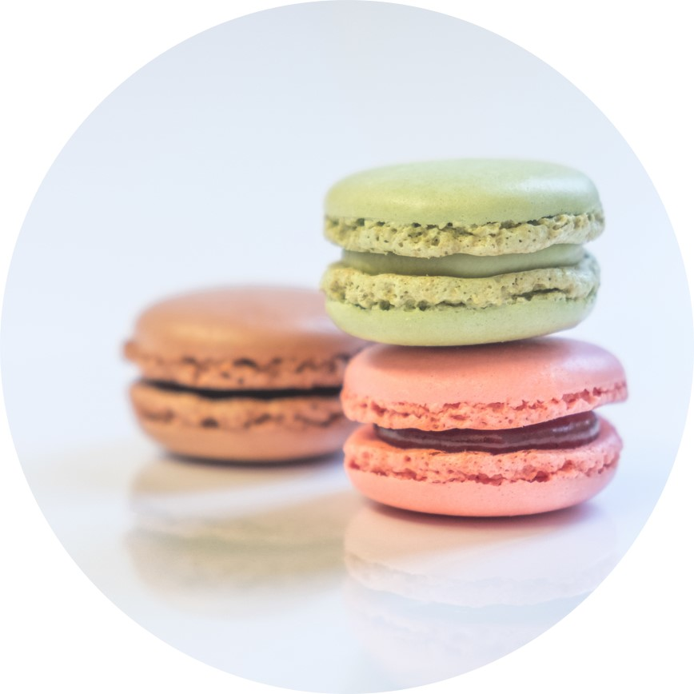
Obesity kills
Nia Smith

Slide 2
Genetics loads the gun, but lifestyle pulls the trigger.
George Bray

Slide 3

Agenda
Hypothesis
Visuals
Tips
Summary

Slide 4
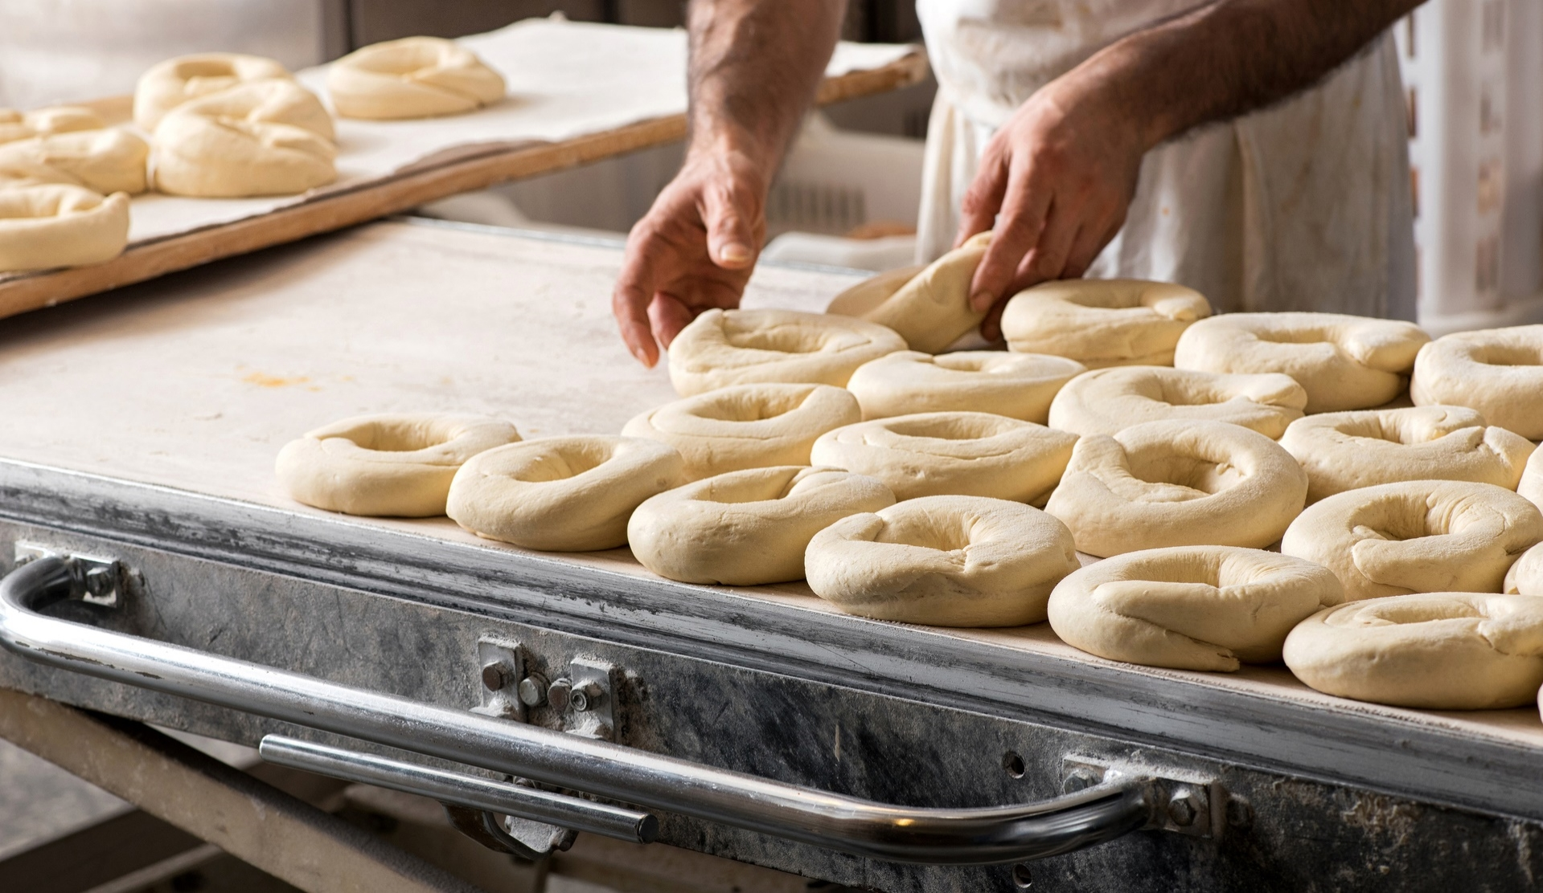
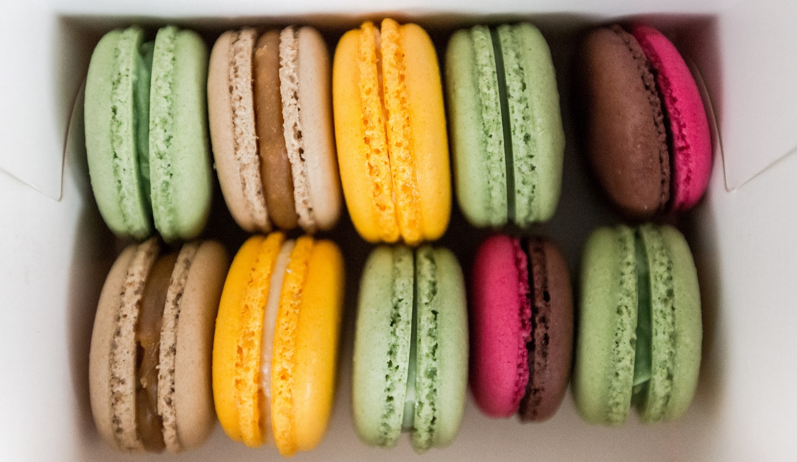
Hypothesis
The risk of obesity of an individual is impacted by the individual’s weight, the number of main meals eaten daily, the amount of daily water intake, and height.

Slide 5
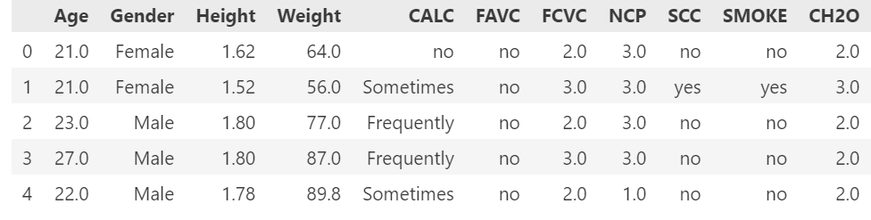
Table

Slide 6
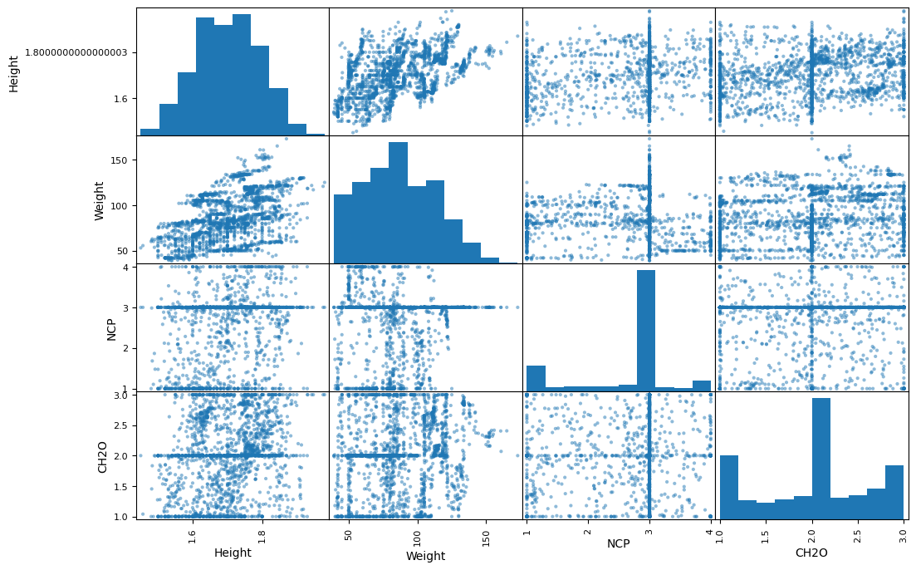

Slide 7
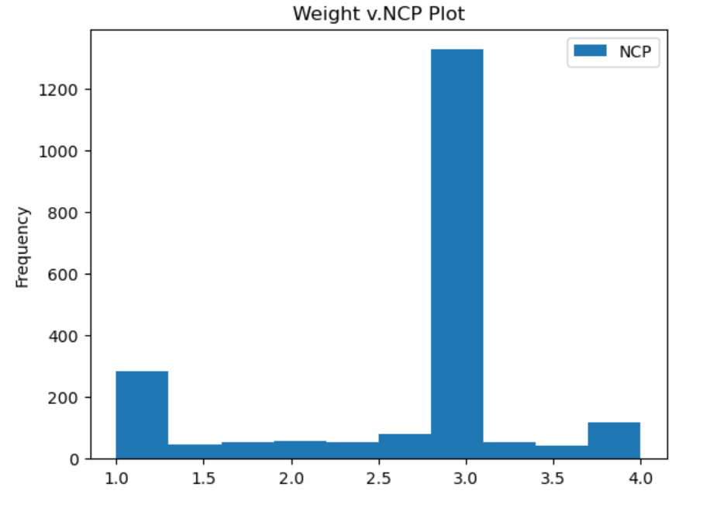
Daily Meals

Slide 8
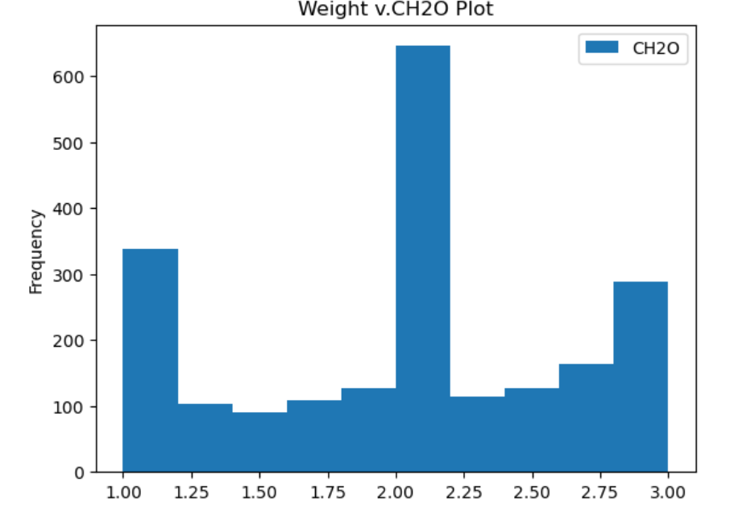
Daily Water Intake

Slide 9
Tips for healthy life
Eat healthy meals.
Hydrate with water.
Rest your body.
Stay healthy.
Smile.

Slide 10


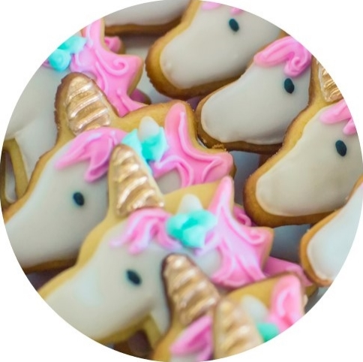
Summary
Be mindful of what you allow to enter inside of your body.
Do not allow your past to influence your future.
You are in control of you!

Slide 11
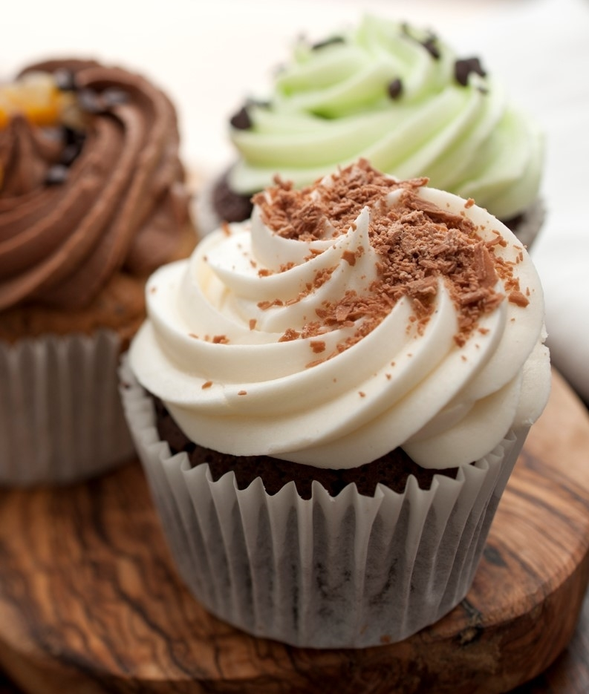
THANK YOU
Nia Smith

