Slide 1
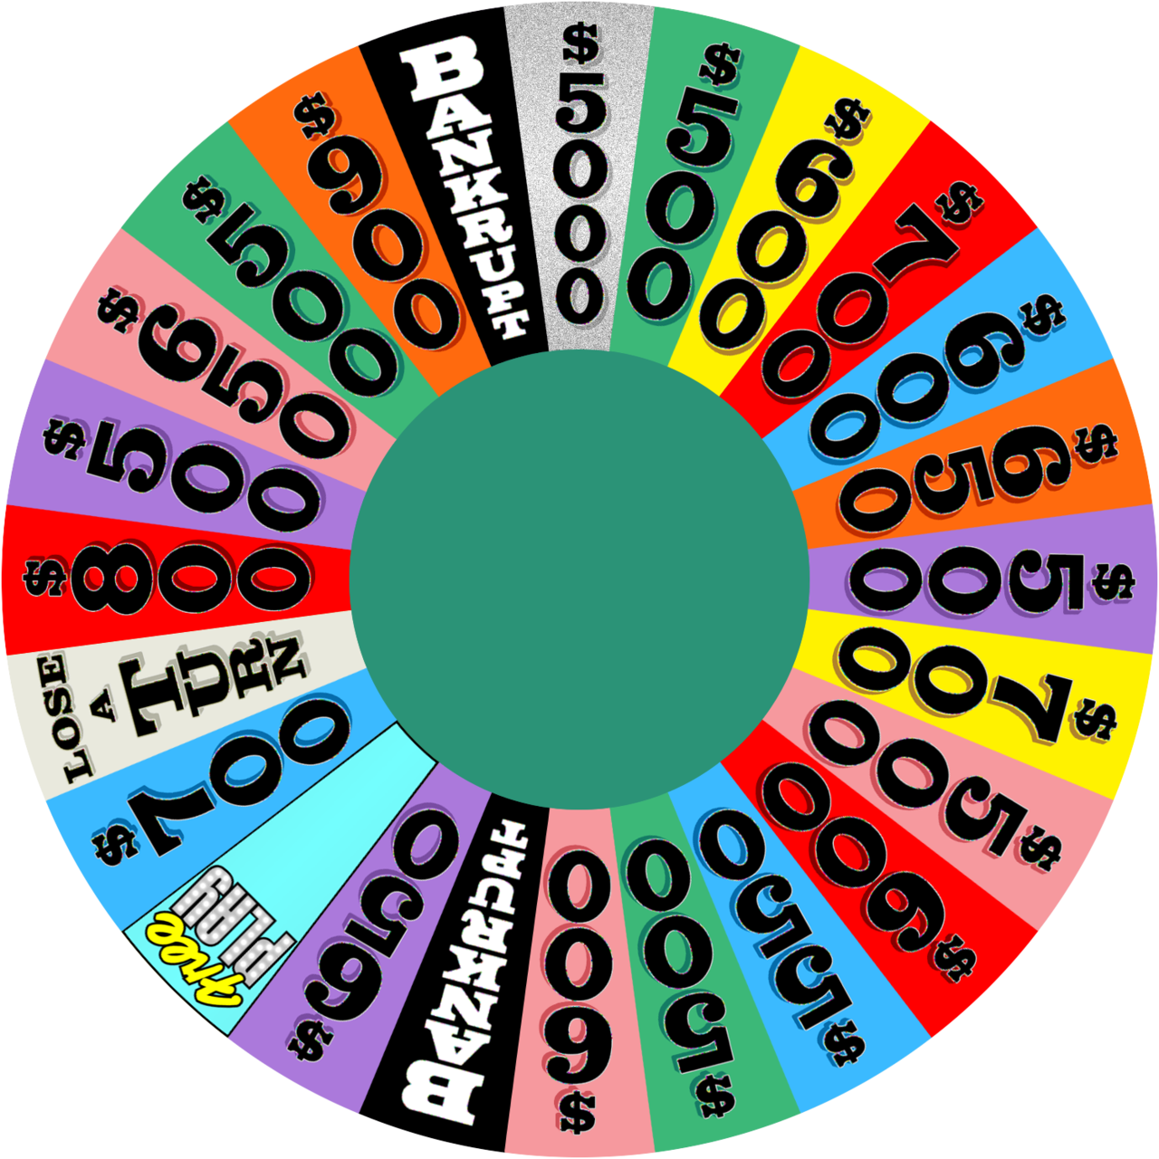
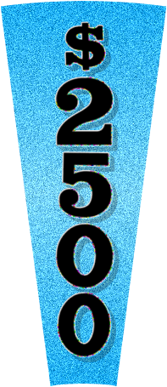

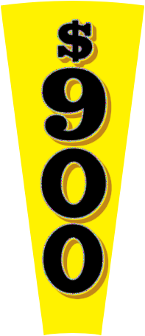



Macros/active content are disabled.
Please enable them to use this template. Learn more
PowerPoint Edition
How to Use
Set Up Puzzles
Puzzle Board
Version 6.4 ~ Check for Updates
© Games by Tim ~ About/Credits

Slide 2

Wheel
Wheel
Wheel
Wheel
?
B
C
D
F
G
H
J
K
L
M
N
RSTLNE
gamesbytim.com
Settings
Clear Board
End Game
Toss-Up Puzzle
Ñ
P
Q
R
S
T
V
W
X
Y
Z
Reveal a Letter
WHEEL OF FORTUNE
A
E
I
O
U
1
0
5
9
12
13
15
16
21
23
22
24
27
26
25
14
11
10
8
7
6
4
3
2
1
29
28
20
19
18
17
FINAL SPIN
On your turn, call any letter.
Vowels are free, consonants will add $1,000 + this spin.
If your letter is in the puzzle, you get a limited time to solve.
Click anywhere to spin
10
9
8
7
6
5
4
3
2
1
NO MORE VOWELS
FINAL SPIN
NO MORE CONSONANTS
Load Puzzle
Bonus Round
Fourth Round
Express Round
Mystery Round
Normal Round
-
3 Players
+
Player 1
Player 2
Player 3
Player 4
Round
$
0
Manually Set Final Spin Value
$
0
x
$
0
$
0
x
x
x
Totals
$
0
$
0
$
0
$
0

Slide 3

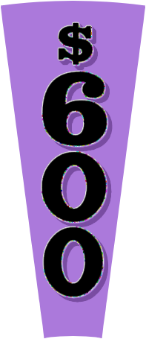
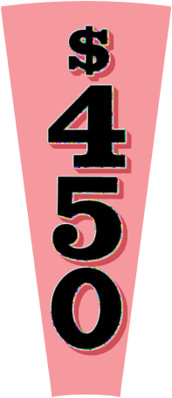

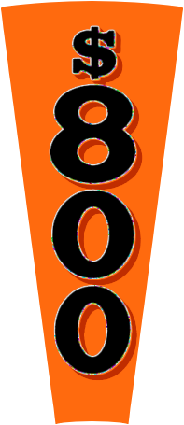
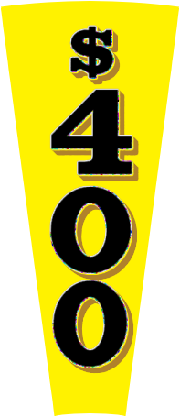
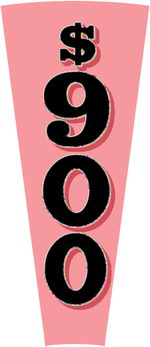

Back
Normal Round
Click the wheel to spin!
?
Wheel Settings
You landed on
Restore wheel items

Slide 4
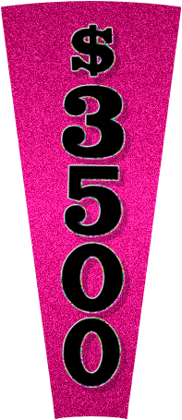

Back
Mystery Round
Click the wheel to spin!
?
Wheel Settings
You landed on
Restore wheel items
?
x

Slide 5

Back
Express Round
Click the wheel to spin!
?
Wheel Settings
You landed on
Restore wheel items

Slide 6
Back
Fourth Round
Click the wheel to spin!
?
Wheel Settings
You landed on

Slide 7
0
Set Up Puzzles
Settings
1
2
3
4
5
6
7
8
9
10
11
12
FOR HOST’S EYES ONLY!
Select a number above to set up your puzzle.
You’ll use that number to load it to the puzzle board.
How to Use
Puzzle Board

Slide 8
Set Up Puzzles
1
2
3
4
5
6
7
8
9
10
11
12
Category:
(Pick Random)
How to Use
Puzzle Board

Slide 9
Settings
1
2
3
4
5
6
7
8
9
10
11
12
Appearance
Gameplay
?
Game Name:
?
Vowel Price:
$250
?
Solve Button:
reveal
WHEEL OF FORTUNE
?
House Minimum:
$1000
Wheel Settings
?
Backdrop:
studio
Shot Clock:
none
Sound Effect Settings
?
?
Color Scheme:
blue
No More Vowels/ Consonants:
Show All Puzzles
?
on
?
Blue Tiles:
on
Spanish Ñ:
off
Delete All Puzzles
?
Games by Tim Attribution:
Special Score Bonuses:
?
on
?
off
Back to Title
How to Use
Puzzle Board
ÁÀÂÄÃÇÉÈÊËÍÌÎÏÑÓÒÔÖÕÚÙÛÜ
Ñ
AÁÀÂÄÃ
CÇ
EÉÈÊË
IÍÌÎÏ
OÓÒÔÖÕ
UÚÙÛÜ
AÁÀÂÄÃEÉÈÊËIÍÌÎÏOÓÒÔÖÕUÚÙÛÜ

Slide 10
Wheel Settings
The wheel layout defines the permanent spaces on the wheel.
Wheel items are taken out the wheel when a player lands on its space and calls a correct letter.
Wheel Layout
$5 Wedge:
?
off
?
Values Range:
$500-$900
$5,000 Sliver:
off
?
?
Free Play Wedge:
off
Wheel Items
?
Number of Bankrupts
?
Wild Card:
off
Normal Round:
2
Express Round:
2
?
Gift Tag:
off
Mystery Round:
2
Fourth Round:
2
?
Claimable:
once
Go Back

Slide 11
Sound Effect Settings
Click a sound effect box to preview its sound.
To customize sound effects, switch to Editing view and follow the steps on this slide’s notes.
Load Puzzle Chime
Guess Letter Correct
Guess Letter Wrong
Spin Wheel
Solve Puzzle Chime
Triple Toss-Up Solve
Final Spin Alert
Bonus Countdown
Sounds Not Included By Default
Toss-Up Music
Final Spin Music
Go Back
Notes:
HOW TO CUSTOMIZE SOUND EFFECTS
Each sound effect is an action button with a sound file set to play on click. During the game, Wheel of Fortune for PowerPoint uses macros to dynamically “click” the action button, playing its sound effect.
To change a sound effect:
Select the sound effect box.
On the PowerPoint ribbon, go to the Insert tab -> Action. An Action Settings pop-up should appear.
On the Mouse click tab, change the Play sound file (scroll down to Other Sound… in the dropdown menu). All sound effects must be in WAV format.
To disable the sound effect, select [No Sound].

Slide 12
1
2
3
1
2
3
4
5
6
4
5
6
7
8
9
7
8
9
10
11
12
10
11
12
Go Back

Slide 13
Normal Round
A typical Wheel of Fortune game has multiple rounds with different wheels. This is the normal wheel.
Want to change things up by adding Free Play, Wild Card, and other additions? Tweak the wheel in Wheel Settings.
Wheel Settings
Close

Slide 14
Mystery Round
If a player lands on the Mystery Wedge and calls a correct letter, they can:
  1) Receive $1,000 for each letter in the puzzle or
  2) Chance receiving $10,000 or a Bankrupt.
If the player chooses option 2, click the giant question mark on the bottom left to determine their fate.
That Mystery Wedge disappears. The other Mystery Wedge becomes a standard $1,000 space.
Close

Slide 15
Express Round
If a player lands on the Express Wedge and calls a correct letter (worth $1,000), they have the option to “hop aboard” the Express.
When aboard, the player gets to call letters continuously at $1,000. But be careful: an incorrect letter leads to a Bankrupt.
The Express is a high risk, high reward challenge. Hop aboard if you dare!
Close

Slide 16
Fourth Round
This is the last wheel in the main game. All wheel items are disabled for this wheel.
The game continues with this wheel for as many rounds until the host calls the Final Spin.
To start the Final Spin, click the Final Spin button on the puzzle board and follow the steps in the banner that appears.
Close

Slide 17
Bonus Round
The winning player tries to solve a puzzle with a limited number of letters.
Reveal all the R, S, T, L, N, and Es in the puzzle.
RSTLNE
?
The player chooses three more consonants and a vowel. (Add another consonant if they have a Wild Card.)
Use the letter selector to input these letters. Then click these letters to reveal them in the puzzle.
RSTLNE
GJMA
?
The player has ten seconds to guess the puzzle.
10
Close

Slide 18
Thank you for using
Wheel of Fortune for PowerPoint
End show
Wipe all scores and end show
Wipe all puzzles/scores and end show
Wait! Go back
Remember to save before closing PowerPoint, and check out more projects at Games by Tim.

Slide 19
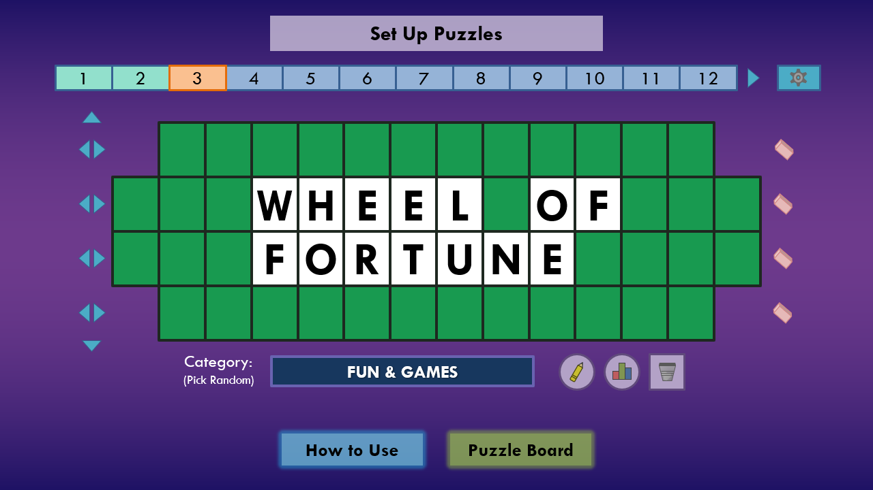
How to Use – Setup
Before you start your game, you’ll need to set up puzzles.
Remember the puzzle number you’re currently on.
Fine-tune your game in Settings.
Type the puzzle here.
Write puzzles faster with Puzzle Scribe.
Type the puzzle category.
Analyze puzzles with Puzzle Properties.
Set Up Puzzles
Puzzle Board
Next

Slide 20
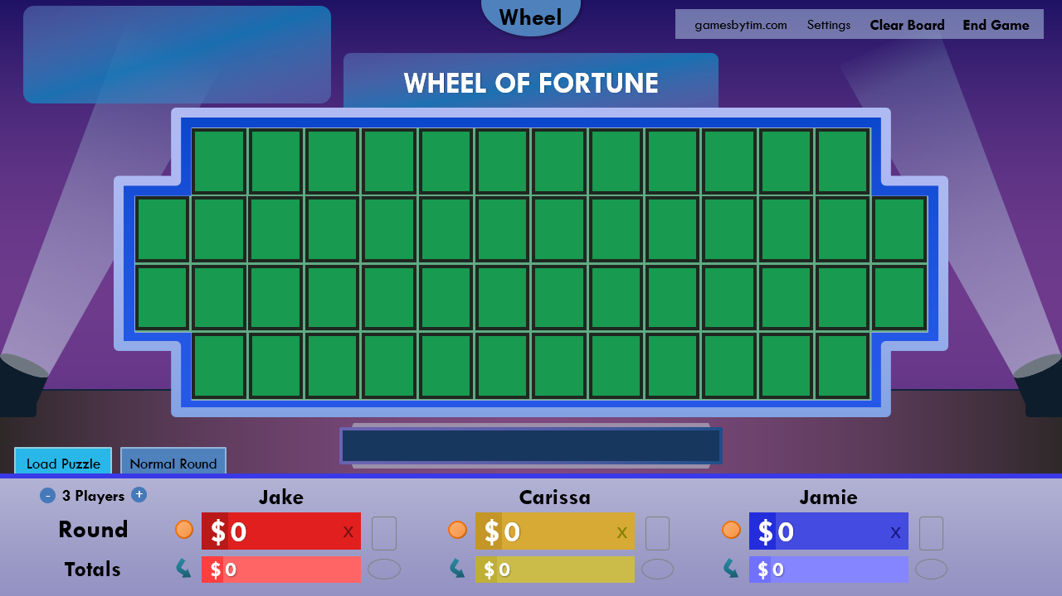
How to Use – Setup
Once you have enough puzzles, you’re ready for the puzzle board.
Load puzzles using your puzzle numbers.
Edit the player names.
Set the number of players.
Prev.
Set Up Puzzles
Puzzle Board
Next

Slide 21
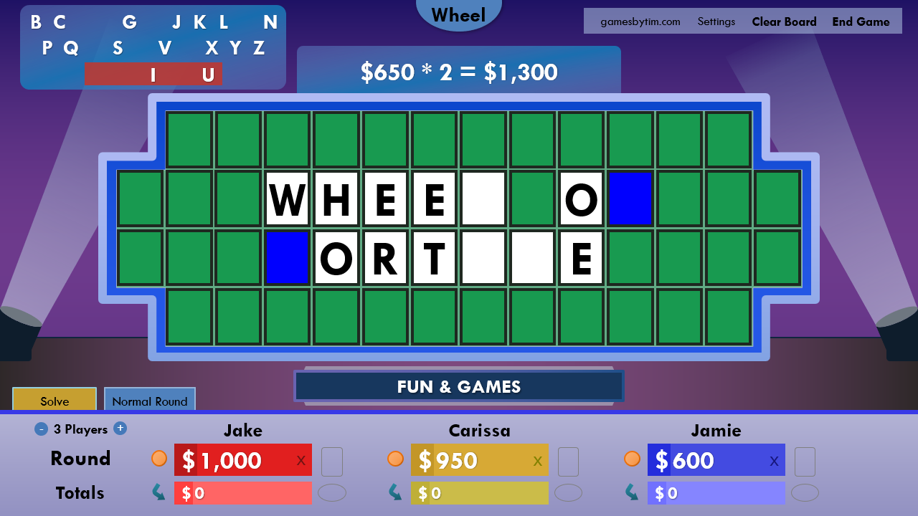
How to Use – Gameplay
The Value Panel holds the scored amount based on letters found and the spun wheel value.
Click letters in the Letter Selector to see if they’re in the puzzle.
Click the blue tiles that appear to reveal the letter.
Click the player’s round score to add the amount shown on the Value Panel.
Manually adjust score if needed with the player’s dollar sign.
Toggle who has the Wild Card/Gift Tag.
Click here if the player buys a vowel.
Prev.
Set Up Puzzles
Puzzle Board
Next

Slide 22
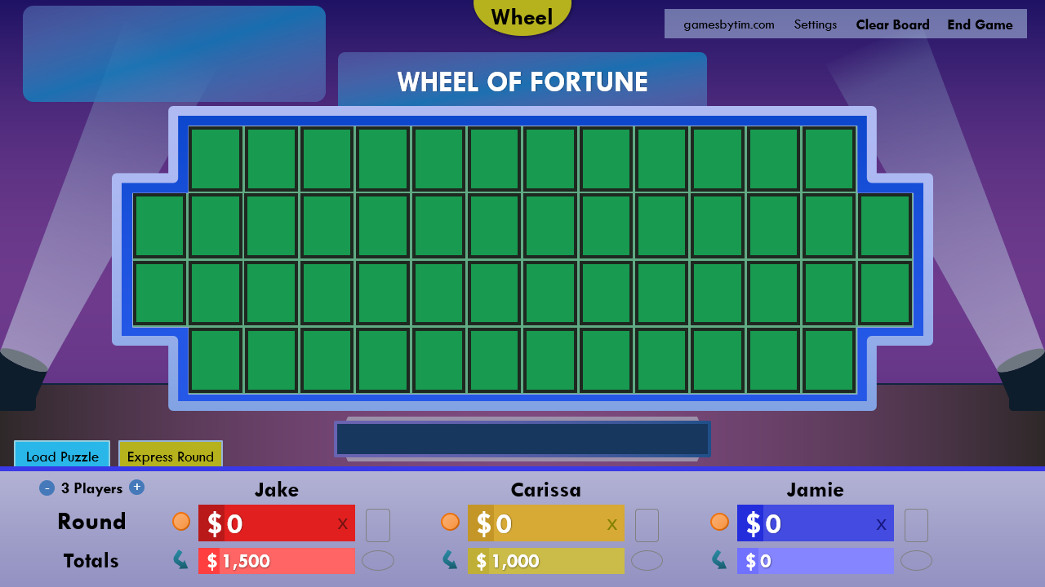
How to Use – The Next Round
Clear the board for a new round.
Change the type of wheel used for the next round.
Transfer the winning player’s round score to their totals.
Prev.
Set Up Puzzles
Puzzle Board
Next

Slide 23
How to Use – Tips & Tricks
Using a real-life wheel? Click the Value Panel to manually set the spun wheel value.
Want a Toss-Up? When loading a puzzle, append T to the puzzle number (1T, 2T, etc).
Want a Triple Toss-Up? When loading a puzzle, append TTT to the puzzle number. For example, 3TTT will start a Triple Toss-Up sequence with puzzles 3, 4, and 5.
Hosting through video call? It may help to run the slide show as a window. In editing view, go to the View tab and switch to Reading View.
Prev.
Set Up Puzzles
Puzzle Board
Next

Slide 24
How to Use – Troubleshooting
PowerPoint 2010 (Windows)/2016 for Mac or newer is required.
You can find the last versions to support PowerPoint 2007/2011 for Mac here.
Enable macros and editing for Wheel of Fortune for PowerPoint to work.
If you run the slide show as a window, do not change slides with the scroll wheel/keyboard.
Remember to save when closing the file to retain your puzzles.
Report bugs to the project’s comments page. Here’s some tips to help me debug.
Prev.
Set Up Puzzles
Puzzle Board

Slide 25
Wheel of Fortune for PowerPoint
Developer: Timothy Hsu Revision Date: November 6, 2023
Wheel Graphics
wheelgenius from Deviantart
MarioGS from Buy a Vowel Boards
Timothy Hsu with Inkscape ($5,000 Sliver)
Sound Effects
Timothy Hsu with
Logic Pro
Special Thanks
Merv Griffin (creator of Wheel of Fortune)
Pat Sajak/Vanna White (hosts of Wheel of Fortune)
SuperNikestar (YouTuber who inspired me to create this project)
Rusnakcreative (inspiration from his Wheel of Fortune template)
JapanYoshi (option to verify answer when pressing Solve)
The family/friends who participated in my test playthroughs
Legal
“Wheel of Fortune” is a registered trademark of Califon Productions, Inc, which was not involved in the production of, and does not endorse, this product. For more information about the game show, visit www.wheeloffortune.com.
For more projects from the developer, visit www.gamesbytim.com.
Important Notice
Back to Title
Wheel of Fortune for PowerPoint is licensed under a Creative Commons Attribution-NonCommercial-ShareAlike 4.0 International License.

Slide 26
Important Notice
This is the final feature update to Wheel of Fortune for PowerPoint.
No further changes or wheel value adjustments will be released. Future updates (if any) will be for bug fixes only.
Due to several factors, I am ending development on Wheel of Fortune projects. It has been an amazing near-12-year run, and I am satisfied capping off this project as it currently stands.
Thank you to everyone who supported Wheel of Fortune for PowerPoint over all these years. It has been an honor to build a project that made a lasting impact for classrooms, parties, churches, retirement homes, virtual gatherings, and much more.
Keep on spinning,
Timothy Hsu (Games by Tim)
Back to Title

