Slide 1


Welcome
To the introduction to Keycloak
This is Nur Mohammad (soikat)
Full Stack Developer
BYSL E-Commerce

Slide 2
Agenda
What is keycloak?
Why we use keycloak?
How to install?
  Docker
  Open JDK
How it is work?
  Keycloak workflow
  Admin console overview
Pros & Cons
Some problems and solution
Reference

Slide 3
What is keycloak?
Keycloak is an open-source Identity and Access Management (IAM) solution that allows you to add authentication and authorization to your applications and services.
Keycloak is primarily written in Java

Slide 4
Why we use keycloak?
Keycloak provides many features, including:
Single-Sign On
Login once to multiple applications
Authorization and permission
Easily management role. (Create role, permission and assign to user)
Social login
Easily enable social login(Facebook, Google, GitHub, etc.)
CORS Support
Client adapters have built-in support for CORS.
Admin Console
For central management of users, roles, role mappings, clients and configuration.
Two-factor Authentication - Support for TOTP/HOTP via Google Authenticator or FreeOTP.

Slide 5
How to install?
(Using Docker)
Docker
Get started with Keycloak on Docker
1. Install Docker
2. Open Terminal and use this command
docker run -p 8080:8080 -e KEYCLOAK_ADMIN=admin -e KEYCLOAK_ADMIN_PASSWORD=admin quay.io/keycloak/keycloak:21.0.1 start-dev
https://www.keycloak.org/getting-started/getting-started-docker

Slide 6
How to install?
(Using OpenJDK)
OpenJDK
Get started with Keycloak on bare metal
1. Make sure you have OpenJDK 11 or a higher version installed.
2. Download and extract keycloak-21.0.1.zip from the Keycloak website.
3. Open terminal
/bin/kc.sh start-dev
https://www.keycloak.org/getting-started/getting-started-zip

Slide 7
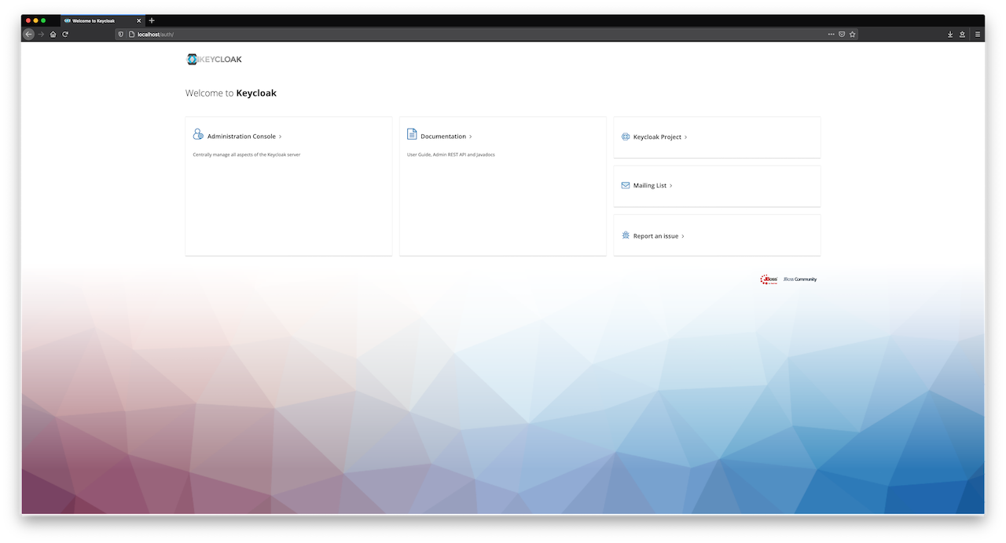

Slide 8
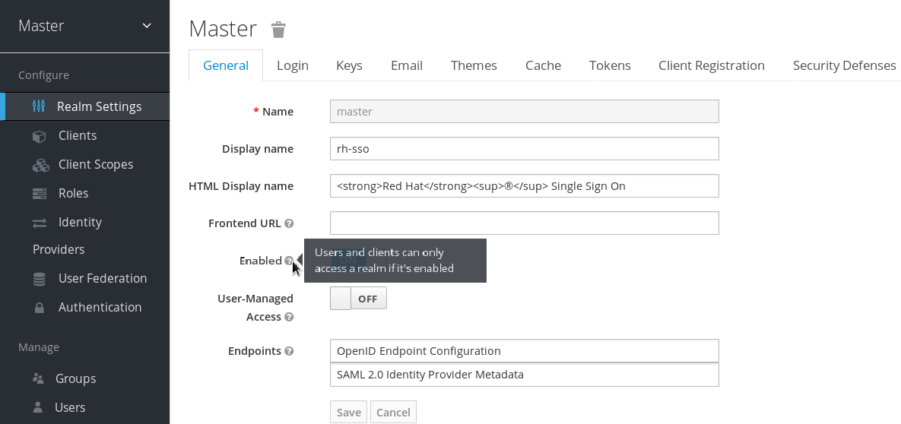

Slide 9
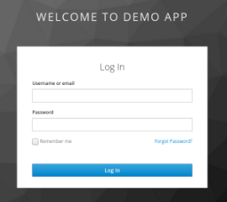
How it is work?
(Keycloak workflow)
User
Application
Keycloak
User enter url of an application
Application redirect to keycloak
Login page
Keycloak uses the OpenID Connect (OIDC) protocol to authenticate a user.
(OpenID Connect builds on top of OAuth 2.0 to add an authentication layer.)
User gives credential
If valid redirect to application
“Invalid Credential”
If invalid

Slide 10
How it is work?
(Admin console overview)
Realms
In Keycloak, a realm is a logical container for a set of users, groups, and applications, along with the corresponding authentication and authorization settings.
Client
In Keycloak, a client is a representation of an application or service.Each client in Keycloak has its own set of configuration settings (Client ID,Redirect URIs, Web Origins, Client Secret)
Group
User 1
User 2
User 3
User 4

Slide 11
Pros & Cons
Keycloak offers a range of benefits and drawbacks. Here are some of the pros and cons of using Keycloak:
Pros:
Open-Source: it is freely available to download and use without any licensing fees. This makes it an attractive option for organizations with limited budgets.
Support for Multiple Protocols: Keycloak supports a variety of protocols, including OAuth 2.0, OpenID Connect, SAML, and LDAP. This flexibility allows organizations to integrate Keycloak into a wide range of applications and services.
Flexible Authentication Flows: Keycloak offers several authentication flows that can be customized to meet specific needs. This includes multi-factor authentication, social login, and passwordless authentication.
Single Sign-On (SSO): Keycloak provides SSO capabilities, which means that users only need to authenticate once to access multiple applications and services.
Role-Based Access Control (RBAC): Keycloak offers RBAC capabilities, which allow organizations to manage access to resources based on roles and permissions.

Slide 12
Pros & Cons
Cons:
Steep Learning Curve: Keycloak is a complex piece of software that can be challenging to set up and configure, especially for users without a strong background in IAM.
Heavy Resource Usage: Keycloak can be resource-intensive, especially for large deployments with a high volume of traffic. This can lead to performance issues and increased costs for hardware and infrastructure.
Limited Community Support: While Keycloak has a growing community of users and contributors, it may be more challenging to find support compared to other commercial IAM solutions.
Limited Integrations: While Keycloak offers support for a variety of protocols, it may not integrate as smoothly with certain applications and services as other commercial IAM solutions.
Overall, Keycloak is a powerful and flexible IAM solution that offers a range of benefits, but it may not be the best fit for every organization. Before deciding to use Keycloak, it's essential to consider its pros and cons carefully and ensure that it meets your specific needs and requirements.

Slide 13
Some problems and solution
Release Notes: Keycloak 21.0.0
Old Admin Console removed
In Keycloak 19 the new admin console was graduated to the new default admin console, and the old admin console was deprecated. In this release the old admin console has been removed completely.
For API:
{base url}/admin/realms
http://localhost:8080/admin/realms
GET /{realm}/clients/{id}/roles
/e-com/clients/dd333330ksdkfsdf/roles
/admin/realms/e-com/clients/dd333330ksdkfsdf/roles

Slide 14
References
https://www.keycloak.org/
https://www.keycloak.org/docs/latest/server_admin/
https://www.keycloak.org/docs/latest/release_notes/index.html
https://www.keycloak.org/docs-api/21.0.1/rest-api/index.html
https://github.com/keycloak/keycloak-nodejs-admin-client
https://medium.com/codex/introduction-to-keycloak-227c3902754a

Slide 15
Thank you!

