Slide 1

Project Asset Optimization
A Strategic Comparative Study for Smarter Portfolio Management
Sudarsan Nallur Murali
June 13th , 2025

Slide 2


Goal / Constraints / Objective Clear goals and robust constraints drive yield optimization
Goal
Constraints
Objective
To maximize Yield
To Create an optimizer
that can handle data of arbitrary length
The optimizer needs to follow constraints like asset level min/max weight, liquidity, sector level, quality level and duration
$$maximize (\sum_{i=1}^{N}{wiyi} )$$
$wi$​ = portfolio weight of asset $i$ (decision variable)
$yi$ = yield of asset $i$
Introduction
Workflow
Identifying Base Solver
Base Model Performance
Base Model vs Other Model
Evaluation
Conclusion

Slide 3


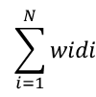

Constraints Rule Book
Constraint Name | Mathematical Meaning
Asset-level bounds | 𝑤_{min_𝑖} ≤ 𝑤_{𝑖} ≤ 𝑤_{max_𝑖} ​
Full Allocation
Portfolio-duration band
Minimum average rating must be A+ | ≤ 5​
Same-day liquidity | (𝐿_{𝑖}=1) ≥ 0.20
$$\sum_{i=1}^{N}{wi}$$
= 1
$$\sum_{i=1}^{N}{widi}$$
≤ 8
2 ≤
$$\sum_{i=1}^{N}{wiqi}$$
$$\sum_{i=1}^{N}{wi}$$
Introduction
Workflow
Identifying Base Solver
Base Model Performance
Base Model vs Other Model
Evaluation
Conclusion

Slide 4
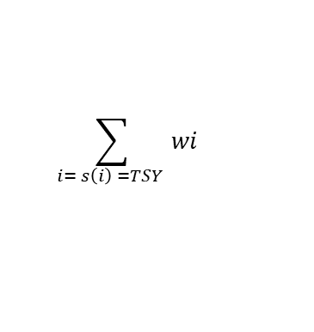
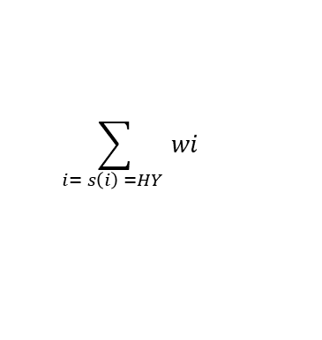
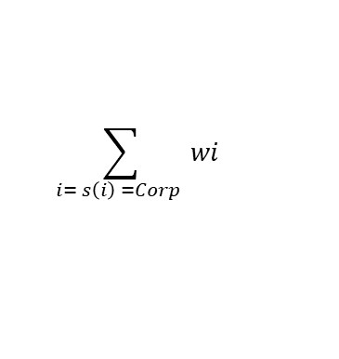
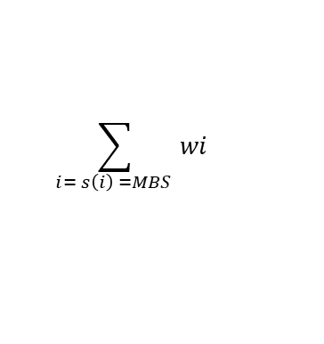
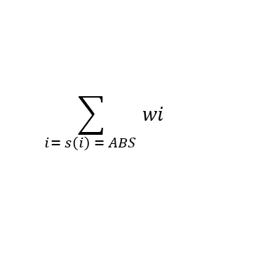
Constraints Sector Level Constraints
Sector Name | Mathematical Representation
Treasury (TSY) | ≥ 0.10
Asset-Backed Securities (ABS) | 0 ≤ ≤ 0.20
Mortgage-Backed Securities (MBS) | ≤ 0.40
Corporate Bonds (Corp) | ≤ 0.5​
High-Yield Bonds (HY) | ≤ 0.05
$$\sum_{i= s\left(i\right) =TSY }{wi}$$
$$\sum_{i= s\left(i\right) = ABS }{wi}$$
$$\sum_{i= s\left(i\right) =MBS }{wi}$$
$$\sum_{i= s\left(i\right) =Corp }{wi}$$
$$\sum_{i= s\left(i\right) =HY }{wi}$$
Introduction
Workflow
Identifying Base Solver
Base Model Performance
Base Model vs Other Model
Evaluation
Conclusion

Slide 5
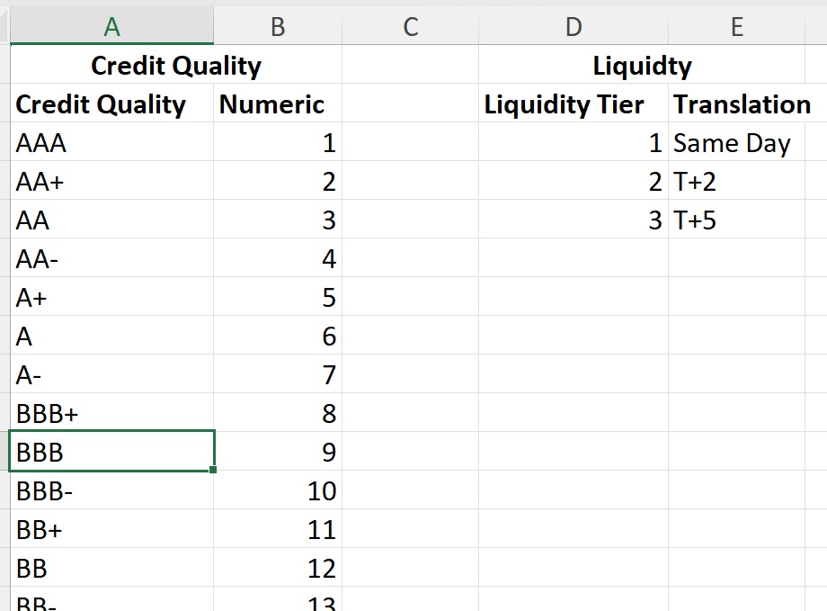
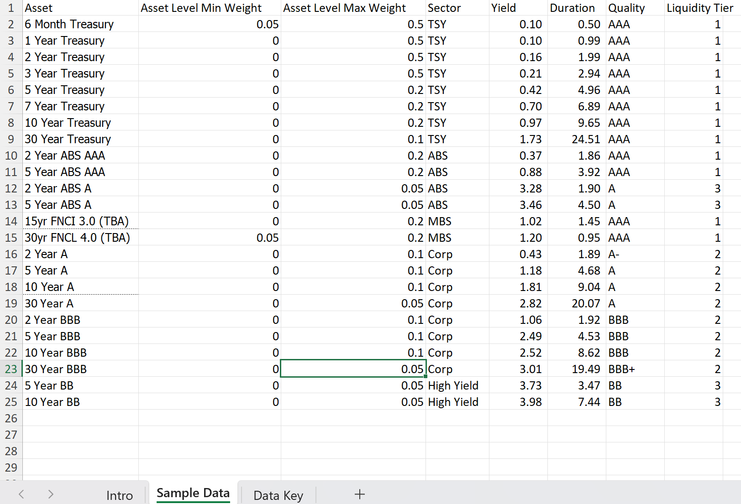
Data source More about the data
Data Set
Candidate Optimizer Project.xlsx
Sample Data Sheet:
Contains information about the securities like the asset name, min/max asset weight, sector, yield, duration, quality and liquidity tier
Data Key Sheet:
Credit Quality table
Contains the numeric mapping for each credit quality from AAA – 1 to BB- – 13
Liquidity table
Contains information on liquidity tier, translate number from sample data sheet to actual days it takes to sell the asset.
Introduction
Workflow
Identifying Base Solver
Base Model Performance
Base Model vs Other Model
Evaluation
Conclusion

Slide 6
Workflow Architecture
Pre-Processing
Define constraints
Identify base model / solver
Define objective
Benchmarking (run multiple models)
Solve the optimization problem
Final suggestions
Evaluate results
Introduction
Workflow
Identifying Base Solver
Base Model Performance
Base Model vs Other Model
Evaluation
Conclusion

Slide 7
Solvers Exploring the solvers used
Solver | Type | Methodology | Strengths
CVXPY (ECOS) | Conic / Linear Programming | Interior Point Method (conic solver) | Stable, reliable for convex problems with constraints
CVXPY (OSQP) | Quadratic Programming (QP) | Operator Splitting (ADMM-based) | Scalable, fast for large sparse problems
CVXPY (SCS) | Conic / LP Solver | First-order splitting method | Handles large, loosely constrained problems
CVXOPT | Conic / Quadratic Programming | Interior Point Method | Suitable for small to mid-sized problems
PuLP (CBC) | Linear Programming | Branch-and-Cut (Simplex-based LP solver) | Intuitive, open-source, simple LP support
OR-Tools (GLOP) | Linear Programming | Google's Simplex Implementation | Blazing fast, ideal for pure LPs
SciPy (SLSQP) | Nonlinear Optimization | Sequential Least Squares Programming | Supports nonlinear constraints
Introduction
Workflow
Identifying Base Solver
Base Model Performance
Base Model vs Other Model
Evaluation
Conclusion

Slide 8
Base Model Selection Why ECOS?
ECOS handles floating-point precision very well, avoiding divergence in sensitive constraint configurations
Easily accommodates a wide range of real-world constraints (duration bands, sector caps, liquidity)
Seamless integration with Python via the CVXPY interface — ideal for rapid prototyping and deployment
Consistently delivers optimal or near-optimal solutions without excessive tuning
Numerical Stability
Constraint Flexibility
Integration Friendly
Solver Reliability
Introduction
Workflow
Identifying Base Solver
Base Model Performance
Base Model vs Other Model
Evaluation
Conclusion

Slide 9
Portfolio Optimization Using ECOS Resulted in a yield of 2.04% upholding all constraints
Portfolio Yield: 2.0363%
Means the portfolio is expected to generate $2.036 in interest income each year for every $100 of principal invested
Portfolio Duration: 7.86 years
This indicates a long-term investment strategy—matching the duration target range (2–8 years).
Suitable for liability-driven investors like insurers or pension funds looking to stabilize long-term returns.
Average Rating Number: 5.00
Maintained credit quality at A+ or better, minimizing credit risk.
Same-Day Liquidity: 40.00%
Double the required liquidity threshold (20%)—enabling rapid reallocation in volatile markets.
Portfolio yield | 2.0363 %
Portfolio duration | 7.86 yrs
Average rating num | 5.00
Same-day liquidity | 40.00%
Introduction
Workflow
Identifying Base Solver
Base Model Performance
Base Model vs Other Model
Evaluation
Conclusion

Slide 10
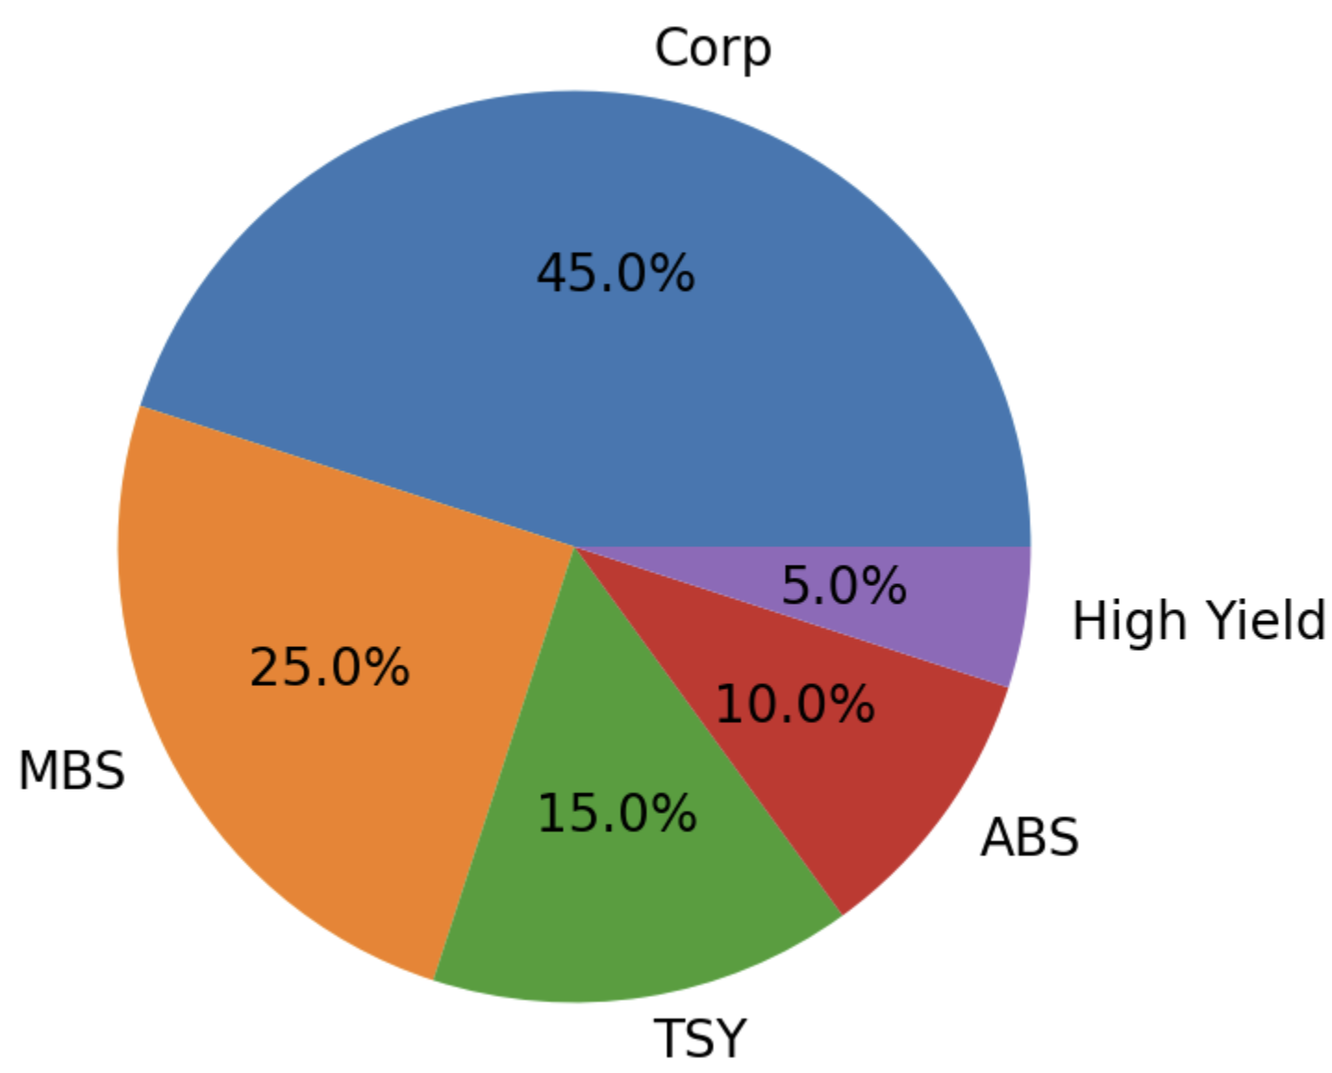
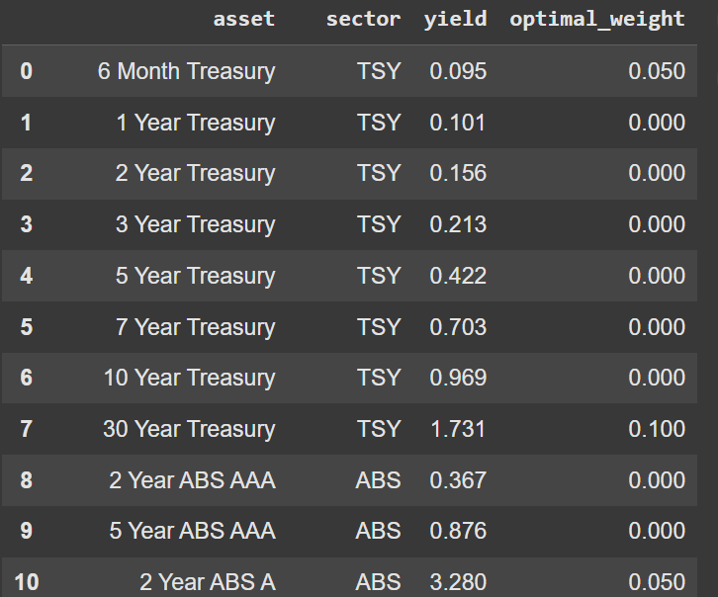
Portfolio Optimization Using ECOS Sectors and Assets weight split up
Sector Allocation Breakdown
Corporate Bonds (45%): Driving most of the yield while staying within sector limits.
MBS (25%) & ABS (10%): Balancing returns with diversification.
TSY (15%): Providing stability and risk-free exposure.
High Yield (5%): Capped exposure to enhance returns without overleveraging credit risk.
Sample Asset-Level Decisions
Shows granular weight distribution—e.g., 6-Month Treasury allocated 5%, 30-Year Treasury 10%
Each asset weightage will sum up to the corresponding sector and adds up to the total 100% of weight distribution
Introduction
Workflow
Identifying Base Solver
Base Model Performance
Base Model vs Other Model
Evaluation
Conclusion

Slide 11
Comparison between solvers within CVXPY library ECOS and SCS run the fastest, and all solvers yielded the same result
Solver | Yield % | Duration | SameDay % | SectorHY % | Runtime (s) | Status
ECOS | 2.036 | 7.86 | 40.0% | 5.0% | 0.015 | Optimal
SCS | 2.036 | 7.86 | 40.0% | 5.0% | 0.015 | Optimal
OSQP | 2.036 | 7.86 | 40.0% | 5.0% | 0.017 | Optimal
CVXOPT | 2.036 | 7.86 | 40.0% | 5.0% | 0.043 | Optimal
Introduction
Workflow
Identifying Base Solver
Base Model Performance
Base Model vs Other Model
Evaluation
Conclusion

Slide 12
Comparing ECOS solver results with other open-source solvers Ortools – GLOP by google is the fastest of all other solvers
Solver | Yield % | Duration | SameDay % | SectorHY % | Runtime (s) | Status
CVXPY-ECOS | 2.036 | 7.860 | 0.400 | 0.050 | 0.015 | Optimal
PuLP-CBC | 2.036 | 7.860 | 0.400 | 0.050 | 0.006 | Optimal
ORtools-GLOP | 2.036 | 7.860 | 0.400 | 0.050 | 0.001 | Optimal
SciPy-SLSQP | 2.036 | 7.860 | 0.400 | 0.050 | 0.018 | Optimal
Introduction
Workflow
Identifying Base Solver
Base Model Performance
Base Model vs Other Model
Evaluation
Conclusion

Slide 13
Evaluation Memory usage and run time
Solver | Peak Memory Usage (mb) | Time (s)
ORtools-GLOP | 0.0 | 0.001
PuLP-CBC | 0.0 | 0.008
ECOS | 0.0 | 0.024
SCS | 0.0 | 0.024
OSQP | 0.0 | 0.027
CVXOPT | 0.0 | 0.032
SciPy-SLSQP | 0.0 | 0.034
Execution Time (s) Cuts analyst cycle-time from hours to milliseconds Peak Memory Usage (mb) Low memory footprint reduces risk of crashes in constrained environments
OR-Tools GLOP completes in 0.001 s — even the slowest solver finishes < 0.04 s, allowing on-demand refreshes
All solvers consumed ~0 MB; OR-Tools and PuLP are essentially “free” to scale
Introduction
Workflow
Identifying Base Solver
Base Model Performance
Base Model vs Other Model
Evaluation
Conclusion

Slide 14
Our model performs 47 bps better than naïve investment How did our base model perform in contrast to naive model with equal weight split across assets
KPI | Equal-Weight Baseline | Optimised Portfolio (ECOS) | Value-Add / Delta
Yield | 1.57 % | 2.04 % | Difference of 0.47 % (~ +47 bps )
Duration | 6.17 yrs | 7.86 yrs | Within 2 – 8 yr policy band
Same-Day Liquidity | 50 % | 40 % | Still 2× the 20 % minimum
Average Rating | 4.50 (AA-) | 5.00 (A+) | Inside ≤ 5 limit
Runtime / Memory | n/a | 0.024 s / <1 MB | Scales to real-time use
Incremental Income @ $1 bn AUM | – | – | ≈ +$4.7 million per year
Introduction
Workflow
Identifying Base Solver
Base Model Performance
Base Model vs Other Model
Evaluation
Conclusion

Slide 15
Our optimizer can yield $4.7 million in $1 billion AUM Why should we use our model in contrast to Excel / Manual asset optimization
Benefit | What It Means | Impact
+47 bp Yield Uplift | Optimized portfolio yield of 2.04 % vs 1.57 % in the current benchmark allocation | + $4.7 million in extra interest every year on a $1 billion book – $20 million over a 5-year horizon
Double the Liquidity Buffer | Same-day assets = 40 % (regulatory floor 20 %) | Meets stress-testing with head-room, enabling opportunistic trading without breaching limits
A+ Average Credit Quality | Weighted rating number = 5.0 (≥ A+) | Preserves capital and no downgrade risk versus current holdings
Sub-Second Re-Optimization | OR-Tools GLOP and CVXPY solvers run in < 0.02 s using < 1 MB RAM | From “overnight Excel” to real-time what-if. Cuts analyst cycle time by over 95 %
Scalable & Open-Source Stack | Python + CVXPY/OR-Tools; container-ready Streamlit UI | Zero license cost; cloud-ready for instant deployment
Introduction
Workflow
Identifying Base Solver
Base Model Performance
Base Model vs Other Model
Evaluation
Conclusion

