Slide 1
BlueDBM : An Application for Big Data Analytics
Presented By: Nitin Mukesh Tiwari
Instructor : Dr. Akhilesh Tyagi
Some of the material is taken from original presentation of MIT research group

Slide 2
Authors
Sang- Woo Jun Ming Liu
Sungjin Lee Jamey Hicks
John Ankcorn Myron King
Shuotao Xu Arvind
Presented at: ISCA’ 2015 (The 42nd International Symposium on Computer Architecture )

Slide 3
Big Data Revolution
Analysis of data at large scale can give important insights.
Google predicted Flu out breaks before CDC.
Nate Silver predicted US presidential election results with 100% accuracy using Twitter Data.
Amazon is planning anticipatory shipping of products based on Big Data
etc …
Biggest economic driver for IT industry in future

Slide 4
RamClouds- popular solution for Big Data
Cluster of machine with large DRAM capacity and fast inter connect
Fastest in in terms of execution time.
Very Costly and Power hungry
Performance of system falls sharply even with small fraction of references to secondary memory
What if Data does not fit in DRAM ??

Slide 5
Proposed Solution
Flash based memory
Faster than disk and cheaper than DRAM
Relatively low power consumption
Legacy storage systems are burdening
Slower than DRAM

Slide 6
Related Work
Flash Memory
SSDs, PCIe enabled SSD, SanDisk ZetaScale
Moneta, NoFtl
Networks
Faster network fabrics like Infiniband, RDMA, User Level TCP stack, QuickSAN
Accelerator
In-store processing, Smart SSD, Ibex, XSD

Slide 7
BlueDBM
BlueDBM
Flash Based Storage
Low latency high throughput inter controller network
In Store Processing capability

Slide 8
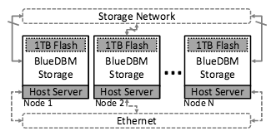
BlueDBM Overall System Architecture
Homogeneous cluster of host servers
BlueDBM is plugged in Host

Slide 9
BlueDBM Node Architecture
Each Node contains:
In-store processing capability
Host Interface
Flash interface
Network Interface

Slide 10
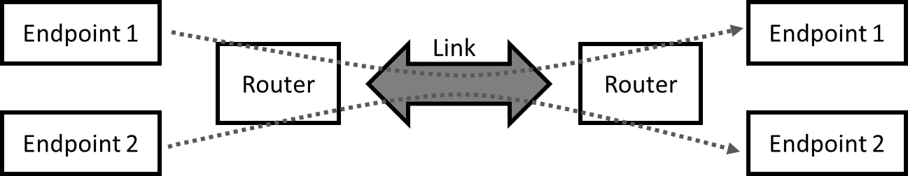
BlueDBM node architecture
Lightweight flash management with very low overhead
Adds almost no latency
ECC support
Flash Device
Custom network protocol with low latency/high bandwidth
x4 20Gbps links at 0.5us latency
Virtual channels with flow control
Flash
Controller
Software has very low level access to flash storage
High level information can be used for low level management
FTL implemented inside file system
Flash
Controller
Network
Interface
Network
Interface
In-Storage
Processor
PCIe
Host Server
Host Server
Notes:
All three components involve a lot of engineering and ideas and there is just no time to present everything in detail.
We will try to publish multiple publications regarding each of these components, or we can talk about details separately after the talk.

Slide 11
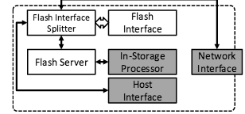
Flash Interface
A low-level thin and Fast hardware interface which:
Minimizes the access latency from network or in store processors
Exposes all degree of parallelism of device
Writes and Reads Data in 128 bit bursts

Slide 12
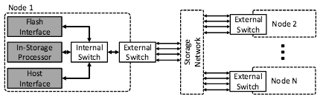
Network Interface
Low latency High bandwidth network infrastructure across all BlueDBM storage
Enables a flexible and configurable topologies among storage eg. Distributed start
Contains: Logical End Points, Link layer and Routing layer

Slide 13
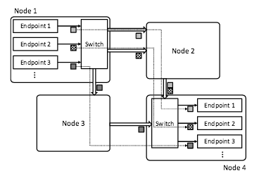
Simple Token based flow control
Back pressure ensures the packets are not dropped.
Deterministic Routing Optional end-to-end protocol support

Slide 14
Host Interface
In store processor can be accessed by Host interface which works on RPC
Read and Write have 128 page buffers each.
Uses DMA to parallelize read and write.
Parallelizing read is tricky as data is read in 128 bit burst.

Slide 15
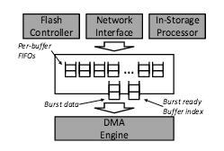

Slide 16
Software Interface
Flash system interface
Complete FTL implementation
RFS like implementation for better performance
Block Driver Interface
Accelerator interface

Slide 17
BlueDBM software view
User-
space
Hardware-assisted Applications
File System
Kernel-
space
Block Device Driver
Connectal (By Quanta)
Flash Ctrl
HW Accelerator
Accelerator Manager
Network
Interface
FPGA
NAND Flash
BlueDBM provides a generic file system interface as well as an accelerator-specific interface (Aided by Connectal)

Slide 18
Latency in Distributed Flash-based Analytics
Distributed processing involves:
Flash Device Access
Storage Software
Network
Actual Processing
Latency is additive
Flash
Access
75 μs
Storage
Software
100 μs
Network
20 μs
Processing
50~100 μs
100~1000 μs
20~1000 μs
…

Slide 19
Latency in distributed flash-based analytics
Architectural modifications can remove unnecessary overhead
Near-storage processing
Cross-layer optimization of flash management software*
Dedicated storage area network
Accelerator
Flash
Access
75 μs
Storage
Software
100 μs
Network
20 μs
Processing
50~100 μs
< 20μs
100~1000 μs
…
20~1000 μs
…
Notes:
Latency is additive because data needs to be copied to and from DRAM

Slide 20
Power consumption is low
Component | Power (Watts)
VC707 | 30
Flash Board (x2) | 10
Storage Device Total | 40
Storage device power consumption
is a very conservative estimate
Component | Power (Watts)
Storage Device | 40
Xeon Server | 200+
Node Total | 240+
GPU-based accelerator will double the power
Notes:
20%

Slide 21
Application Example: Graph traversal
Very latency-bound problem, because often cannot predict the next node to visit
Beneficial to reduce latency by moving computation closer to data
Flash 1
Flash 2
Flash 3
In-Store Processor
Host 1
Host 2
Host 3
Notes:
Benefits of lower latency access into distributed flash for computation on large graphs

Slide 22
Other potential applications
Genomics
Deep machine learning
Complex graph analytics
Platform acceleration
Spark, MATLAB, SciDB, …

Slide 23
Conclusion
Fast flash-based distributed storage systems with low-latency random access may be a good platform to support complex queries on Big Data
Reducing access latency for distributed storage require architectural modifications, including in-storage processors and fast storage networks
Flash-based analytics hold a lot of promise, and we plan to continue demonstrating more application acceleration

Slide 24
Near-Data Accelerator is Preferable
Traditional Approach
Hardware & software latencies are additive
NIC
Accelerator
FPGA
NIC
DRAM
DRAM
Flash
Accelerator
FPGA
Flash
CPU
CPU
Motherboard
Motherboard
BlueDBM
Flash
Flash
NIC
NIC
DRAM
DRAM
CPU
CPU
FPGA
FPGA
Motherboard
Motherboard

Slide 25
References
BlueDBM: An Appliance for Big Data Analytics
people.csail.mit.edu/

Slide 26
Thank you

