Slide 1
Optimization via Search
CPSC 315 – Programming Studio
Spring 2009
Project 2, Lecture 4
Adapted from slides of
Yoonsuck Choe

Slide 2
Improving Results and Optimization
Assume a state with many variables
Assume some function that you want to maximize/minimize the value of
  E.g. a “goodness” function
Searching entire space is too complicated
  Can’t evaluate every possible combination of variables
  Function might be difficult to evaluate analytically

Slide 3
Iterative improvement
Start with a complete valid state
Gradually work to improve to better and better states
  Sometimes, try to achieve an optimum, though not always possible
Sometimes states are discrete, sometimes continuous

Slide 4
Simple Example
One dimension (typically use more):
function
value
x

Slide 5
Simple Example
Start at a valid state, try to maximize
function
value
x

Slide 6
Simple Example
Move to better state
function
value
x

Slide 7
Simple Example
Try to find maximum
function
value
x

Slide 8
Hill-Climbing
Choose Random Starting State
Repeat
From current state, generate n random
steps in random directions
Choose the one that gives the best new
value
While some new better state found
(i.e. exit if none of the n steps were better)

Slide 9
Simple Example
Random Starting Point
function
value
x

Slide 10
Simple Example
Three random steps
function
value
x

Slide 11
Simple Example
Choose Best One for new position
function
value
x

Slide 12
Simple Example
Repeat
function
value
x

Slide 13
Simple Example
Repeat
function
value
x

Slide 14
Simple Example
Repeat
function
value
x

Slide 15
Simple Example
Repeat
function
value
x

Slide 16
Simple Example
No Improvement, so stop.
function
value
x

Slide 17
Problems With Hill Climbing
Random Steps are Wasteful
  Addressed by other methods
Local maxima, plateaus, ridges
  Can try random restart locations
  Can keep the n best choices (this is also called “beam search”)
Comparing to game trees:
  Basically looks at some number of available next moves and chooses the one that looks the best at the moment
  Beam search: follow only the best-looking n moves

Slide 18
Gradient Descent (or Ascent)
Simple modification to Hill Climbing
  Generallly assumes a continuous state space
Idea is to take more intelligent steps
Look at local gradient: the direction of largest change
Take step in that direction
  Step size should be proportional to gradient
Tends to yield much faster convergence to maximum

Slide 19
Gradient Ascent
Random Starting Point
function
value
x

Slide 20
Gradient Ascent
Take step in direction of largest increase
(obvious in 1D, must be computed
in higher dimensions)
function
value
x

Slide 21
Gradient Ascent
Repeat
function
value
x

Slide 22
Gradient Ascent
Next step is actually lower, so stop
function
value
x

Slide 23
Gradient Ascent
Could reduce step size to “hone in”
function
value
x

Slide 24
Gradient Ascent
Converge to (local) maximum
function
value
x

Slide 25
Dealing with Local Minima
Can use various modifications of hill climbing and gradient descent
  Random starting positions – choose one
  Random steps when maximum reached
  Conjugate Gradient Descent/Ascent
    Choose gradient direction – look for max in that direction
    Then from that point go in a different direction
Simulated Annealing

Slide 26
Simulated Annealing
Annealing: heat up metal and let cool to make harder
  By heating, you give atoms freedom to move around
  Cooling “hardens” the metal in a stronger state
Idea is like hill-climbing, but you can take steps down as well as up.
  The probability of allowing “down” steps goes down with time

Slide 27
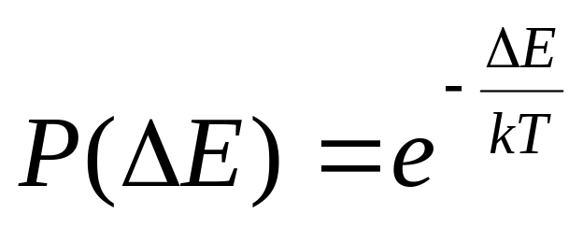
Simulated Annealing
Heuristic/goal/fitness function E (energy)
  Higher values indicate a worse fit
Generate a move (randomly) and compute
ΔE = E_{new}-E_{old}
If ΔE <= 0, then accept the move
If ΔE > 0, accept the move with probability:
Set
T is “Temperature”

Slide 28
Simulated Annealing
Compare P(ΔE) with a random number from 0 to 1.
  If it’s below, then accept
Temperature decreased over time
When T is higher, downward moves are more likely accepted
  T=0 means equivalent to hill climbing
When ΔE is smaller, downward moves are more likely accepted

Slide 29
“Cooling Schedule”
Speed at which temperature is reduced has an effect
Too fast and the optima are not found
Too slow and time is wasted

Slide 30
Simulated Annealing
T = Very
High
Random Starting Point
function
value
x

Slide 31
Simulated Annealing
T = Very
High
Random Step
function
value
x

Slide 32
Simulated Annealing
T = Very
High
Even though E is lower, accept
function
value
x

Slide 33
Simulated Annealing
T = Very
High
Next Step; accept since higher E
function
value
x

Slide 34
Simulated Annealing
T = Very
High
Next Step; accept since higher E
function
value
x

Slide 35
Simulated Annealing
T = High
Next Step; accept even though lower
function
value
x

Slide 36
Simulated Annealing
T = High
Next Step; accept even though lower
function
value
x

Slide 37
Simulated Annealing
T = Medium
Next Step; accept since higher
function
value
x

Slide 38
Simulated Annealing
T = Medium
Next Step; lower, but reject (T is falling)
function
value
x

Slide 39
Simulated Annealing
T = Medium
Next Step; Accept since E is higher
function
value
x

Slide 40
Simulated Annealing
T = Low
Next Step; Accept since E change small
function
value
x

Slide 41
Simulated Annealing
T = Low
Next Step; Accept since E larget
function
value
x

Slide 42
Simulated Annealing
T = Low
Next Step; Reject since E lower and T low
function
value
x

Slide 43
Simulated Annealing
T = Low
Eventually converge to Maximum
function
value
x

Slide 44
Other Optimization Approach: Genetic Algorithms
State = “Chromosome”
  Genes are the variables
Optimization Function = “Fitness”
Create “Generations” of solutions
  A set of several valid solution
Most fit solutions carry on
Generate next generation by:
  Mutating genes of previous generation
  “Breeding” – Pick two (or more) “parents” and create children by combining their genes

Slide 45
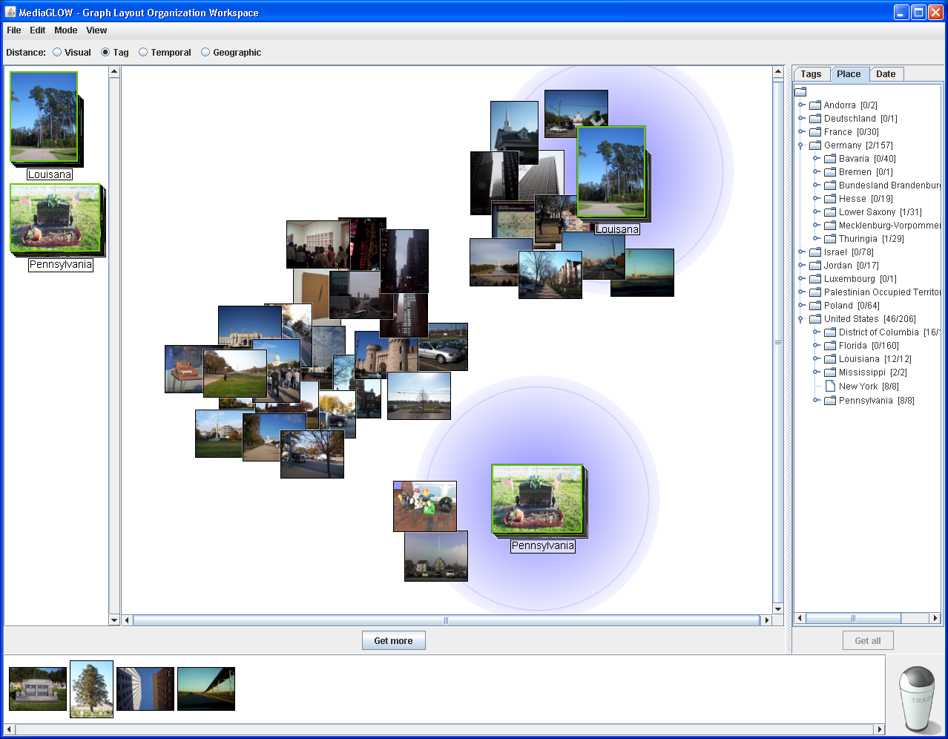
Example of Intelligent System Searching State Space
MediaGLOW (FX Palo Alto Laboratory)
  Have users place
  photos into piles
  Learn the
  categories they
  intend
  Indicate where
  additional photos
  are likely to go

Slide 46
Graph-based Visualization
  Photos presented in a graph-based workspace with “springs” between each pair of photos.
  Lengths of springs is initially based on a default distance metric based on their time, geocode, metadata, or visual features.
  Users can pin photos in place and create piles of photos.
  Distance metric to piles change as new members are added, resulting in the dynamic layout of unpinned photos in the workspace.

Slide 47
How to Recognize Intention
Interpreting the categories being created is highly heuristic
  Users may not know when they begin
  System can only observe organization
  System has variety of features of photos
    Time
    Geocode
    Metadata
    Visual similarity

Slide 48
System Expression through Neighborhoods
Piles have neighborhood for photos that are similar to the pile based on the pile’s unique distance metric.
Photos in a neighborhood are only connected to other photos in the neighborhood, enabling piles to be moved independent of each other.
Lingering over a pile visualizes how similar other piles are to that pile, indicating system ambiguity in categories.

Slide 49
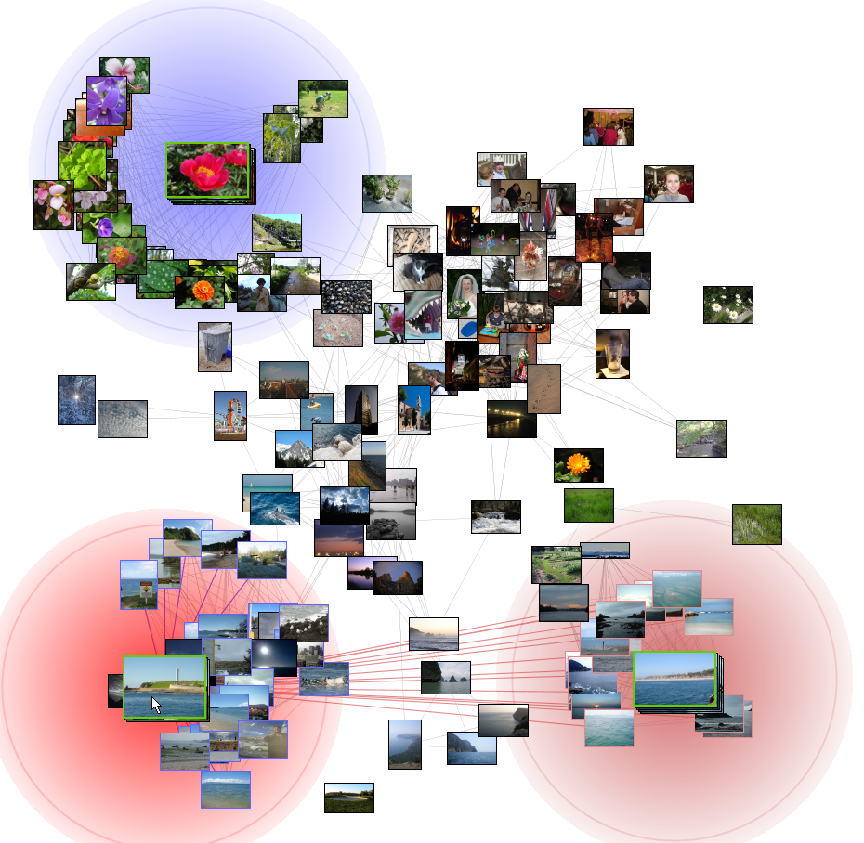

Slide 50
Search: Last Words
State-space search happens in lots of systems (not just traditional AI systems)
  Games
  Clustering
  Visualization
  Etc.
Technique chosen depends on qualities of the domain

